Slide 1
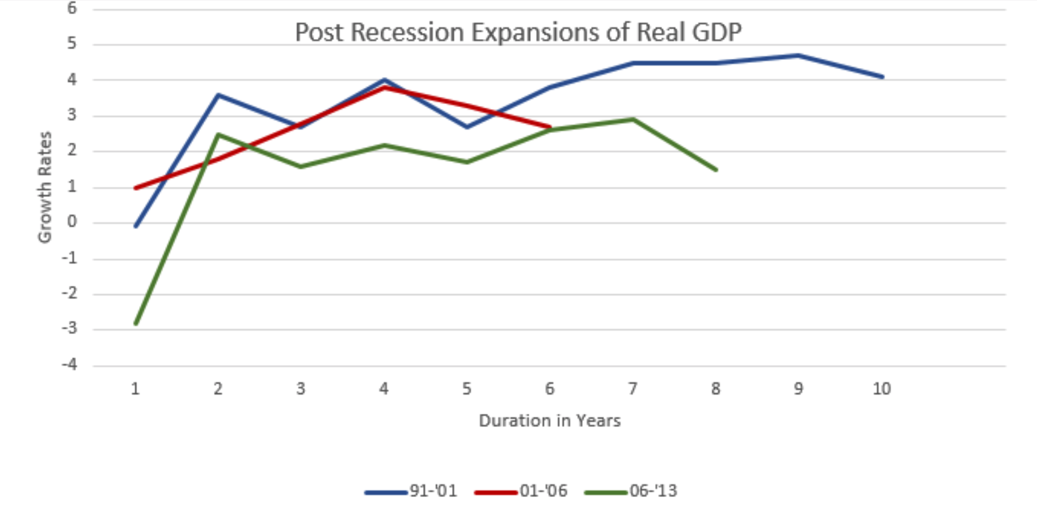

Slide 2
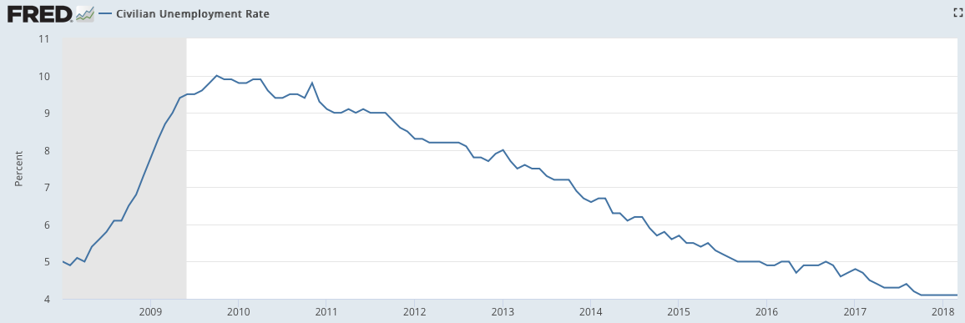
Tight Labor Market
Longer Term Natural Rate of Unemployment 4.8%

Slide 3
Employment Cost Index

Slide 4
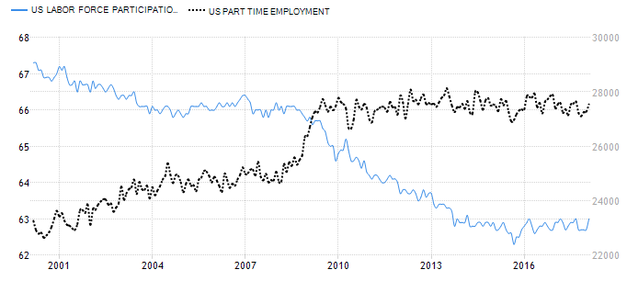
Labor Market Slack
Trading Economics

Slide 5
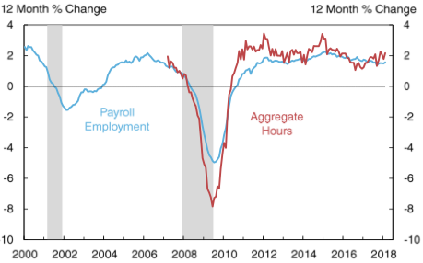
Payrolls and Aggregate Hours

Slide 6
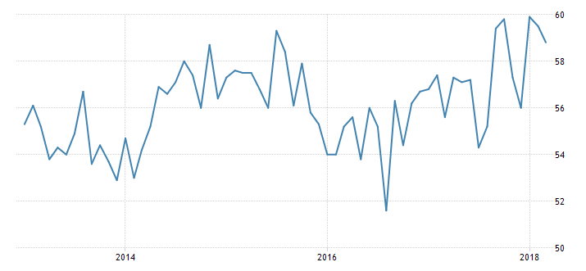
Purchasing Managers Index
Increase in service costs
Increase in cost of inputs
Higher Weekly earnings.
Tightening labor market.
Longer work week

Slide 7
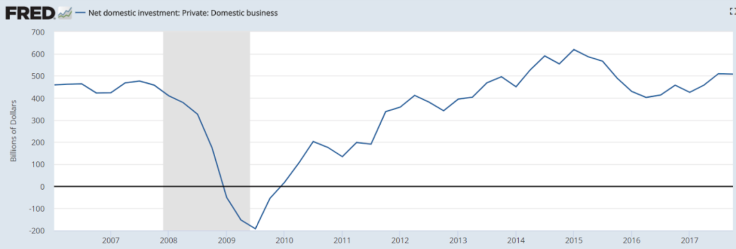

Slide 8
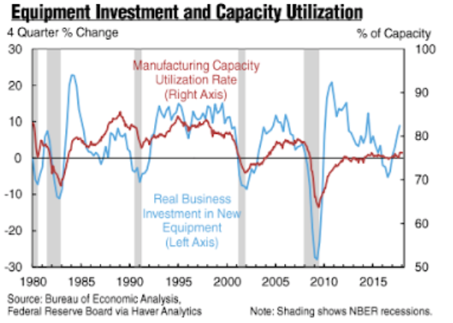

Slide 9
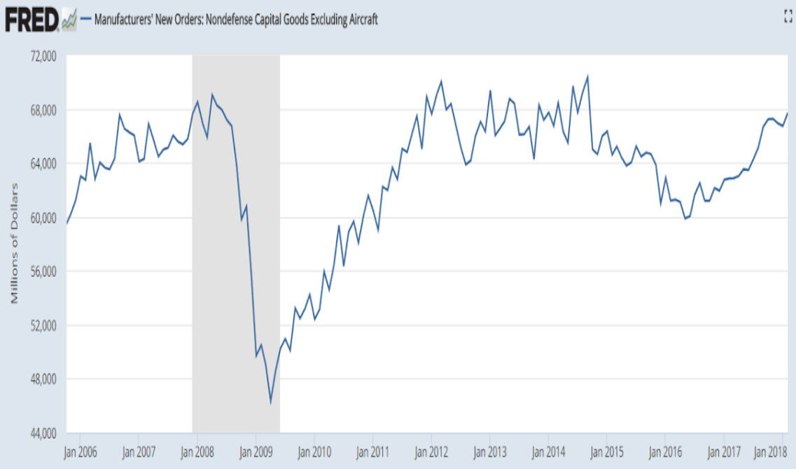

Slide 10
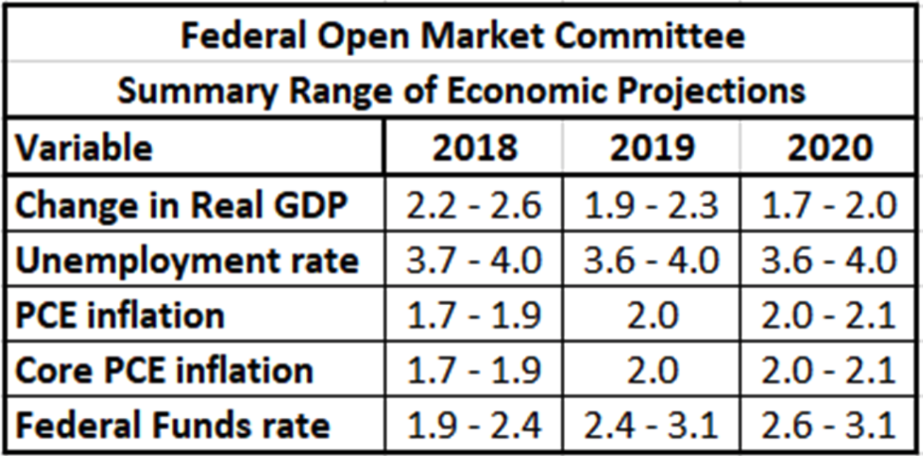

Slide 11
Revolving Credit

Slide 12
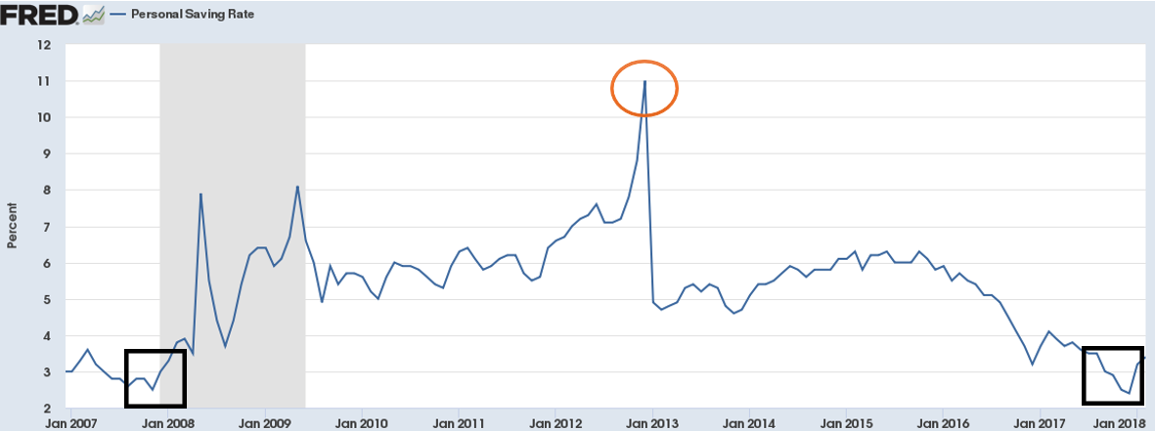
Personal Savings Rate

Slide 14
Corporate VS. Treasury Yields

Slide 15
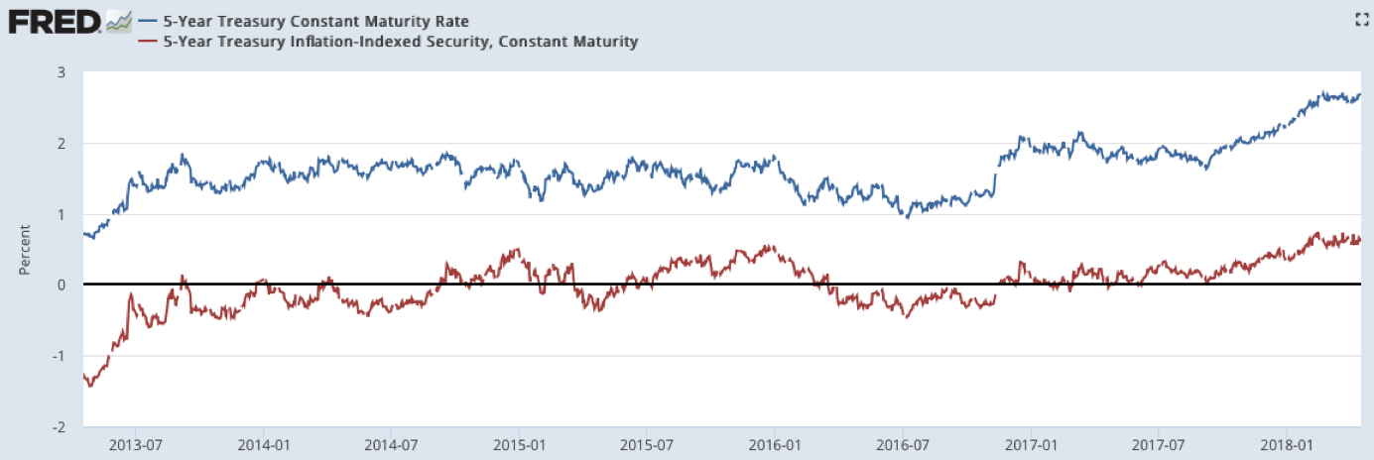
TIPS

Slide 16
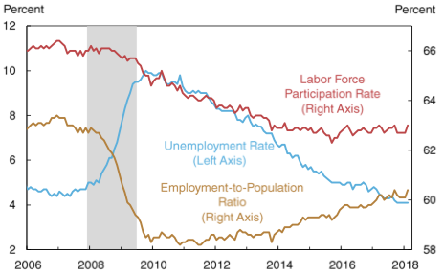
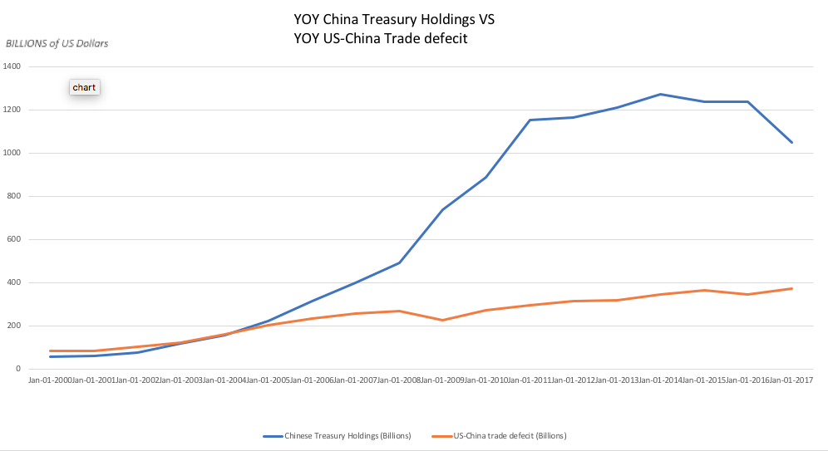
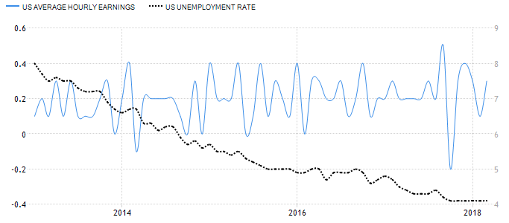
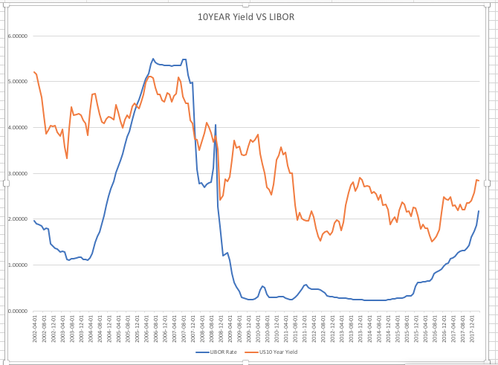
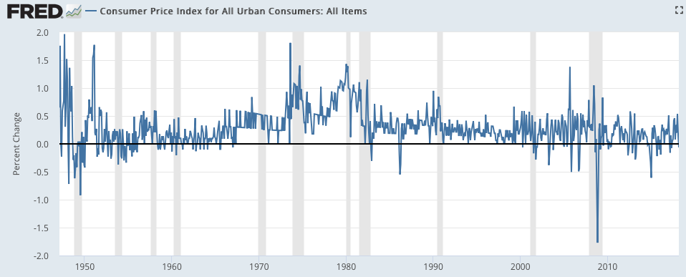
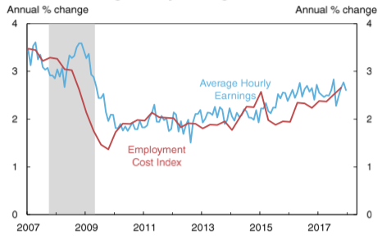
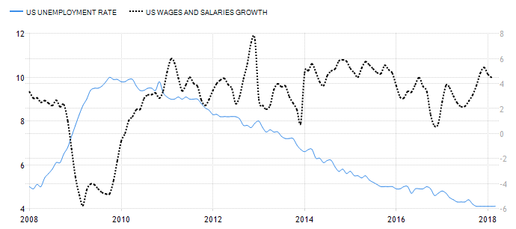
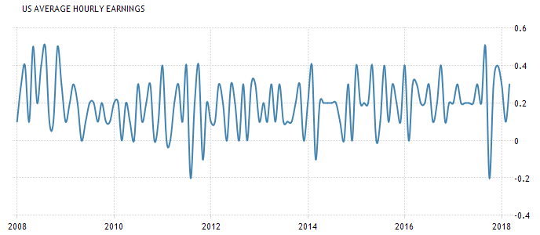
Trevor Godston
Emma Stent
Wilder Rumpf
Steven Schilder
Jonathan Herman
Jessica Tavarez
Fed Challenge

