Slide 1
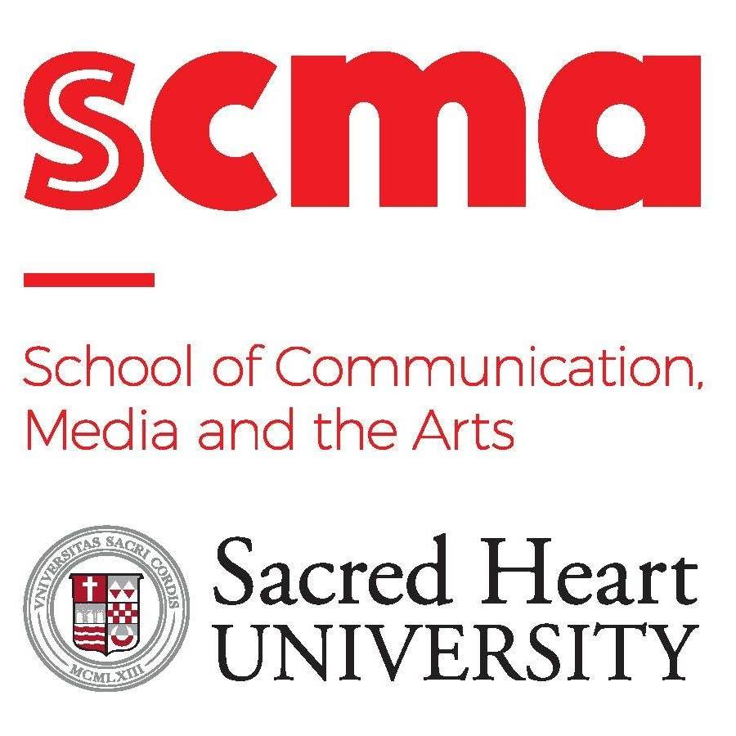
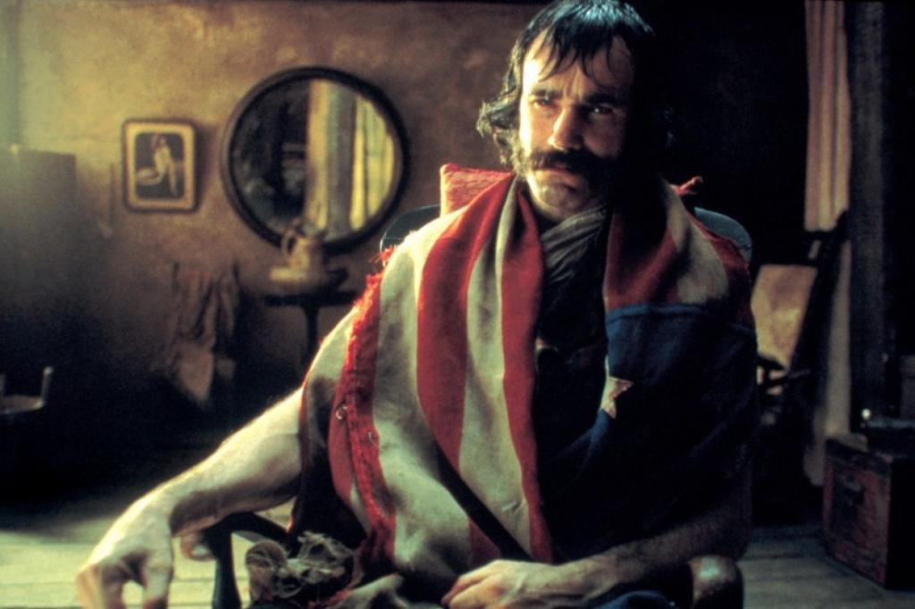
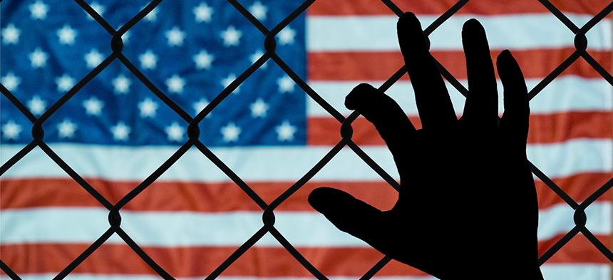
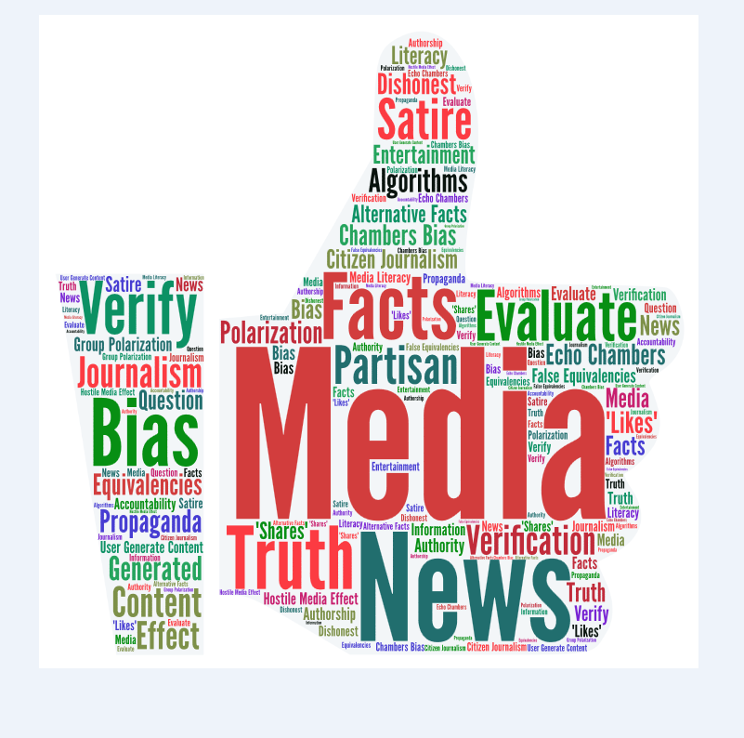
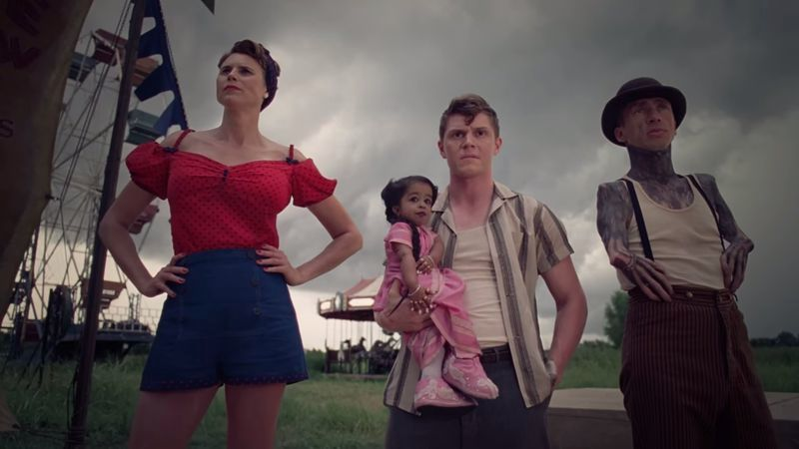
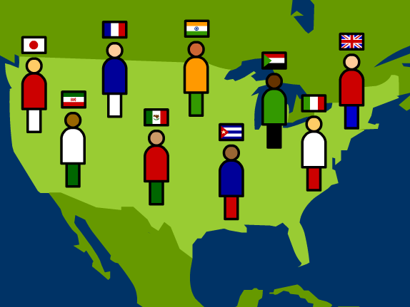
Immigration: How the Media Influences Your Opinion
Leela Gallucci
Sacred Heart University, College of Arts and Sciences
INTRODUCTION
IMMIGRATION PERCEPTION IN FILM/TELEVISION
IMMIGRATION PERCEPTION IN NEWS MEDIA
CONCLUSION
Media has a direct effect on how we perceive everything within our society. Our view of immigration is no different. Through technology, the news, film, and television, we get a plethora of misconceptions regarding the views of immigration. It is important to understand how the media works to influence our knowledge of the information that we receive from these sources.
Film and television is not only one of the main forms of entertainment in society, but also an essential expressive and informative tool for spreading information in the media.
Filmmakers get the chance to be creative, and to bring their own ideas and thoughts about the world to life. Often, these include their own personal experiences that they use to educate, entertain, and affect their audiences; whether it be through true stories or even fictional ones.
Films that harp on real experiences can be extremely beneficial to understanding a topic that may not be too familiar.
Martin Scorsese, an academy award winning director and producer created a film called Gangs of New York in which he uses experiences from his own childhood to construct a captivating film about the Irish-American and the Italian-American immigrants in Little Italy New York.
Seventeen years after the release of this critically acclaimed film, Scorsese reflects on the themes and issues regarding immigration that are constantly emulated throughout the film, and how they continue to be just as prevalent today.
Interpretations of immigration on the big screen can also appear in a completely abstract way, through a more intuitive and symbolic lens. Allusions to current controversies can be seen through fictional, and out of the ordinary depictions.
The themes throughout the show “American Horror Story” as a whole, continuously reflect present issues in society through a fictional lens each season. Although this fictional depiction could not happen in today’s society, the symbolism throughout the “freak show” season, are extremely prevalent to how society views outcasts in the real world.
Politicians who wish to promote an anti-immigration position use carefully selected words and metaphors to highlight the "alien," "foreign," and "inferior" characteristics of non-citizens. Symbolic language and spectacles clearly overstate that immigration poses a national threat.
News agencies and news coverage of raids refer to the undocumented immigrants in non-human terms such as "net of 56 captured" or "rounded-up.”
The constant use of anti-immigration terms by the mainstream media and elected officials evokes a conditioned uncritical response and a mentally restful one for their audiences.
A study from the University of Kansas states that because of the aversive media portrayal of Latino immigrants in the United States, the perception of these immigrants has become extremely negative. In response, immigrants have been trying to find ways to highlight their images as being hardworking, driven, and to steer themselves away from their negative stereotype. Leaders such as our president, are continuing to make comments the suggest that these immigrants are detrimental to society.
The more a message is repeated, in this case, the news media, it becomes a fact, even if it is not true. Because most people don’t fact-check the media, they tend to believe the things that they constantly hear on the news, because that is everyone’s main source of information
There is a “media-induced subjective impression, which has no credible or factual echo in reality, that there is a crime epidemic threatening society.” This causes viewers of the media to have an unrealistic impression of crime in society, especially when concerned with minority groups.
Since the media puts such an emphasis on the harshness of crime, it becomes such a big fear factor amongst viewers. When minority groups are targeted in these crimes, we then become frightened of minorities.
As a society, we are influenced by the media on a daily basis, whether we realize it or not. Understanding media literacy is extremely important for us to be able to avoid getting targeted and manipulated by the media’s sneaky and subliminal messages. In terms of immigration discussion, it is important to be aware of the false representations that can arise from the media. Part of understanding media literacy, is to not believe everything that you may hear, and to make sure to do proper research before making any assumptions. This directly correlates to discussions about immigration.
UNDERSTANDING MEDIA LITERACY
Media literacy has been defined as the ability to access, analyze, evaluate and create media. A highly developed level of media literacy involves understanding the technologies, structures, and economics of media industries; critically evaluating media messages; exploring how media influence individuals and society; and learning how to be active participants, rather than passive consumers, in our mediated worlds.
REFERENCES
Costa, Stevi. “American Horror Story: Capital, Counterculture, and the Freak.” European Journal of American Culture, vol. 38, no. 1, Mar. 2019, pp. 71–82.
De Loera-Brust, Antonio. “Martin Scorsese Has Something to Say about Immigration.” America, vol. 218, no. 3, Feb. 2018, p. 42.
Douai, Aziz, and Barbara Perry. “A Different Lens? How Ethnic Minority Media Cover Crime.” Canadian Journal of Criminology & Criminal Justice, vol. 60, no. 1, Jan. 2018, p. 96.
"NEGATIVE MEDIA PORTRAYALS DRIVE PERCEPTION OF IMMIGRATION POLICY,
STUDY FINDS." States News Service, 6 Dec. 2016. Academic OneFile,
Romero, Mary. "Are Your Papers in Order: Racial Profiling, Vigilantes, and America's Toughest Sheriff," Harvard Latino Law Review vol. 14, no. 1 (Spring 2011): p. 337-358.
Share, Jeff, et al. 5 Key Questions That Can Change the World: Lesson Plans for Media Literacy. Center for Media Literacy, 2007.
Five Key Concepts of Media Literacy:
All messages are constructed
Media messages are constructed using a creative language with its own rules.
Different people experience the same media message differently.
Media have embedded values and points of view.
Most media messages are organized to gain profit and/or power.
CONTACT
galluccil6@mail.sacredheart.edu

