Slide 1
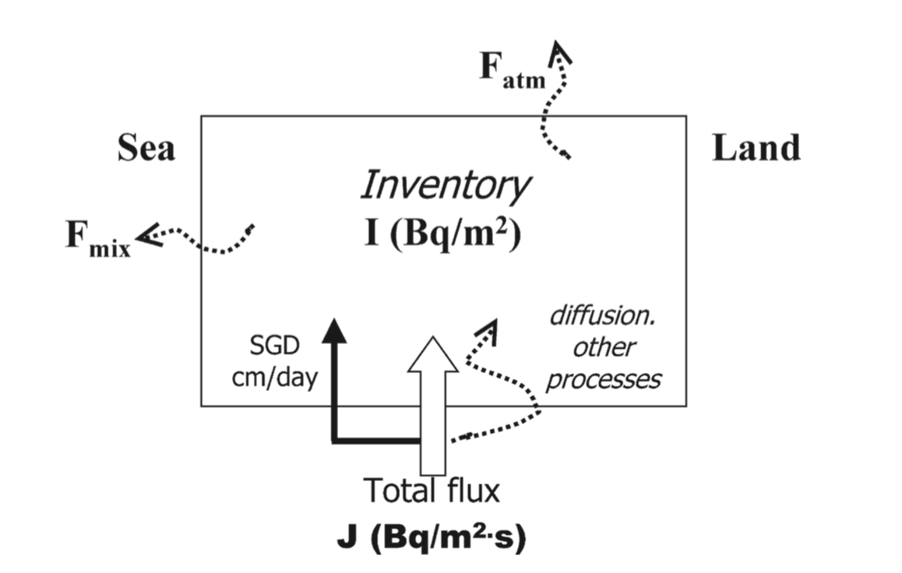
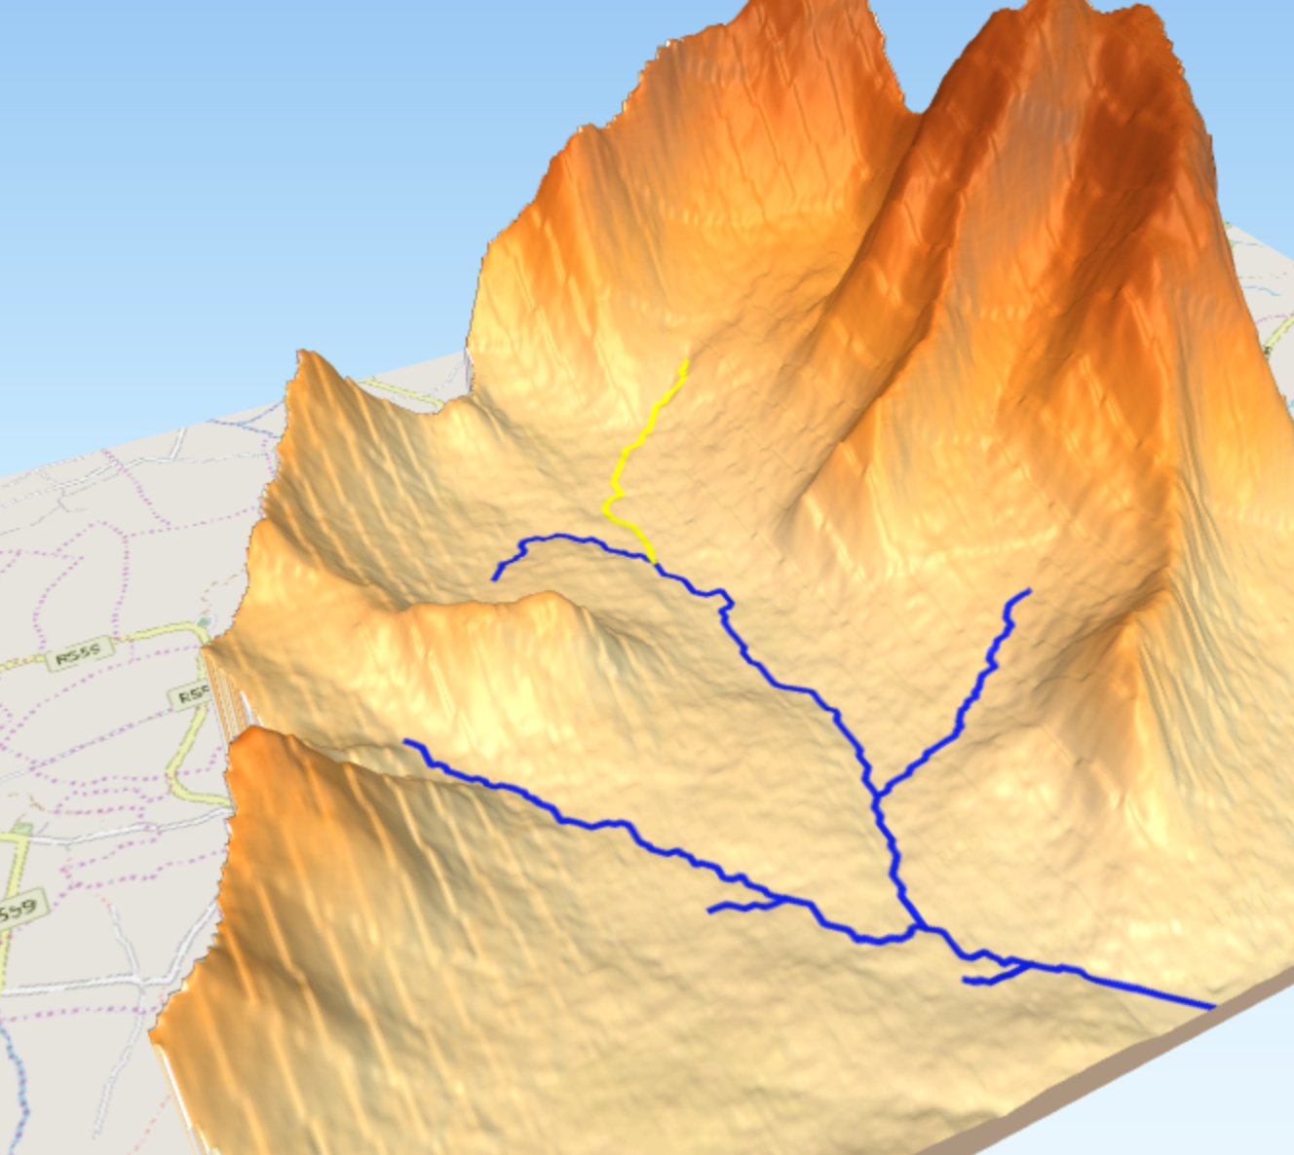
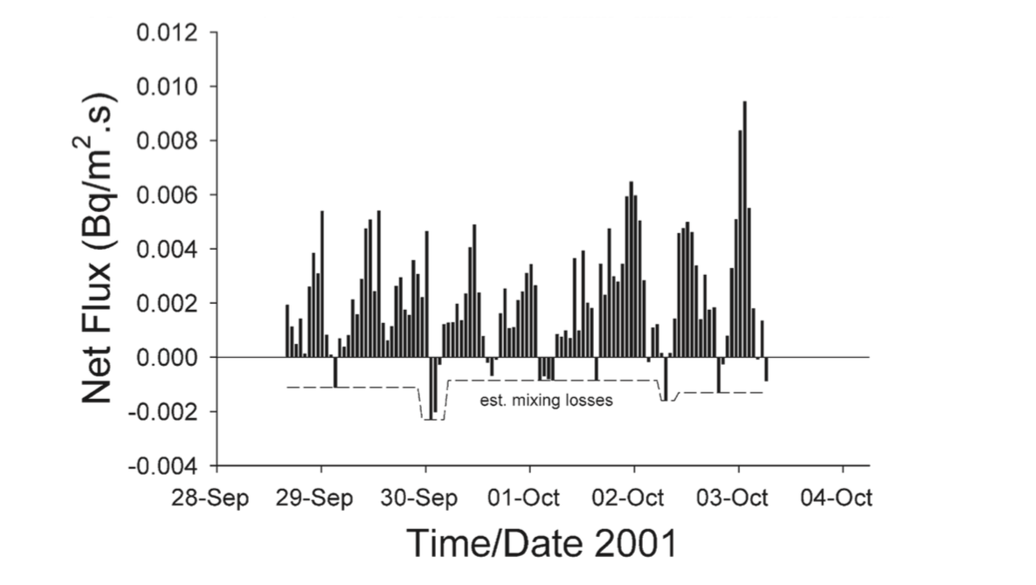
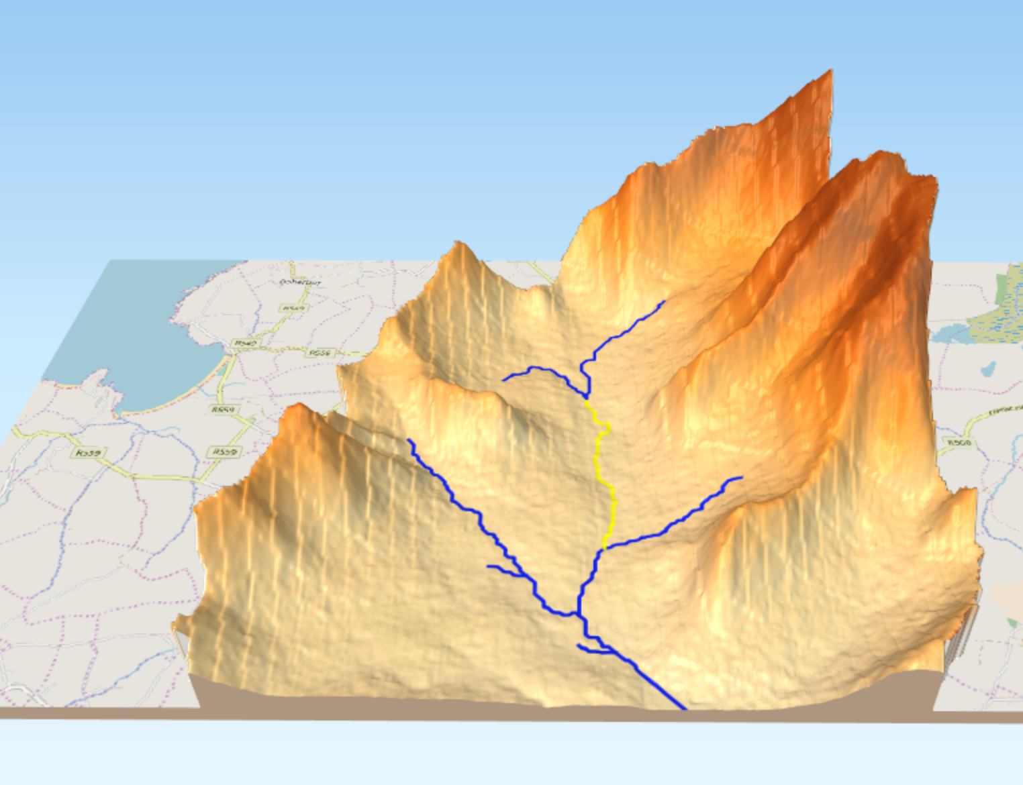
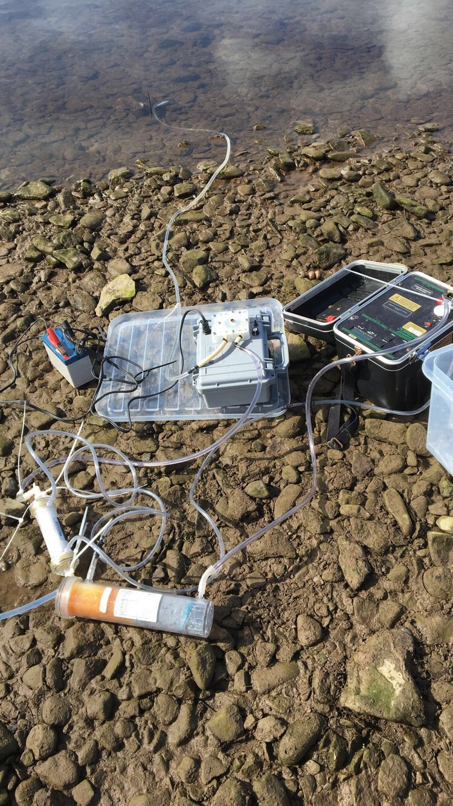
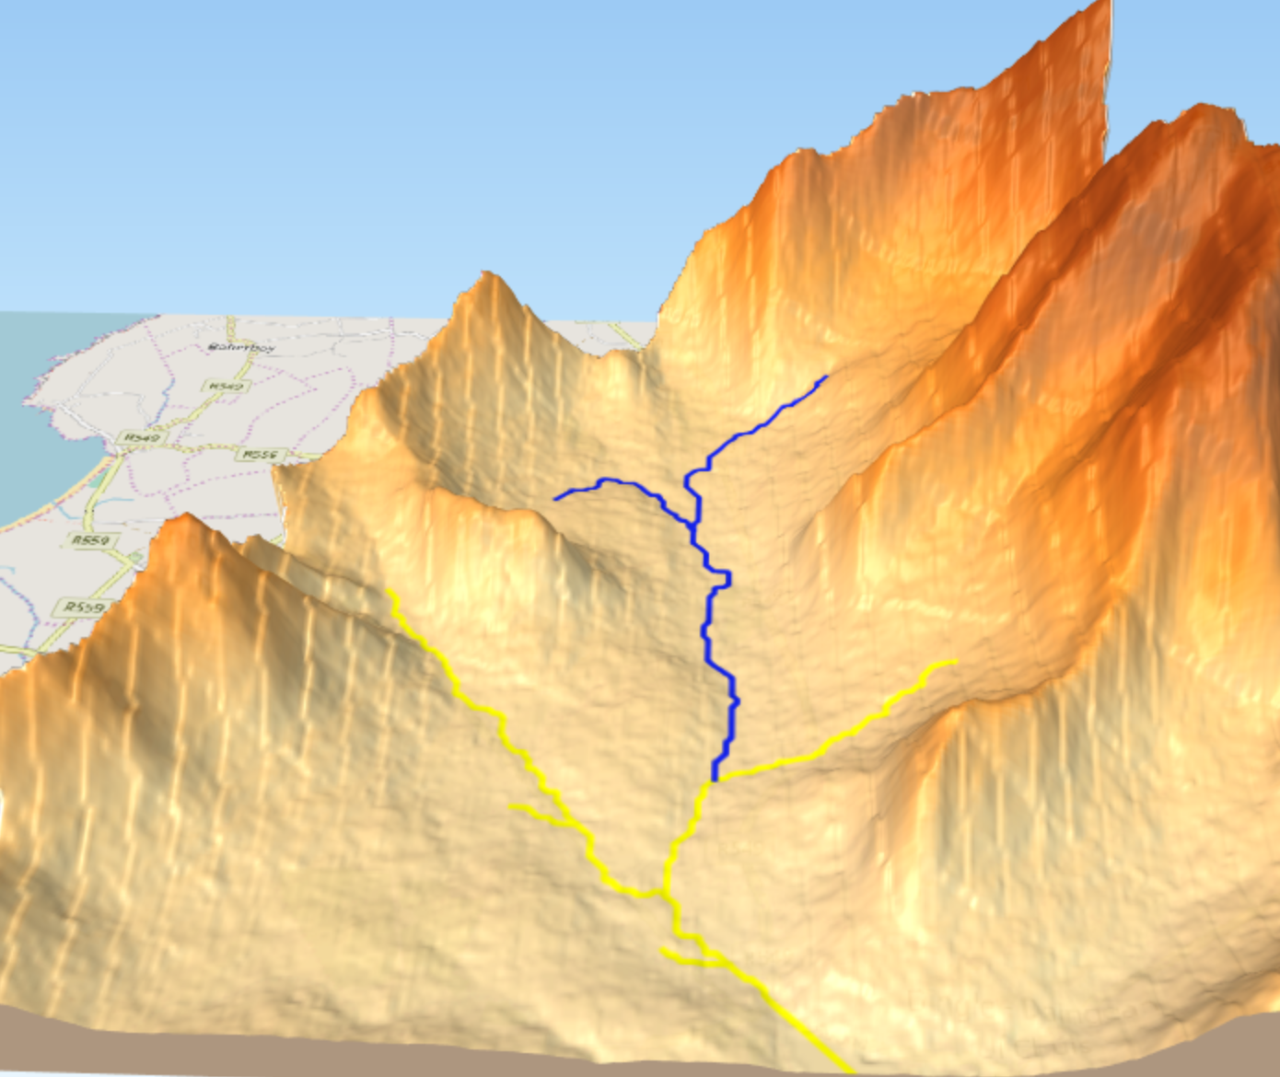
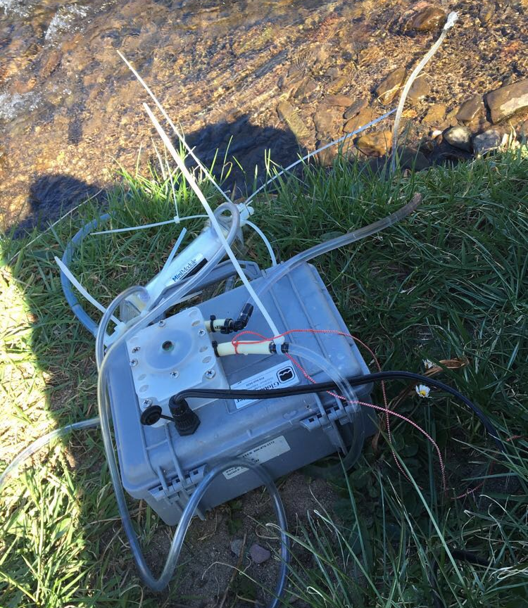
Effect of storm events on submarine groundwater discharge measured by Radon Flux
Victoria Schoenwald
Undergraduate Program
Department of Biology, Sacred Heart University, Fairfield, CT
Radon has been used as a tracer of submarine
groundwater discharge (SGD) in Donnalucata Siciliy
(Burnett and Dulaiova 2005)
This is important for establishing marine geochemical
mass balances
Radon is a valuable tracer of SGD because its
concentration is very high in groundwater but low in seawater
Residence time of ²²²Rn in coastal waters is short (t^{1/2} = 3.84 days)
The goal is to convert changes observed in Rn inventories to
fluxes by monitoring ²²²Rn at fixed locations over time
SGD facilitates transport of dissolved components
from coastal aquifers to the sea (Valiela et al., 1990;
Moore, 1996; Burnett et al., 2001; Slomp and van Cappellen, 2004)
SGD rates are difficult to quantify but can be assessed through
geochemical tracers such as radon
Groundwater in the aquifer that is in contact with
sediment and rocks is enriched with radon
A major source of uncertainty is quantifying radon
loss be evasion to the atmosphere
INTRODUCTION
RESULTS
Before Rain Event
Figure 1. Displaying what the radon flux calculation would involve.
Figure 4. Radon concentrations at Mill River before a rain event.
Figure 5. Radon concentrations at Mill River zoomed in.
Figure 8. Source to M1 site on Mill River is 6981m. Ground water is measured by the rate of radon flux. This is 3,232.9 Bq m⁻¹/s.
After Rain Event
Figure 2. Example of continuous radon measurements in a Bay in Tallahassee Florida.
Radon measured continuously using automated Radon system at three sites
along the Mill River as well as at the source of the river
System analyses ²²²Rn from a constant stream of water driven by
a submersible pump which then passes through an air-water exchanger
that channels radon through a closed air loop
The air stream is guided through a commercial radon-in-air monitor
that determines the concentration of ²²²Rn by measuring the
α – emitting daughters of ²¹⁴Po and ²¹⁸Po
RAD-7 (Durridge Co., Inc.) was used for the radon-in-air monitor which
uses a silicon semiconductor detector at ground potential to attract
the positively charged polonium daughters
The water air exchanger is a plastic cylinder that has
water pumped from the desired location
The time it takes for the system to generate
accurate radon
measurements is between 30-40 minutes after
water is initially pumped in
Radon values are measured in Bq per m³
To accomplish the goal of measuring the flux rate
of radon, radon values are
calculated by the flow rate of the river
Figure 6. Radon concentrations at Mil River after a rain event.
Figure 7. Radon concentrations zoomed in.
METHODS
Radon is measured at each location (M1= 1km from source; M2= middle of river; M3= downstream) before and after rain events. After the rain event radon levels increased relatively. The rain event most likely increased the groundwater concentration.
Figure 9. From site M1 to M2 radon decreases to a flux of 73 Bq m-¹/s . The length of this section of the river is. 8912m.
Radon Fluxes
Before Rain Event
After Rain Event
Figure 11. Radon fluxes were calculated to determine how quickly groundwater is moving throughout the Mill River. These calculations can be used to determine the rate of other pollutants that move into the coastal system. From the source to M1 3159 Bq is lost possibly to turbulence due to higher elevations of land and faster water movement. Groundwater is likely intruding at M2 to M3 due to the increase in Radon concentrations.
Figure 3. Water pump
Figure 4. Closed air radon system
Figure 10. From site M2 to M3 radon increases dramatically to 823.9 Bq m⁻¹/s. Radon is collected over a distance of 34,793m.
The data shows that there is groundwater coming into the river by using radon as a tracer
Rain influences the radon concentration and therefore stronger storms may alter the amount of groundwater influencing a coastal system
This river eventually empties into the Dingle Harbor which means that pollutants in groundwater may have an effect on the ecosystem in the Harbor
There is a significant loss of radon from the source of the river to M1 indicating a loss through atmosphere which complicates the SGD calculations
Flux calculations show how much and how fast radon is flowing through the system which corresponds to the amount and speed of groundwater discharge at the different sections of the river
This can help determine where pollutants are affecting groundwater the most
Other applications for using radon as a tracer of groundwater are earthquake predictions due to observations of radon decrease right before an earthquake
References
CONCLUSIONS/ FUTURE WORK
Dulaiova, H., Gonneea, M.E., Henderson, P.B. and Charette, M.A., 2008. Geochemical and physical sources of radon variation in a subterranean estuary—implications for groundwater radon activities in submarine groundwater discharge studies. Marine Chemistry, 110(1-2), pp.120-127.
Burnett, W.C. and Dulaiova, H., 2006. Radon as a tracer of submarine groundwater discharge into a boat basin in Donnalucata, Sicily. Continental Shelf Research, 26(7), pp.862-873.
Burnett, W.C. and Dulaiova, H., 2003. Estimating the dynamics of groundwater input into the coastal zone via continuous radon-222 measurements. Journal of environmental radioactivity, 69(1-2), pp.21-35.

