Slide 1
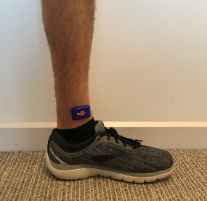
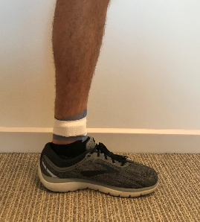
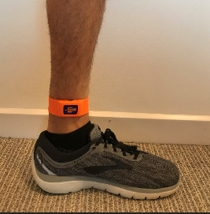
Reliability of Attachment Methods of a Wearable Tibial Accelerometer
Hannah Tucker
Faculty Mentor: Matthew Moran, PhD
Department of Physical Therapy & Human Movement Science (Exercise Science)
ABSTRACT
Tibial accelerometers are a common tool used in clinical practice to determine tibial acceleration as well as an athletes return to play ability by utilizing assessments such as the single leg maximal hop test.¹⁻³ In this study, the IMeasureU Blue Trident (IMU, Vicon; Auckland, New Zealand) tibial accelerometer was used to measure peak tibial acceleration (PTA), time to peak acceleration, and rate of acceleration (biomechanical jerk). 16 healthy subjects (10 female, 6 male) volunteered to perform single leg maximal hop tests with two different attachment methods (DST=double sided tape with elastic bandage, SS=manufacturer silicon strap) to determine which is more reliable. It was hypothesized that DST would be more reliable than SS. The device was attached 3 cm proximal to the medial malleolus of the dominant leg and subjects were given two practice trials prior to three real trials with 30 seconds rest between each jump. The subject was given a 3-5-minute rest while attachment methods were changed, and the test was then repeated. Data processing was done with a custom-written MATLAB script which filtered data with a 4th order dual pass Butterworth low-pass filter and statistical analysis was performed in SPSS software. Results showed insignificant differences for peak tibial acceleration, time to peak tibial acceleration, or jerk. Fixation type (DST or SS) did not influence metrics of the IMU device thus clinicians can confidently use either fixation method (DST or SS) to collect data using the IMeasureU Blue Trident device.
PARTICIPANTS
16 participants free from any musculoskeletal lower extremity injuries
10 female, 6 male
20 ± 0.89 years old
1.67 ± 0.08 m
66.03 ± 8.5 kg
IRB approved study; All granted informed consent
SLH Single Leg Hop for Distance - Attachment method (DST or SS) - Dominant leg - 2 practice trials - 3 measured trials - 30 sec rest between trials | REST 5 min Attachment Method changed | SLH Single Leg Hop for Distance - Attachment method (DST or SS) - Dominant leg - 2 practice trials - 3 measured trials - 30 sec rest between trials
DISCUSSION
No significant differences in single leg hop and hold maximal hop distance based on IMU fixation type (T=tape, S=strap) (T: 102.9 ± 24.9 cm, S: 103.8 ± 25.4 cm, p=0.91) were found across the 16 healthy subjects.
No significant differences were found with
Peak tibial acceleration (T: 27.2 ± 7.9 g, S: 26.2 ± 10.5 g, p=0.76)
Time to peak tibial acceleration (T: 9.5 ± 2.5 ms, S: 10.2 ± 2.5 ms, p=0.46)
Rate of acceleration (biomechanical jerk; g/s) (T: 2846.5 ± 1132.0 g/s, S: 2505.2 ± 1585.7 g/s, p=0.49).
Results show that fixation type (T or S) does not influence the acceleration metrics of an IMeasureU device during the single leg hop test thus, neither fixation method is significantly better than the other with regards to the measured values.
Table 1 - Testing protocol order during Part One of study.
METHODS
5-minute standardized warm-up
Vicon Capture.U iPhone app to collect live data
Ankle circumference (cm) measured to determine strap size
Measure 3 cm proximal to the medial malleolus and marked to determine location of the center of the IMU device placement
Distance measured with each hop (cm)
IMU attached in contralateral order for each participant
A Double-sided tape (DST) | B DST + elastic adhesive tape | C Silicon strap (SS)
Figure 1 – Two fixation methods of the tibial activity monitor are displayed. One fixation method uses double-sided tape and elastic adhesive tape (A, B) and the second fixation method uses manufacturer-supplied silicon straps (C).
CLINICAL APPLICATIONS
Clinicians
Clinicians can be confident using the manufacturer silicon straps with the IMU Blue Trident device by following the ankle circumference guidelines which is more time efficient than DST.
Database
Clinicians could use the IMU Blue Trident device to create a database for athletes during training seasons for return to sport ability if an injury occurred.
Rehabilitation
Clinicians can collect data of athletes or patients during their first visit after an injury to track progression during treatment.
Research
Researchers could use the IMU Blue Trident device to determine reliability of ACLR return to play ability, for example.
DATA PROCESSING
Tibial acceleration processed with a custom-written MATLAB script
Filters data with a 4th order dual pass Butterworth low-pass filter
Determines resultant peak tibial acceleration (PTA) for each hop
PTA averaged across three trials
Statistical analysis performed in SPSS software by Dr. Moran
Determine if attachment method (DST, SS) influenced PTA or hop distance during SLH
Intraclass correlation coefficients (ICCs) computed to determine level of agreement within each attachment method
ICC > 0.8 is excellent outcome
What is a tibial accelerometer?
A tibial accelerometer is a small device (right) that can be attached to the tibia via skin or bone mounting to measure tibial acceleration, ground reaction forces, and time to peak tibial acceleration.
RESULTS
Why determine reliability of attachment methods for IMU device?
No previous research has been conducted to determine which attachment method of the IMeasureU device is most reliable. This will allow future researchers and users to collect the most accurate data when using the IMU device.
REFERENCES
1. IMeasureU. Building a university wide database. IMeasureU. September 2019. https://imeasureu.com/2019/09/12/building-a-university-wide-database-a-case-study-with-stephen-f-austin-university
2. Dingenen B, Truijen J, Bellemans J, Gokeler A. Test–retest reliability and discriminative ability of forward, medial and rotational single-leg hop tests. The Knee. August 2019.
3. Gustavsson A, Neeter C, Thomeé P, et al. A test battery for evaluating hop performance in patients with an ACL injury and patients who have undergone ACL reconstruction. Knee Surg Sports Traumatol Arthrosc Off J ESSKA. 2006;14(8):778-788.
Figure 2 – Average distance hopped during single leg maximal hop test (SLH).
Figure 3 – Average peak tibial acceleration (PTA).
Figure 4 – Average time to peak tibial acceleration (PTA).
This work was presented virtually at the 2020 Sacred Heart University Academic Festival

