Slide 1
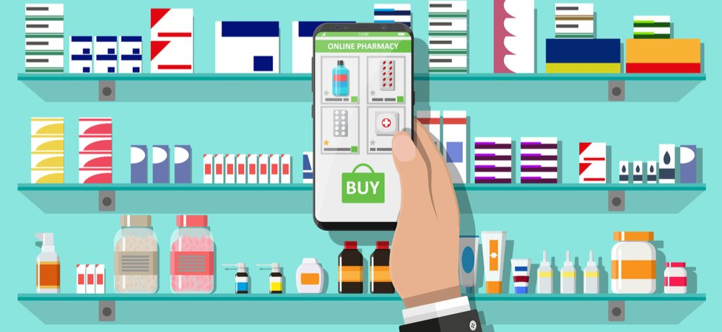
Disruptive Innovation in Pharmacy: Technology’s Influence on a Lifetime Necessity
Michaela Vieira, Thomas More Honors Program - Sacred Heart University
DI: THE ONLINE PHARMACY
What is Disruptive Innovation (DI)?
The process whereby a newcomer utilizes innovation/new technology to focus on the needs of an emerging market, typically at a lower cost, creating a new business model which, when successful, eventually disrupts the incumbent leader of an industry (Bower & Christensen, 1995)
Barriers to Disruptive Innovation
in Pharmacy
Inadequate education and training: It is important to teach the logistics of pharmacy but also encourage creative thinking so DI can be developed.
Lack of leadership/role models: It is necessary to collaborate with colleagues and all stakeholders to provide innovative services and drug discoveries.
Laws and regulations of the healthcare industry: These provide guidelines on what can be done and when.
THE INCUMBENT
Your Neighborhood Pharmacy
Mainstream is obtaining necessary medication. This environment is very personal, however, very expensive.
THE INNOVATION
World Wide Web Launches in 1991
E-commerce technology creates a virtual marketplace providing easy access goods and services at much lower costs.
Financial Impact
-more affordable
-takes away from
profit made by retail
pharmacies
-leads to in person
pharmacy closures
Social Impact
-no face-to-face
communication
-lack of rapport
amongst patients
and pharmacists
Privacy
-HIPAA violations
-unreliable
websites
THE LATEST DEVELOPMENTS
2013: PillPack.com is launched → providing an enhanced online pharmacy service that provides door step delivery of pre-packaged medications by daily dose (Farr, 2019)
2018: PilPack.com (a leader among online pharmacies) → generates $299 million in annual revenue by 2018 (Farr, 2019)
2018: Amazon buys PillPack.com → looking to “crack the $500 billion prescription market” (Farr, 2019 p. 1).
Continuing to lower the cost of prescriptions → “engaging a less skilled workforce to deliver a lower-cost solution in an affordable, convenient, and accessible way,” (Tohme Shaya & Eddington, 2019)
An often neglected market → populations such as the elderly, the impaired or other patients with several medical diagnoses that require a variety of medications have an easy and more affordable option with pre packaged medication dosages
https://www.clipart.email/make-a-clipart/?image=9196159
http://econintersect.com
http://clipart-library.com/clipart/money-clip-art-11.html
THE NEWCOMER
The First Online Pharmacy Launches in 1999
This causes a shift in pharmaceutical product attainment within the healthcare industry, (Stergarchis, 2001)
http://clipart-library.com/free-speech-bubble.html
THE FATE OF THE INCUMBENTS
With pharmaceutical availability online to the extent of PillPack by Amazon Pharmacy, established pharmaceutical businesses have to either adapt to survive or risk losing a significant market share
https://www.pillpack.com
How does Pill Pack work? Visit https://youtu.be/yogL3fpiq6s
http://clipart-library.com/confidential-cliparts.html
Conclusion
The creation of PillPack, Amazon Pharmacy and others provided a viable alternative for people to make their pharmacy experience more convenient, less expensive and easily accessible. But more needs to be done as more and more people require medication. In 2019, Americans spent over $360 billion on prescription drugs (Mikulic, 2019). Nearly 1 in 2 Americans take prescription drugs (Hagan, 2019) and 58 million Americans report they are unable to afford their prescription drugs (Witters, 2019). The process of DI is desperately needed in pharmacy in order to continue to challenge existing pharmaceutical services to improve accessibility that is efficient and, perhaps more importantly, affordable.
https://www.epmmagazine.com
THE EMERGING MARKET
With the increase in Internet use and availability of goods and services, the online marketplace became a more favorable option for many people.
The online purchasing and shipment system established by online pharmacies increased the availability of medication to populations with limited accessibility (i.e. elderly, several comorbidities).
https://www.clipartkey.com/view/xiJmwwtransparent-person-shopping-clipart-clip-art-online-shopping/
https://www.123rf.com/photo_57770719_stock-vector-pill-bottle.html

Slide 2
References
Bower, J.L. &amp; Christensen, C.M., (January-February 1995). Disruptive technologies: Catching the wave. Retrieved from
https://hbr.org/ 1995/01/disruptive- technologies-catching-the-Wave.
Farr, C (2019, May 10). The inside story of why Amazon bought PillPack in its effort to crack the $500 billion prescription market.
Retrieved from https://www.cnbc.com/2019/05/10-whyamazon-bought-pillpack-for-753-million-and-what-happens-next.html.
Hagan, S. (2019, May 8). Nearly one in two Americans takes prescription drugs: Survey. Retrieved from
https://www.bloomberg.com/news/articles/2019-05-08/nearly-one-in-two-americans-takes-prescription-drugs-survey.
Mikulic, M. (2019, August 9). Prescription drug expenditure in the United States from 1960 to 2019. Retrieved from
https://www.statista.com/statistics/184914/prescription-drug-expenditures-in-the-us-since-1960/.
Stergachis, A. (December 2001). The evolution and role of the online pharmacy. Retrieved from
https://www.ptcommunity.com/journal/article/archives/2001/12/628/evolution-anD-role-online-pharmacy.
Tohme Shaya, F. & Eddington, N.D. (2020, January 29). Disruptive innovation in pharmacy:Lessons from the Amazon frontier.
Retrieved from https://jamanet work.com/channels /health-forum/fullarticle/2760416.
Witters, D. (2019, November 12). Millions in U.S. Lost Someone Who Couldn’t Afford Treatment.Retrieved from
https://news.gallup.com/poll/268094/millions-lost-someone-couldn-affor d-treatment.aspx.

