Slide 1
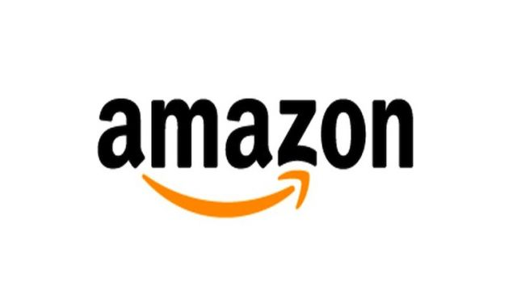
Veena Weerakoon
Honors Program
Innovation- Entering New Markets
Amazon has never been seen to be complacent in the industry and is always finding new ways to compete. Jeff Bezos, the chief executive officer of Amazon has been on record saying, “One thing that I tell people is...if you’re going to do anything new or innovative, you have to be willing to be misunderstood.” (Clifford, 2018)
New innovation: Amazon Go: is a chain of self-service convenience stores around the United States. Go was founded in 2018 and it is the first store of its kind where there is no checkout required. Amazon Go lets customers enter the store while using the Amazon Go app to browse around and find the products they need and then leave.
The Amazon Effect
Generally refers to the hardships that other companies have had to endure because of Amazon
This does not necessarily mean that Amazon is entirely putting their competition out of business- they are just changing the industry and the expectations of retail. (Agraval 2019)
“In 2009, Amazon had 2 million Prime members, and in 2011, that grew to 5 million; in 2015, Prime membership is estimated to be around 40 million, and worldwide paid membership grew 53% last year.” (Shorr)
Innovation: Entering New Markets
Intro:
Amazon Prime changed the retail industry as we know it through their innovative two day shipping. Prime is the reason why retail stores both online and in person have lost a vast amount of business from consumers.
Violation of Trust
Amazon is known for delving into people’s private lives due to technology. (Lynskey, 2019)
New product created known as Alexa.
Alexa records people's conversations to further develop its artificial intelligence
An Amazon spokeswoman stated, “While all information is treated with high confidentiality and we use multi-factor authentication to restrict access, service encryption, and audits of our control environment to protect it, customers can always delete their utterances at any time." Amazon has battled against all controversies but customers will alway be uncertain whether Alexa or other people are always listening to you.
Prime Disrupting Retail Industry
COVID-19 Effect
“With tens of millions of Americans now dependent on online delivery for their food, medicine, and other essential items, the nation’s No. 1 e-commerce company is buckling under increased demand.” (Newton, 2020) The coronavirus has altered the priorities of Amazon in all aspects of the company. (Newton, 2020)
The virus has had a negative impact on the company warehouses and their operations
Deliveries have been extended all the way to mid April and some even May.
The Amazon workers are some of the most exposed people in the country because of their intake and outtake of inventory.
Violation Of Trust
COVID-19 Effect
1994
2005
2015
2017
2019
Amazon is born
Amazon Prime is launched
Echo launch
Acquires Whole Foods
25 year anniversary of Amazon

