Slide 1
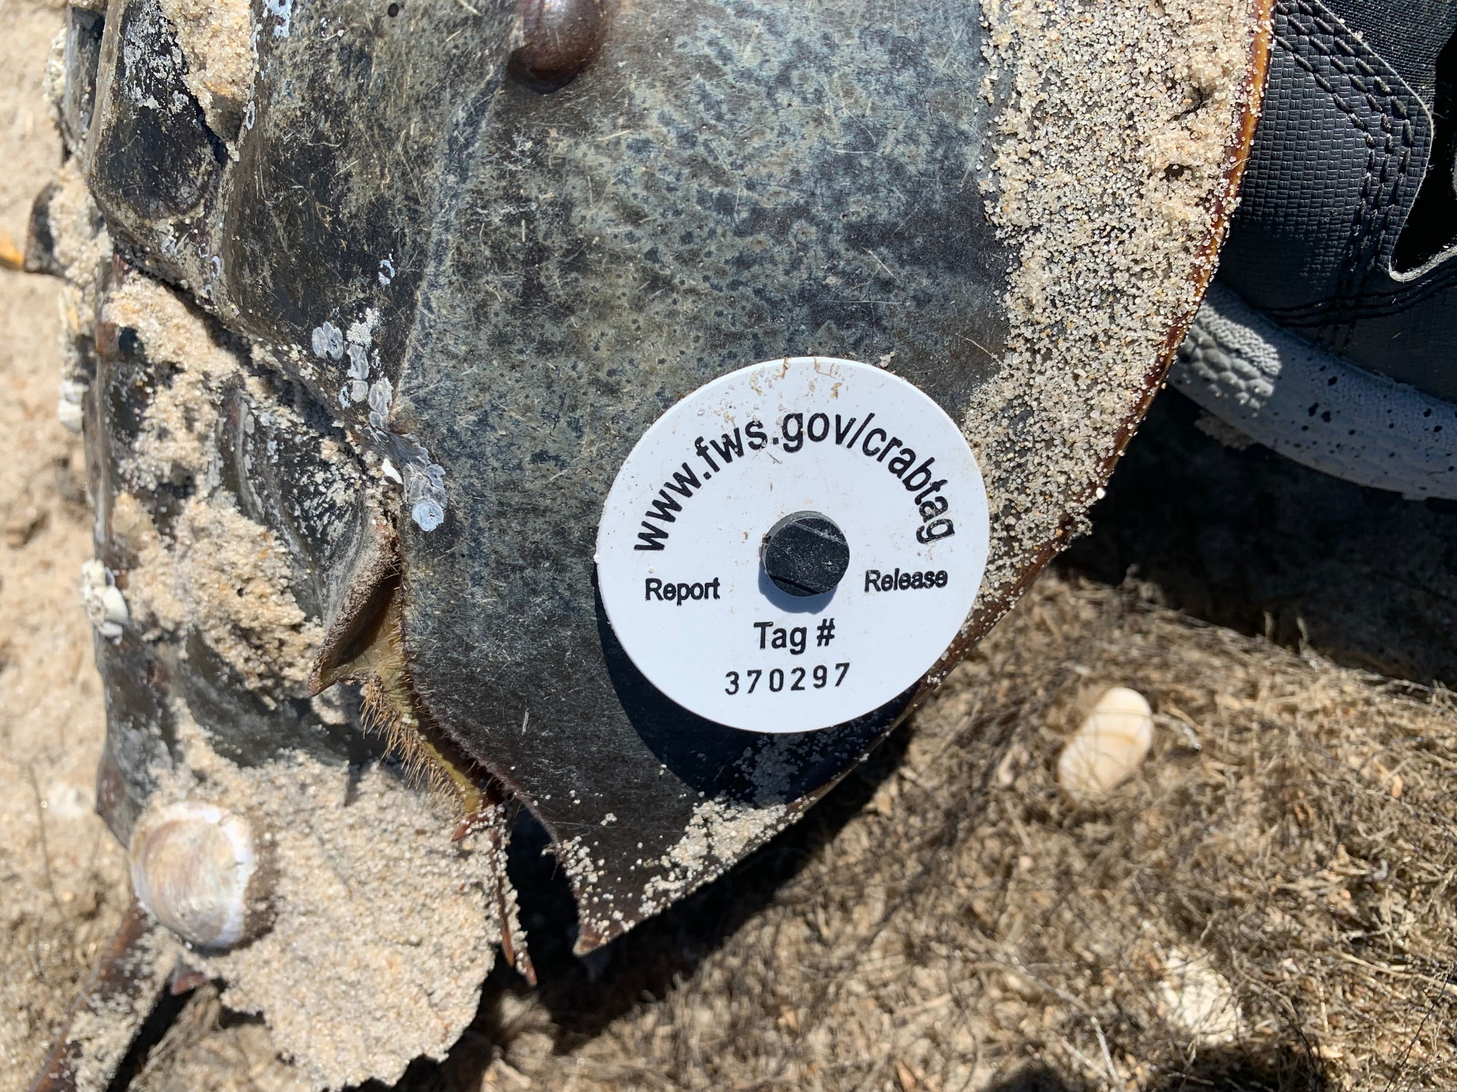
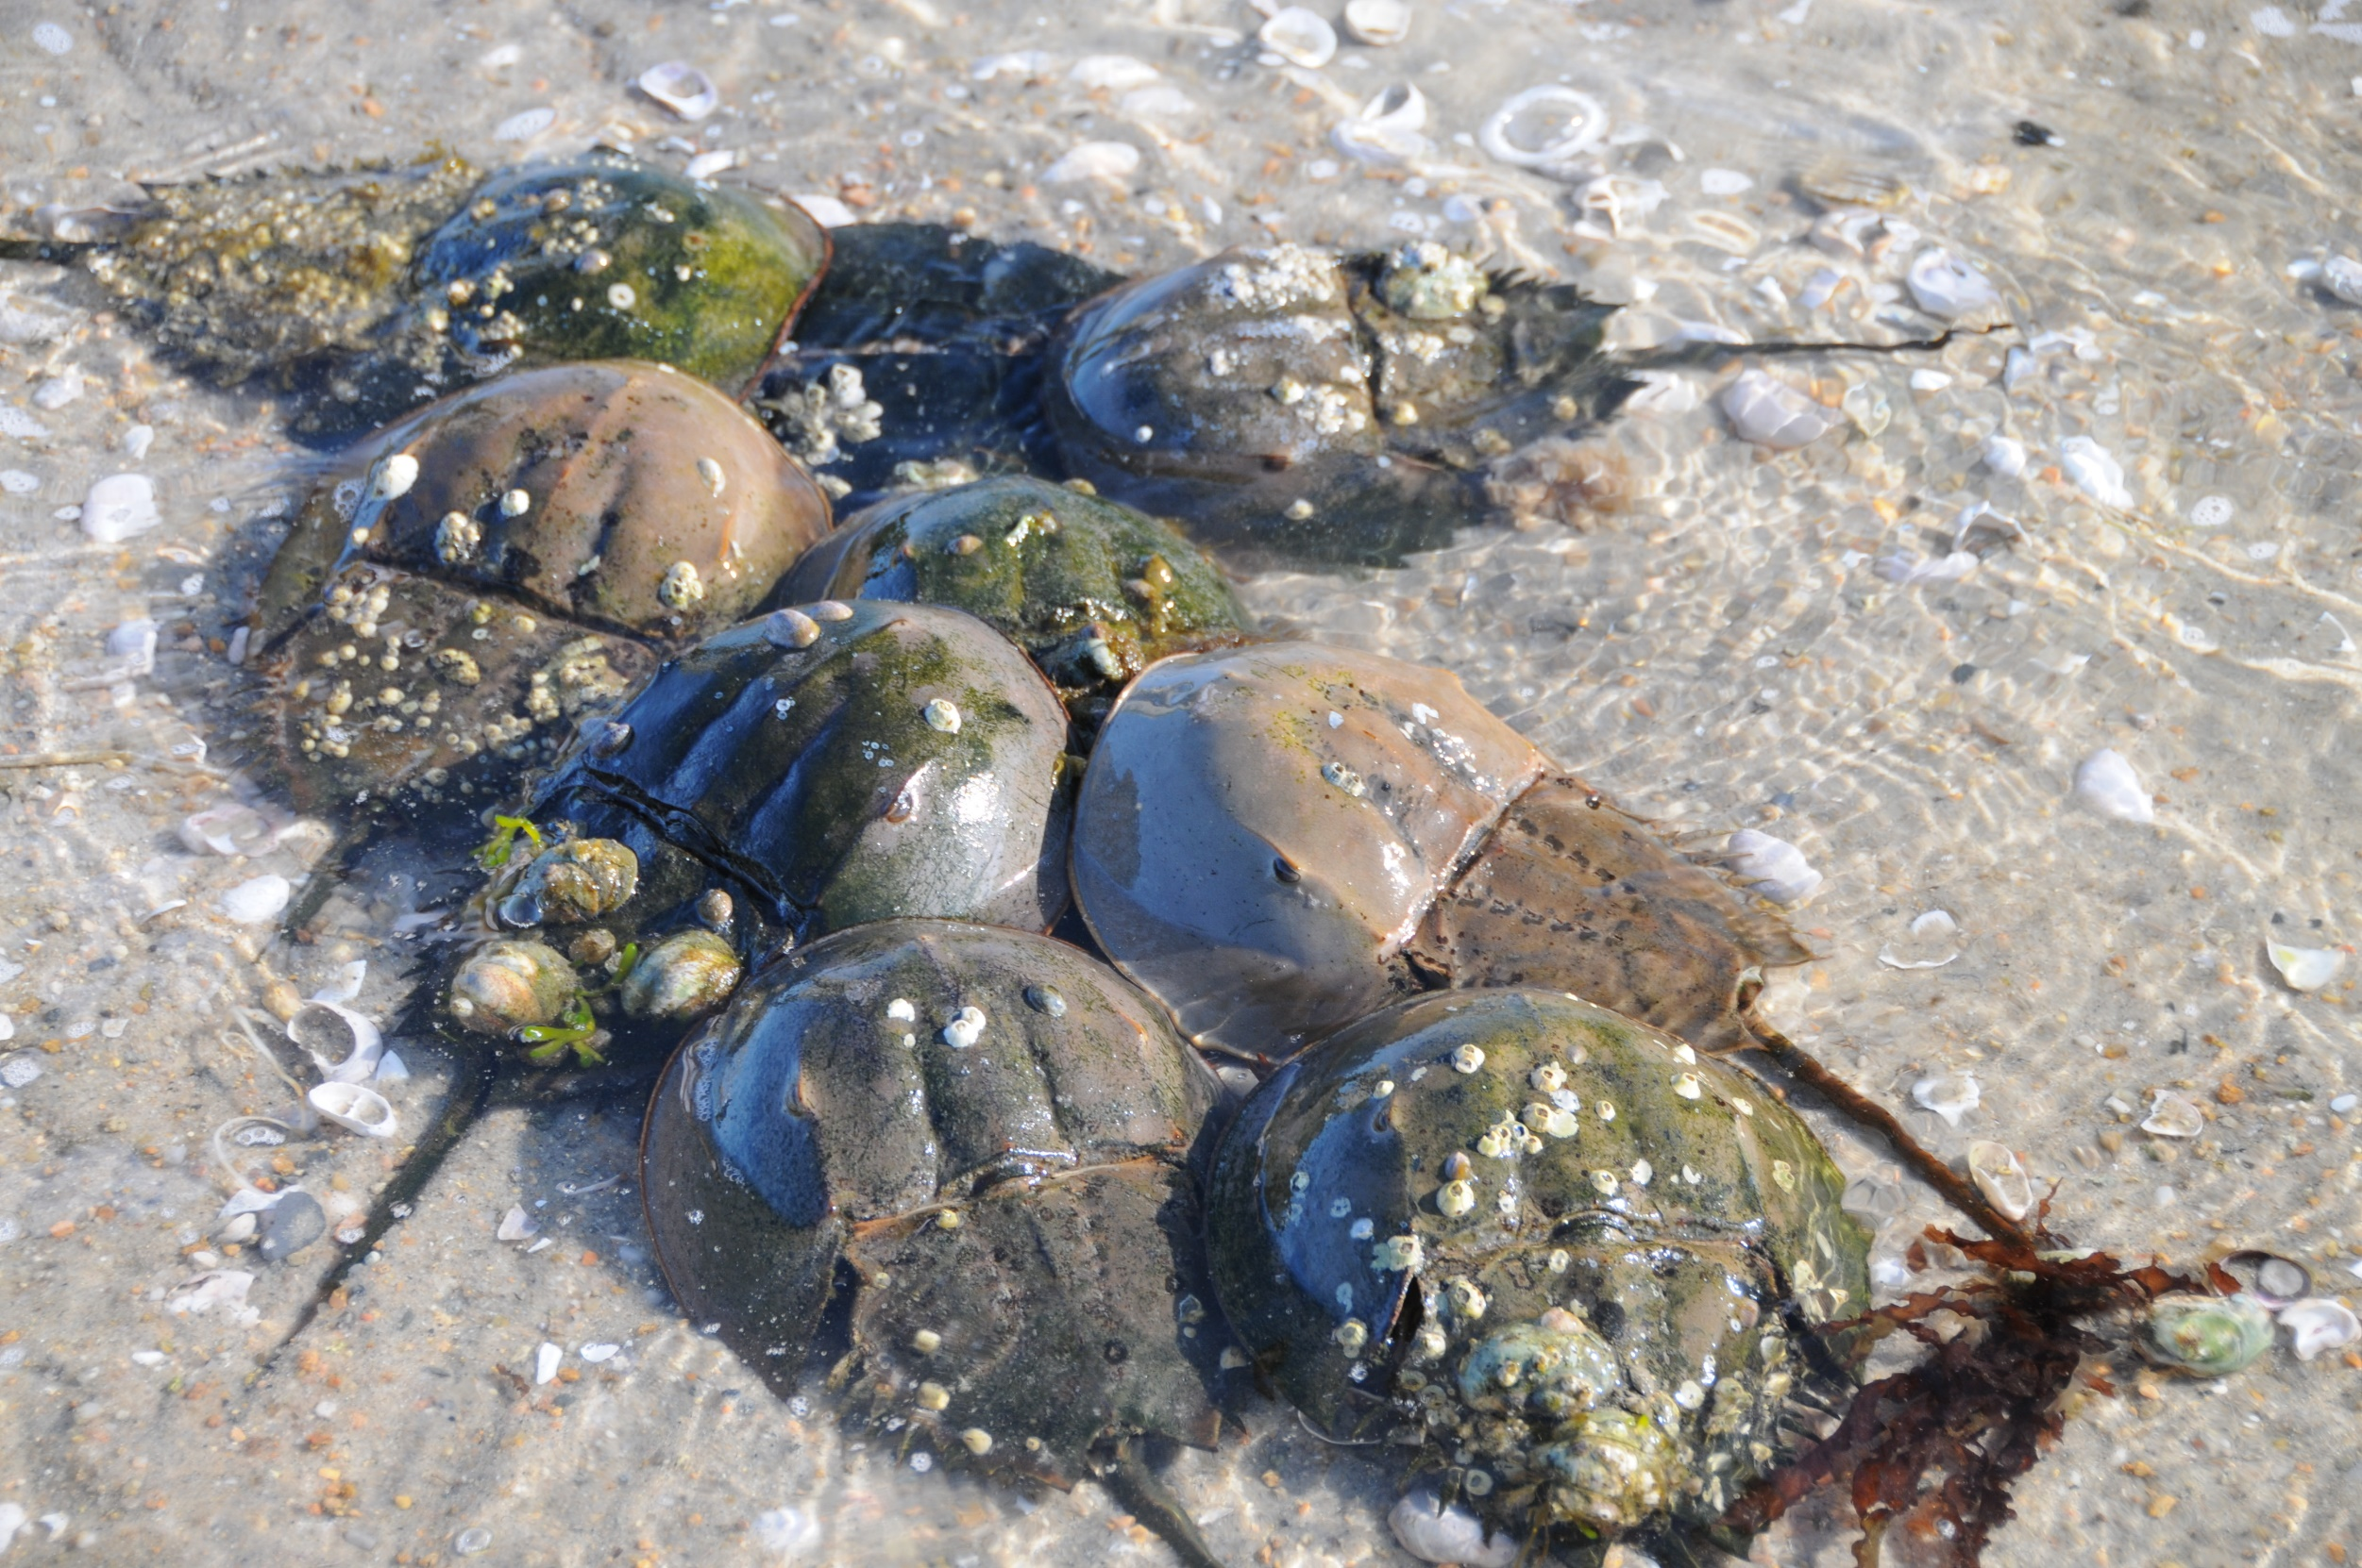
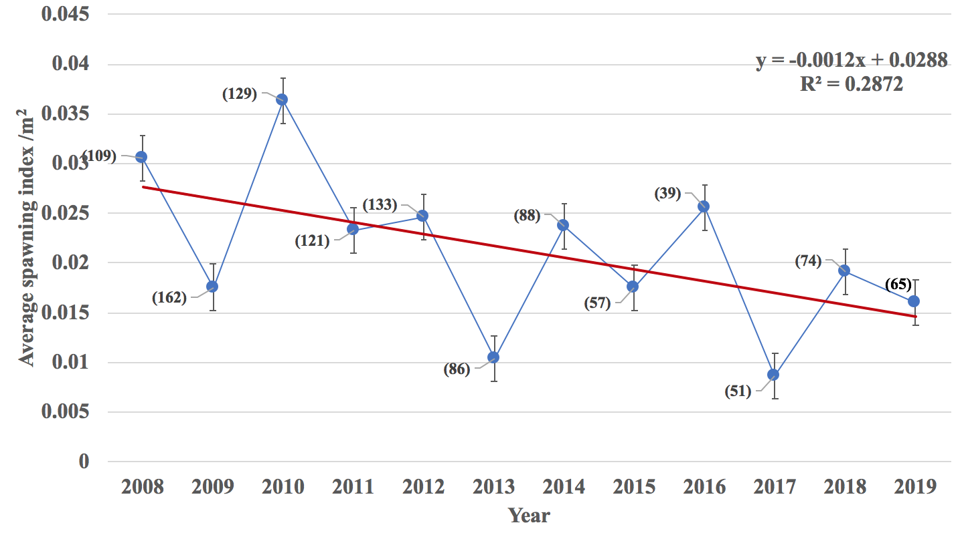
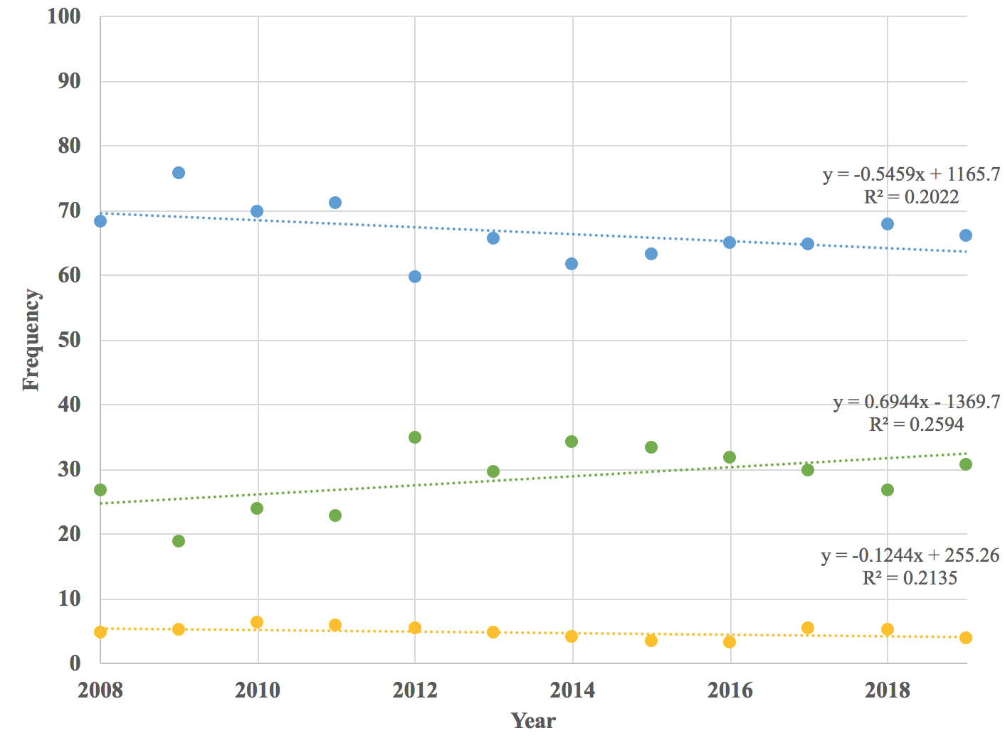
The Decline of the Horseshoe Crab in Long Island Sound
Adrian Nelson, Jennifer Mattei, Jo-Marie Kasinak
Department of Biology, Sacred Heart University, Fairfield, CT
Introduction
The long island sound is home to many kinds of marine and coastal animals. Each one plays a key role the ecosystem.
The Horseshoe crab (Limulus polyphemus) is one of the oldest lineages in our coastal ecosystem, over 400 million years!
It is an essential member of Long Island Sound. Spring migrating shore birds will stop and eat Limulus eggs, an essential part of their diet when traveling along the Atlantic flyway (Beekey et al. 2013).
Horseshoe crabs are important for human health. Their blood is harvested and required for testing vaccines and medical devices for bacterial toxins before these medical products are given to humans and our pets (Mattei et al. 2010)!
We need to track the Horseshoe crab population in the Sound to determine if it is increasing, stable or decreasing.
We predict a continued decline due to overharvest and habitat loss.
Fig. 1. The average number of spawning females across all beaches surveyed (# in parentheses = number of surveys) in CT for each spawning season.
Discussion
We found that the spawning population of horseshoe crabs in Long Island Sound is declining. We predicted a continued decline mainly because the CT Department of Energy and Environmental Protection has not changed its management strategy in over 12 years.
The population of horseshoe crabs in the Sound is shared with New York which harvests double the number of Limulus as CT.
NY and CT need to work together to manage this population to bring it back to the level where shorebirds and other wildlife can benefit from their eggs as sources of food.
Future research from the Mattei Lab will concentrate on coastal habitat restoration to help increase the survival rate of juvenile horseshoe crabs.
Methods
Surveys were conducted at night across Connecticut beaches during the full and new moons in May and June (see Beekey & Mattei 2015).
The number of horseshoe crabs were counted along the high tide line for a premeasured distance and 3 m into the water.
Horseshoe crabs were recorded as alone , in a pair, in a trio etc.
Horseshoe crabs were measured and checked for shell condition and damage.
Pairs
Single Females
Results
The average number of spawning females (averaged across all beaches and surveys) indicates a general decline in the spawning population over eleven years (Fig.1.).
The frequency of single females coming up to the beach alone each spawning season is increasing (Fig. 2 in Green).
The frequency of the number of pairs coming onto the beaches to spawn is declining (Fig. 2. in Blue).
The frequency of females with multiple mates is low but relatively stable (Fig. 2. in Yellow).
Multiple Mates
Fig. 2. The frequency of pairs (blue), single females (green) and females with multiple mates (yellow) across all beaches surveyed in CT for each spawning season (year).
References
Beekey, M.A., J.H. Mattei and B.J. Pierce. 2013. Horseshoe crab eggs: A rare resource for predators in Long Island Sound. Journal of Experimental Marine Biology and Ecology 439:152-159.
Mattei, J.H., M.A. Beekey, A. Rudman, A. Woronik. 2010. Reproductive behavior in horseshoe crabs: does density matter? Current Zoology 56(5):634-642.
Beekey, MA, JH Mattei. 2015. The Mismanagement of Limulus polyphemus in Long Island Sound: What are the Characteristics of a Population in Decline? In Carmichael, R, Botton ML, Cheung SG (eds.) Changing global perspectives on biology, conservation, and management of horseshoe crabs. Springer Pub. New York, NY.
.

