Slide 1
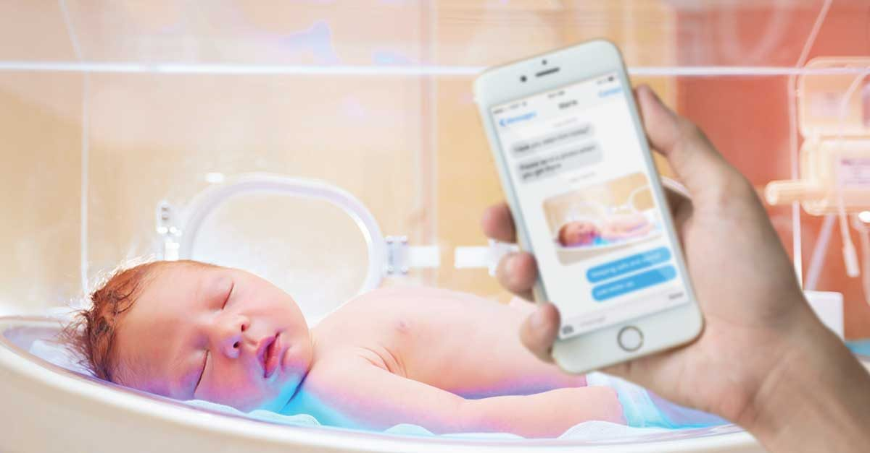
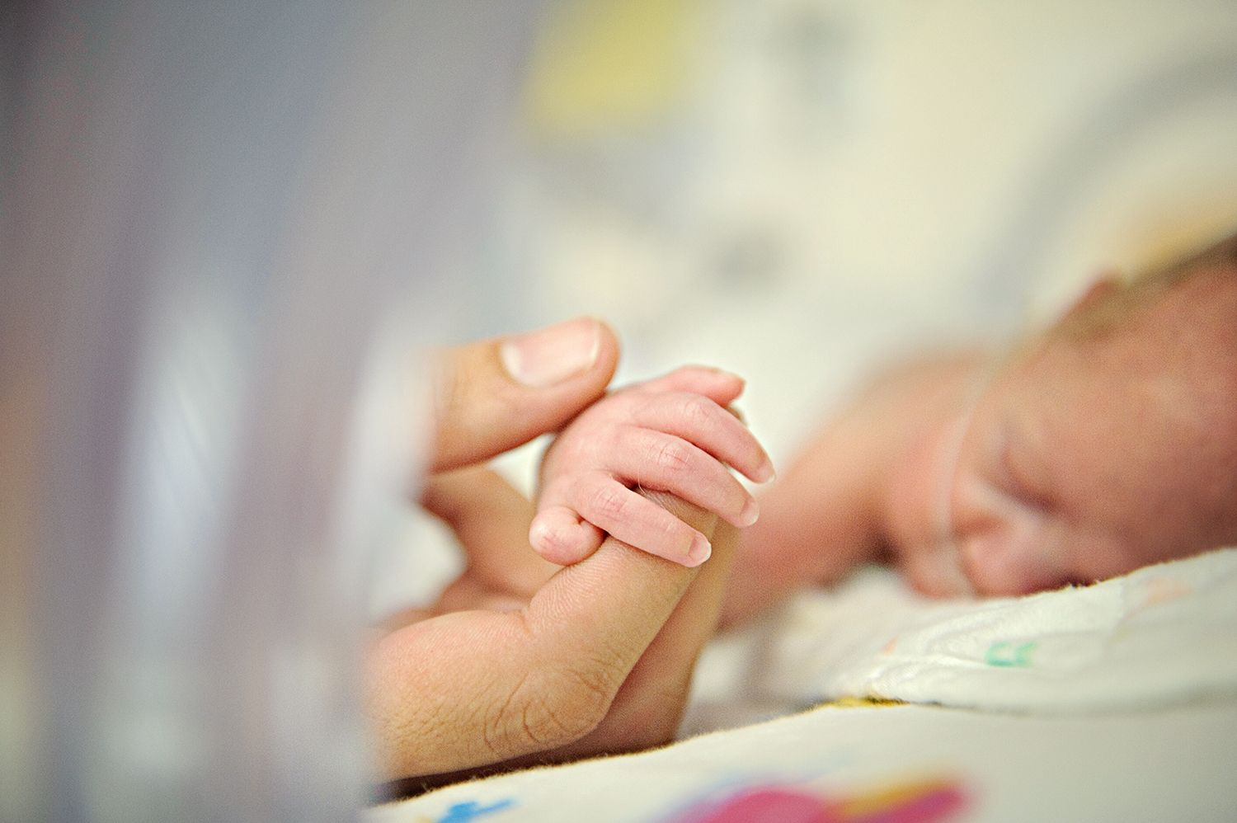
The Benefits of Cell Phone Disinfection in the NICU Olivia Lyon, SN CON Faculty Mentor: Dr. Michelle Cole, DNP, MSN, RN, CPN Sacred Heart University- Davis and Henley College of Nursing- Fairfield, CT Thomas More Honors Program
Purpose
Implementation
Conclusion
Educate NICU nurses and families on
Harmful pathogens on cell phones and potential harm to the neonate
Cell phone disinfection practices to reduce pathogen presence on cell phones
Develop a cell phone disinfection practice.
Minimize the risk of transmission of pathogens from cell phone surfaces to neonates.
Reduce the risk of nosocomial infection in the neonate.
The teaching tools will educate key stakeholders in the NICU.
Informational posters on display in three specific areas for target audiences
Care provider poster explains the significance of cell phone disinfection
Family poster at the bedside describes their role
Poster for visitors at the scrub stations describes the process of cell phone disinfection
Cell phone use is now part of patient care delivery and requires strategies to reduce the transmission of pathogens and the need for a disinfection practice.
The development of disinfection practice recommendations and teaching tools were viewed as significant to practice by staff on the unit.
The disinfection practice will promote a safe environment for neonates to grow and develop.
A new culture of consciousness regarding technology use and its possible impact on neonates was considered.
A disinfection practice will reduce pathogen exposure.
Reducing nosocomial infections results in decreased length of stays and associated hospital costs.
Background
Neonates are extremely vulnerable to infection due to immature immune systems, invasive medical devices, life sustaining invasive procedures, multiple caregivers, and traffic in NICU setting (Biggs & Kirkby, 2016).
There is a direct link between cell phone use and the acquisition of nosocomial infections, or infections obtained by a patient in the hospital setting (Curtis, Moore, Nugent, O'Connor, & Patton, 2018).
Nosocomial infections in neonates can result in neurodevelopmental delays, increased mortality and morbidity rates, longer hospital stays, and financial burden (Alotaibi et al., 2015).
Future Implications
Evaluation of outcome measures related to cell phone disinfection practice
Transition disinfecting practices into a hospital wide policy
Follow trends of nosocomial infection in the neonatal populations as well as the pediatric population
Clinical Implications
Nosocomial infections cost hospitals 6.5 billion dollars annually and result in an additional 16 million days in the hospital (Curtis et al., 2018).
PDI Sani-Cloth® AF3 germicidal disposable wipes are effective against 45 microorganisms, including 13 multi-drug resistant organisms, in three minutes (PDI, 2020).
These wipes are safe to use on cell phones and is already a trusted product in the NICU at Connecticut Children’s.
160 wipes cost an average of $10.40, and are discounted for hospitals.
Supplying an extra cannister at each of the three scrub stations could save the unit tens of thousands of dollars in infection treatment costs as well as costs associated with length of stay.
Significance to Nursing
Nurses now use cell phones as an essential tool in patient care.
Pathogens on cell phones pose a risk to the health, wellness, and safety of neonates.
Nurses have an obligation to act in accordance to non-maleficence and minimize the potential for harm to the neonate
A nurse’s role is to advocate, educate, promote safety, and implement change
Acknowledgements
Thank you to my preceptors Tracey Prioulx, Sarah McDonald, and Jennifer Bunnell as well as the rest of the NICU team at Connecticut Children’s for their ideas, guidance, and continuous support throughout this endeavor.
References available upon request

