Slide 1
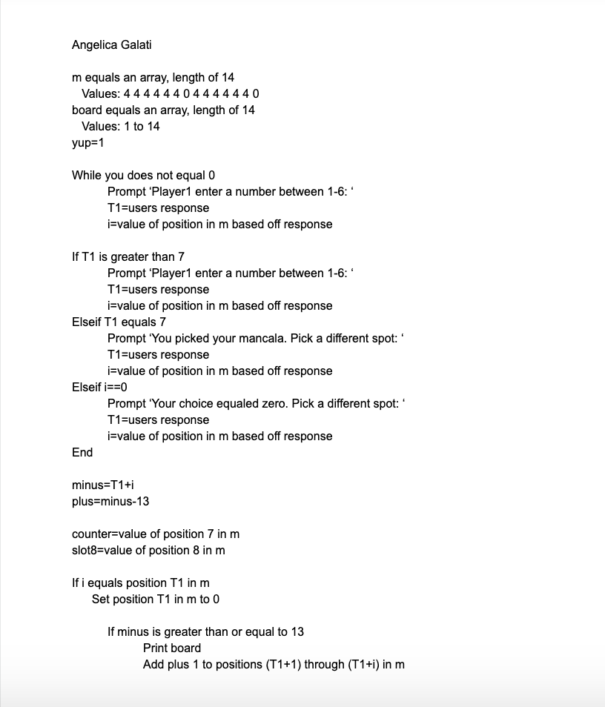
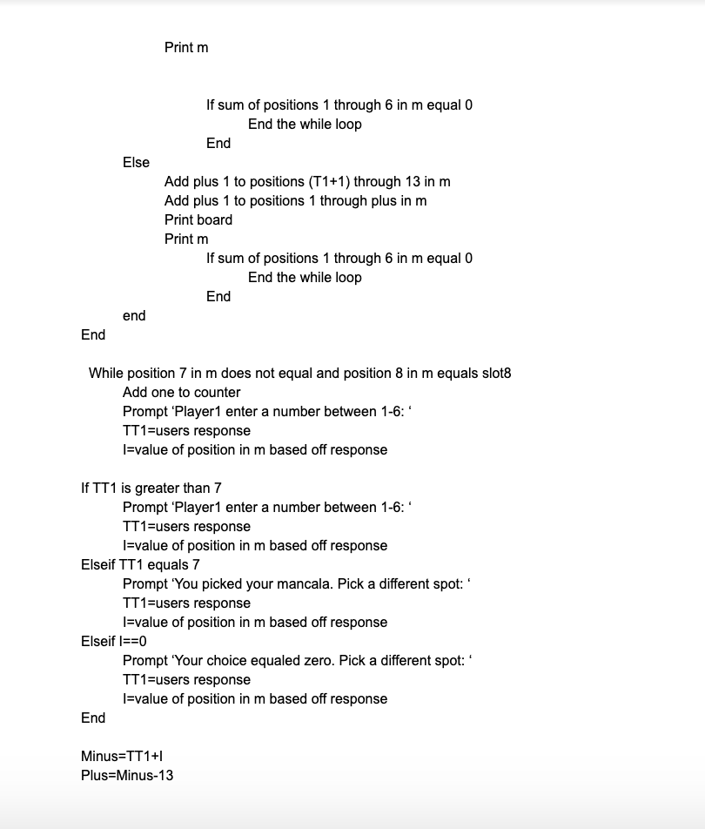
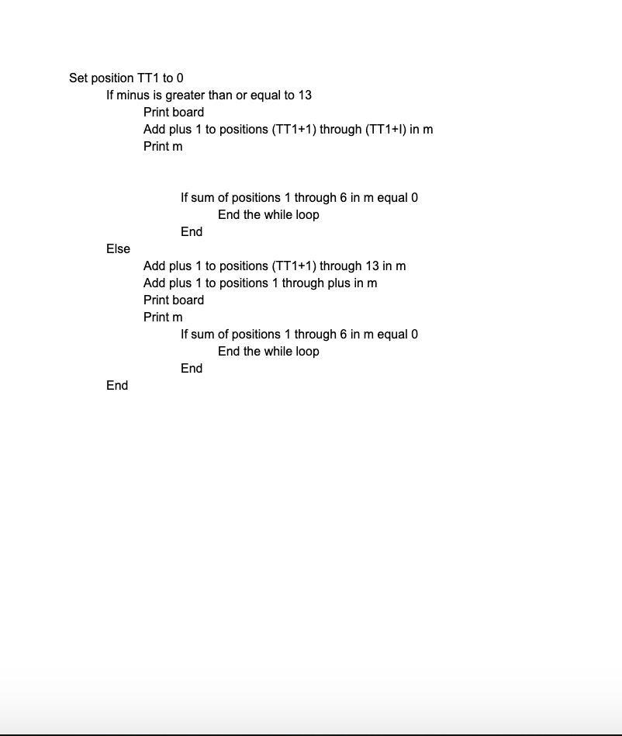
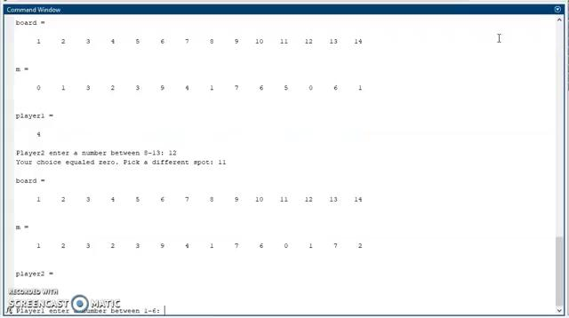
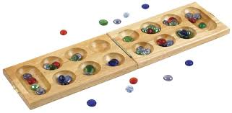
MANCALA in MATLAB
Angelica Galati
MANCALA
Mancala is a great game that everyone should play. It is a simple strategy game that puts the brain to work. So simple that you could play it in the dirt by making holes and using seeds. Yet strategic enough to improve memory and observation skills.
History
There are many different versions of Mancala all over the world. The game can be found throughout history, all the way back to 1400 BC.
Rules
Player one picks up all stones in any one of the pits on their side.
The player puts one stone in each pit, counter-clockwise, until there are no more stones.
If you reach your Mancala, then drop one stone in. Never add a stone into your opponents Mancala.
You take another turn if the last stone lands in your Mancala.
If the last stone lands in an empty pit on your side, then you take that stone and the stones in the pit, opposite of the pit your stone landed in and put them into your Mancala.
When all six pits are empty on either side of the board, then the game ends.
The player with stones left in their pits, captures them and puts them into their Mancala.
Count the stones in each Mancala. The player with the most stones wins!
MATLAB was a great tool to use to create Mancala. Using MATLAB made it much easier to understand mancala and how much a simple game can have so many parts to it. Having to make every aspect of the game in MATLAB showed that with every step you make in Mancala you have to be looking ahead to see what will happen next.
My Struggles
One of my biggest struggles was adding to an individual value in the array. I figured it out by using variables for the positions I want to add values to.
Another one of my struggles was figuring out how to end the game. I could not figure out what the condition should be for the while loop.I first tried to set it to, when the sum of positions 1 through 6 is 0 or when the sum of positions 8 through 13 is 0, which did not work. Instead I put breaks throughout my while loop to end the while loop once one side’s sum is equal to zero.
Pseudocode
-player one’ turn
Video
MATLAB
MATLAB is a programming platform that is very useful and easy to learn. The MATLAB language is simple to use yet complex enough to use it for almost anything. In other words, beginner programmers and experienced programmers would both enjoy using MATLAB.
Usage
Analyze data
Develop algorithms
Modeling, simulation, and prototyping
Math and computation
MathWorks
MATLAB is part of the company MathWorks that specializes in computer software. MathWorks has developed MATLAB and Simulink. Simulink focus more on simulations and modeling. Both MATLAB and Simulink can work together with in their program.

