Slide 1
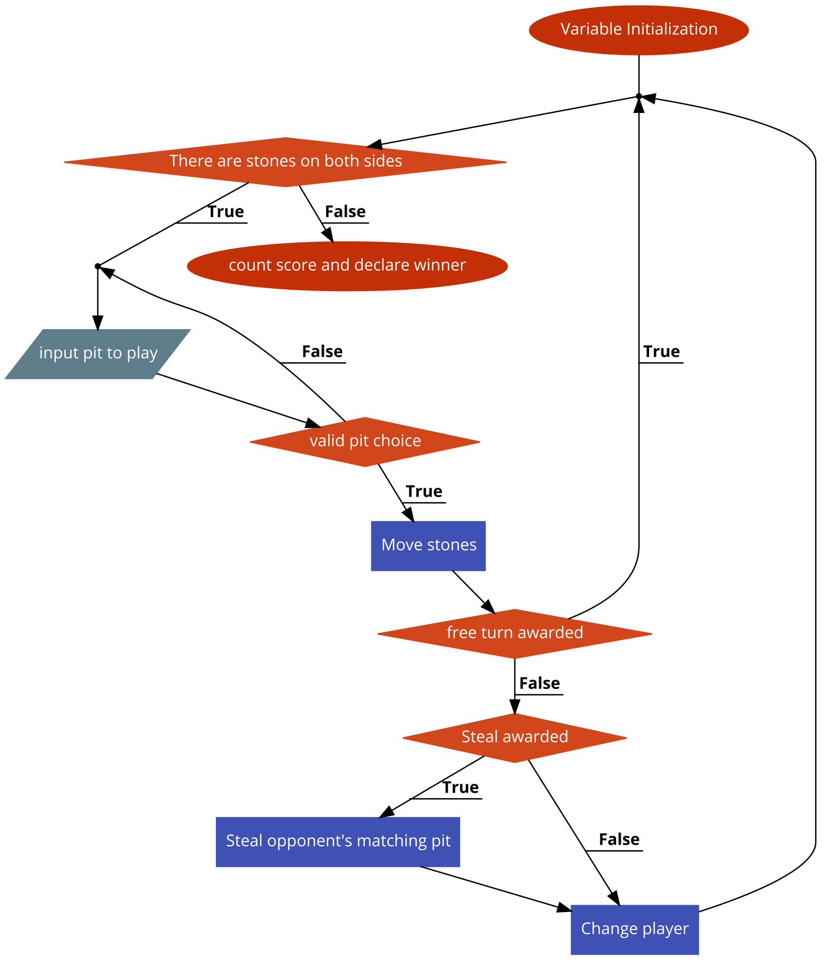
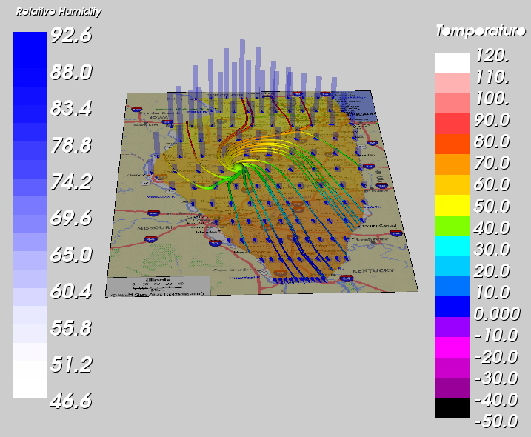
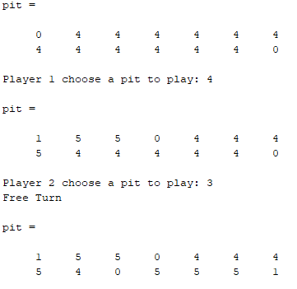
Old Games on New Computers
Jonathan Carpenter, Computer Engineering
Code flowchart
Uses
Matlab can be used to program Arduino boards for data colleciton and testing of modules. Matlab can then be used to store and transform the data for use in various fields that could make use of advanced data processing
What is Mancala?
Mancala is a game that has existed since at least the 7th century in areas of Asia and Africa. There are many variants of mancala, the most popular in America being Kalah
What is Matlab?
Matlab is an advanced program used for data collection and analysis and uses its own programming language
Matlab is used by more than 3 million professionals in science, engineering, and economics
Basic Rules
Each player chooses either the top or bottom row and can only play from their own row
The large pits are called the mancalas and are used to keep score, a player can only deposit stones into their own mancala
To play, a pit is chosen and the stones are removed and distributed one at a time to the next pit in the counterclockwise direction
Extra Rules
If a player’s last stone in a move ends in their mancala, they get a free turn
If a player’s last stone ends in an empty pit on their side, the stones in the pit on the other row are stolen and placed directly in the stealer’s mancala including the one stone that stole them`
Advanced Uses
Matlab has been used by Sacred Heart engineering professors to collect, analyze, and visualize data for use in research papers and is used to help create graphs and charts in many fields of research, especially in engineering and science as well as such mathematical fields as statistics and economics. Matlab is viewed as the easiest scientific programming language to use due to how easy it is to use and fix problems in compared to C and Fortran, especially across so many disciplines and fields, and also especially with regard to its advanced plotting and charting features
Code Rundown
My program runs mancala in a 2x7 matrix with the top right and bottom left positions being the mancalas
The majority of this program is run in a while loop to check for the game ending condition of having no stones in one row
The first section asks for the player to input the pit to play and also checks to make sure it is a valid move.
Next, the program starts moving the stones, checking for when the row needs to change and checking for the extra rules.
After checking for all special conditions, the player will change and the loop will repeat
Once one row has no stones, the stones in each rown are added and presented as a final score with a couple of simple if statements to check which player won or if there is a tie
There are currently no analytics involved in the program however, they would be simple enough to introduce to keep statistics over multiple games
At left, a chart made in Matlab showing humidity and temperature data overlaid on a map of southern Illinois
Coding challenges
Matlab is a very easy language to learn with knowledge of C++ although I did have a few troubles in making sure variables and data in general was in the right format to be used in certain ways, such as reformatting a number to a string to be output as a request for an input. I also had a design challenge with deciding how to format the game itself to try and convert the real game into an array usable by Matlab with my final format shown to the left
Going further with mancala in Matlab
Matlab can be used to analyze results across multiple games and perform statistics analysis across many games. This data could then be leveraged to predict moves or to provide statistical feedback for individual players. All of these could then be used to help program an AI to play mancala.

