Slide 1
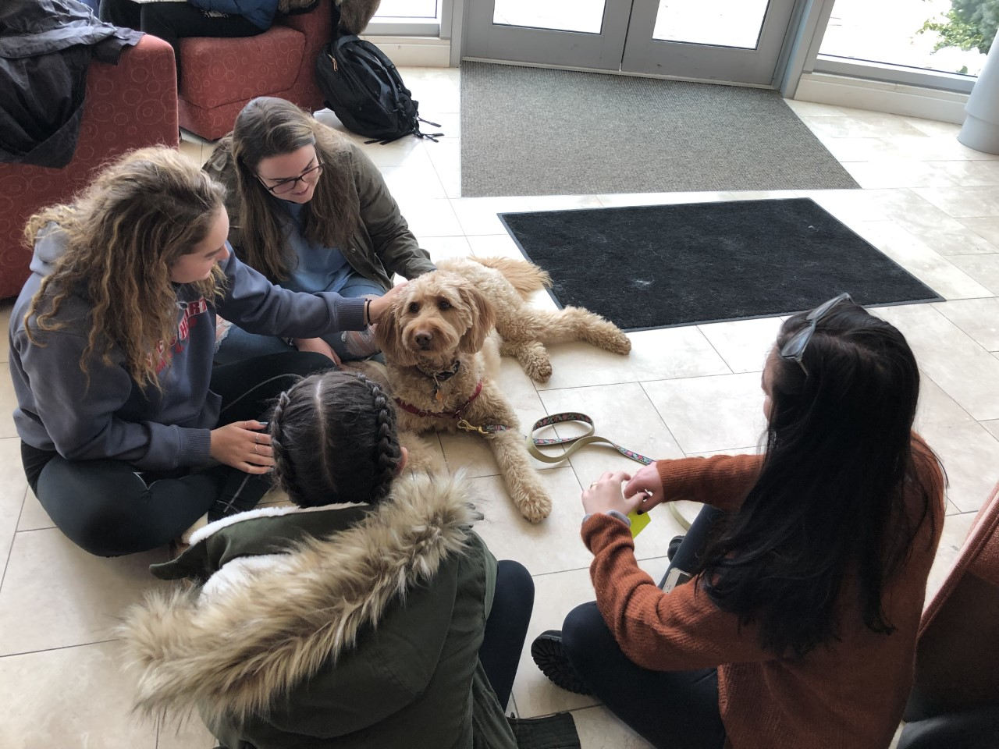
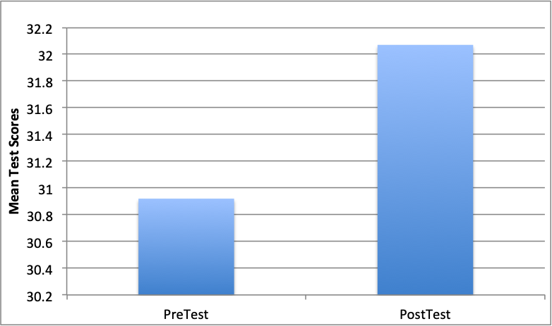
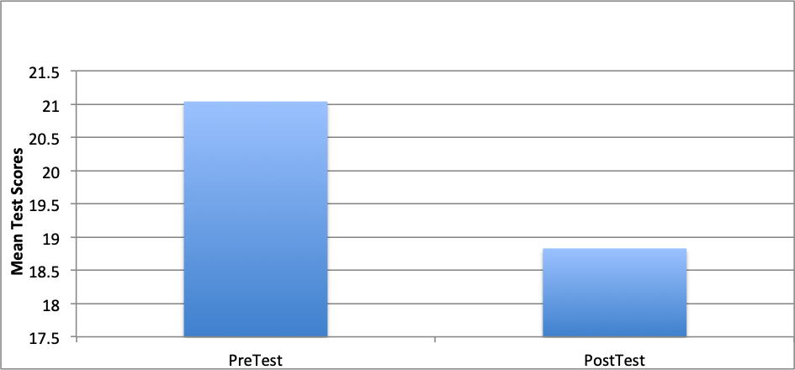
Therapy Dogs as a Wellness Incentive For Stress Management on a College Campus
Brenden Berger, Vanessa Vizcarrondo, & Jordan Devlin
Mentors: Dr. Dawn Melzer & Dr. Deirdre Yeater
Abstract
Limited research has been done to investigate the effectiveness of Animal Assisted Activity (AAA) programs to combat students' stress. The current study attempts to explore the possible benefits of AAA programs. Students were asked to complete two surveys; the Perceived Stress Scale (PSS) and the General Self-Efficacy Scale (GSES). They were then randomly assigned a 5 or 10 minute period to interact with the therapy dogs. The individuals were given post PSS and GSES surveys to complete 48 hours after exposure. Increased self-efficacy and decreased perceived stress levels after exposure to therapy dogs were predicted. Preliminary results show some support for these predictions.
Results
Multiple paired t-tests revealed significant overall differences between the pre- and post-tests for the PSS and GSE for both the 5 and 10 minutes groups, t (28) = 3.01, p = .005; t (27) = 2.12, p = .043, respectively. Participants perceived stress levels decreased and their self-efficacy increased after interacting with the dogs.
Introduction
The use of Animal Assisted Therapy programs are currently on the rise on college campuses due to an increase in student mental health issues.
Jalongo, Astorino, & Bomboy (2004), found that a student's well being improves with the use of therapy dogs in a classroom.
In the current study stress and self- efficacy levels were measured both before and after interacting with a therapy dog on campus for either 5 or 10 minutes.
It was hypothesized that undergraduate students who interact with a therapy dog will have decreased stress levels and increased self-efficacy scores after their interaction with the dog and that those with longer interactions times will have greater improvements compared to students who spend less time interacting with the therapy dog.
Discussion
Results were consistent with the hypothesis that participants stress levels would decrease, and their self-efficacy would increase.
The decrease in stress in the post test could be due to the fact that the participants knew they were participating in a stress exercise therefore they had the experienced the placebo effect.
Future research will be conducted to obtain a larger sample size and compare therapy dog’s interactions of varying lengths of time (5 vs. 10 mins.). In addition, cortisol samples will be analyzed measuring the psychological response to therapy dogs.
Stress is very common among college students. Being able to provide ways for students to relieve stress, such as therapy dogs, will help decrease their stress and increase their self-efficacy. Students could calm themselves, relax, and relieve stress in a positive way ( McCullough et al., 2018).
Figure 1. Mean Pre- and Post-Test Self Efficacy Scores.
Methods
Participants
- Nine undergraduate students and three therapy certified dogs.
Procedure
Prior to interacting with the therapy dogs the participants completed two online surveys, the Pre - PSS Survey and the GSE Survey.
A follow up survey was distributed to participants by email 48 hours after the interactions.
Measurements
Participants were given the Perceived Stress Scale (PSS) and Generalized Self-Efficacy Scale (GSE) before the interactions and then again 48 hours after the interactions.
References
Jalongo, R.M., Astorino, T., & Bomboy, N. (2004) Canine Visitors: The Influence of Therapy Dogs on Young Children's Learning and Well-Being in Classrooms and Hospitals . Early Childhood Education Journal, 32.
McCullough. A.,Jenkins. A. M.,Ruehrdanza, A.,JoGilmerb, M.,Olsonc.J., Paward, A.,Holleye.L.,...O’Haireh. E.M. (2018) Physiological and Behavioral Effects of Animal -Assisted Interventions on Therapy Dogs in Pediatric Oncology Settings. Applied Animal Behavior Science, 200, 86-95.
Acknowledgements
We would like to thank Karen Flanagan, the SWEET peer educators, and Pet Partners for scheduling assistance and allow us to collect data during the dog therapy sessions.
Figure 2. Mean Pre- and Post-Test Perceived Stress Scale Scores.

