Slide 1
Geoimpairment: How Pollution Has Affected Disability in the United States
Aidan Walraven
Double Major in Finance and Economics
Minors in Business Analytics and Honors

Slide 2
Introduction
Arguments regarding the care of the global environment has been debated for long over a century by government officials and academics.
To help analyze how Americans may be directly impacted by their care of the environment, this research entails finding correlation between the changes in air quality to the growth of disability claims made per month in every U.S state.

Slide 3
Hypothesis
I predict that change in Air Quality and growth in the number of Disability Claims filed are directly correlated.
Large centers of pollution have been shown to disincentivize people to perform physical activities, resulting in obesity. (Frank)
Negative views of the environment has been shown to have an effect on mental health. (Stiffman)
The handling and disposal of Clinical Solid Waste by healthcare professionals increases the chance of exposure to disease for themselves and others. (Hossain)

Slide 4
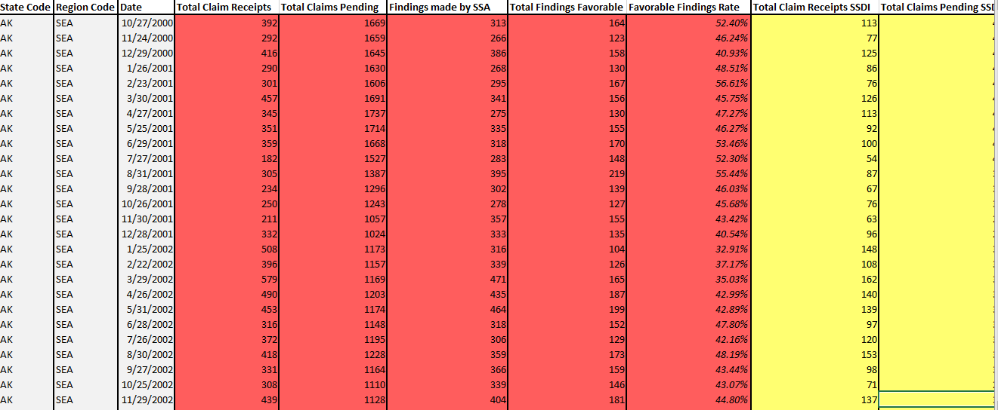
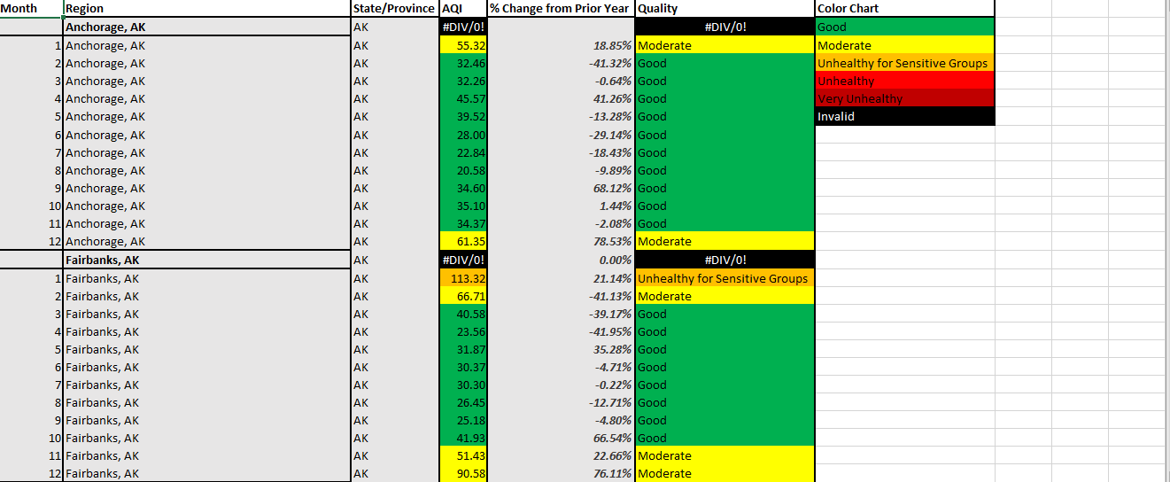
Methodology
Ran Regression Models for 2001 through 2019 using:
Monthly AQI of each state
AQI: Air Quality Index
Monthly Total Disability Claims
SSI, SSDI, and Concurrent Claims
Supplementing Missing Data
Used Eviews program to build regression models

Slide 5
Evidence Found
Dependent Variable: AQI_GROWTH
Method: Panel Least Squares
Date: 04/16/20 Time: 21:03
Sample: 1 612
Periods included: 12
Cross-sections included: 50
Total panel (balanced) observations: 600
Variable | Coefficient | Std. Error | t-Statistic | Prob.
C | 0.032365 | 0.007965 | 4.063261 | 0.0001
DISABILITY_CLAIM_GROWTH | 0.210547 | 0.034725 | 6.063264 | 0
R-squared | 0.057916 | Mean dependent var |  | 0.03869
Adjusted R-squared | 0.056341 | S.D. dependent var |  | 0.199117
S.E. of regression | 0.193426 | Akaike info criterion |  | -0.444511
Sum squared resid | 22.37345 | Schwarz criterion |  | -0.429854
Log likelihood | 135.3532 | Hannan-Quinn criter. |  | -0.438805
F-statistic | 36.76316 | Durbin-Watson stat |  | 2.280493
Prob(F-statistic) | 0
Correlation was not found between AQI and Total Claims
Varying P-Values
Scatterplot Graphs show little to no correlation
Trendlines

Slide 7
Additional Factors Affecting Pollution Levels
Population Density
Larger Population = More Potential for Pollution
Poverty Levels
Lower income areas tend to have less than ideal means of waste disposal
Technology
Technological Innovations of the past decade have helped in waste reduction and “eco-friendly” disposal.

Slide 8
Conclusion
Although correlation was not found, this does not mean the number of disability claims made per year are not affected by pollution.
Previously mentioned Pollution Factors
Evidence in Hypothesis of pollution’s effect on human health
Unfiled/Unconsidered Claims
Missing AQI Data
The Earth is our home, and we should be taking care of it regardless.

Slide 9
Bibliography
Frank, L. D., & Engelke, P. (2005). Multiple Impacts of the Built Environment on Public Health: Walkable Places and the Exposure to Air Pollution. International Regional Science Review, 28(2), 193–216. https://doi.org/10.1177/0160017604273853
Hossain, M. S., Santhanam, A., Norulaini, N. N., & Omar, A. M. (2011). Clinical solid waste management practices and its impact on human health and environment–A review. Waste management, 31(4), 754-766.
Stiffman, A.R., Hadley‐Ives, E., Elze, D., Johnson, S. and Doré, P. (1999), IMPACT OF ENVIRONMENT ON ADOLESCENT MENTAL HEALTH AND BEHAVIOR: Structural Equation Modeling. American Journal of Orthopsychiatry, 69: 73-86. doi:10.1037/h0080383
The United States Environmental Protection Agency. (2001 - 2019). AirData | US EPA. Retrieved from https://aqs.epa.gov/aqsweb/airdata/download_files.html#AQI
The United States Social Security Administration. (2001, January 1). SSA Fiscal Year Disability Claim Data. Retrieved from https://www.ssa.gov/disability/data/ssa-sa-fywl.htm

