Slide 1

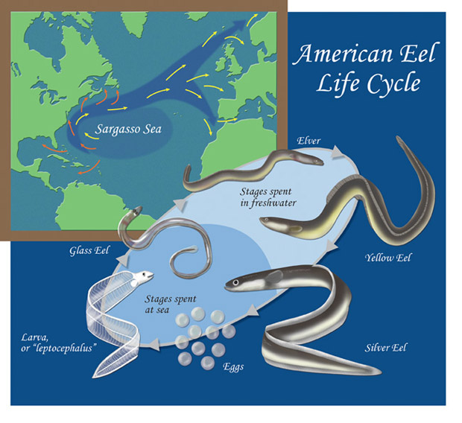
We conclude that the eel passage system (lights and notch) may have improved downstream protection of emigrant eels but given problems with lighting and incompleteness of PIT system coverage the degree of effectiveness is unknown. Another year of study with more reliable lighting and improved power and PIT monitoring systems is therefore warranted.
Migration Challenges of the Anguilla rostrata (American Eel) from Anthropogenic Impacts.
Benjamin Miller, Biology, SHU; Jennifer Mattei, Ph.D., SHU;
Alex Haro, Ph.D., USGS; Steve Gephard, CTDEEP
Introduction
Results
The life cycle of Anguilla rostrata (American Eels) involves a migratory route that originates at Sargasso Sea, where adults spawn and hatchling glass eels traverse up rivers along the U.S. east coast. They spend their time feeding until they pass into the adult silver phase, when return to the Sargasso Sea (see Fig 1.). This life cycle is threatened by anthropogenic barriers, such as hydropower plants and reservoirs. During downstream migration, eels are routinely injured/ killed when attempting to traverse these barriers. Here, effects of lighting and increased flow from a spillway notch to deter migrating eels from intake pipes was examined. Fifty silver phase eels were tagged and released into the Aspetuck Reservoir. PIT telemetry was used to determine their preferred route; either down a dam spillway notch or the intake pipe of the Hemlock Reservoir.
Of the original 25 eels released during release 1, only 16 (65%) were detected. Detections occurred at either the spillway notch or the Toy Factory location.
Many detections during release 1 occurred during the high flow event of 10/17-10/18 (Figure 3).
During release 2 on 10/27, three eels were detected moving downstream to Toy Factory; two of them passing via the spillway notch (Figure 3).
Another rain event on 11/25 resulted in one eel detected at Toy Factory location.
System outages due to power and battery failures may have caused fish to be missed at antennas during critical high flow events.
Methodology
Adult, silver-phase eels were collected from the airlift downstream eel bypass at Kelseytown Reservoir, Menunketesuck River, Clinton, CT. Prior to release, eels were anesthetized, measured (total length and eye diameter) and individually intraperitoneally tagged with a 32 mm glass-encapsulated PIT tag.
Passage routes were monitored using half-duplex passive integrated transponder (PIT) telemetry, with stationary PIT receivers (Oregon FID antenna multiplexing reader/logger) and custom-built loop antennas installed at strategic points. PIT antennas were installed at three locations:
1) the newly-constructed Aspetuck Dam bypass notch gate (notch antenna) (Fig. 2.)
2) the gatehouse outlet between Aspetuck and Hemlock Reservoirs (gatehouse antenna)
3) a full-stream-width antenna at the Toy Factory Dam, 2.2 rkm
downstream of the Aspetuck Reservoir (Toy Factory antenna).
PIT systems were operated continuously from October 5 to December 4, 2019. Marker tags (reference tags that transmitted every 15 min to monitor operation/performance of antennas) were placed directly on notch and Toy Factory antennas.
Halogen work lights temporarily installed below the intake access hatch. Light output and dispersion pattern of the combination LED and replacement halogen work lights was not measured and is unknown.
The newly installed notch gate was opened to elevation -1.0 ft (1 ft below the crest of the Aspetuck Dam spillway) and fixed at that level for the duration of the study.
Figure 1. The complex life cycle of the American eel. (Richard Schweid 2015. Slippery Business. Natural History Magazine) .
Conclusion
Figure 3. Time series of lower river flow (USGS gauge), Aspetuck Reservoir water level, total daily rainfall, and daily counts of eel detections by release group at notch and Toy Factory antennas (blue and green vertical bars). Eel detections are represented as only first detections of individual fish at each antenna. Red horizontal dashed line indicates level of Aspetuck Dam spillway crest. Vertical bands indicate significant PIT system outage periods (approximately 24 hours or greater) for notch (orange band) and Toy Factory (yellow band) antennas. Arrows indicate dates/times of Release 1 and Release 2.
Discussion
The general pattern of movement for the tagged eels was to primarily pass the dam during high rain events and increased flow, which is a common environmental cue to promote downstream migration. It is unclear if whether the tagged eels traversed over the spillway notch during low/no flow periods. PIT system outages due to power and battery failures may have resulted passing eels to evade detection during crucial high flow events.
Figure 2. The newly installed spillway notch at the Aspetuck dam spillway, at a fixed level 1ft below the spillway crest.
References
Haro, A. 2019. Passage Technologies for American Eel. https://www.usgs.gov/staff-profiles/alexander-haro?qt-staff_profile_science_products=0#qt-staff_profile_science_products l
Haro A, Watten B, Noreika J. 2016. Passage of downstream migrant American eels through an airlift-assisted deep bypass. Ecological Engineering.91:545–552. doi:10.1016/j.ecoleng.2016.02.028
Jessop BM. 2010. Geographic effects on American eel (Anguilla rostrata) life history characteristics and strategies. Jonsson B, editor. Canadian Journal of Fisheries and Aquatic Sciences. 67(2):326–346. doi:10.1139/F09-189

