Slide 1

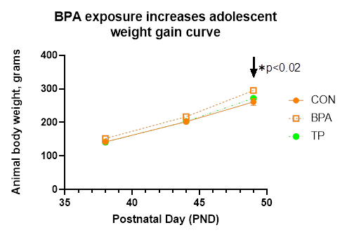
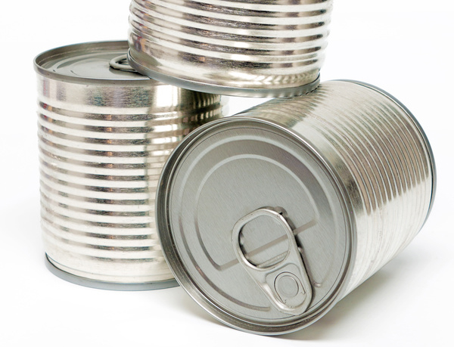


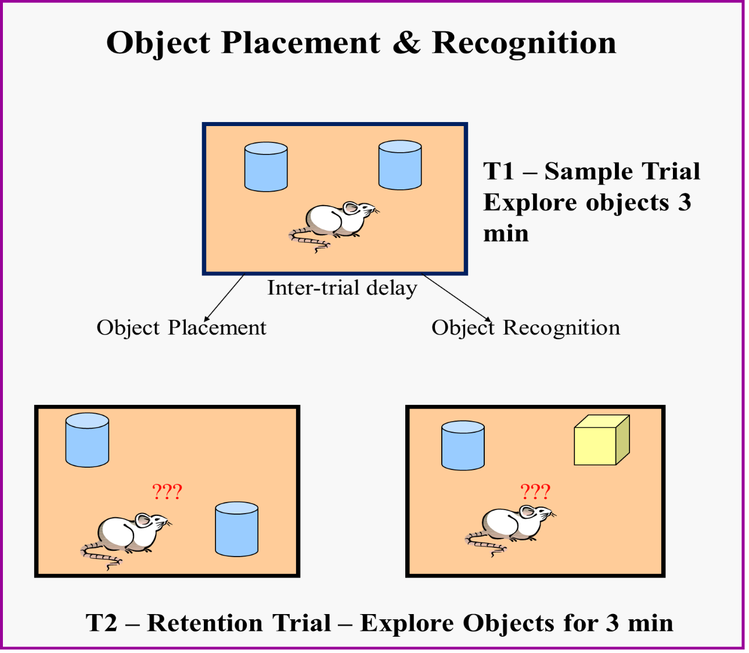

Effects of Bisphenol-A or Testosterone treatment during adolescence on memory
and weight gain in gonadectomized male rats.
Adrianne Alfonso¹, Olivia Downey², Emma Devanny¹, Caroline Loiodice² & Sean Mefford¹
(Mentor: Rachel E. Bowman^{1, 2} )
Department of Psychology¹ & Neuroscience Major²
Introduction
Experimental Research Timeline:
RESULTS: Aim 2
Bisphenol-A (BPA) is a common environmental endocrine disrupter exerting effects on many parameters (neural, physiological, and behavioral measures) via both estrogen and androgen receptors. BPA is an industrial compound used to make polycarbonate plastics and epoxy resins, such as CDs and DVDs, electronic equipment, cars, sports safety equipment, widely used in manufacture of hard plastic products such as food storage containers, bathtubs and countertops, can linings, and reusable bottles. BPA has many negative effects in humans. It may have carcinogenic effects leading to breast cancer, be toxic to the liver, linked to obesity due to effects on fat-cells, and can be associated with cardiovascular disease, diabetes and liver disease (Huang, et a.,2012).
l
Our studies are designed to assess the effects of low-dose levels of BPA (below the current reference safe daily limit of 50 µg/kg/day set by the United States Environmental Protection Agency) exposure during the vulnerable adolescent period when the brain is undergoing rapid neurodevelopment changes.
We have previously demonstrated that short-term, low-dose BPA exposure (40 µg/kg/bodyweight) during adolescent development in intact male and female rats impairs memory in both adolescence and adulthood (Frankfurt, et al., 2020). Given that the mechanism of action of BPA is presumed to involve gonadal steroid receptors, we repeated these experiments in gonadectomized male rats. In the present study we assessed the effects of BPA on gonadectomized (GDX) adolescent males.
RESULTS: Aim 1
CONCLUSIONS
When tested in late adolescence, neither BPA, nor T spatial and non-spatial memory as assessed by OP and OR.
The behavioral results in GDX males differ from those previously observed in intact males and suggest that intact males are more vulnerable than GDX males and also that T may not be directly involved in mediating the effects of BPA.
The current data also provides experimental data about the negative effects of BPA exposure on weight gain during male adolescent development. This is important because in humans, correlational data shows that overweight people were found to have high levels of BPA’s in their urine. Increased BPA is associated with central obesity and an increase risked of diabetes due to increased waist circumference and insulin resistance (Bertoli, et al., 2015).
The dosage used in this experiment was below what is approved by the EPA, and was found to have some detrimental effects. This indicates that the EPA should reconsider the current restrictions on BPA use.
References
Bertoli S, Leone A, Battezzati A. 2015. Human Bisphenol A Exposure and the “Diabesity Phenotype”. Dose Response. 13(3): 1559325815599173.
Frankfurt, M., Luine, V., & Bowman, R.E (2020). Bisphenol-a and memory: a role for dendritic spines. Hormones and Synapse, Volume 114, in the Vitamins and Hormones series. Publication date, August 1, 2020.
Huang, Y., Wong, C.K., Zheng, J.S., Bouwman, H., Barra, R., Wahlstroem, B.G., Neretin, L.N., & Wong, M. (2012). Bisphenol A (BPA) in China: a review of sources, environmental levels, and potential human health impacts. Environment international, 42, 91-9
UnitedStatesEnvironmentalProtectionalAgency,1993.BisphenolA,CASRN80-05-7. IntegratedRiskInformationSystem.U.S.EnvironmentalProtectionAgency, Washington,DC Available at: http://www.epa.gov/iris/subst/0356.htm.
Methods
Aim 1: Male Sprague-Dawley rats were gonadectomized (GDX) on PND 21 by the vendor and arrived in our facilities on PND28. Subjects were randomly assigned to a control (vehicle control), BPA (40 µg/kg bodyweight), or Testosterone Propionate (TP) (500 µg/kg bodyweight) group and received subcutaneous injections during adolescent development PND 38 – 49. Anxiety and memory was measured in adolescence.
Aim 2: GDX male rats arrived on PND 28 were randomly assigned to a control (vehicle control), BPA (40 µg/kg bodyweight), or Testosterone Propionate (TP) (500 µg/kg bodyweight) group and received subcutaneous injections during adolescent development PND 38 – 49. Rats were weighed regularly.
Object Placement & Recognition Tests:
Spatial memory was tested using the
object placement and non-spatial
working memory was tested using
the object recognition test. The time spent
with old versus new
location/object was recorded and used
as an index of memory performance.
All experimental procedures were approved by
the Sacred Heart University IACUC #2019-R002.
#SHUFest20
Vote for the poster about BPA!

