Slide 1
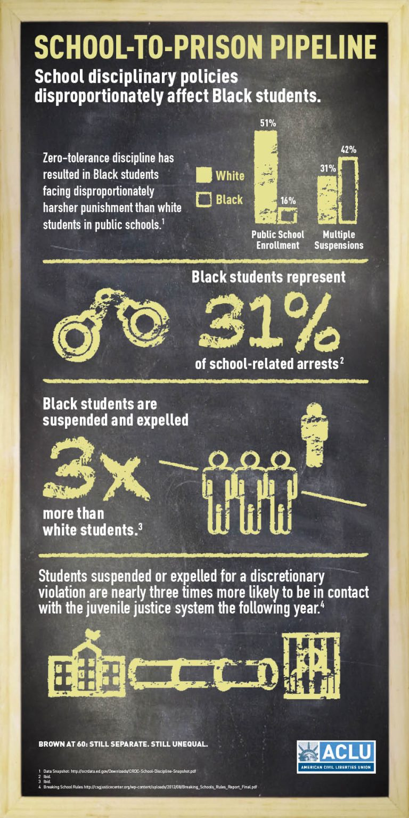
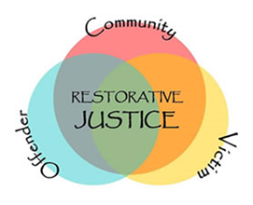
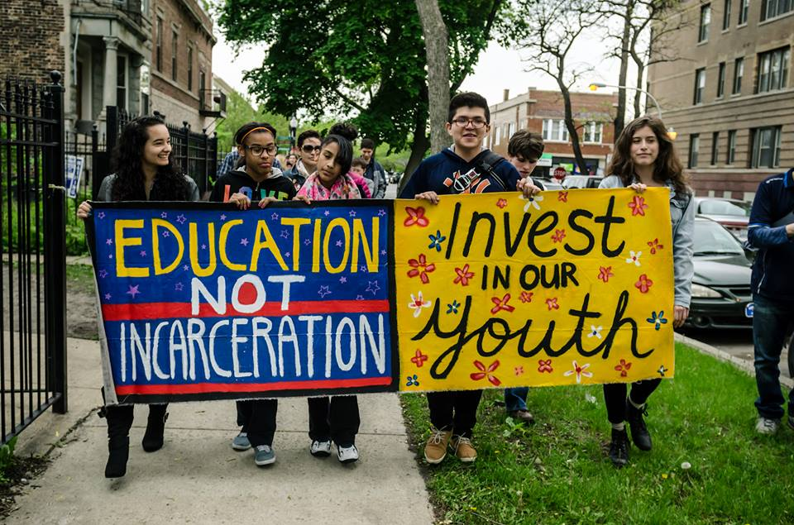
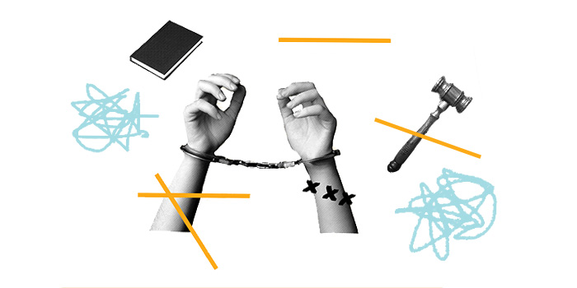
The Deconstruction of the School-to-Prison Pipeline
Emmalyn Walenda, Social Work
Research Question:
What causes the school-to-prison pipeline and what measures can be taken to combat it?
Main Impacted Groups:
Mental Illness
65-70% of youth in the juvenile justice system have a mental illness
Potential Causes
Lack of funding to school mental health services
Trauma-informed approach not utilized
Disabilities
75% more likely to be expelled
Potential Causes
Lack of professional training
- Inadequate funding
Minority Groups
Individuals of minority groups represent two-thirds of youth in the juvenile justice system
Potential Causes
Unconscious bias
Discrimination
Thesis:
Educational facilities in the U.S. utilize a wide variety of harsh seclusive forms of discipline with students that trigger the beginning to the school-to-prison pipeline. In order to officially diminish the existence of this phenomenon, schools must implement more guided and constructive methods of discipline.
https://www.educationviews.org/restorative-justice-is-about-more-than-just-reducing-suspensions/
Potential Solutions:
Restorative Justice
Learn life-long problem-solving skills
Unearth underlying issues
Discover possible resources
More Funding for Mental Health and Special Education Programs
Have adequate mental health and support staff
Unearth and receive support for any underlying issues
Obtain adequate academic and personal supports
Decrease possible disengagement
Decrease possible behavioral disturbances and dropouts through increased resources
Increased Teacher and Staff Professional Development
Learn more trauma-informed approach methods
Address discrimination
Gain knowledge of diverse student populations
Less resorting to exclusionary discipline
https://www.aclu.org/issues/juvenile-justice/school-prison-pipeline/school-prison-pipeline-infographic
Potential Causes:
Exclusionary Discipline
Exp: Suspension; Expulsion, Zero Tolerance Policies
Zero Tolerance Policies in 94% of U.S. public schools
Trivial Offenses – 95% of Suspensions
Court Referrals and Student Arrests
Minor and unviolent infractions
“Disturbing schools”
Discrimination against certain student population groups when making the arrests or referrals
https://www.nationofchange.org/2018/09/20/four-black-female-judges-use-their-courtrooms-to-break-the-school-to-prison-pipeline/
What is the School-to-Prison Pipeline?:
The process of which methods and practices used by the educational system push students out of school, and into the juvenile or criminal justice systems.
https://www.aclu.org/issues/juvenile-justice/juvenile-justice-school-prison-pipeline

