Slide 1
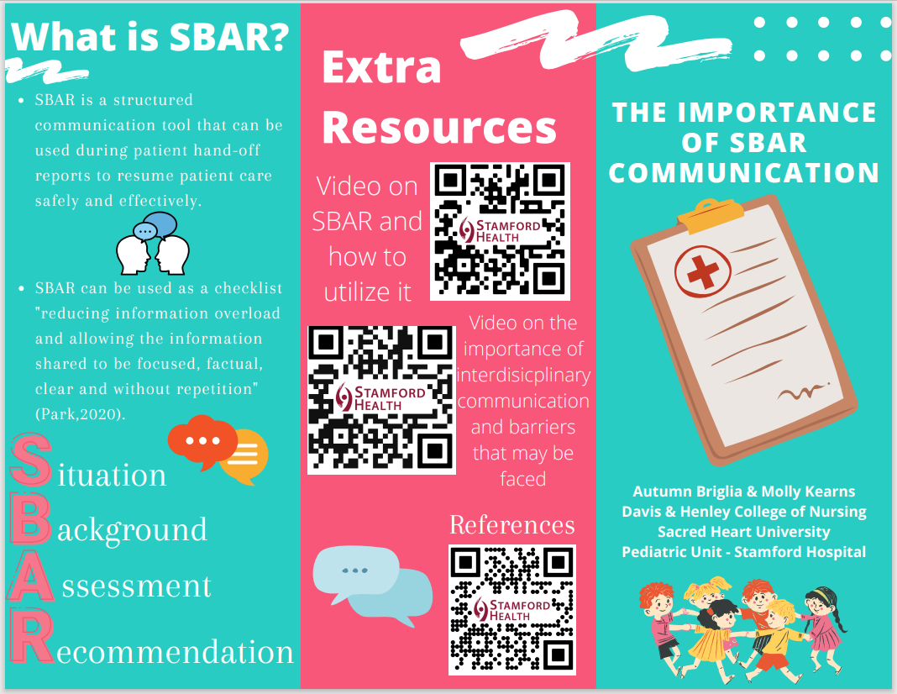
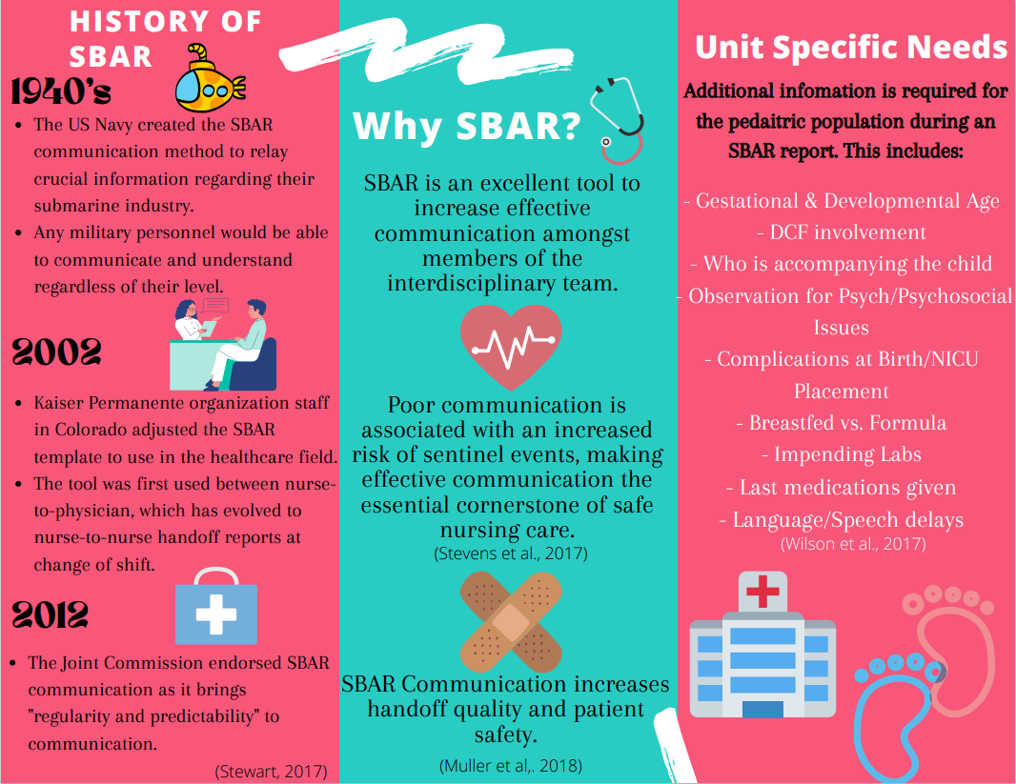
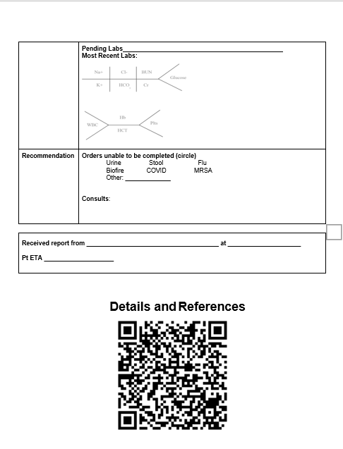
Pediatric Specific SBAR Sacred Heart University - Fairfield, CT Davis & Henley College of Nursing Autumn Briglia & Molly Kearns
Purpose
Educational Pamphlet (Front)
Clinical
The purpose of this project was to create a Pediatric specific SBAR report sheet that would guide the Stamford Hospital Pediatric Nurses to give and receive a proper handoff to ensure effective communication and safe care.
At Stamford Hospital, the Pediatric nurses often find missing information when they receive patient hand-off from the Emergency Department nurses. This is a problem as critical information regarding the patient’s status are often missed. Some information that tends to be missing includes orders that still need to be completed and medications given during the Emergency Department visit. The pediatric patients are a vulnerable population, who tend to deteriorate quicker than adults (Mannix et al., 2017). By improving the way SBAR is given at Stamford Hospital, the Pediatric nurses can provide safer and higher quality care for these patients.
Background
SBAR is a pneumonic for Situation, Background, Assessment, and Recommendation.
Situation involves the patient’s immediate need-to-know information, including name, age, gender, admitting diagnosis, and allergies.
Background involves the patient’s past medical history, recent surgeries, mental status changes, and diet.
Assessment involves pertinent patient findings such as vital signs, specific body system assessment, and lab work. Nurses can give their input at this point as to what they believe is happening to the patient.
Recommendation is the point where what orders still need to be completed for the patient are shared.
Conclusion
Overall, the SBAR tool alone can help improve effective communication amongst the healthcare team. However, when the SBAR tool is individualized for a specific unit, safer care is a direct result.
Significance to Nursing
SBAR is significant to nursing as it can be utilized during patient hand-off. Hand-off can be defined as “the transfer of accountability and responsibility of patient care from 1 professional or professional group to another” (Tobiano et al., 2021, p 339). Patient hand-off occurs in the beginning, middle, and at the end of a nurse’s shift. Proper communication allows nurses to resume safe patient care. It has been shown, that when SBAR is utilized, there is a 11% decrease in communication errors that occur (Stewart, 2017). The better the communication, the less likelihood of a patient enduring preventable adverse events and longer hospital stays.
Future Directions
Every unit in the hospital will have a modified SBAR tool to follow to cater the specific population’s needs for safe patient care.
Future studies can be done to analyze how these specialized SBAR tools have decreased communication-related patient adverse and sentinel events.
Educational Pamphlet (Back)
Pediatric SBAR Tool
Acknowledgement
We would like to thank the Stamford Hospital Pediatric unit for allowing us the opportunity to have our Capstone Rotation there, specifically Jessica Aiken & Nicole Bobko for being our preceptors. We would also like to thank Professor McDonough for mentoring us throughout this process.
References

