Slide 1
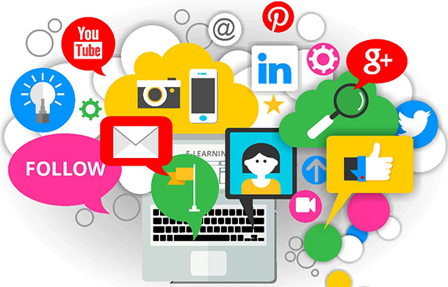
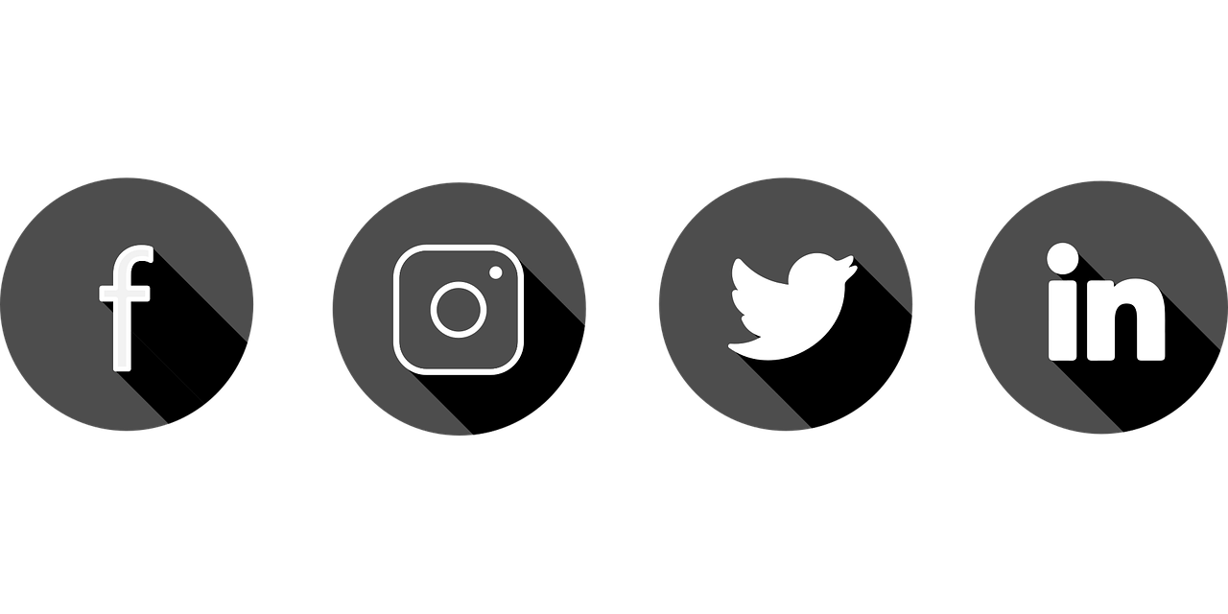
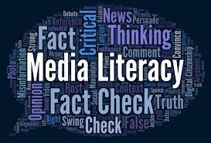
Conclusion: What can we do? -It is important that our society has education in media literacy to prevent the rise of personalization and algorithms, as well as fake news. This will prevent the stunting of the growth to our society, as well as the influence of extreme ideological positions amongst individuals. -We must acknowledge the problem and proactively educate each other on how to effectively view the media we are exposed to everyday. -Click on content that goes against our prior beliefs, so the algorithms show us both perspectives. -Media Ownership: those who run the internet need to make sure the algorithms have encoded a sense of public life and civic responsibility, as well as give us some sort of control so we can connect with one another as well are introduce ourselves to new ideas and perspectives .
Media Literacy: Why is it Important in Today’s Digital Age?
Deanna Drakopoulos
Media Arts, School of Communication and Media Arts
Research Question
Why is media literacy important in today’s digital age?
Thesis
The education of media literacy is prudent to society in today’s digital age, as the rise of personalization and fake news has stunted the growth of society and influenced the adoption of extreme ideological positions.
My Findings: Issues That Are Causing Our Need to Educate Society on Media Literacy
Personalization and Filter Bubbles:
A filter bubble, or ideological frame, is a state of intellectual isolation that can result from personalized searches when a website algorithm selectively guesses what information a user would like to see based on information about the user, such as location, past click-behavior and search history. Here people are only exposed to their prior beliefs.
Fake News & Political Polarization:
People get most of their news online and anyone can put information out there.
Citizen Consciousness and Media Literacy:
There is need for media literacy
for individuals to be knowledgeable about power relations, be respectful towards others, be responsible citizens, and to transform marginalizing values and
mechanisms instead of serving to reproduce extreme standpoints.
What is Media Literacy?
-Media literacy is the ability to access, analyze, evaluate, and create media in a variety of forms.
-An understanding of media literacy will allow our media consuming society to look with a critical eye at media messages we experience.

