Slide 1
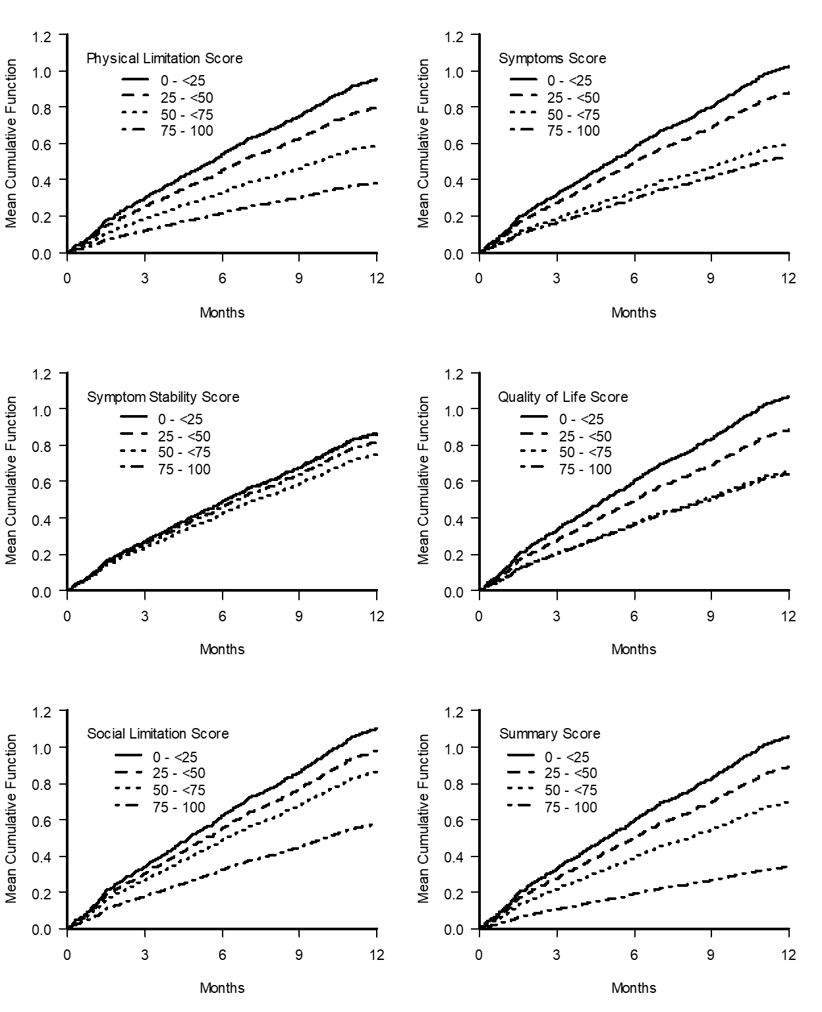
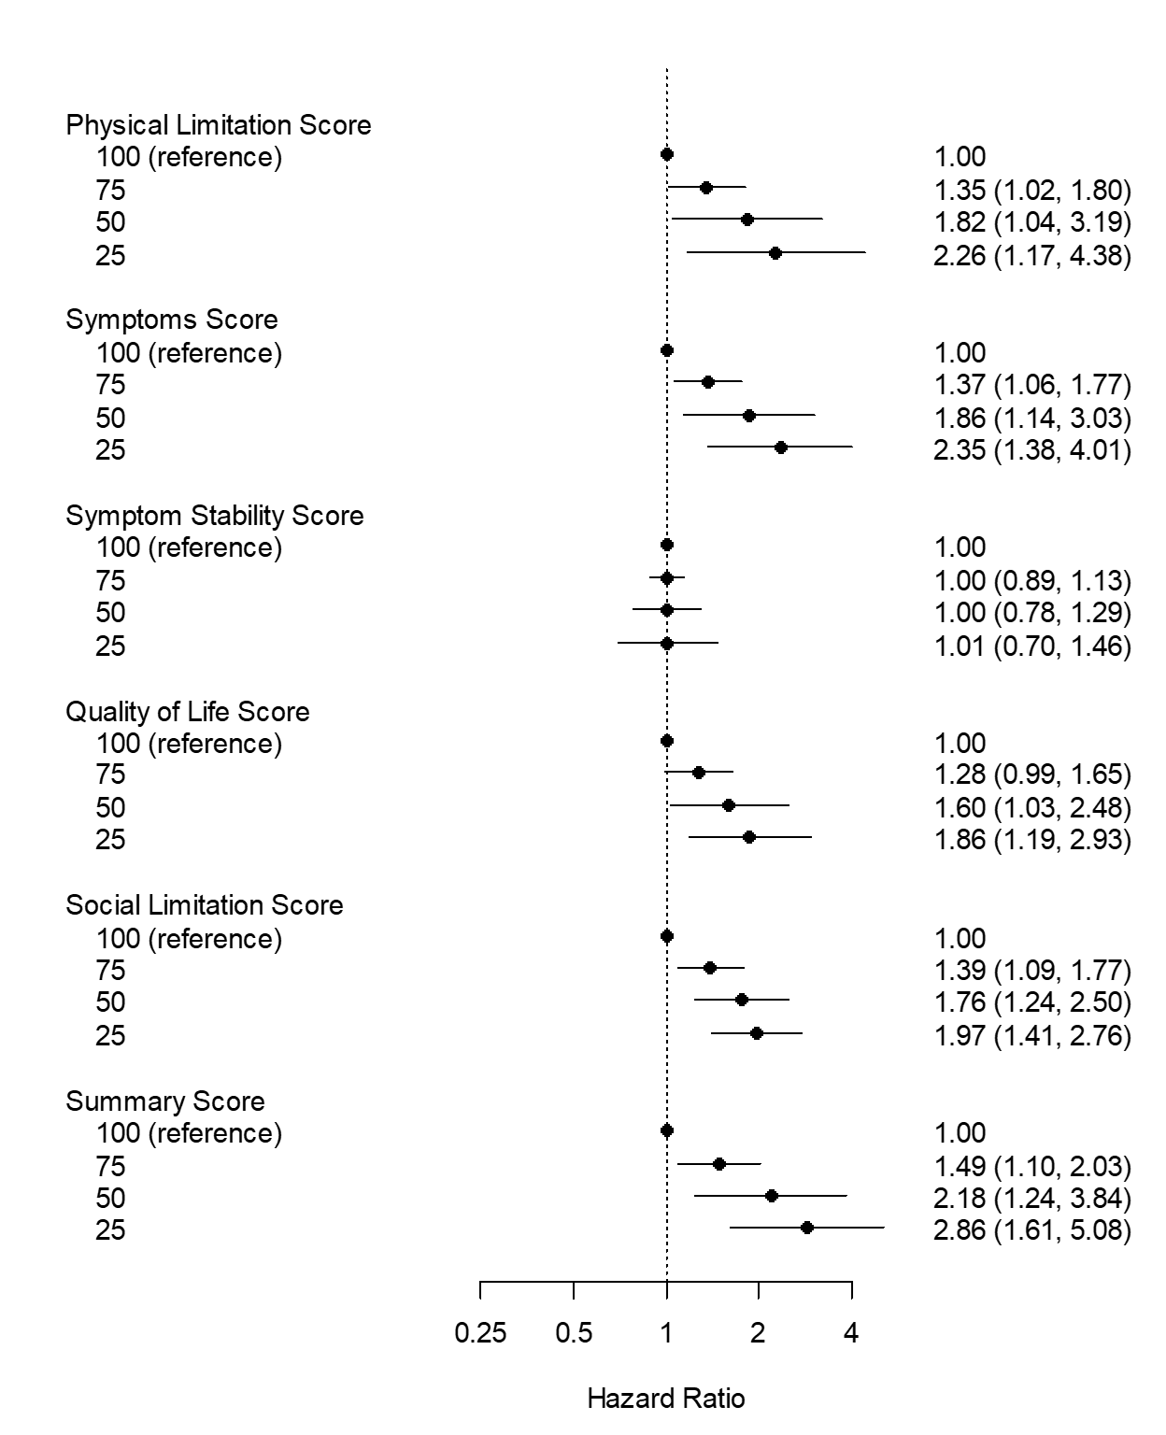
Patient Reported Health Status and the Risk of Subsequent Hospitalizations in PAD Patients with Intermittent Claudication
Brooklyn Bradley, Lindsey E. Scierka, MD MPH, Clementine Labrosciano BSc BHlthSc(Hons)PhD, John F. Beltrame BSc MBBS, Robert Fitridge MBBS MS PhD FRACS, Joseph Dawson MD MRCS, Rachel P. Dreyer PhD^{6,7}, Prue Cowled Bsc(Hons) PhD, Ruth Battersby BSc, Philip G. Jones MS, John A. Spertus MD MPH, Carlos Mena-Hurtado MD, and Kim G. Smolderen PhD.
Yale Medicine | Department of Internal Medicine | Section of Cardiovascular Medicine | Vascular Medicine Outcomes Program
BACKGROUND
METHODS
RESULTS
Figure 2. Kaplan – Meier curves for time to first hospital encounter by Peripheral Artery Questionnaire score categories.
797 patients with PAD (ABI < 0.9) and new or worsening claudication were enrolled in the PORTRAIT Registry from 10 specialty clinics in the US between June 2011 and December 2015.
The PAQ is a disease-specific assessment of the health status of patients with PAD. Each domain is scored from 0 to 100, where higher scores indicate better health status.
The primary outcome was 12-month all-cause hospitalization resulting in admissions (including ED). A secondary outcome included ED-only visits.
The frequency of hospital visits were examined as cumulative rate over time, incorporating repeating visits. The independent effect of PAQ scores on hospitalization risk was estimated using a proportional means model. A separate model was constructed for each score, adjusting for all covariates listed in Table 1 and stratifying baseline mean cumulative functions by site of enrollment.
Table 1. Baseline Characteristics of the study population comparing patients who were admitted to those were were not admitted, all values presented as n (%) or mean ± SD.
Characteristic | Hospitalized (n=335) | Not hospitalized (n=462) | p-value | Total (n=797)
Sociodemographic
Age, years | 68.4±10.1 | 68.7±9.4 | 0.600 | 68.6±9.7
Female | 147 (43.9) | 187 (40.5) | 0.336 | 334 (41.9)
Caucasian | 228 (68.1) | 349 (75.5) | 0.019 | 577 (72)
Married | 175 (52.9) | 254 (55.2) | 0.513 | 429 (4.2)
Paid employment | 62 (18.7) | 116 (25.3) | 0.028 | 178 (22.5)
Lifestyle Factors
Smoking status Never Former Current | 40 (12.0%) 188 (56.3%) 106 (31.7%) | 64 (13.9%) 263 (56.9%) 135 (29.2%) | 0.624 | 104 (13.1) 451 (56.7) 241 (30.2)
Alcohol – AUDIT-C positive | 57 (17.1) | 109 (28.3) | 0.021 | 166 (21.0)
Medical History
Dyslipidemia | 295 (88.1) | 411 (89.0) | 0.692 | 706 (88.6)
Hypertension | 296 (88.4) | 410 (88.7) | 0.865 | 706 (88.6)
Diabetes | 144 (43.0) | 161 (34.8) | 0.019 | 305 (38.3)
Coronary artery disease | 165 (49.3) | 225 (48.7) | 0.877 | 390 (48.9)
Chronic Heart Failure | 63 (18.8) | 52 (11.3) | 0.002 | 115 (14.4)
Chronic kidney disease | 63 (18.8) | 58 (12.6) | 0.015 | 121 (15.2)
Chronic lung disease | 62 (18.5) | 65 (14.1) | 0.091 | 127 (15.9)
Sleep apnea | 43 (12.8) | 42 (9.1) | 0.090 | 85 (10.7)
Chronic back pain | 51 (15.2) | 55 (11.9) | 0.173 | 106 (13.3)
History of cancer | 30 (9.0) | 46 (10.0) | 0.634 | 76 (9.5)
Peripheral Artery Disease Characteristics
Bilateral symptoms | 200 (59.7) | 251 (54.3) | 0.130 | 451 (56/6)
Rutherford category Mild claudication Moderate claudication Severe claudication | 62 (18.6%) 168 (50.3%) 104 (31.1%) | 96 (21.0%) 237 (51.9%) 124 (27.1%) | 0.418 | 158 (20.0) 405 (51.2) 228 (28.8)
Resting ABI | 0.65±0.18 | 0.70±0.19 | <0.001 | 0.68±0.19
Peripheral artery disease (PAD) involves atherosclerotic occlusion of arteries in the lower extremities affecting over 230 million people worldwide¹
Patients with PAD have the highest rates of hospitalizations among atherothrombotic conditions²
Health status plays an important role in outcome for patients with PAD
Poor health status has been shown to be associated with ~3 times increased risk rehospitalization in patients with coronary artery disease³, but this has not been studied in PAD
We used a large, multicenter registry of patients with symptomatic PAD (the PORTRAIT Registry) to investigate the relationship between health status and rehospitalization
RESULTS
Figure 1. Forest plot for the effect of Peripheral Artery Questionnaire scores on the mean cumulative function after adjusting for all baseline characteristics.
CONCLUSIONS
AIMS
In this study of symptomatic patients with PAD, baseline health status (PAQ) was associated with an increased 12-month hospitalization risk
Measuring patient’s health status may allow us to better assess their risk of rehospitalization independent of other clinical factors
It is vital to identify patients at risk for poor outcomes at the beginning of care and supplementing them with additional resources to help reduce the risk of hospitalization
To determine whether health status is associated with 12-month hospitalization risk
Examine whether subdomains of health status including symptoms, physical limitations, and quality of life were independently associated with risk of hospitalization
Disclosures:
Dr. Smolderen reports unrestricted research grants from Cardiva Medical Inc., Cook Medical, Inc., Merck & Co., Inc., Shockwave Medical Inc., and Janssen Pharmaceutical Companies of Johnson&Johnson. She is a consultant for Optum Labs, Inc., and Abbott Laboratories.
Dr. Mena-Hurtado reports grant funding from Shockwave Medical, Inc. and is a consultant for Abbott Laboratories, Cook Medical, Inc., Optum Labs, Inc.
Dr. Spertus is a consultant to Bayer, Janssen, Merck, Myokardia, Novartis, Terumo and United Healthcare. He receives grant support from Janssen and Myokadia. He holds the copyright to the Peripheral Artery Questionnaire, Kansas City Cardiomyopathy Questionnaires, and the Seattle Angina Questionnaire. He serves on the Board of Blue Cross/Blue Shield of Kansas City.
REFERENCES
Aday, A. W., & Matsushita, K. (2021). Epidemiology of peripheral artery disease and polyvascular disease. Circulation Research, 128(12), 1818–1832. https://doi.org/10.1161/CIRCRESAHA.121.318535
Secemsky, E. A., Schermerhorn, M., Carroll, B. J., Kennedy, K. F., Shen, C., Valsdottir, L. R., Landon, B., & Yeh, R. W. (2018). Readmissions after revascularization procedures for peripheral arterial disease: A nationwide cohort study. Annals of Internal Medicine, 168(2), 93. https://doi.org/10.7326/M17-1058
Spertus, J. A., Jones, P., McDonell, M., Fan, V., & Fihn, S. D. (2002). Health status predicts long-term outcome in outpatients with coronary disease. Circulation, 106(1), 43–49. https://doi.org/10.1161/01.CIR.0000020688.24874.90

