Slide 1
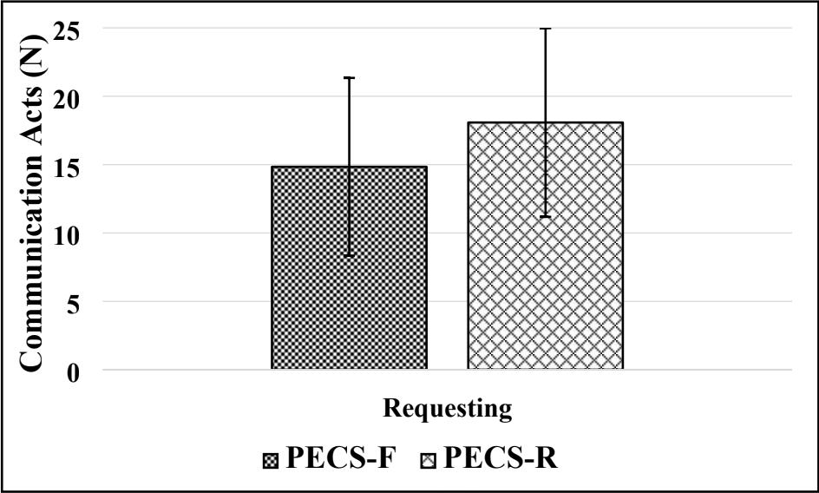
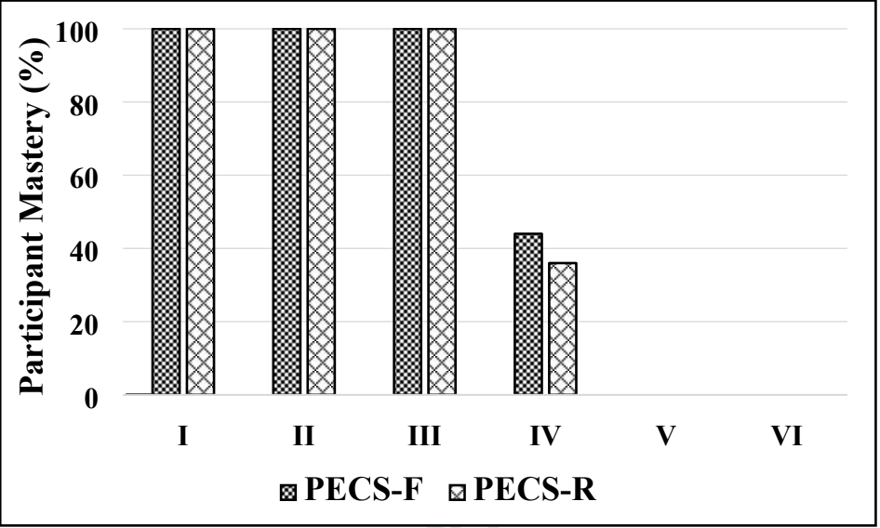
PECS for Success: The Telehealth Pivot
Jonah Savage and Grace Sullivan
Faculty Mentor: Avinash Mishra, Ph.D., CCC-SLP
Department of Communication Disorders
Introduction
Methods
Results (Continued)
Defining PECS
The Picture Exchange Communication System (PECS) is a low-tech form of Augmentative and Alternative Communication (AAC)¹
PECS assists minimally verbal children diagnosed with Autism Spectrum Disorder to develop communication skills²
The PECS protocol follows a step by step hierarchy, beginning with single pictures exchanged for desired objects, and culminating in sequenced pictures used to produce sentences³
The Telehealth Pivot
Access to PECS via telehealth is required for several reasons relating to health, location, and socioeconomic status (SES) disparities⁴
COVID-19 has required clinicians to develop alternatives to in-person intervention
Children diagnosed with ASD and of higher SES are more likely to receive early-intervention compared to those of lower SES
Teletherapy can enhance the frequency and intensity of treatment⁵
PECS was delivered either Face-to-Face (PECS-F) (n=15) or remotely (PECS-R) (n=15) depending on their randomly assigned group allocation
All children (n=30) (average chronological age: 24 months; average developmental age: 18 months) received preference assessments
Treatment was implemented in accordance with the PECS manual
Sessions were provided for 30 minutes, three times per week, for three months.
For remote delivery, research assistants roleplayed the implementation of PECS via HIPAA-compliant video software in order to educate caregivers on how to provide PECS to their children.
The six steps of the PECS hierarchy was strictly followed:
How to communicate
Distance and persistence
Picture discrimination
Sentence structure
Responsive requesting
Commenting
Figure 2. Between-group comparisons of the mean and standard deviation for PECS communication acts
Conclusions
Results
PECS is a frequently recommended AAC-based intervention
All participants demonstrated communication gains regardless of service delivery model
Clinicians should consider using remote services to provide PECS treatment to children diagnosed with Autism Spectrum Disorder
The two groups of children displayed similar results across communication outcomes.
Figure 1. Between-group comparisons of percent mastery by PECS level
Purpose
References
The purpose of the present investigation was to compare the efficacy of face-to-face (PECS-F) versus remote (PECS-R) delivery of PECS on communication outcomes in children diagnosed with Autism Spectrum Disorder
Outcomes included: PECS proficiency, number and type of PECS-mediated communication acts, and number and type of spontaneous verbalizations.
Bondy, A. S., & Frost, L. A. (1994). The picture exchange communication system. Focus on autistic behavior, 9(3), 1-19.
Ganz, J. B., Davis, J. L., Lund, E. M., Goodwyn, F. D., & Simpson, R. L. (2012). Meta-analysis of PECS with individuals with ASD: Investigation of targeted versus non-targeted outcomes, participant characteristics, and implementation phase. Research in developmental disabilities, 33(2), 406-418.
Frost, L. (2002). The picture exchange communication system. Perspectives on Language Learning and Education, 9(2), 13-16.
Flack, C. B., Walker, L., Bickerstaff, A., & Margetts, C. (2020). Socioeconomic disparities in Australian schooling during the COVID-19 pandemic. Melbourne, Australia: Pivot Professional Learning.
Sutherland, R., Trembath, D., Hodge, M. A., Rose, V., & Roberts, J. (2019). Telehealth and autism: Are telehealth language assessments reliable and feasible for children with autism? International Journal of Language & Communication Disorders, 54(2), 281–291.

