Slide 1
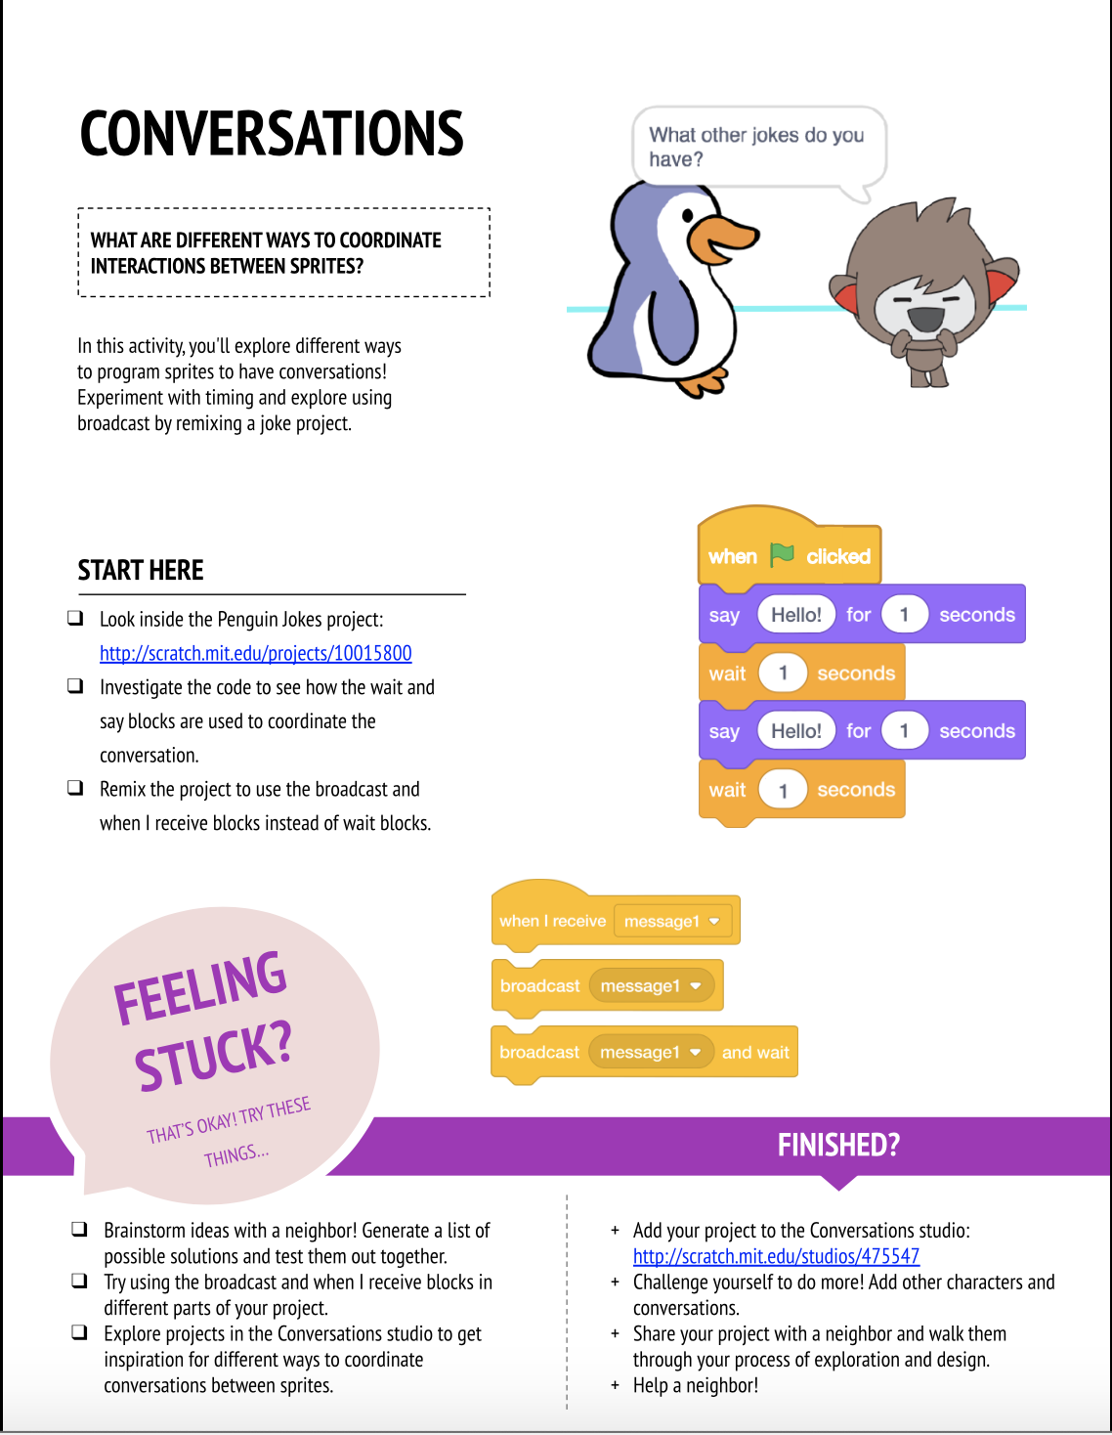
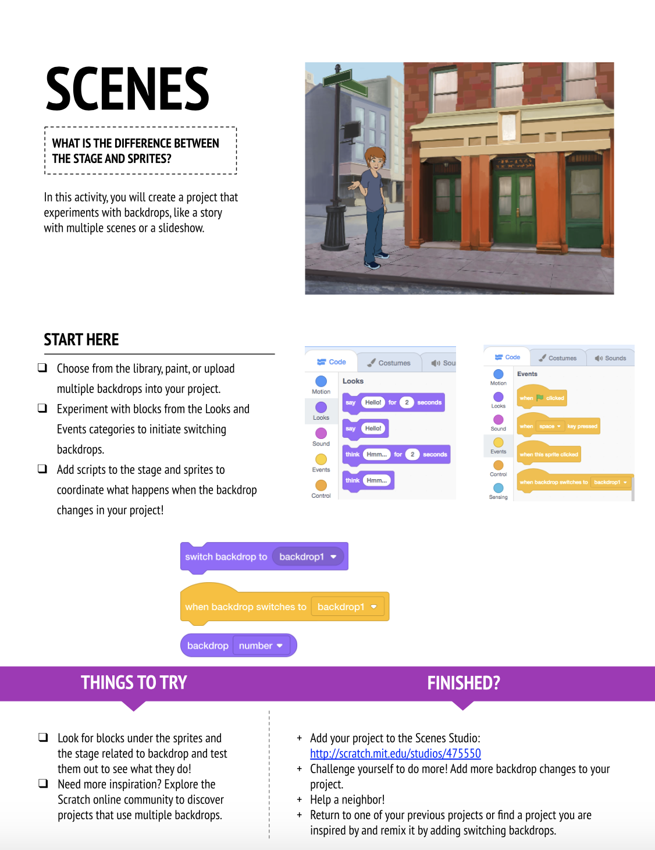
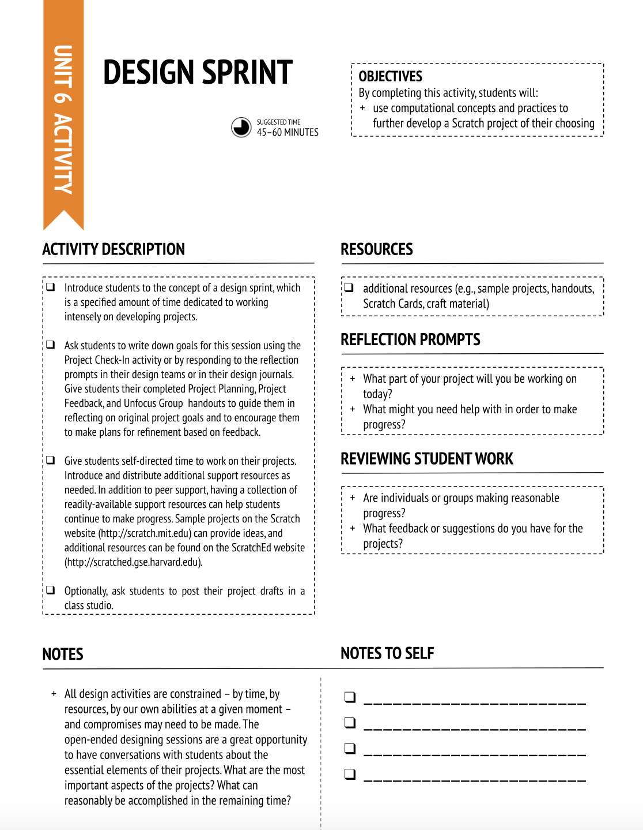
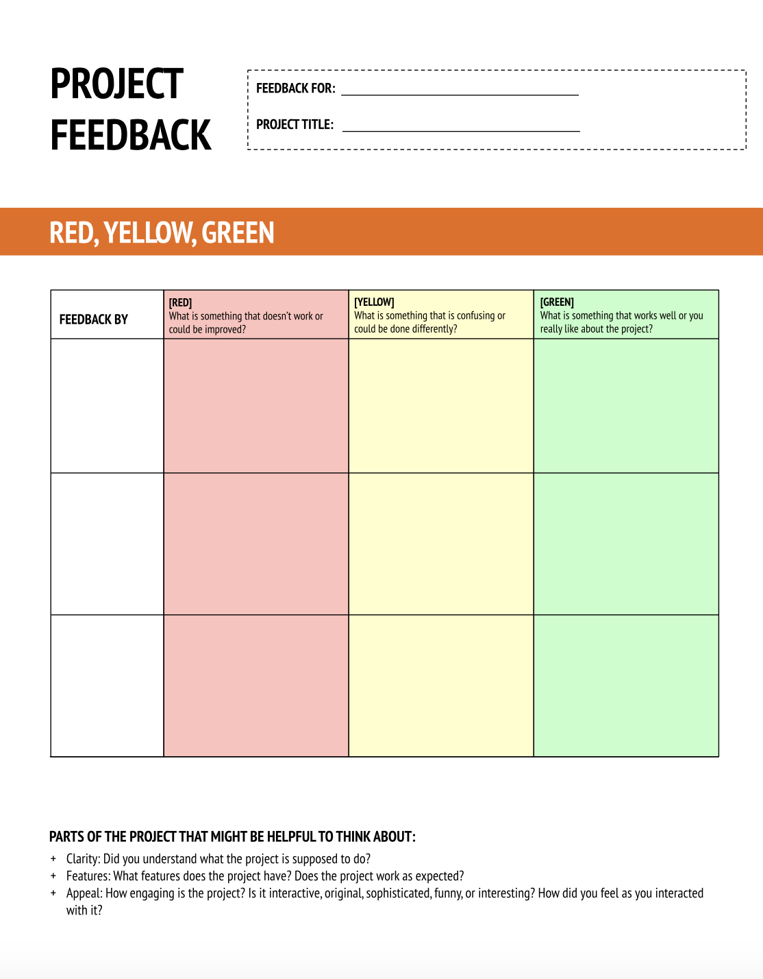
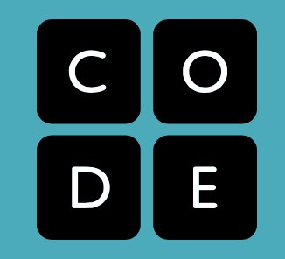
Insights: As explored, there are already existing lessons that bridge CS and literacy. It is now the time to prove to other education professionals why this bridge has such an importance within their students’ lives. CS is not a stand alone subject. Just as writing is used in other subjects such as history, math, and science, CS must be used within literacy to enhance and strengthen student learning. CS and literacy hold an incredibly valuable reciprocal relationship that is extremely beneficial to curriculum and learning as a whole, and it is time to implement it into curriculum now. Future Research: Looking towards the future, research can be done in multiple areas. For example, future research could be seeing how willing educators are to try a CS lesson embedded in literacy, as opposed to stand-alone CS lessons. In the future, implementation rates can be analyzed to see how many educators access CS lessons with literacy connections as opposed to CS math or CS science lessons. Research can also be done through surveying different school districts to see if CS literacy lessons have been added to school curricula.
Computer Science and Literacy in K-5 Education:
A Reciprocal Relationship
Kayleigh Murphy, Interdisciplinary Studies
Mentors: Dr. Darcy Ronan, Assistant Professor, Teacher Education; Dr. Kristin Rainville, Associate Professor, Literacy
Computer Science (CS) is becoming more important within our society, proving itself to be a necessary skill. Anette Vee explores this as she states in her research “..[a]s programming becomes more important, it will leave the back room and become a key skill and attribute of our top intellectual and social classes, just as reading and writing did in the past” (Vee, p. 43). One might ask themselves, if it is such a vital skill, how will we find opportunities to teach it? While there are important CS lessons that should be taught in their own subject, there are also great lessons that teach CS and literacy together. There are many comparisons and bridges between computer science and literacy as seen through literature research. CS and literacy have many parallels, as seen throughout already existing lessons. It is beneficial to have CS lessons embedded in literacy lessons as CS supports literacy learning through the bridging of writing, reading, drafting, and more. CS and literacy have a reciprocal relationship, therefore they should be taught together as opposed to having CS taught as a separate subject.
Literacy and CS are intertwined, “Coding is the new literacy. To thrive in tomorrow's society, young people must learn to design, create and express themselves with digital technologies” (Werrell, 2014, as cited by Williams, 2021,p. 26). As CS becomes more prevalent within society, the need for it to be weaved within the curriculum strengthens. CS must be bridged into the curriculum as it can enhance the learning of students. As Integrating Computer Science Across the Core Strategies for K-12 Districts explores, “Computer science is not a STEM subject. It can deepen and expand learning in all grades and disciplines” (Lynch, p.11). Some education programs and professionals have begun integrating computer science into curriculum, but it is now time to truly finish building the bridge of CS into the literacy curriculum for the benefit of our students and of our ever-evolving society.
Currently, CS is primarily viewed within the area of STEM. It is often seen as a stand-alone subject meant as a special or elective within elementary education. Literacy is a core area in elementary curricula as it is a foundational skill and necessary for students, guided by state and national standards and testing. Attaching CS with literacy would be beneficial to both subjects and to all educators and students involved.
CCC Unit 3 Stories Instructions for “Conversations” and “Scenes”
CCC Unit 6 Hackathon “Design Sprint” and “Project Feedback”
Anchor Lessons:
CCC Unit 3 Stories – Grades 4-5
Literacy Skills:. Students are using computer science to animate a story, the literary product.
CS Skills: Students are learning about sprites, timing, events, backgrounds, etc. as well as thinking/dispositional skills of pair programming and iterating.
Demonstrates computer science used as a medium to express standard literacy product (story)
CCC Unit 6 Hackathon
CS Skills: Students are creating a culminating Scratch project through a plan, make, share process which include a project “pitch”, planning, providing/receiving feedback, reflection, showcase.
Literacy Skills: The Hackathon lesson connects to literacy as students are going through the writing and publication process (reading, researching, drafting, revising) through culminating a Scratch project.
Demonstrates literacy skills used as a part of the process of generating a computer science product.
Code.org Course D Blank Space Stories
Literacy Skills: Incorporates parts of speech as well as components of sentences into computer science learning proving it is a cross curricular lesson.
CS Skills: Using variables to manage data in programs.
It is a literacy-based analogy used to teach a computer science concept.
Research Questions:
- What types of CS and literacy integrations are already contained within popular computer science curricula?
-How can CS integrated literacy lessons provide an accessible way for elementary educators to teach CS?
Works Cited
Lynch, T.L. (October 2019) Electrical Evocations: Computer Science, the Teaching of Literature, and the Future of English Education. English Education National Council of Teachers of English. https://library.ncte.org/journals/EE/issues/v52-1
Vee, A. (n.d.). Understanding computer programming as ... - D-SCHOLARSHIP@PITT. Retrieved February 20, 2022, from http://d-scholarship.pitt.edu/21695/1/24-33-1-PB.pdf
Williams, H. (2021) No Fear Coding Computational Thinking Across the K-5 Curriculum. International Society for Technology in Education.
CCC Unit 3 Stories https://docs.google.com/presentation/d/e/2PACX-1vQ7pZU_Ke8tZUweZAet7Wk02kHUZc95-olMKb9a-IOVopDZd9vXN1SrZMgM-9QThD-LY6APCx5BZTGJ/pub?start=false&loop=false&delayms=3000&slide=id.g5c4b017bf6_0_0
CCC Unit 6 Hackathon https://docs.google.com/presentation/d/e/2PACX-1vSL53m7PyCrrie815tpfho4UduCdVSc7Dk6pHKz4azzT0WBqDN6aVOlV-axeqmBpdJQbI9xcaBwV14K/pub?start=false&loop=false&delayms=3000&slide=id.g5c4fc9a6c1_0_0
Code.org Lesson 6 Blank Space Stories https://studio.code.org/s/coursef-2021/lessons/6https://code.org
https://creativecomputing.gse.harvard.edu/guide/
https://code.org
Resources Examined:
Code.org is an international non-profit organization rooted in expanding access to CS within K-12 curriculum through lesson plans, activities, and more.
Creative Computing Curriculum was created by the Creative Computing Lab at Harvard Graduate School of Education in conjunction with Scratch introductory computing learning and lessons.

