Slide 1
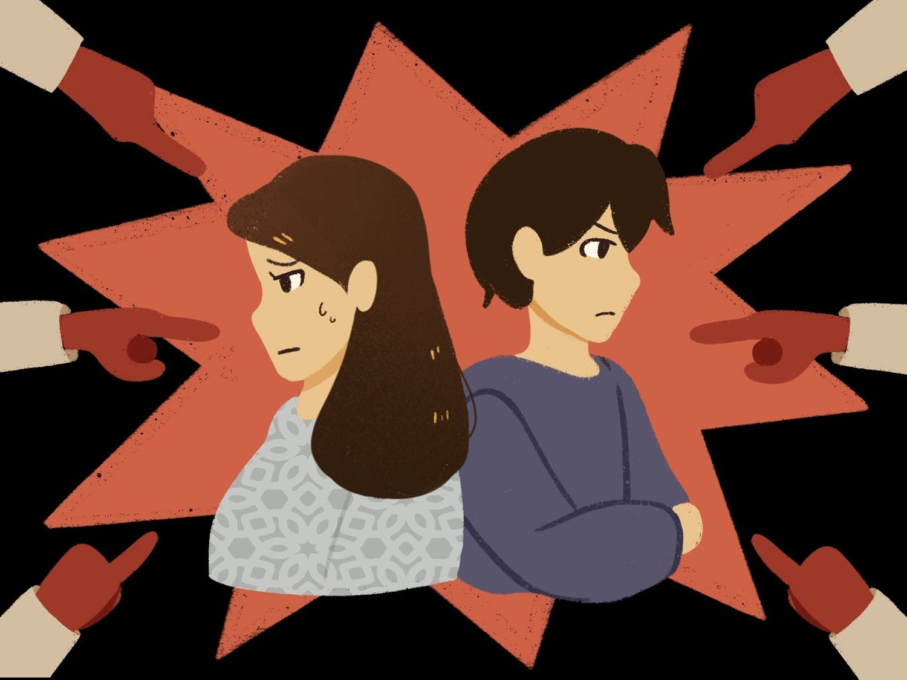
The Racial Impact of COVID-19 on Asian Americans’ Mental Health
Chenchen Cui
Health Science Program, College of Health Professions
Mentor: Dr. Rui Liu
Background
Methods
Results
Conclusions
COVID-19-related anti-Asian discrimination and stigmatization increased dramatically during the pandemic
Study results suggest that for Asian Americans, exposure to COVID-related racial discrimination significantly increases symptoms of depression, anxiety, and PTSD
Future research is needed to study the long-term effects of anti-Asian discrimination and mental health outcomes in Asian communities
Creating tailored public health interventions and community-based programs to help raise awareness and empower Asian Americans is imperative
The emergence of coronavirus disease 2019 (COVID-19) took the world by surprise with its alarming rate of spread and devastating consequences.
The spread of COVID-19 has led to many fatalities, financial hardships, and physical restrictions, resulting in fear, distress, and anger in people.
The origin of first reported cases of COVID-19 in Wuhan, China, coupled with racial references to the virus as the “Chinese virus” or “Kung Flu,” fueled the rise of anti-Asian sentiment and xenophobia in the United States (Santos et al., 2021).
Fear and anger further cultivated negative stereotyping and discrimination during the pandemic. Asian Americans have been burdened by heightened racial tension, microaggressions, and verbal and physical attacks (Gover et al., 2020).
Many Asian Americans have been experiencing clinically significant mental health issues due to racial/ethnic discrimination (Zhou et al., 2021; Hahm et al., 2021).
A literature search was performed using journal databases including PubMed and Google Scholar.
Searches were restricted to peer-reviewed journal articles published from 2016 to 2021.
Keywords used for the search included: “Asian Americans”, “coronavirus pandemic”, “COVID-19”, “prejudice”, “stigma”, “discrimination”, “mental health”, “stress”, “anxiety”, and “depression”.
Of the articles that met the selection criteria, five are discussed in this poster.
Among the selected articles, COVID-19-related discrimination were assessed using:
A 7-item questionnaire. Example items included: “Someone has made a comment about Chinese/Asian people being the source of the virus” (Hahm et al., 2021)
Racial and Ethnic Microaggressions Scale and Asian American Racism-Related Stress Inventory (Cheah et al., 2020)
A single (Yes/No) question: “As a result of the COVID-19 pandemic, have you experienced any discriminatory or hostile behavior due to your race/ethnicity?” (Zhou et al., 2021)
The Multidimensional Scale of Perceived Discrimination (Chen et al., 2021)
A 7-item questionnaire assessing frequency of vicarious racism experiences (Chae et al., 2020)
Among the selected articles, mental health outcomes were assessed using:
Vigilance: Racial Discrimination-Related Vigilance (Chae et al., 2021)
Depression: Depression Patient Health Questionnaire and Beck Depression Inventory; (Hahm et al., 2021; Zhou et al., 2021; Cheah et al., 2020; Chen et al.,2021; Chae et al., 2021)
Anxiety: Generalized Anxiety Scale (Hahm et al., 2021; Cheah et al., 2020; Chae et al., 2021).
Post-traumatic stress disorder (PTSD): PTSD Checklist-Civilian Version; The Primary Care PTSD Screen for DSM-5 (Hahm et al., 2021; Chen et al., 2021)
51% of Asian Americans reported experiencing vicarious racism during the COVID-19 pandemic (Chae et al., 2021)
Hate crimes targeting Asians and Asian Americans increased by 150% in 2020 to 194% in 2021 (Hahm, 2021)
58% of Asian Americans perceived higher anti-Asian racial discrimination during the pandemic (Hahm, 2021)
Vigilance
40% of Asian Americans reported experiencing racial-discrimination related vigilance at least once a week (Chae et al., 2021)
Depression & Anxiety
Higher frequency of experiencing vicarious racism was associated with significantly higher symptoms of depression and anxiety in Asian Americans (Chae et al., 2021)
Asian American students with a higher perceived racial discrimination reported significantly higher levels of depression and anxiety symptoms (Chen et al., 2021)
Asian American/Pacific Islander students who experienced COVID-related discrimination had 2 times higher odds of having moderately severe or severe depression (Zhou et al., 2021)
Anxiety and depression symptoms were positively associated with in-person and online direct and vicarious racial discrimination and Sinophobia (Cheah et al., 2020)
PTSD
Increases in COVID-19-related discrimination experiences were significantly related to increased PTSD symptoms (Hahm, 2021)
Asian American students with higher perceived racial discrimination reported significantly higher PTSD symptoms (Chen et al., 2021)
References
Chae, D. H., Yip, T., Martz, C. D., Chung, K., Richeson, J. A., Hajat, A., Curtis, D. S., Rogers, L. O., & LaVeist, T. A. (2021). Vicarious racism and vigilance during the covid-19 pandemic: Mental health implications among asian and black americans. Public Health Reports, 136(4), 508–517. https://doi.org/10.1177/00333549211018675
Cheah, C. S. L., Wang, C., Ren, H., Zong, X., Cho, H. S., & Xue, X. (2020). Covid-19 racism and mental health in chinese american families. Pediatrics, 146(5), e2020021816. https://doi.org/10.1542/peds.2020-021816
Chen, PhD, RN, PMHNP-BC, A. C.-C., Han, PhD, S., Li, PhD, W., Leong, PhD, K. J., & Ou, MSN, RN, L. (2021). COVID-19 and Asian American college students: Discrimination, fear, and mental health. Journal of Emergency Management, 19(9), 121–131. https://doi.org/10.5055/jem.0598
Gover, A. R., Harper, S. B., & Langton, L. (2020). Anti-asian hate crime during the covid-19 pandemic: Exploring the reproduction of inequality. American Journal of Criminal Justice, 45(4), 647–667. https://doi.org/10.1007/s12103-020-09545-1
Hahm, H. C., Ha, Y., Scott, J. C., Wongchai, V., Chen, J. A., & Liu, C. H. (2021). Perceived COVID-19-related anti-Asian discrimination predicts post traumatic stress disorder symptoms among Asian and Asian American young adults. Psychiatry Research, 303, 114084. https://doi.org/10.1016/j.psychres.2021.114084
Santos, P. M. G., Dee, E. C., & Deville, C. (2021). Confronting anti-asian racism and health disparities in the era of covid-19. JAMA Health Forum, 2(9), e212579. https://doi.org/10.1001/jamahealthforum.2021.2579
Zhou, S., Banawa, R., & Oh, H. (2021). The mental health impact of covid-19 racial and ethnic discrimination against asian american and pacific islanders. Frontiers in Psychiatry, 12, 708426. https://doi.org/10.3389/fpsyt.2021.708426
How do COVID-19-related racial prejudice, stigma, and discrimination impact Asian Americans’ mental health?
Research Question
Figure 1. Finger pointing and discrimination towards people of Asian descent (Saley, 2021).

