Slide 1
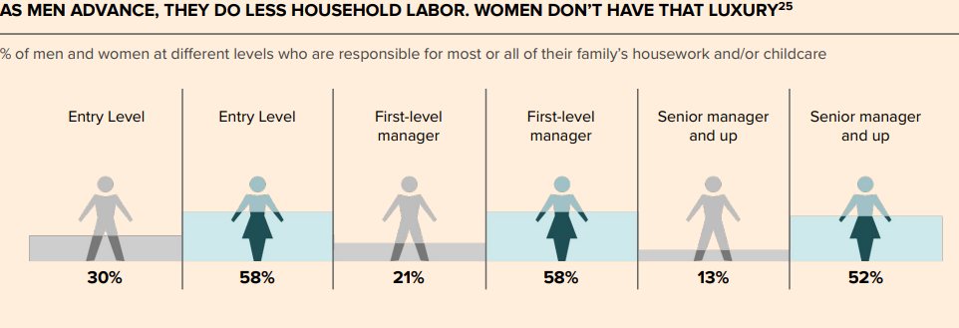
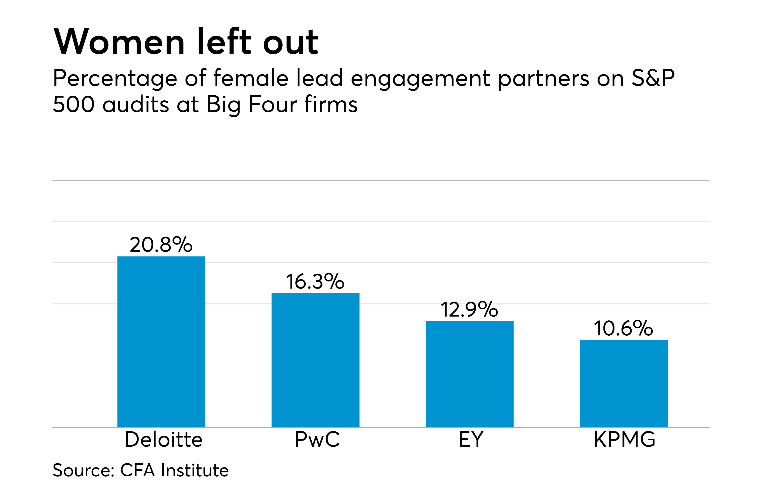
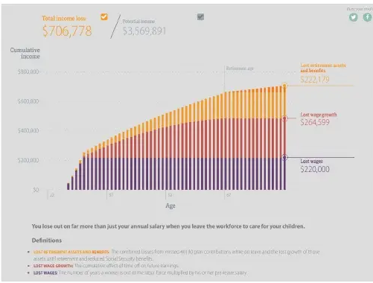
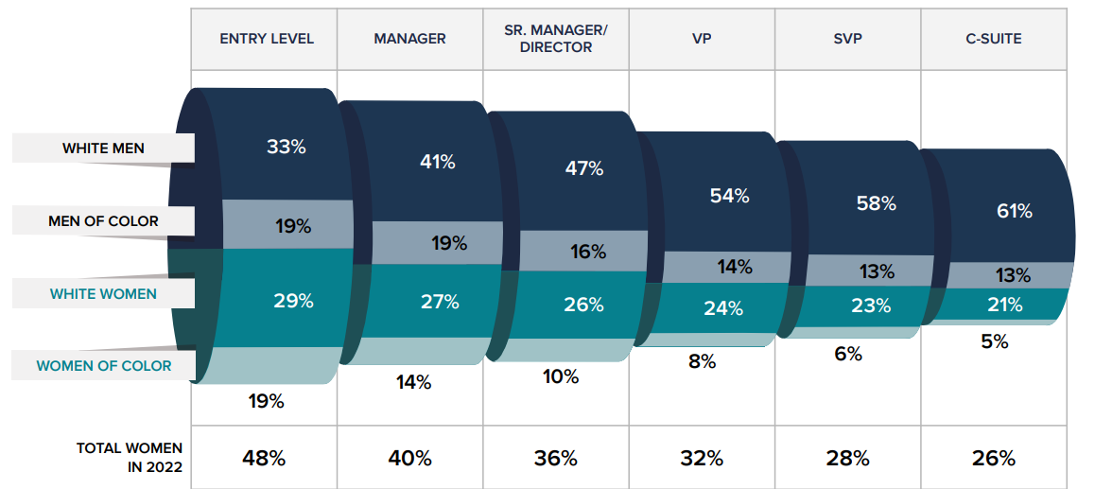
Impact of Sociological Views on Working Women and the Economy
^{Erin Washbourn, Accounting}
Sacred Heart University
Fairfield, CT, USA
washbourne@mail.sacredheart.edu
Introduction
Sociological Perspective
Economic Perspective
Invisible Labor and the GDP
Invisible labor refers to unpaid work that goes unnoticed, unacknowledged, and thus, unregulated (Daniels, 1987)
The most significant occurrence of invisible labor is work done inside the home for one’s family, including cooking, cleaning, and childcare (Daniels,1987)
For unpaid labor, women do three out of every four hours of unpaid labor. (Piñon, 2021)
According to the report, unequal division of unpaid work can reduce earnings and the economic independence of an individual (Piñon, 2021)
Activities that produce significant amounts of goods and services are unrecognized by the GDP
Women’s participation in the U.S. workforce decreases by 17% during the mid-career stage, from 46 percent at entry-level to 29 percent by the time they reach V.P. status. This mid-career stage is when women start to have diversions in their career path, including marriage, having children, caring for aging parents.
When 1 percent of mothers leave the workforce, it results in an estimated $8.7 billion loss in wages, and if 1 percent of full-time working mothers shift from full-time to part-time work, that would mean an estimated $5 billion less in wages per year (Kashen et al., 2021)
Multiplying the percent of women who leave the workforce by 17 to show the percent of women who leave the labor force would total an economic impact of 147.9 billion dollars of lost revenue per year. Following similar math, according to Statista, an average of 15.52 percent of women work part-time in the U.S., this reduction in work estimates $77.6 billion less in wages per year
In 2018, 53.3% of families are dual careers (Cerrato et al., 2018)
In households where both partners work full-time, “41% of women report doing more childcare and 30% report doing more chores” (Bateman, 2015)
Women’s gendered role in family life
women’s role in a family has been linked to homemaker and caretaker
The gendered role of women in a family consists of ideologies about their wifehood and motherhood. Beliefs that “women want and emotionally prefer self-sacrificing behavior, particularly for their husbands and children” (Kohen, 1981)
Workplace Culture
Workplace culture can be defined as what is expected of an employee in the workplace; it is a set of values, norms, and goals, which can be intentionally or unintentionally instilled (Carter, 2019)
Companies use not having equal representation at the high executive levels due to the fact that,“high-level jobs require extremely long hours, [and] women’s devotion to family makes it impossible for them to put in those hours, and their careers suffer as a result” (Ely et al., 2020)
Childless women’s promotion record was no better than women with children (Ely et al., 2020). Women are lumped together by gender stereotypes. Causing “all women are mothers” in the eyes of the company and society’s reasoning (Ely et al., 2020)
Work Life Balance
A survey taken in 2021 states, 83% of 22–40-year-old’s feel they do not have a work-life balance (Moody, 2017).
Work-life balance is not a single-gender issue but something that is affecting everyone. However, women suffer professionally because they cannot put in the long hours their male counterparts can because of needs at home that are still seen as solely the women’s responsibility.
Pipeline
A corporate pipeline, also known as “climbing the ladder,” can be used to describe an employee’s track of jobs needed to achieve upper-level positions within their company and advance one’s career (Hargrave, 2021)
Women make up 51% of all accounting staff throughout the industry. However, only make up 24% of partners and principals at accounting firms across the U.S. (Gaetano, 2018)
Senior managers with male and female subordinates who are similar in job performance, ambition and other variables, were more inclined to assign challenging tasks to the male—resulting in women having fewer promotional opportunities than men, as women are denied important developmental opportunities by their superiors” (Gaetano, 2018).
Accommodations
Eighty percent of companies provide flexible options, including going part-time, taking a leave of absence, or going remote to allow individuals to choose what work-life balance means to them (Howington, 2021).
“Employees who took advantage of [accommodations]—virtually all of whom were women—were stigmatized and saw their careers derailed.” (Ely et al., 2020)
“women who took time off at some point in their work life to care for a child or other family member were twice as likely as men who did the same to say that this hurt their career overall (35% vs. 17%)” (Parker, 2015)
Thesis
There are many reasons women are derailed from the pipeline to executive positions before making sacrifices for more work-life balance. Keeping women on the pipeline benefits women and increases a business’s bottom line with female representation at the top. When companies implement changes to make work a more inclusive environment, society will create a work-life balance. For women in business to continue the pipeline path to executive positions in corporate America, society must make significant changes to workplace culture’s idea of work-life balance and the expectations of women both at work and in society.
Interaction & Conclusion
Cost-benefit Analysis
the cost verse benefit analysis is not as simple as comparing salary loss to the cost of home and childcare responsibilities. Looking at more than just a yearly salary, it is important to consider long-term monetary factors, including lost retirement funds, smaller Social Security payouts after retirement, lost benefits, lost wages, and lost years of wage growth
COST: mother leave the traditional workforce for five years so that the couple does not have to pay for household work or childcare during those years there are two factors they may take into consideration. One being her salary, a median salary for “28-year-old, college-educated woman [is] $48,500” (Madowitz et al., 2016). Multiplying that by 5 years creates a loss of revenue of $242,500
BENEFIT: Childcare in the United States can cost upward of $21,678 (Wheelwright, 2021). The average annual pay for a cleaner in the United States is $24,302 a year (2021). Adding the cost of a cleaning service with the cost of childcare turns the loss of income to only be $12,600.
REALITY: The mother will also give up $213,018 in lost retirement assets and benefits and $244,811 in lost wage growth” (Madowitz et al., 2016). If you add that to her $242,500 in lost wages, that’s a total income loss of more than $700,000.
Conclusion
Women are derailed from the pipeline to executive positions many times before getting promoted to manager
When companies promote work-life balance and allow for more flexibility, they record two times more productivity than companies that do not. However, only 23% of companies promote work-life balance (Volini et al., 2021)
There is a much higher cost to temporally leaving the workforce than just lost salaries
References
Bateman, K., Chugh, A., The Adecco Group · Adecco Group, Guntur, V. A., Peter Levell · The Conversation, & Broom, D. (2015). 6 things holding US women back at work. World Economic Forum. Retrieved November 30, 2021, from https://www.weforum.org/agenda/2015/10/6-things-holding-us-women-back-at-work/.
Berman, J. (2018, April 15). Women's unpaid work is the backbone of the American economy. MarketWatch. Retrieved November 30, 2021, from https://www.marketwatch.com/story/this-is-how-much-more-unpaid-work-women-do-than-men-2017-03-07.
Bloomenthal, A. (2021, November 20). Who's in the C-suite? Investopedia. Retrieved November 30, 2021, from https://www.investopedia.com/terms/c/c-suite.asp#:~:text=%22C-suite%22%20refers%20to%20the%20executive-level%20managers%20within%20a,stays%20true%20to%20its%20established%20plans%20and%20policies.
Burns, T., Haung, J., & Lee, L. (2021, November 2). Women in the workplace 2021. McKinsey & Company. Retrieved November 30, 2021, from https://www.mckinsey.com/featured-insights/diversity-and-inclusion/women-in-the-workplace.
Carter, T. (2019, August 21). Workplace culture: What it is and how to make yours better (with examples): Process street: Checklist, Workflow and SOP software. Process Street. Retrieved November 29, 2021, from https://www.process.st/workplace-culture/#:~:text=To%20break%20it%20down%2C%20a%20company%E2%80%99s%20culture%20informs,workplace%20culture%2C%20let%E2%80%99s%20examine%20them%20in%20closer%20detail.
Caven, V. (2010, September 1). Work-life balance among architects. Procs 26th Annual ARCOM Conference. Retrieved November 30, 2021, from https://www.academia.edu/61713675/Work_life_balance_among_architects#:~:text=Our%20findings%20support%20Fleetwood%E2%80%99s%20%282007%29%20suggestion%20that%20many,and%20travel%20considerable%20distances%20to%20meet%20workload%20demands.
Cerrato, J., & Cifre, E. (2018, August 3). Gender inequality in household chores and work-family conflict. Frontiers in psychology. Retrieved November 30, 2021, from https://www.ncbi.nlm.nih.gov/pmc/articles/PMC6086200/.
Coltrane, S. (2000). Research on household labor: Modeling and measuring the social embeddedness of routine family work. Journal of Marriage and Family, 62(4), 1208–1233. https://doi.org/10.1111/j.1741-3737.2000.01208.x
Crookston, D. (2005). Should unpaid labor be included in GDP? - CMU. CMU. Retrieved November 30, 2021, from https://www.cmu.edu/ips/research/ips-journal/ips-journal-online/jps-issue-1_4_crookstond.pdf.
Daniels, A. K. (1987). Invisible Work. Social Problems, 34(5), 403–415.
https://doi.org/10.2307/800538
Ely, R., & Padavic, I. (2020, February 19). What's really holding women back? Harvard Business Review. Retrieved November 30, 2021, from https://hbr.org/2020/03/whats-really-holding-women-back.
Fernando, J. (2021, November 20). Gross domestic product (GDP). Investopedia. Retrieved November 30, 2021, from https://www.investopedia.com/terms/g/gdp.asp.
Franklin, N. (2019, July 30). Toxic workplace environments plague accountancy profession. Workplace Insight. Retrieved November 30, 2021, from https://workplaceinsight.net/toxic-workplace-environments-plague-accountancy-profession/.
Gaetano, C. (2018). Study: While women enter big four in large numbers, few ever lead audits of large firms. NYSSCPA. Retrieved November 30, 2021, from https://www.nysscpa.org/news/publications/the-trusted-professional/article/study-while-women-entering-big-four-in-large-numbers-few-ever-lead-audits-of-large-firms-091718.
Hargrave, M. (2021, September 13). Corporate ladder: Behind the climb. Investopedia. Retrieved November 30, 2021, from https://www.investopedia.com/terms/c/corporate-ladder.asp#:~:text=%22Climbing%20the%20corporate%20ladder%22%20is%20an%20expression%20used,positions%20than%20it%20does%20management%20or%20executive%20positions.
Howington, J. (2021, May 18). 80% of companies offer flexible work options. FlexJobs Job Search Tips and Blog. Retrieved November 30, 2021, from https://www.flexjobs.com/blog/post/80-companies-offer-flexible-work-options/.
Huang, j, Krivkovich, A., Yee, l, & Zanoschi, D. (2019). McKinsey women in the workplace 2019 - agec.org.au. McKinsey & Company. Retrieved November 30, 2021, from https://www.agec.org.au/wp-content/uploads/2019/10/McKinsey-Women-in-the-workplace-2019.pdf.
Johns, M. L. (2013). Breaking the glass ceiling: Structural, cultural, and organizational barriers preventing women from achieving senior and executive positions. Perspectives in health information management. Retrieved November 30, 2021, from https://www.ncbi.nlm.nih.gov/pmc/articles/PMC3544145/.
Kashen, J., Glynn, S. J., Novello, A., Greenhouse, S., & Vallas, R. (2021, March 4). How covid-19 sent Women's Workforce Progress Backward: Congress' $64.5 billion mistake. The Century Foundation. Retrieved November 30, 2021, from https://tcf.org/content/report/how-covid-19-sent-womens-workforce-progress-backward-congress-64-5-billion-mistake/?session=1.
Kohen, J. A. (1981, January 1). Housewives, breadwinners, mothers, and Family Heads: The changing family roles of women: in NA - Advances in Consumer Research Volume 08, eds. Kent B. Monroe, Ann Abor, MI : Association for Consumer Research, Pages: 576-579, from https://www.acrwebsite.org/volumes/5862/volumes/v08/NA-08.
Madowitz, M., Rowell, A., & Hamm, K. (2016). Calculating the hidden cost of interrupting a career for child care. Scribd. Retrieved November 30, 2021, from https://www.scribd.com/doc/316023499/Calculating-the-Hidden-Cost-of-Interrupting-a-Career-for-Child-Care.
Moody, B. (2017, May 15). Study finds employee engagement critical to fixing the financial industry. Study Finds Employee Engagement Critical to Fixing the Financial Industry | Business Wire. Retrieved November 30, 2021, from https://www.businesswire.com/news/home/20170515005127/en/Study-Finds-Employee-Engagement-Critical-Fixing-Financial.
Parker, K. (2015, August 14). Women more than men adjust their careers for family life. Pew Research Center. Retrieved November 30, 2021, from https://www.pewresearch.org/fact-tank/2015/10/01/women-more-than-men-adjust-their-careers-for-family-life/ .
Part-time employed women - number in the U.S. 1990-2020. Statista. (2021, January 25). Retrieved November 30, 2021, from https://www.statista.com/statistics/192337/number-of-part-time-employed-women-in-the-us-since-1990/.
Piñon, N. (2021, October 29). Invisible labor is real, and it hurts: What you need to know. Mashable. Retrieved November 30, 2021, from https://mashable.com/article/what-is-invisible-labor#:~:text=Around%20the%20world%2C%20women%20do%20three%20out%20of,agency%20of%20women%20in%20communities%20around%20the%20world.
Ross, C. (2006, October). Separate spheres or shared dominions? - JSTOR. Jstor. Retrieved November 30, 2021, from https://www.jstor.org/stable/43052674.
Schnieders, A. (2017, October 11). Why companies lose 17 percent of women employees at mid-career. Entrepreneur. Retrieved November 30, 2021, from https://www.entrepreneur.com/article/300533.
U.S. Bureau of Labor Statistics. (2019). Charts related to the latest "American time use survey" news release | more chart packages. U.S. Bureau of Labor Statistics. Retrieved November 30, 2021, from https://www.bls.gov/charts/american-time-use/activity-by-work.htm.
Veerle, M. (2011). Around the world volunteering: Unpaid work cooking ... - OECD. OECD Social. Retrieved November 30, 2021, from https://www.oecd.org/berlin/47258230.pdf.
Ven, P., Zwijnenburg, J., & Quelioe, M. D. (n.d.). OECD ilibrary | including unpaid household activities: An ... OECD iLibrary. Retrieved November 30, 2021, from https://www.oecd-ilibrary.org/docserver/bc9d30dc-en.pdf?expires=1535552610&id=id&accname=guest&checksum=E127C765EFB6A48032560D75751219C0.
Volini, E., Schwartz, J., Eaton, K., Mallon, D., Durme, Y. V., Hauptmann, M., Poynton, S., & Scoble-Williams, N. (2021, August 25). The worker-employer relationship disrupted. Deloitte Insights. Retrieved November 30, 2021, from https://www2.deloitte.com/us/en/insights/focus/human-capital-trends/2021/the-evolving-employer-employee-relationship.html.
Wheelwright, T. (2021, November 16). Average cost of child care by State. Move.org. Retrieved November 30, 2021, from https://www.move.org/child-care-cost/.
Zip Recruiter. (2021). Cleaning Lady Salary. ADP. Retrieved from https://www.ziprecruiter.com/Salaries/Cleaning-Lady-Salary#:~:text=How%20much%20does%20a%20Cleaning%20Lady%20make%3F%20As,This%20is%20the%20equivalent%20of%20%24467%2Fweek%20or%20%242%2C025%2Fmonth.
https://open.maricopa.edu/culturepsychology/chapter/socioeconomic-status-ses/.
Acknowledgements
I express my sincere thanks to Dr. Mary Ignagni and Dr. Jennifer McLaughlin my Honors Capstone professors, for assisting me in this project. Both professors helped me solidify my topic, kept track of my progress, and provided support and beneficial feedback throughout the entire process.

