Slide 1
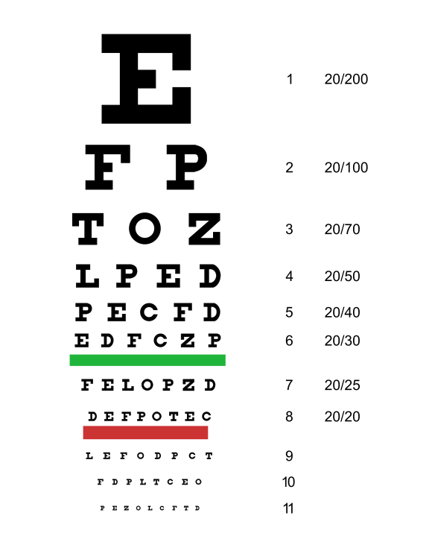
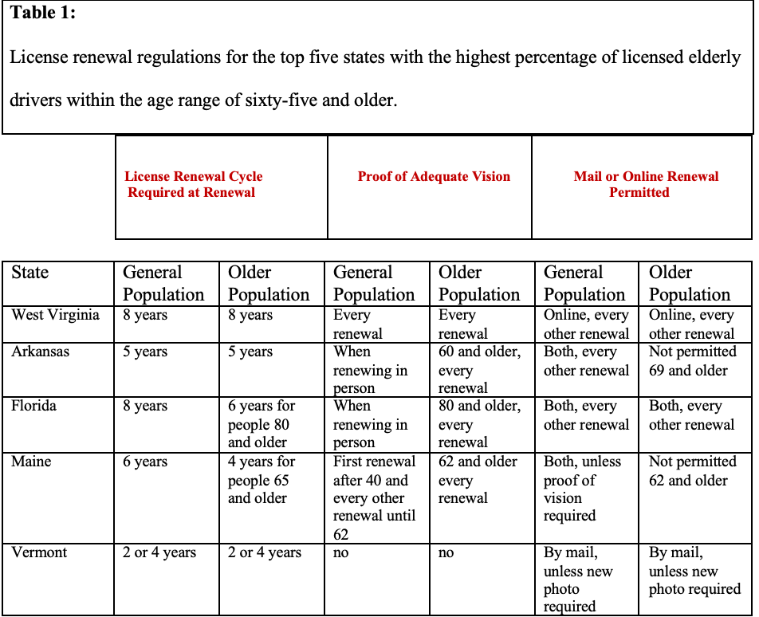
REPLACE THIS BOX WITH OUR ORGANIZATION’S
HIGH REOLUTION LOGO
When Should Grandpa Stop Driving?: The Need for New Mutual State License Renewal Regulations and Testing in Regard to Elderly Drivers
Christina Valdes
References:
RESEARCH QUESTION/ THESIS
Research And Findings: Increased Risk of Injury and/or Death
Research And Findings: Increased Risk of Injury and/or Death
“Older Adult Drivers.” Centers for Disease Control and Prevention, 28
June 2022,
. https://www.cdc.gov/transportationsafety/olderadultdrivers/index
.html.
Owsley, Cynthia, et al. “Visual/Cognitive Correlates of Vehicle Accidents
in Older Drivers.” Psychology and Aging, vol. 6, no. 3, Sept. 1991,
pp. 403–15. EBSCOhost,
https://searchebscohostcom.sacredheart.idm.oclc.org/login.aspx?direct=true&db=pdh&AN=1992-01154-001&site=eds-live&scope=site
Lyon, Craig, et al. “Age and Road Safety Performance: Focusing on
Elderly and Young Drivers.”
IATSS Research, vol. 44, no. 3, Oct. 2020, pp. 212–19. EBSCOhost,
https://search-ebscohost-com.sacredheart.idm.oclc.org/login.aspx?direct=true&db=edselp&AN=S0386111220300704&site=eds-live&scope=site
Susilowati, Indri Hapsari, and Akira Yasukouchi. “Correlation of Visual,
Cognitive, Physical Motor Skills and Risk Perception with Driving
Performances of Young and Elderly Drivers.” International Journal of
Pharmaceutical Research & Allied Sciences, vol. 7, no. 4, Oct. 2018,
pp. 86–96. EBSCOhost,
https://searchebscohostcom.sacredheart.idm.oclc.org/login.aspx?direct=true&db=aph&AN=134266797&site=eds-live&scope=site
Collis, Hope M. “Why Ms. Daisy Was Not Allowed to Drive Herself: An
Examination of the Need for Federally Mandated Driver’s License
Renewal Procedures for Elderly Drivers.” Transportation Law Journal,
vol. 41, no. 1, Jan. 2014, pp. 45–66. EBSCOhost,
https://searchebscohostcom.sacredheart.idm.oclc.org/login.aspx?direct
=true&db=edshol&AN=edshol.hein.journals.tportl41.6&site=eds-l
ive&scope=site
Nakano, Tomoaki, et al. “A Method for Assessing the Driving Ability of the
Elderly and Thoughts on Its Systematization.” IATSS Research, vol.
32, no. 1, Jan. 2008, pp. 44–53. EBSCOhost,
https://searchebscohostcom.sacredheart.idm.oclc.org/login.
aspx?direct=true&db=ed selp&AN=S0386111214601990&site=eds
ive&scope=site
Sollitto, Marlo. “Taking the Keys Away: What to Do If a Senior Won't Stop
Driving.” AgingCare, 6 Mar. 2020,
www.agingcare.com/articles/taking-the-keys-if-mom-or-dad-wont-stop-
driving- 112307.htm.
“Parkinson's Disease: Causes, Symptoms, and Treatments.” National Institute on Aging, U.S. Department of Health and Human Services, 2022, www.nia.nih.gov/health/parkinsons-disease.
“Official Site of the State of New Jersey.” NJ MVC | Medical Review FAQ, n.d.,
www.state.nj.us/mvc/drivertopics/medfaq.htm.
“Older Drivers: License Renewal Procedures.” IIHS, 2020,
www.iihs.org/topics/older-drivers/license-renewal-laws-table.
“Medication Overload and Older Americans.” Lown Institute, 29 Jan. 2020,
https://lowninstitute.org/projects/medication-overload-how-the-drive-to-prescribe-isharmingolderamericans/#:~:text=Scope%20of%20Medication%20Overload&text=More%20than%20four%20in%20ten,take%20ten%20drugs%20or%20more.
Eyecare NG. “Visual Skills for Driving.” Eyecare NG for Patients and Consumers, 6 Mar. 2019,
www.eyecareng.com/consumer-resources/other/visual-skills-driving/.
“Adult Vision: 41 to 60 Years of Age.” AOA, n.d.,
www.aoa.org/healthy-eyes/eye-health-for-life/adult-vision-41-to-60-years-of- age?sso=y#:~:text=This%20is%20among%20the%20most,away%20to%20see%20them%20clearly.
“Side Effects of Medications Can Affect Driving Ability.” AARP, 3 Sept. 2013,
www.aarp.org/auto/driver-safety/medications-and-driving/.
“When Do Age-Related Problems with Memory and Decision-Making Begin to Affect
Older Adults' Ability to Drive?” Health in Aging, 23 Apr. 2018,
www.healthinaging.org/blog/when-do-age-related-problems-with-memory-and-decision-making-begin-to-affect-older-adults-ability-to-drive/.
My research question: Should the United States mandate new nationwide license renewal regulations and testing procedures regarding elderly drivers?
Why it matters: As an individual approaches their elderly years their ability to safely operate a motor vehicle often declines. Therefore, influencing increased risk for injury and/or death for all individuals on the road alongside elderly drivers.
My thesis: All states should have mutual license renewal regulations and testing, in regard to elderly drivers, in order to decrease the crash death rates of elderly drivers and overall increase the safety of all individuals on the road.
Approximately 7,500 elderly drivers were killed in traffic accidents in 2020 (CDC, 2022)
Approximately 200,000 elderly drivers were treated for crash injuries in 2020 (CDC, 2022).
As an elderly driver increases in age, the likelihood of experiencing death or injuries due to a vehicle accident increases
Require vision testing: 43 states
Utilizes Snellen Eye Chart:
only focuses on distance vision impairments.
Lack cognitive testing
Regulations on license renewal vary for each state
Research And Findings: Decline in Cognitive Abilities
Cognitive skills necessary to drive:
Working memory, problem-solving, multitasking, sustaining attention, and quick reaction time.
Common cognitive issues that are developed with age include:
Overall slowness in thinking and trouble with sustaining attention, multitasking, memory, and word finding. (USCF, n.d.).
Cognitive decline typically begins at 70 years old (Salthouse, 2010).
CONCLUSION/ Suggestions:
All states should have mutual license renewal regulations and testing, in regard to elderly drivers, in order to decrease the crash death rates of elderly drivers and overall increase the safety of all individuals on the road.
Vision declines in elderly drivers often impact their ability to: easily read road signs, notice pedestrians at crosswalks, notice oncoming vehicles, and clearly see the road at night.
Cognitive declines in elderly drivers impact the driver’s ability to: multitask, sustain attention, maneuver the vehicle when there is oncoming traffic, maintain rapid reaction time, and main the vehicle within the driving lane.
Approximately only half of the states have age-related precautions in regard to the frequency of license renewals for the elderly population.
The national license renewal regulations that I urge to be implemented:
The U.S. should develop laws that require yearly license renewals for elderly drivers sixty-five years old and older.
Require an annual physical examination of visual levels, physical abilities, and cognitive abilities.
Figure 1. Snellen Eye Chart
Research And Findings: Decline in Vision
Vision skills necessary to drive:
visual acuity, peripheral vision, depth perception, eye movements, accommodation, night vision, visual integration, and color vision (Eyecaring NG, 2019).
Common vision issues that are developed with age include:
difficulty seeing in the dark
difficulty reading
changes in color perception
Increase in experience of glare
Most individuals will begin to experience changes in vision between the ages of 41 to 60 years old (AOS, n.d.)
CONTACT
Christina Valdes
Sacred Heart University
Email: Valdesc@mail.sacredheart.edu
Phone: 917-287-1216

