Slide 1
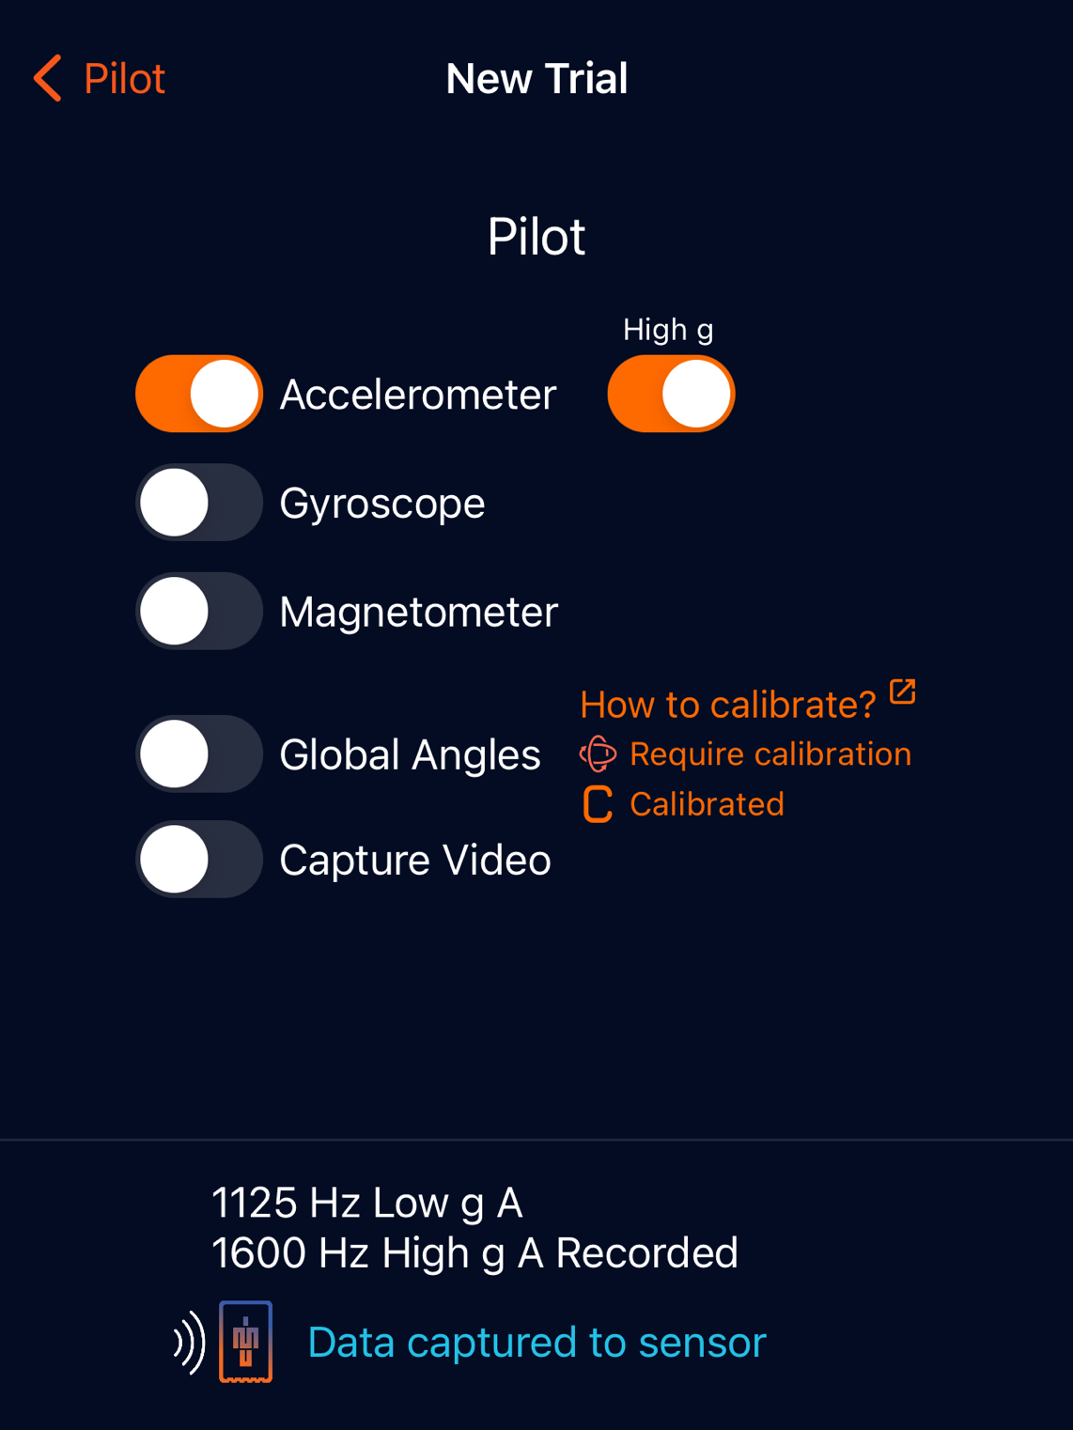
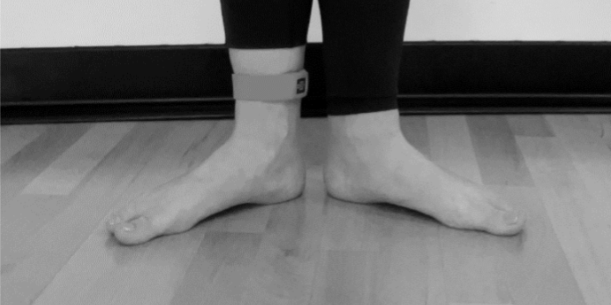
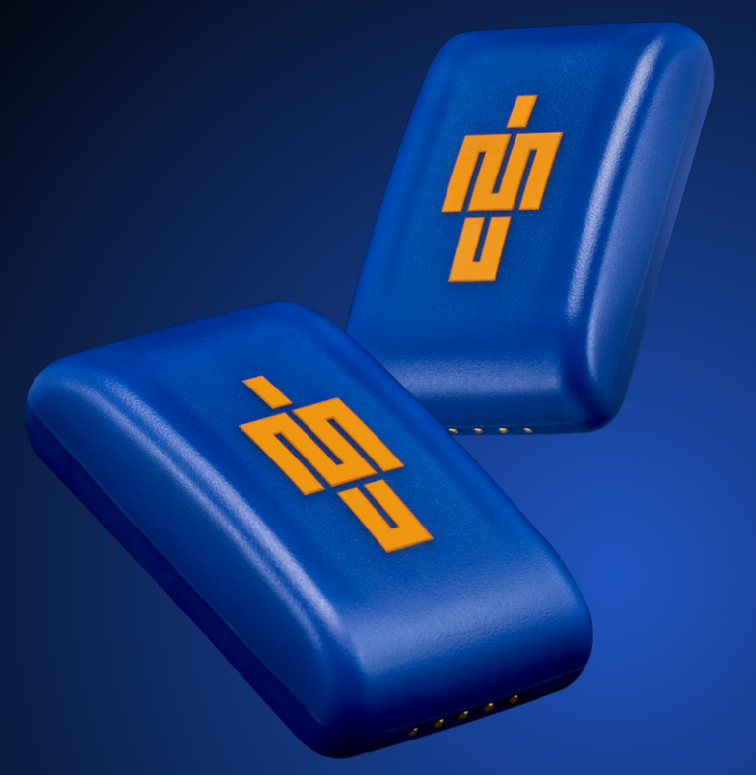
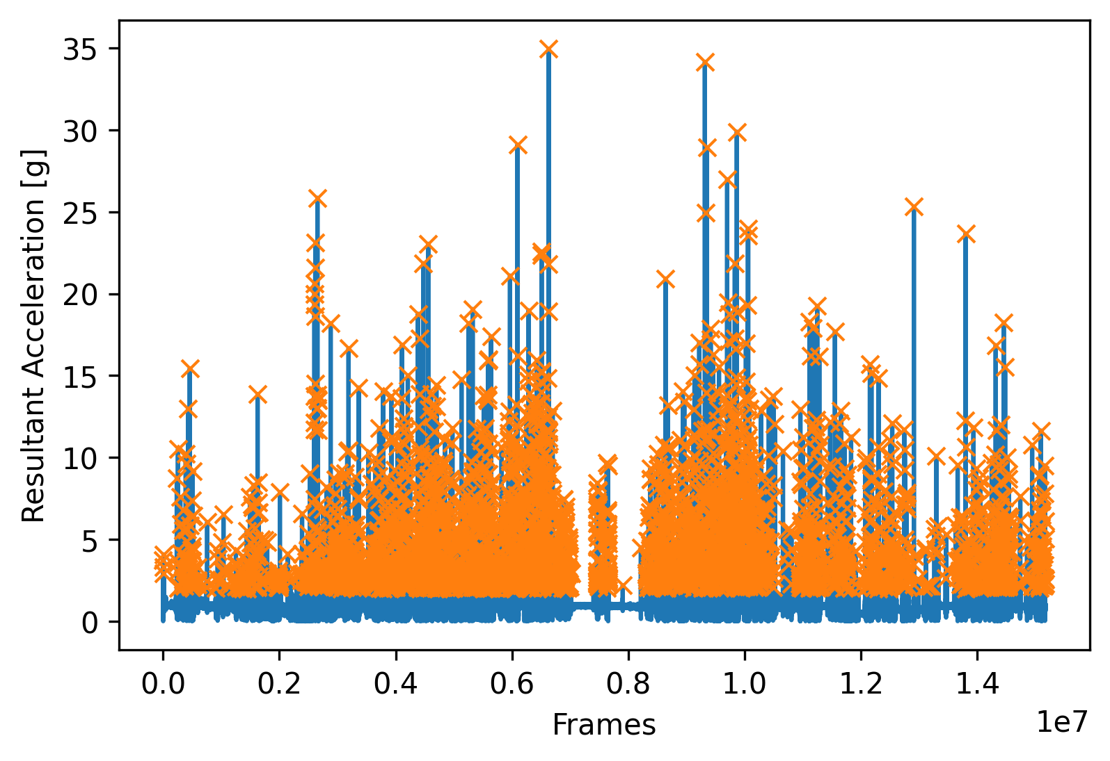
DANCE CLASS INTENSITY AND TIBIAL LOAD FLUCTUATIONS DURING A 5-WEEK TRAINING BLOCK IN DANCERS
Stephanie Svede [Mentor: Matthew F. Moran, PhD ]
College of Health Professions
Department of Physical Therapy and Human Movement Science
ABSTRACT
INTRODUCTION: Dancers experience high training loads in training¹ and do not currently have a viable method of measuring external load.² Dancers often experience symptoms of overuse as well as an increase in musculoskeletal pain with higher training loads.³ Previously, PlayerLoad (PL), from an inertial measurement unit (IMU) worn on the upper back, has been observed to increase as intensity and RPE increase in dancers^{.4}
PURPOSE: To measure tibial load and load fluctuations during a period of standard dance classes classes as well as assess how PL and RPE relate to these measures.
METHODS: A wearable IMU was secured on both ankles of two participants using the manufacturer supplied silicon strap. Data was collected across five distinct sessions of a weekly modern or ballet dance class. The participants were then asked to report their RPE for that class. PL was calculated via a custom Python script.
RESULTS: PL per minute on the dominant leg varied between both participants across their five sessions (Range: 5.49-8.21; 4.73-10.1). PL per minute during treadmill walking was substantially higher (18.67, 23.22). Total high impact peaks (>20 g) per minute varied between both participants (Range: 0.176-0.400; 0.019-0.036) with both substantially higher than treadmill walking (0.00).
DISCUSSION: This pilot study found that PL per minute correlated poorly with RPE in dancers while high impact peaks per minute did seem to correspond with RPE. Future research could possibly focus on high peaks or other measures that correlate with RPE such as heart rate.²
PARTICIPANTS
Two dance members of the Sacred Heart University Dance Company.
Each met following criterion: (1) Free of any lower extremity musculoskeletal injury at time of testing and in the preceding 8 weeks, (2) minimum 6 years of dance training, (3) currently participating in at least 120 minutes of ballet/modern dance per week, (4) between the ages of 18 and 30.
Table 1 – Aggregate data [mean (SD)] for total impacts per minute across five dance sessions and one 30-minute treadmill walk at a low intensity.
Total Impact Peaks Per Minute of Activity
 | Low (2-5g) | Moderate (5-20g) | High (>20g)
Dance | 13.1 (1.7) | 6.5 (2.4) | 0.16 (0.15)
Walk | 109.1 (4.3) | 4.2 (3.5) | 0.0 (0.0)
DISCUSSION
PlayerLoad (PL), traditionally calculated for field sport athletes, may not be the best measure to quantify load in dancers.
PL per minute correlated poorly with RPE (Figure 3)
Aggregate PL per minute in walk trial was substantially higher (99.8%) than dance sessions, while the RPE of the participants was substantially higher (82.4%) in dance sessions.
Higher moderate and high impact peaks per minute in dance sessions seem to correspond more accurately with dancer’s RPEs.
Previously, RPE and PL have both been considered viable means of measuring intensity and load in dancers.^{2,5}
Boyd et al. reported that PL varied with IMU placement and stated that lower limb IMU placement should be studied.⁵
This pilot study suggests that anteromedial tibial placement of IMU does not result in correlation between PL and RPE.
It is important for future research to continue studying training load in dancers since they do not currently have a feasible method of doing so for the general dancer population. This could minimize overuse injuries and help properly progress dancers in their training.
Future potential studies
Vary IMU placement (e.g., upper back)²
Relate quantity of high impact peaks (> 20 g) during a given dance session to incidence of lower extremity injury.
Figure 2 - Capture.U mobile app used to collect in-field inertial measurement unit data.
Figure 1 - The iMeasureU (Vicon) is positioned securely on the tibia (i.e., shin) via a silicon Velcro strap.
METHODS
All procedures approved by the Sacred Heart University IRB committee.
Participants danced barefoot (modern) or in ballet shoes (ballet) for each data collection session. Sessions were the participant’s weekly modern or ballet dance class (2 hours and 45 minutes) and take place on a foam-backed dance floor. A 30-minute sample of normal walking on a treadmill was also collected for comparative purposes.
A wearable tibial activity monitor (Blue Trident IMeasureU (IMU) device; 1600 Hz) was secured on both ankles of the participant using the manufacturer supplied silicon strap (Figure 1). Pre-wrap and athletic tape were used to fully secure the silicon strap.
Participants self-report rating of perceived effort (RPE; 1-10 scale) for each session
Data was collected via mobile app (Figure 2) and processed with a custom-written Python script that filtered acceleration data with a 4th order dual pass Butterworth low-pass 60Hz filter and then calculated resultant peak tibial accelerations (PTA) for trials. Analysis was delimited to dominant leg for both participants. PlayerLoad⁵ was then calculated using the following equation: $PL= \sqrt{\frac{\left(a_{y1 }−a_{y−1 }\right)2+\left(a_{x1 }−a_{x−1 }\right)2+\left(a_{z1 }−a_{z−1 }\right)2}{100}}$.
What is a typical training load for dancers?
Young competitive dancers and collegiate level dancers train anywhere between 15 and 25 hours a week. Professional dancers train for a minimum of 30 hours a week, not including performances. Most train much more. Dancers do not typically measure these amounts and are often instructed to continue training until they reach extremely fatigued states.
TAKE HOME MESSAGES
IMU placement on ankles is viable for use in dance classes. Data collection to the IMU mobile app is simple and does not interrupt training.
PL is not viable metric for measuring external load in dancers when wearing an ankle-mounted IMU.
High impact peaks per minute may be related to dance class intensity and potentially lower extremity injuries.
Sample Dance Session
RPE vs PlayerLoad Per Minute Comparison
RPE
What is tibial load?
Tibial load is a measure of peak tibial acceleration that indicates the ground reaction forces present on the tibia. This pilot study used PlayerLoad as a measure of tibial load. PlayerLoad is a measure of external load based on data from triaxial accelerometry. Triaxial accelerometry, as measured by the inertial measurement unit (IMU) devices used in this study, measures acceleration in each plane of motion and provides insight regarding the impact taking place during a given practice session.
PlayerLoad
RESULTS
Aggregate PlayerLoad Per Minute
Dance Classes: 7.00 ± 1.01
Walking: 20.95 ± 2.27
REFERENCES
Jeffries AC, Wallace L, Coutts AJ. Quantifying Training Loads in Contemporary Dance. Int J Sports Physiol Perform. 2017;12(6):796-802.
Shaw JW, Springham, Matthew, Brown DD, Mattiussi AM, Pedlar CR, Tallent J. The Validity of the Session Rating of Perceived Exertion Method for Measuring Internal Training Load in Professional Classical Ballet Dancers. Front Physiol. 2020;11:480.
Boeding JRE, Visser E, Meuffels DE, de Vos RJ. Is Training Load Associated with Symptoms of Overuse Injury in Dancers? A Prospective Observational Study. J Dance Med Sci. 2019;23(1):11-16.
Brogden CM, Armstrong R, Page R, Milner D, Norris D, Greig M. Use of Triaxial Accelerometry During the Dance Aerobic Fitness Test: Considerations for Unit Positioning and Implications for Injury Risk and Performance. J Dance Med Sci. 2018;22(3):115-122.
Boyd LJ, Ball K, Aughey RJ. The reliability of MinimaxX accelerometers for measuring physical activity in Australian football. Int J Sports Physiol Perform. 2011;6(3):311-321. doi:10.1123/ijspp.6.3.311
Aggregate RPE Per Session
Dance Classes: 6.0 ± 1.4
Walking: 2.5 ± 0.5
Figure 3 – Ratings of perceived effort (RPE) versus PlayerLoad in both participants across five distinct dance session. Correlations were both rated as poor (r² < 0.35).
This work was presented at the 2023 Sacred Heart University Exercise Science Capstone Symposium

