Slide 1
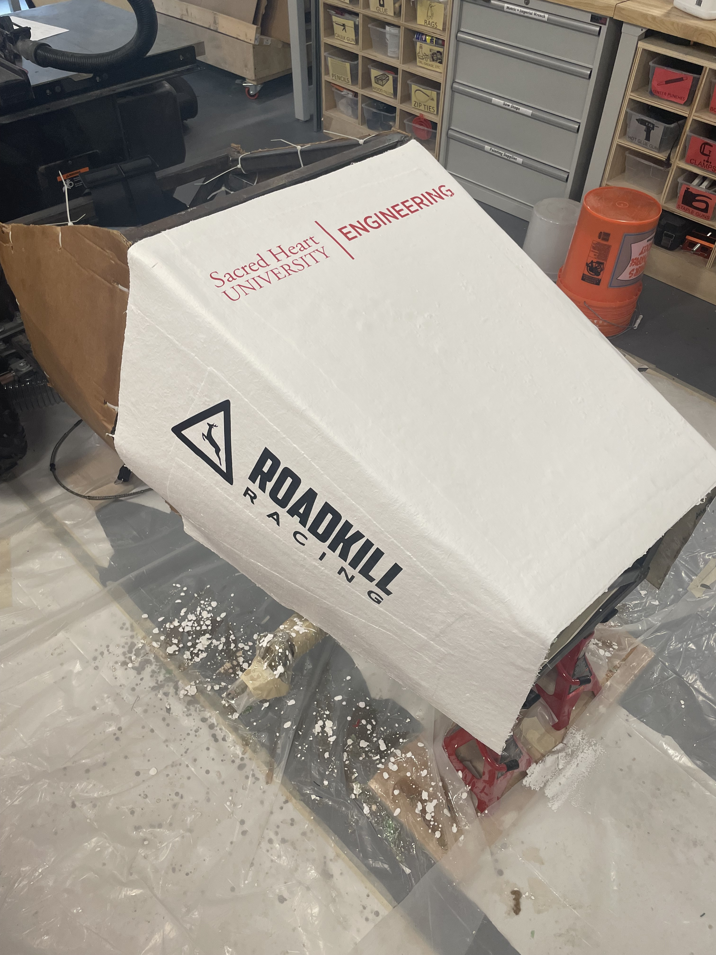
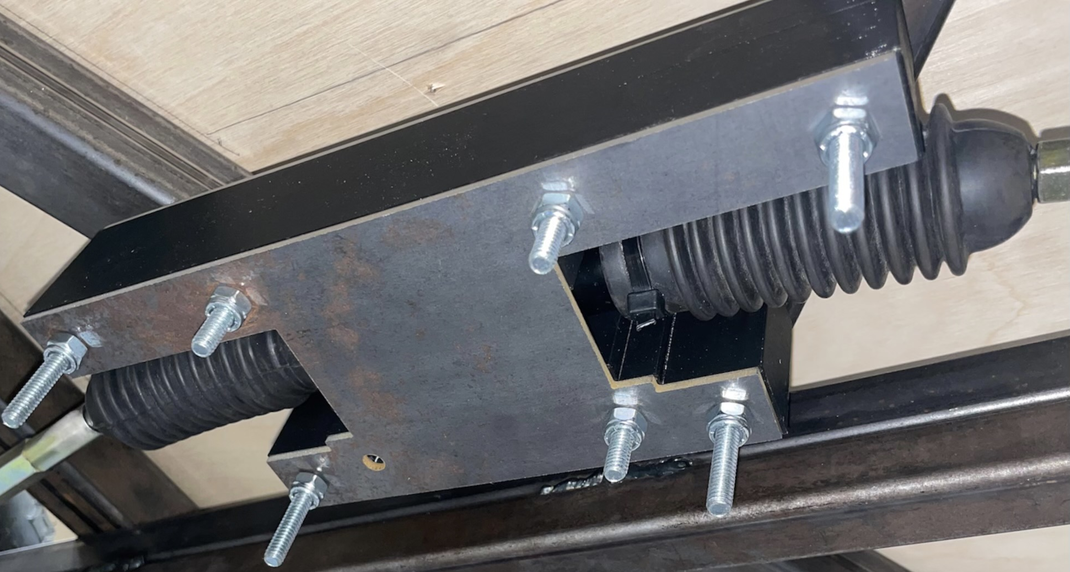
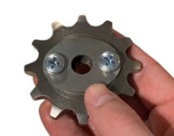
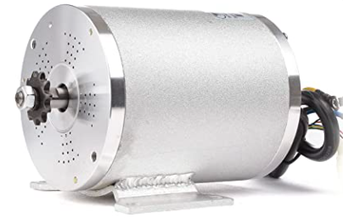
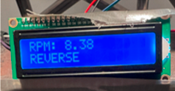
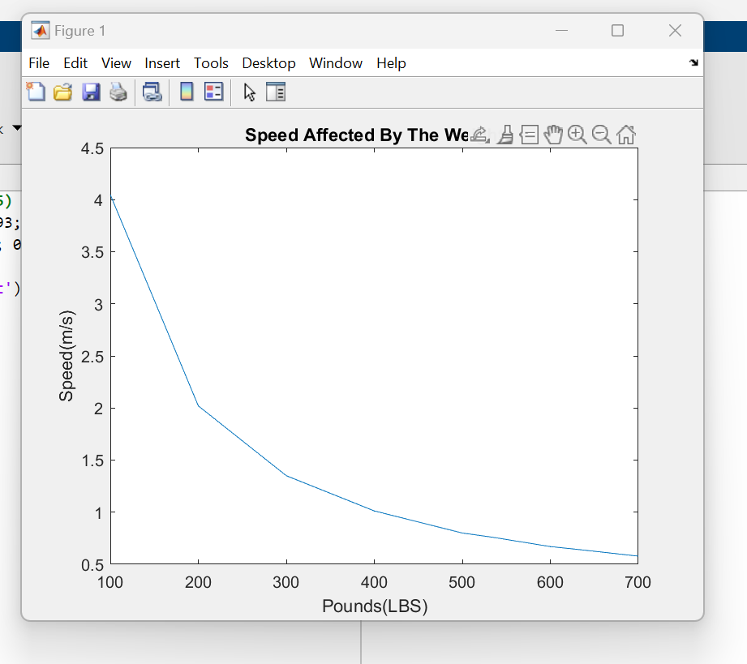
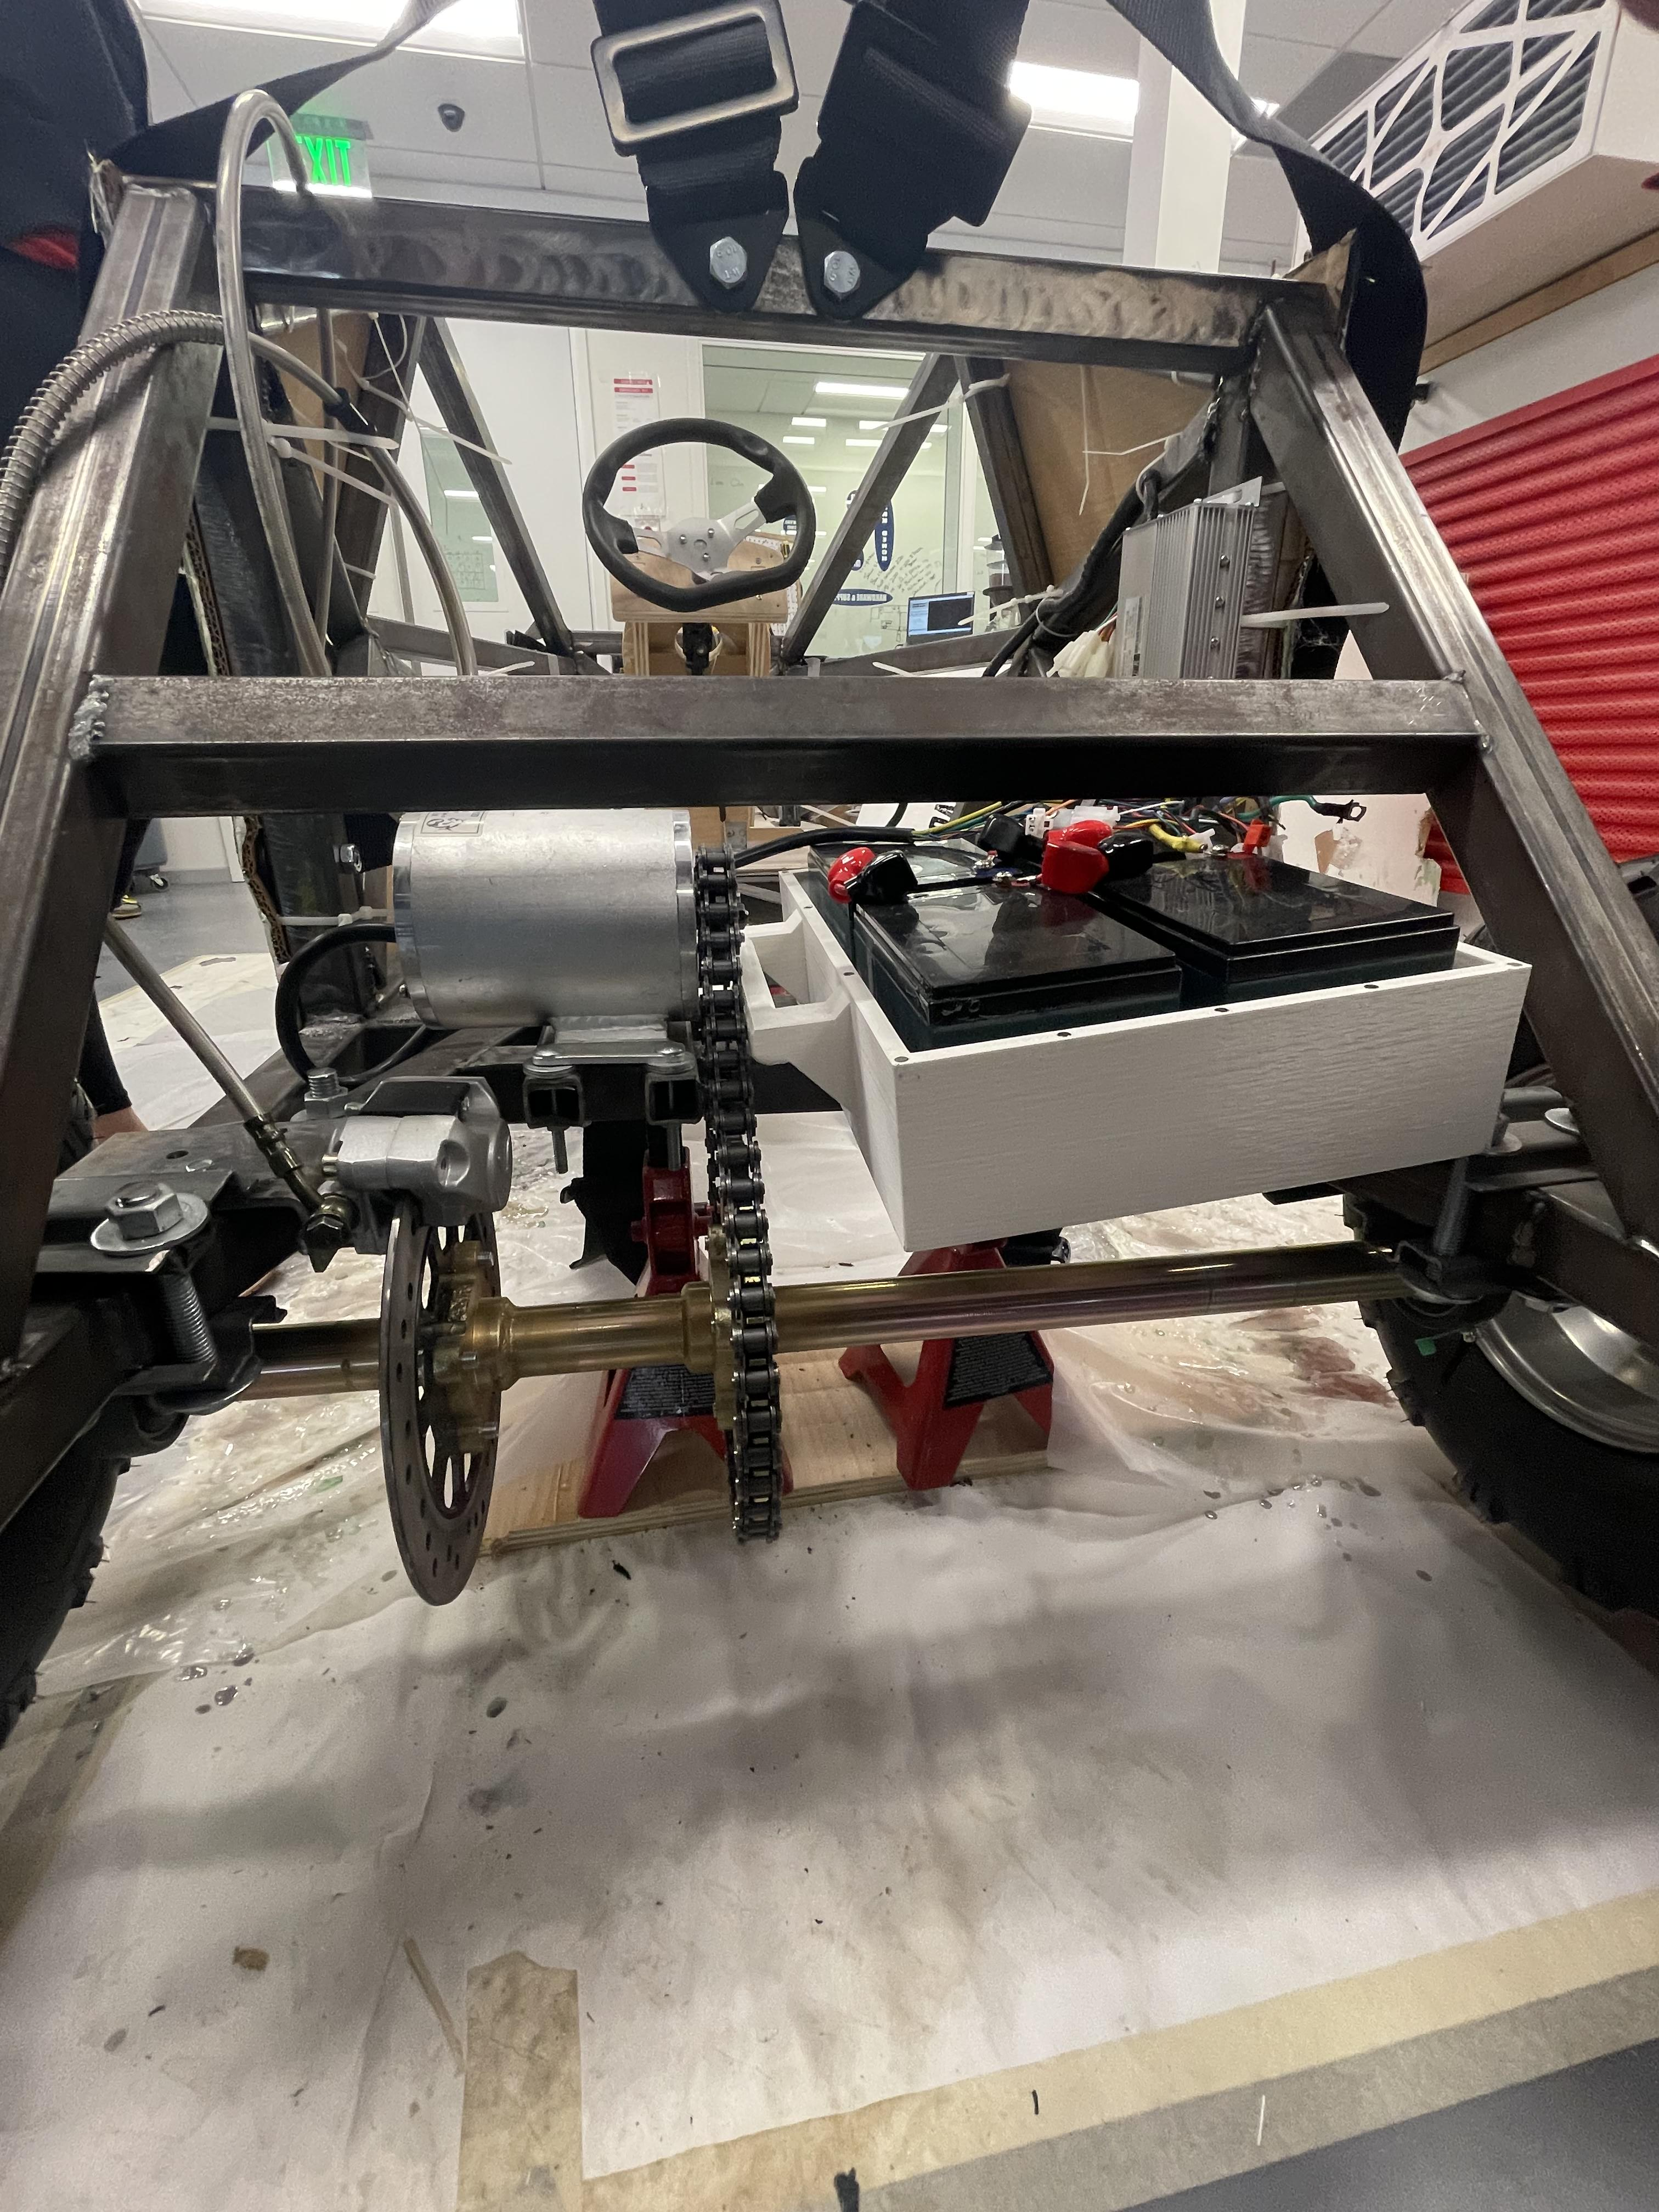
Kaitlyn Mangano, Jeppe Urup Mogensen, Jordan Carlucci, Benjamin Agyemang, Brandon Maruri, and Mario Montuori
Assisted by: Jenna Pfister, Logan Ward, Gurjot Singh, Patrick Milner, Anthony Matos, Nico Galette, Francesco DA’counto, and John Mayo
Introduction
Abstract
In this project, we utilized our engineering skills developed over the last four years as Computer and Electrical Engineering students to develop a Formula SAE EV. Formula SAE EV is a competition where undergraduate and graduate students at universities compete in different categories using personalized electric vehicles. This is our senior project that has been left to us by the previous seniors. Last year, as junior, we assisted the seniors with this project so this year we came into the project with a lot of prior knowledge. This year, we have the current junior assisting us with our goals. This project will continue to get passed down to other seniors engineering students as their capstone. The long-term goal, for years to come, is to be able to compete.
As a team, we combined our knowledge of soldering, computer aided design, coding, and programming to enhance Sacred Heart University’s Formula SAE EV. This year we added an electric powertrain, fiber glass shelling, LEDs, and steering. To accomplish these tasks, it involved preforming calculations on the vehicle. This helped us determine the size motor we should be using and turn radius. Overall, we were able to further develop the vehicle which allows Sacred Heart University’s Formula SAE EV team to get one step closer to competing.
Manufacturing
Electronics
Several parts of the Formula SAE EV are custom designs that are in-house manufactured. The main part of the manufacturing process was centered around designing and manufacturing the chassis of the car. The chassis is designed in Fusion 360 and made from 1.5” square steel tubes, that are put together using a MIG welder. Additionally, the steering system of the car is also in-house manufactured using an OMAX water jet cutter, a Prusa 3D printer, and a ShopBot CNC machine. This shows the center part of the steering system from underneath the car. It consists of two custom made steel brackets enclosing the rack and pinion gearset, shielded by a 3D printed PLA part.
The shell of the car is made from fiberglass. The process of creating the fiberglass shell first involved constructing the mold. In this case we used waterproofed cardboard as the base, layered with joint compound which enabled us to contour the edges as preferred. The next steps involved the placement of fiberglass sheets onto the mold, followed by the application of resin and an outer layer of gelcoat for a smooth finish.
Powertrain
A powertrain consists of the components that thrusts your car into motion. This includes an engine, in our case a motor, differential, pedal, etc. Last years, Formula SAE electric vehicle team made the decision to design the vehicle with rear wheel drive. They were only able to attach the 48V, 1800W BLDC motor to the back left side of chassis and purchase a rear axle that included a gear. The motor also has three phase wires sticking out from it: yellow, green, and blue. These wires are used to change the current direction to the motor so that the motor can constantly run in the same direction. In addition, there are five thinner wires coming from the motor as well. These wires are called the hall wires. They are used to determine the position of the rotor for sensor controller operation. Both the phase wires and hall wires connect to the speed controller. This connection to the speed controller allows different components of the vehicle to talk to one another.
This year we added onto the powertrain. We assembled and attached a kit purchased from Amazon that consisted of a speed controller, wiring harness, four 12V batteries connected in series, forward/reverse switch, foot pedal, ignition key, and a charging plug. These components were tested together for functionality before adding them to the vehicle. The wiring harness is temporarily attached to the chassis with zip ties. The forward/reverse switch and the ignition key slide into a wooden slot that was cut out for them underneath the steering wheel. Furthermore, the foot pedal is drilled to the wooden flooring where the drivers’ feet sit. Both the speed controller and batteries are attached to the back of the chassis behind the driver’s seat. The components of the powertrain allow for the movement of the vehicle.
In this project, we designed a display that shows the speed, direction, and if the car is powered on or off. We have created an app that can show the location and control the lights which are held in a casing. Also, we collect the data from the car and automatically upload it to a website.
Safety
One essential aspect of creating an electric vehicle from scratch is ensuring the proper safety for the driver. Some main elements of the car's safety that needed to be worked on were the seatbelt, the padding around the cockpit, and securing the driver's seat. These three parts were ordered on Amazon and added the car one-by-one. The 5-point seat belt was implemented by drilling holes into the chassis and screwing each point selectively based on the positioning of the straps. The straps are also adjustable on their own, so the holes are symmetrical on the chassis. The padding in the cockpit was originally wrapped around the perimeter of the driver, but since the fiberglass shelling was installed, the padding had to be cut into even pieces and glued to the chassis. The driver's seat was the more difficult part of the vehicle's safety due to the complications bottom of the seat. The rail system that allowed for the seat to be adjusted back and forth was not able to be drilled directly onto the chassis. Therefore, one workaround that helped the process was the designing and printing of a wooden platform in Fusion 360. This platform was meant to be drilled into the chassis so that the seat can be stabilized. All these elements were constructed to create the safest environment possible for the Formula SAE driver.
Theoretical Calculations
Weight: 534 pounds
Speed: 1.7 mph
Maximum turn angle: 150 degrees
Quality Control
To ensure our vehicle is managed and built correctly, a quality control procedure must be followed. Quality control helps us include the needs for the customer. This allows us to follow the requirements for both the Formula SAE events and any go-kart. Our goal is to eventually enter the vehicle into a Formula SAE event so in our case the customer is the judges for the event. A checklist was followed in the making of the vehicle. One of the major requirements that we didn't meet was suspension. This will be incorporated in the future designs. The checklist that was made can help for designs of the next vehicle as we can see what we need to add to enter the Formula SAE competition.
Conclusion
In closing, this project gave us the opportunity to build upon our teamwork, leadership, and time management skills. We were challenged with finding a common time for us all to meet to work on the project. Our biggest takeaway was having developed an understanding of what it takes to accomplish goals in a long-term project. This project will be handed down to next year’s seniors who will continue to develop the vehicle, in hopes of getting closer to competing in the Formula SAE EV competition.

