Slide 1
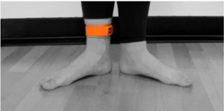
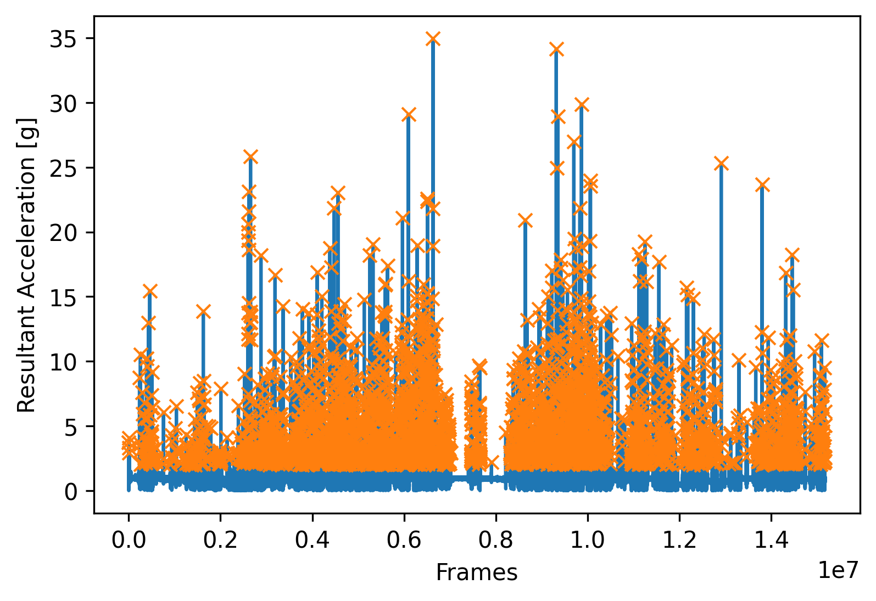
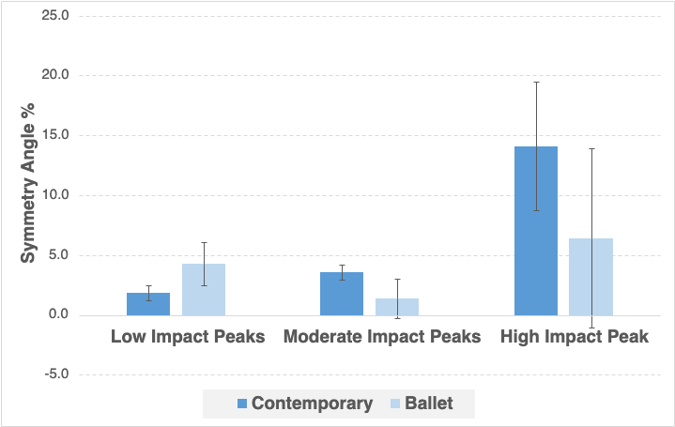
Bilateral Symmetry of Tibial Loads During a Five-Week Training Block in Dancers
Kaitlin Broyles [Mentor: Dr. Matthew Moran]
College of Health Professions
Department of Physical Therapy and Human Movement Science
ABSTRACT
INTRODUCTION: The relationship between tibial acceleration and dance is a limited field of study. Injuries, both from overuse and asymmetry, are prevalent in the dance world, especially towards a dancer’s dominant leg.
PURPOSE: The purpose of this study was to determine the presence of asymmetry among contemporary and ballet dancers in their typical classes.
METHODS: Two experienced female dancers (22/22 years of age, 177.8/160cm, 83.9/55kg, 13/19 years experience) participated in the study and wore tibia-mounted IMU devices bilaterally during five routine dance classes (one ballet, one contemporary). A custom Python script filtered tri-axial accelerations collected at 1600Hz, computed resultant acceleration and symmetry angles were computed for low, moderate, and high impact peaks.
RESULTS: Symmetry angles for both participants, as well as the means and standard deviations for each angle, were calculated. For the contemporary dancer, the averages were as follows (in percentages): low impact peaks = 1.86 ± 0.64, moderate impact peaks = 3.59 ± 0.64, high impact peaks 14.10 ± 5.35. For the ballet dancer, the averages were as follows (in percentages): low impact peaks = 4.26 ± 1.81, moderate impact peaks = 1.38 ± 1.63, high impact peaks = 6.41 ± 7.50.
DISCUSSION: For both the ballet and contemporary dancers, larger asymmetries occur at higher impact peaks as compared to low and moderate impact peaks. The asymmetries are not all in the same direction. The IMU devices were tolerated by dancers and allowed in-field monitoring of dance tibial loads; their use should be considered for future studies.
PARTICIPANTS
Met the following criterion:
Free of any lower extremity musculoskeletal injury at time of testing and in preceding 8 weeks
Minimum 6 years of dance training
Currently participating >120 minutes of ballet/contemporary dance per week
18-30 years old
No contraindications to exercise or procedures
Two participants were recruited from Sacred Heart University from the Dance Company.
DISCUSSION
In a standard contemporary class, there are 33%-48% more low impact peaks, 62-65% more moderate impact peaks, and 233-2900% more high impact peaks than in a ballet class.
Could be explained by differences in flooring compliance as each dancer performed on different surfaces.
Low intensity walking produces over 8 times the number of low impact peaks per minute than dance classes. Moderate intensity walking produces about 1.5 times less moderate impact peaks per minute than dance classes. High intensity walking produces no high impact peaks.
Lower symmetry angles for moderate and high impact peaks for ballet dancer may indicate greater symmetry (Figure 3)
Overall, largest asymmetries occur in high impact peaks (Figure 3). This could be due to a greater variability of movement at these accelerations → harder to control than smaller, more precise, low impact movements
Average symmetry angle at high impact peaks for ballet dancer was 6.4%, as compared to 4.3% at low impact peaks and 1.4% at moderate impact peaks.
Average symmetry angle at high impact peaks for contemporary dancer was 14.1%, as compared to 1.9% at low impact peaks and 3.6% at moderate impact peaks.
Asymmetries were not all in same direction (towards left or right side)
Ballet Dancer: favored right side (100% of sessions) for low impact peaks, right side for moderate impact peaks (60% of sessions) and left side for high impact peaks (60% of sessions).
Low and moderate impact peaks correspond with McMahon et al. (dancers favor right/dominant side)¹
Contemporary Dancer: favored left side (80% of sessions) for low impact peaks and the right side for both moderate and high impact peaks (80% of sessions)
Moderate and high peaks correspond with McMahon et al.¹
FUTURE WORK
Potential for future studies:
Larger variety of dance classes
More participants
Manipulate other variables (sex, flooring compliance)
28.4% of injuries among professional dancers explained by flooring type⁴
Females more likely to sustain injuries related to floor type than males⁴
Figure 1 – The iMeasureU (Vicon) is a tri-axial acceleration measurement device that is positioned securely on the tibia (3-cm anterior to the medial malleolus) via a silicon Velcro strap.
METHODS
Following informed consent, participants wore normal dance attire. The ballet dancer wore So Danca canvas ballet slippers and the contemporary dancer was barefoot.
Wearable tibial activity monitor (Blue Trident iMeasureU (IMU) device)³ was placed on each ankle of each participant using manufacturer supplied silicon straps. The IMU was mounted at the anteromedial side of the tibia, 3 cm proximal to the medial malleolus (Figure 1). Pre-wrap and athletic tape were used to fully secure the silicon strap.
The ballet dancer performed a typical ballet class. All five sessions, in the same dance studio, consisted of an hour at the ballet barre, an hour in the centre, and forty-five minutes of choreography. There was a fifteen-minute break between class (barre and centre) and choreography. IMU devices remained on the ankles during this break.
What is the relationship between bilateral asymmetry and injuries in dance?
Dancers experience symptoms of overuse within their regular training regimen as well as an increase in musculoskeletal pain with higher training loads.⁴ Many pains and injuries are the result of bilateral asymmetry, which often begins to present early on in a dancer's training. In fact, it was reported that 53% of female ballet dancers have a preference to use the same leg for work and support, meaning they will use their dominant leg for whichever task requires more coordination, flexibility, or strength.¹ A similar study, done on male and female ballet dancers, revealed asymmetry during jump landings, with a greater injury risk on the non-dominant limb, as it is weaker, does not produce as much power, and does not absorb as much force as a dancer’s dominant limb.²
Figure 2 – Resultant acceleration (g) over entire dance session. Low impact (2 – 5 g), moderate impact (5 – 20 g) and high impact (>20 g) denoted via color bands.
The contemporary dancer performed a typical contemporary class. All five sessions, in the same dance studio, consisted of a warm-up, centre work, and forty-five minutes of choreography. There was a fifteen-minute break between each class and choreography. IMU devices remained on the ankles during this break.
DATA ANALYSIS
A custom Python script filtered IMU tri-axial acceleration data with 4th order low pass Butterworth filter (60 Hz)
The resultant acceleration was then computed, and peaks were recorded between 2 and 5 g (Low Impact), between 5 and 2- g (Moderate Impact), and > 20 g (High Impact) for each leg.
Symmetry angle (SA) metric between legs was then calculated. SA is a logical method of calculating asymmetry that does not require reference values. It quantifies the degree of asymmetry from a 45-degree angle. Two symmetrical values create a 45-degree angle, and the smaller the percentage, the larger degree of symmetry between the left and right legs. Symmetry angle shows the magnitude, not the direction, of the vector.⁵
TAKE HOME MESSAGES
Definitive conclusion about bilateral symmetry requires more data + more controlled environment
Symmetry angles vary greatly between classes
Ankle mounted IMU devices are tolerated and practical
Suggested in a previous study done on bilateral symmetry between children’s limbs³
IMU devices remained in place, collected data via Bluetooth connection throughout studios, required minimal interaction between researcher and participant
This study serves as an important first step towards safer and more symmetrical training for future dancers
67%
RESULTS
Table 1,2 – Symmetry Angles Between Right and Left Legs
SYMMETRY ANGLES (CONTEMPORARY)
Total Low Impact Peaks | Total Moderate Impact Peaks | Total High Impact Peaks
0.74 | 3.41 | 6.22
2.26 | 3.76 | 18.81
2.45 | 4.71 | 15.04
1.52 | 3.21 | 20.48
2.30 | 2.83 | 9.97
SYMMETRY ANGLES (BALLET)
Total Low Impact Peaks | Total Moderate Impact Peaks | Total High Impact Peaks
5.39 | 0.59 | 20.48
0.76 | 0.04 | 5.77
5.81 | 4.55 | 0.00
4.54 | 1.26 | 5.77
4.79 | 0.47 | 0.00
Of female ballet dancers who participated in a McMahon et al. study investigating lateral limb bias and lower limb injuries had right side limb dominance and injuries correlated with their dominant side.¹
REFERENCES
McMahon E, Pope R, Freire K. Relationships between lateral limb bias, turnout, and lower limb injury in a female pre-professional ballet dancer population. J Dance Med Sci. 2021;25(2):139-146.
Conway CK, Bradshaw EJ, Rice VJ, Clark RA. Are dancers symmetrical during single leg and double legged landings? ISBS. 2016;33:844-847.
Catelli D, Carsen S, Lamontagne M. Week-long protocol to monitor physical activity intensity and impact loading in children. Gait & Posture. 2020;81:56-57.
Wanke EM, Mill H, Wanke A, et al. Dance partner or dance floor: Exogenous factors resulting in accidents in professional dancers. Med Probl Perform Ar. 2013;28(3):131-136.
Bishop C, Read P, Chavda S, Turner A. Asymmetries of the Lower Limb: The Calculation Conundrum in Strength Training and Conditioning. Strength Cond J. 2016;0(0):1-6.
Figure 3 – Mean and Standard Deviation of Symmetry Angles of the Contemporary and Ballet Dancers
This work was presented at the 2023 Sacred Heart University Exercise Science Capstone Symposium

