Slide 1
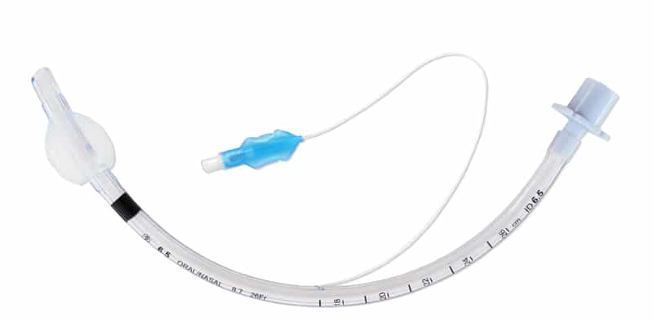
Effectiveness of Continuous Endotracheal Cuff Pressure Control Systems in Prevention of Ventilator Associated Pneumonia (VAP) Hannah Galeucia, SN Mentor: Dr Theresa Soltis, DNP, APRN, FNP-BC Davis and Henley College of Nursing, Sacred Heart University – Fairfield, CT Thomas More Honors program
Background
Clinical Implications
Barriers and Limitations
Ventilator Associated Pneumonia (VAP) is a bacterial pneumonia that is caused by a primary organism. Initiation of an artificial airway or tracheostomy can introduce bacteria into the respiratory tract leading to colonization of the upper airway (Kohbodi et al., 2022).
VAP is the most common type of Hospital-Acquired Pneumonia (HAP) that is found in the ICU setting (Shebl et al., 2022).
The risk of developing VAP increases with the length of time the patient is intubated, “the risk of developing VAP is 6 to 21 times higher in patients intubated for more than 24 hours compared to others…” (Celik et al., 2020).
There was a higher incidence of VAP (22.0% vs. 11.2%) in the group of patients that were treated with intermittent endotracheal cuff pressure control systems compared to the patients that were treated with continuous endotracheal cuff pressure control systems (Lorente et al., 2014).
VAP prevention proved to be higher with CCPC that included SSD (subglottic secretion drainage) (Maertens et al., 2022).
Lack of Knowledge, time, training, and resources (Maertens et al., 2022).
High risk of bias, small sample size, and different CCPC devices used (Maertens et al., 2022).
Implications for Clinical Practice
There is a need for education and training for nurses regarding responsibilities for endotracheal tube and cuff management. Nursing responsibilities include:
(1) the frequency of monitoring of the ETT cuff pressure, (2) the methods used for monitoring the ETT cuff pressure, (3) management of leaks, (4) how much pressure should be maintained in the ETT cuff, (5) patient’s position when monitoring the ETT cuff pressure and (6) the amount of air required to inflate the ETT cuff pressure” (Mpasa et al., 2020).
Frequent assessments and collaboration with the interprofessional team.
https://www.medsourcelabs.com/wp-content/uploads/2018/07/ET-tube-cuffed-.jpg
Introduction & Purpose
Significance to Nursing
The purpose of this project is to determine proper management and the effectiveness of continuous vs. intermittent endotracheal cuff pressure systems in prevention of VAP for mechanically ventilated patients in the ICU setting.
The main question of this research was: Does the use of continuous endotracheal cuff pressure control systems decrease the incidence of VAP in mechanically ventilated patients in the ICU setting?
VAP is one of the most common and deadly hospital-associated infections (HAI), increasing medical costs by $40,000 and lengthening hospital stay by an additional seven to nine days (Liu et al., 2020).
The use of continuous endotracheal cuff pressure systems in the ICU setting will decrease the incidence of VAP and the patient’s length of stay (Papazian et al., 2020).
This is significant to nursing practice, as evidence-based practice can help reduce the incidence of VAP and improve patient outcomes.
Conclusion
The use of Continuous Endotracheal Cuff Pressure Control Systems decreases the incidence of VAP in mechanically ventilated patients in the ICU setting compared to the standard of care .
References

