Slide 1
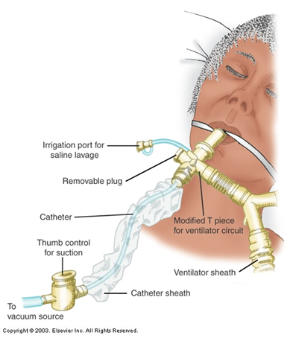
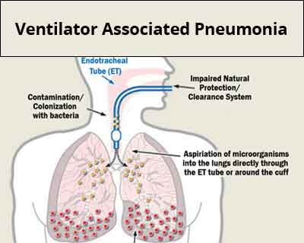
The Impact of Suctioning Frequency on Ventilator Associated Pneumonia Sarah Gehrlein, SN DHCON Faculty Mentor: Dr. Theresa Soltis, DNP, APRN, FNP-BC Sacred Heart University, Davis and Henley College of Nursing - Fairfield, CT Thomas More Honors program
Purpose
Findings
Clinical Implications
The purpose of this research is to evaluate the effectiveness of continuous and intermittent subglottic secretion drainage in mechanically ventilated patients on the prevention of ventilator associated pneumonia.
Research Question: In adult hospitalized patients receiving mechanical ventilation, how does intermittent subglottic secretion drainage compared with continuous suction affect the incidence of ventilator associated pneumonia?
The presence of any kind of suction directly decreases the risk of developing ventilator associated pneumonia.
The type of suction used, continuous vs intermittent, does not have a direct impact on the development of VAP (Wen et al., 2017)
Continuous suction has been found to decrease the duration of mechanical ventilation, which indirectly decreases the risk of VAP (Fujimoto et al., 2018)
Suctioning of any kind is beneficial to the mechanically ventilated patient. Continuous suctioning has the potential to lower the length of time an individual needs ventilation and therefore reduce the risk of VAP
Endotracheal suctioning should be preformed in addition to other care measures to prevent VAP. These measures are:
Continuous cuff pressure control system (Maertens et al., 2022)
Head of bed elevation maintained at 45°(Gruner & Kutluturkan, 2021).
Daily sedation vacations (Liu et al., 2020)
Early mobilization (Sousa et al., 2019)
Mouth care with chlorhexidine solution (de Lacerda-Vidal et al., 2017)
Implications to Nursing Practice
Background
Nurses should be knowledgeable on how to use both continuous and intermittent suction technology
If a patient is receiving intermittent suctioning, frequent respiratory assessments are necessary to provide adequate suctioning
Ventilator associated pneumonia (VAP) is a deadly hospital acquired infection which develops after 48 hours of being placed on a mechanical ventilator.
In the intensive care setting, 20% of mechanically ventilated patients will develop VAP during their stay in the ICU (Wen et al., 2017).
Development of VAP results in:
Elevated crude mortality rate of 20-50% (Fujimoto et al., 2018)
Increase in ICU length of stay by 6-10 additional days (Fujimoto et al., 2018)
Increased healthcare costs (Wen et al., 2017)
References
Notes:
de Lacerda Vidal, C., de Lacerda Vidal, A., de Moura Monteiro, J., Cavalcanti, A., Henriques, A., Oliveira, M., Godoy, M.,
Coutinho, M., Sobral, P., Vilela, C., Gomes, B., Leandro, M., Montarroyos, U., de Alencar Ximenes, R., & Lacerda, H.
(2017). Impact of oral hygiene involving toothbrushing versus chlorhexidine in the prevention of ventilator-associated
pneumonia: a randomized study. BMC Infectious Diseases, 17(1), 112. https://doi.org/10.1186/s12879-017-2188-0
Fujimoto, H., Yamaguchi, O., Hayami, H., Shimosaka, M., Tsuboi, S., Sato, M., Takebayashi, S., Morita, S., Saito, M., Goto, T., & Kurahashi, K. (2018). Efficacy of continuous versus intermittent subglottic secretion drainage in preventing ventilator-associated pneumonia in patients requiring mechanical ventilation: A single-center randomized controlled trial. Oncotarget, 9(22), 15876–15882. https://doi.org/10.18632/oncotarget.24630
Gruner, C., Kutluturkan, S. (2021). Role of head-of-bed elevation in preventing ventilator associated pneumonia bed elevation and pneumonia. Nursing in Critical Care. Liu, W., Yang, Y., Jiao, Y., Zhang, K., Hai, Y., Li, H., Xing, H., Xu, B., Bai, H., Zhao, Y., Bao, H., Zhang, S., Ren, W., Yang, L., Yang, H., Tian, J., Wang, M., & Guo, T. (2020). Evaluation of the effects of applying the ventricular care bundle (VCB) method for reducing ventilator-associated pneumonia (VAP) in the intensive care unit of a general Chinese Tertiary Hospital. Annals of Palliative Medicine, 9(5), 2853–2861. https://doi.org/10.21037/apm-20-289
Maertens, B. , Lin, F. , Chen, Y. , Rello, J. , Lathyris, D. & Blot, S. (2022). Effectiveness of Continuous Cuff Pressure Control in
Preventing Ventilator-Associated Pneumonia: A Systematic Review and Meta-Analysis of Randomized Controlled Trials*. Critical Care Medicine, 50 (10), 1430-1439. https://doi.org/10.1097/CCM.0000000000005630
Sousa, A. S., Paiva, J. A., & Ferrito, C. (2019, February 26). Application of a ventilator associated pneumonia prevention guideline and outcomes: A quasi-experimental study. Intensive & critical care nursing. Retrieved November 5, 2022, from https://pubmed.ncbi.nlm.nih.gov/30366645/
Wen, Z., Zhang, H., Ding, J., Wang, Z., & Shen, M. (2017). Continuous versus intermittent subglottic secretion drainage to prevent ventilator-associated pneumonia: A systematic review. Critical Care Nurse, 37(5), e10–e17. https://doi.org/10.4037/ccn2017940

