Slide 1
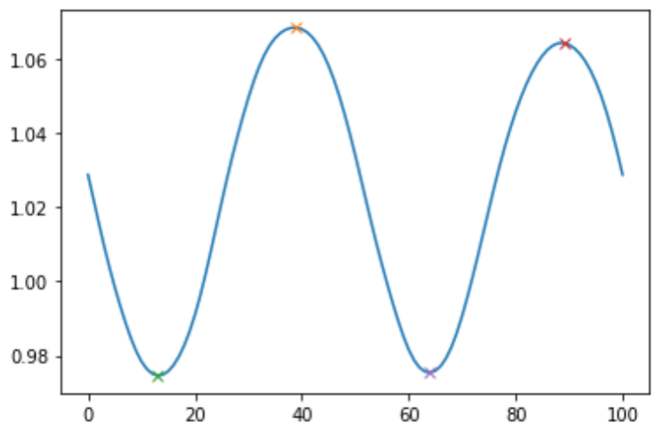
Reliability of Vertical Oscillation during Running Using Marker-less
Motion Capture
Isabella Rogler [Mentor: Matthew Moran, PhD]
College of Health Professions
Department of Physical Therapy and Human Movement Science
ABSTRACT
INTRODUCTION: The spring-mass model explains the way one’s center of mass (COM) fluctuates during running gait. The ‘spring’ represents the structures of the leg that undergo compression and rebound during the stance phase of running. At initial foot contact, the spring compresses and the COM lowers to its maximally compressed state.¹ Measurements are taken at the maximally compressed state and the most superior COM position.² The vertical displacement of the center of mass in running is known as vertical oscillation (VO).
PURPOSE: To develop norms with marker-less motion capture (MLMC) and assess the reliability of measuring VO with MLMC.
METHODS: Twenty-one college-aged runners had to fulfill a set of requirements and grant informed consent before beginning the study. All procedures were approved by the University’s Institutional Review Board. Participants committed to coming on there distinct days and run for a total of six minutes at three self-selected speeds. Data was collected using the Phystread Pressure Treadmill and Sony RX0 II cameras.
RESULTS: The intracclass correlation coefficient (ICC) was calculated using JASP Software and was computed to be 0.909. The mean VO was 8.99 (±) 1.34. Standard error of measurement and minimal detectable change were calculated using MS Excel software and found to be 0.293 cm and 0.959 cm, respectively.
DISCUSSION: Our findings demonstrated that the Theia3D MLMC system was able to reliably measure VO for the twenty-one participants. The intracclass correlation coefficient (ICC) indicated excellent reliability, demonstrating that this technology can accurately measure VO. More research must be completed to determine the implications of how VO can be altered in gait retraining and potential benefits.
PARTICIPANTS
DISCUSSION
Requirements:
Between the age of 18 and 30
Run at least 16 km/ week for a minimum of 3 months before testing
Three years of running experience
Familiar with treadmill running
Twenty-one collegiate/ recreational runners (14 females, 7 males)
Age: 19.5 ± 1.4 years
Height: 1.72 ± 0.08 meters
Mass: 64.2 ± 12.2 kilograms
Running experience: 7.3 ± 2.4 years
The purpose of this study was to assess the reliability of Theia3D MLMC. Our findings demonstrate that it is reliable to measure VO with this ML system. Peer-reviewed research indicates that ICC values below 0.5 demonstrate poor reliability, while values between 0.5 and 0.75 demonstrate moderate reliability, and values between 0.75 and 0.9 indicate good reliability. Values that are greater than 0.90 demonstrate reliability is excellent. Our ICC value of 0.909 indicates that inter-session reliability for VO was excellent.⁶ Knowing this, we conclude that MLMC can be used to determine VO and can be used for future research and clinical work.
From our work, no correlation was found between the following variables
Stature (cm) and VO (cm)
Cadence (spm) and VO (cm)
Step length/ height (cm) and Cadence (spm)
Our study found a mean VO of 8.99 ± 1.34 cm which is consistent with other findings with VO ranges between 6 and 10 cm.⁷
Gait retraining cues have been used to decrease VO in attempt to decrease loading rate and risk of injury.⁸ Knowing MLMC can accurately assess VO will provide clinicians with a method to perform gait retraining for VO if applicable.
*Procedures were approved by the University’s Institutional Review Board and all participants granted informed consent
METHODS
Materials:
Phystread Pressure Treadmill
Sony RX0 II Cameras
DATA PROCESSING
Theia3D MLMC software was used to determine 3D human segment locations for each trial. Kinematic data was exported and processed with Visual3D Professional (C-Motion Inc.; Germantown, MD, USA). A built-in Visual3D model was applied and derived COM for each participant and each trial. The maximum and minimum COM measurements were used to determine VO.
Statistical Analysis
Inter-session reliability was assessed for VO using intracclass correlation coefficient (ICC), standard error of measurement (SEM) and minimum detectable change (MDC). JASP Software (version 0.17.1) was used to compute ICC. Excel was used to compute MDC and SEM variables.
SESSION #1
Trial 1 Trial 2 Trial 3
RPE=3/10 RPE=5/10 RPE=7/10
~25 seconds ~25 seconds ~25 seconds
What is Vertical Oscillation (VO)?
Throughout the running gait cycle, one’s COM projects over the stance limb in a sinusoidal pattern.¹ Compression and rebound of the stance limb occurs and measurements are taken at the most superior COM position to its lowest point of the stance phase. The vertical displacement, or distance from the peak position of COM to the lowest position of the COM, is known as VO.² Clinically, VO is important to measure in running as it may be linked to efficiency, performance, or injury-related benefits.³
SESSION #2
Identical Test Conditions
Right-Left Aerial Max
Left-Right Aerial Max
Meters
VO
FUTURE WORK
Gait retraining may be used to decrease VO and reduce peak vertical ground reaction forces.⁸ This study serves to provide clinicians with a reliable method of collecting VO data.
Future work must be done to determine the impact that altering VO would have on running biomechanics and running economy.
Both SEM and MDC values were low which indicates that future work must be conducted to assess the implications that these small changes may have practically.⁹
SESSION #3
Identical Test Conditions
What is Theia3D Marker-Less Motion Capture?
Right Stance Min
Left Stance Min
COM
% Gait cycle
Allows for reduced data collection and processing time⁴
Seek to measure 3D human segmental motion⁵
Reliably measures biomechanical joint angles and spatiotemporal metrics during treadmill running⁵
Visual3D models are then used in computing segment properties and deriving COM⁵
RESULTS
TAKE HOME MESSAGES
1. VO’s of 8.99 ± 1.34 cm fall within our ‘norms and future work must be done to assess the clinical implications regarding runners falling outside of this range.
2. MLMC can be used to reliably assess VO during running gait and can be used for future research.
Figure 3 – Relationship between cadence (spm) and VO (cm) in 21 runners at self-selected speeds based on a 7/10 RPE
Correlation was rated as poor (r² = 0.0024)
REFERENCES
Lee CR, Farley CT. Determinants of the center of mass trajectory in human walking and running. J Exp Biol. 1998;201(21):2935-2944. doi:10.1242/jeb.201.21.2935
Souza RB. An evidence-based videotaped running biomechanics analysis. Phys Med Rehabil Clin N Am. 2016;27(1):217-236. doi:10.1016/j.pmr.2015.08.006
Smith CP, Fullerton E, Walton L, Funnell E, Pantazis D, Lugo H. The validity and reliability of wearable devices for the measurement of vertical oscillation for running. PLOS ONE. 2022;17(11):e0277810. doi:10.1371/journal.pone.0277810
Wade L, Needham L, McGuigan P, Bilzon J. Applications and limitations of current markerless motion capture methods for clinical gait biomechanics. PeerJ. 2022;10:e12995. doi:10.7717/peerj.12995
Moran MF, Rogler IC, Wager JC. Inter-session repeatability of marker-less motion capture of treadmill running gait. Appl Sci. 2023;13(3):1702. doi:10.3390/app13031702
Koo TK, Li MY. A Guideline of Selecting and Reporting Intraclass Correlation Coefficients for Reliability Research. J Chiropr Med. 2016;15(2):155-163. doi:10.1016/j.jcm.2016.02.012
van Oeveren BT, de Ruiter CJ, Beek PJ, van Dieën JH. The biomechanics of running and running styles: a synthesis. Sports Biomech. Published online March 4, 2021:1-39. doi:10.1080/14763141.2021.1873411
Adams D, Pozzi F, Willy RW, Carrol A, Zeni J. Altering cadence or vertical oscillation during running: effects on running related injury factors. Int J Sports Phys Ther. 2018;13(4):633-642.
Bramah C, Preece SJ, Gill N, Herrington L. The between-day repeatability, standard error of measurement and minimal detectable change for discrete kinematic parameters during treadmill running. Gait Posture. 2021;85:211-216. doi:10.1016/j.gaitpost.2020.12.032
1.
Figure 1 – Visual3D model at most superior COM position (left) and lowest COM position (right)
Figure 2 – Relationship between step length/ height ratio and cadence (spm) in 21 runners at self-selected speeds based on a 7/10 RPE
Correlation was rated as poor (r² = 0.1555)
Figure 4 – Relationship between cadence (spm) and VO (cm) in 21 runners at self-selected speeds based on a 7/10 RPE
Correlation was rated as poor (r² = 0.0919)
This work was presented at the 2023 Sacred Heart University Exercise Science Capstone Symposium and Academic Festival

