Slide 1
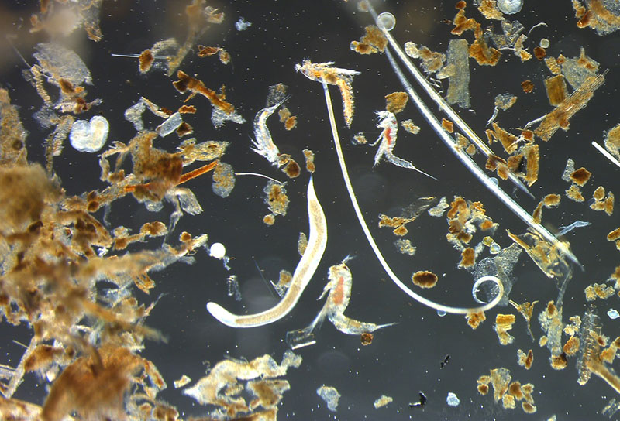
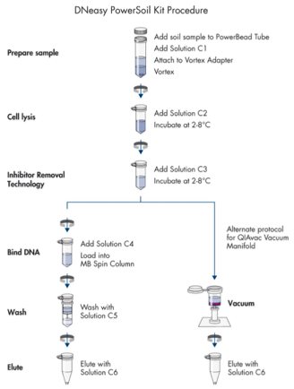
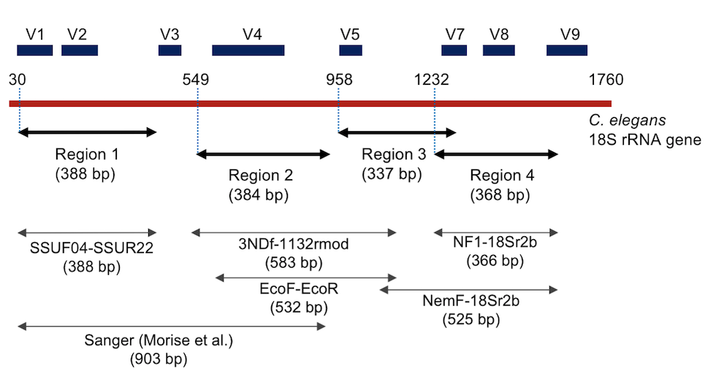
Optimization of a DNA Extraction Protocol for Identification of Meiofauna in Sediment
Lilly Bove¹, Joanna Coreno¹, Lisa Piastuch², Ashley Stoehr¹, and Alyssa Woronik¹
¹ Sacred Hearty University ²University of Connecticut, Avery Point
Background and Importance
Here we optimized a protocol to extract meiofauna DNA from sediment samples.
Combined use of frozen samples and the Mini BeadBeater-8 yielded more concentrated and purer DNA extractions, but further comparisons are necessary.
Methods
Field Sampling & Sample Preparation
Samples were obtained along a 100 m transect across a mudflat exposed at low tide at Seaside Park, Bridgeport CT. For visual identification, samples were decanted and preserved in 70% ethanol using the methodology of Aylagas et al. 2016. For genetic identification, replicates of samples were stored in the -80^{oC} freezer, while others were stored at 4^{oC} in a 70-95% ethanol solution at a 2:1 ratio.
DNA Extraction
The Qiagen DNeasy PowerSoil Pro Kit was used to purify the DNA for amplification and sequencing. To further aid cell lysis, a modification to the Qiagen protocol was made where a Mini Beadbeater-8 is used to mechanically lyse cells instead of a vortex (Bartholomew, personal communication). After DNA extraction, a Nanodrop spectrophotometer was used to measure the quantity and quality of extracted DNA.
Results & Future Directions
A
B
Figure 1: Example of meiofauna that can be seen coastal
sediment. Nematode and copepods are visible. Image: https://oceanexplorer.noaa.gov/facts/marine-meiofauna.html
L 1 2 3 4
L 1 2 3
Meiofauna are a diverse group of benthic invertebrates that range between 0.04 mm and 1mm in size.
The community composition of these organisms indicates anthropogenic influence and environmental health.
There are 2 methods used to monitor the meiofauna community composition in the sediment. Each method has differing benefits and drawbacks.
Figure 2: PCR Screening to confirm presence of DNA.
(A) Lanes 1 and 3 contained soil samples stored in ethanol, while lanes 2 and 4 contained frozen samples. (B) Lane 1 contains DNA extracted from a frozen sample. Lane 2 contains DNA extracted from a sample stored in ethanol, then frozen. Lane 3 contains a sample stored in ethanol. Ladder (L) = 1 Kb Plus DNA Ladder (1 Kb Plus DNA Ladder, Catalog #: 10787018, Invitrogen, Waltham, MA).
Preparation of DNA for Sequencing
Polymerase chain reactions (PCR) was utilized to amplify targeted 18S rRNA (V1 and V2 hypervariable regions, ∼380 bp) (Blaxter et al. 1998) using the SSU-F04 forward primer (5′-GCTTGTCTCAAAGATTAAGCC-3′) and the SSU-R22 reverse primer (5′-GCCTGCTGCCTTCCTTGGA-3′). Gel electrophoresis on a 1% agarose gel was used to confirm DNA amplification
Monitoring strategy | Pro | Con
Visual assay | Inexpensive | Time consuming and requires expertise to identify organisms at lower taxonomic levels
Genetic assay | More expensive | More efficient than visual identification because it allows for a larger amount of soil to be processed in a shorter amount of time It reduces misidentifications which may be common in visual identifications
Protocol Step
Sample Storage | Ethanol + 4oC | Ethanol + -80oC
Cell Lysis | Vortex | Mini BeadBeater-8
Future Directions: Extracted DNA will be sent for DNA sequencing. The community composition detected in the sequenced DNA will be compared to species identified by visual assays. The best monitoring scheme will be determined and used in a long-term research project
(Kenmotsu,2021)
References
Aylagas E, Mendibil I, Borja A, Rodriguez-Ezpeleta N. 2016. Marine Sediment Sample Pre-processing for Macroinvertebrates Metabarcoding: Mechanical Enrichment and Homogenization. Front. Mar. Sci. 3(203): 1-8.
Kenmostu H, Ishikawa M, Nitta T, Hirose Y, Eki T. 2021. Distinct community structures of soil nematode from three ecologically different sites revealed by high-throughput amplicon sequencing of four 18S ribosomal RNA gene regions. PLOS ONE. 16(4): e0249571
Blaxter M, De Ley P, Garey J, et al. 1998. A molecular evolutionary framework for the phylum Nematoda. Nature 392, 71–75 (1998)

