Slide 1
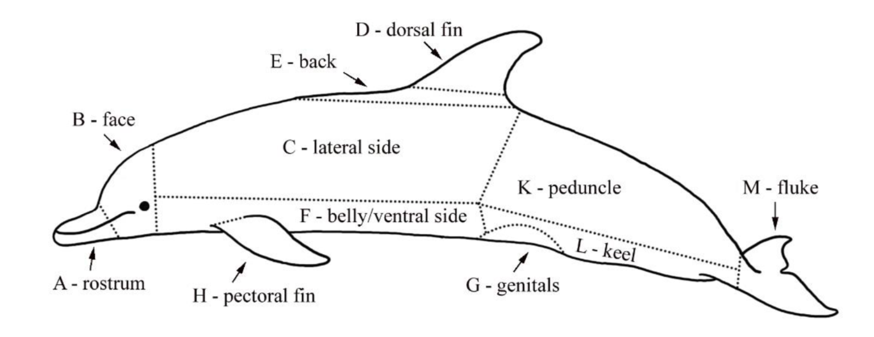
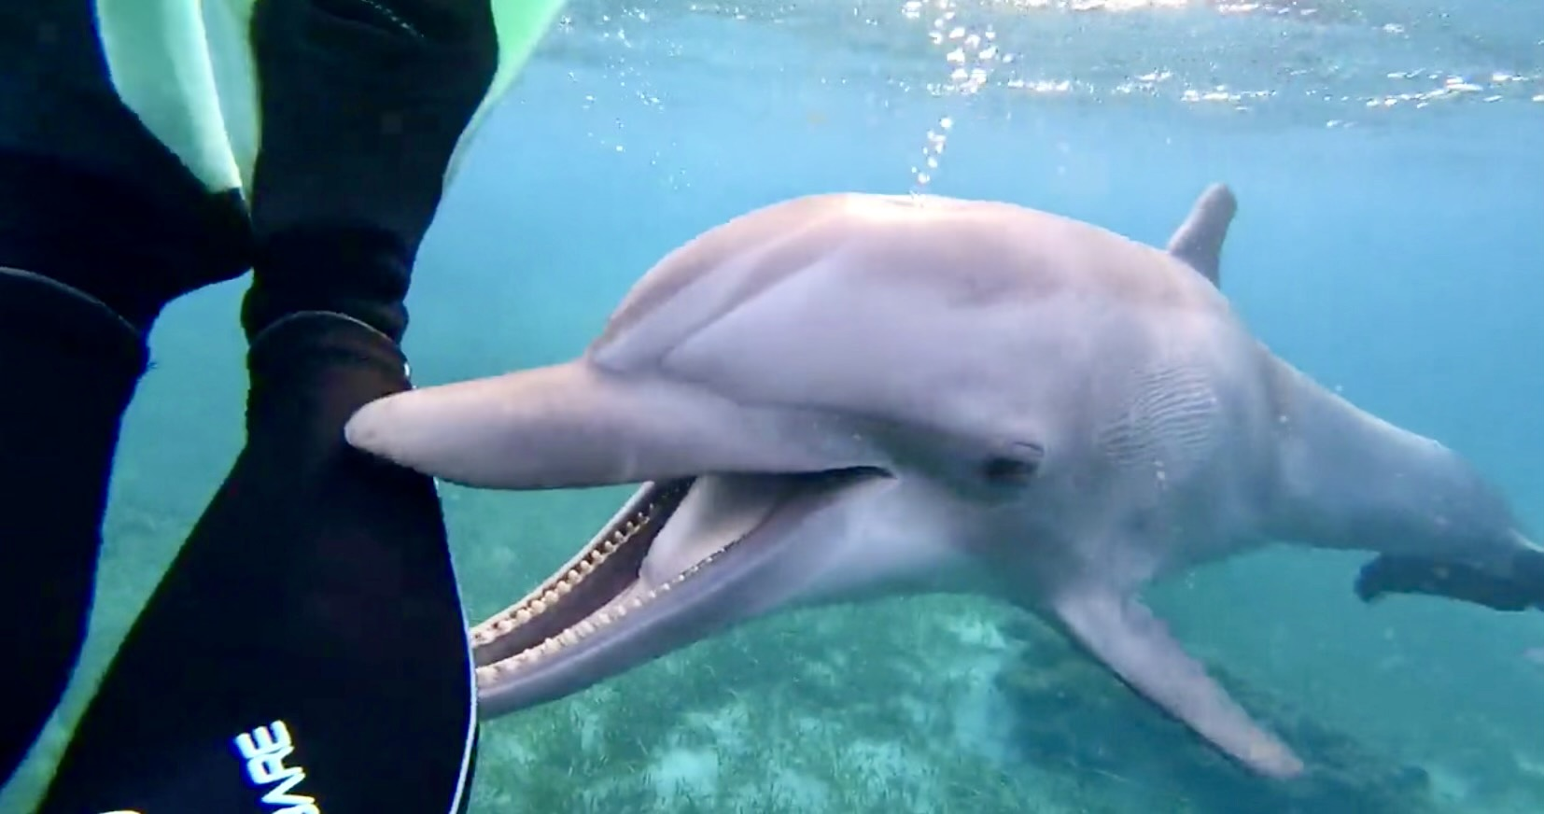
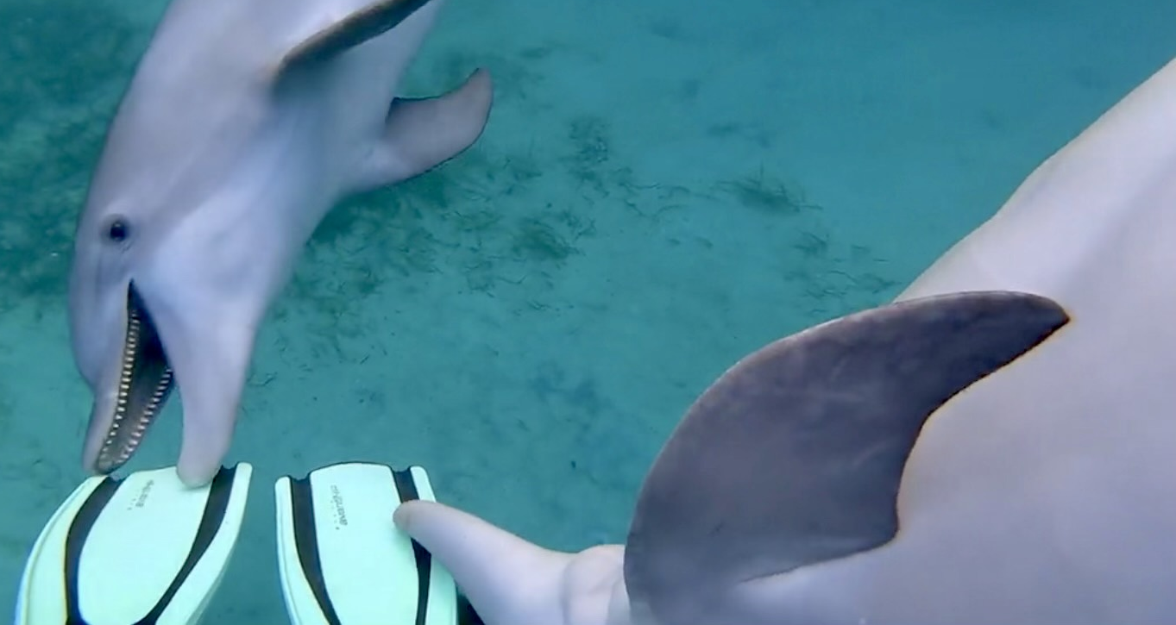
Object Play in Bottlenose Dolphins (Tursiops truncatus)
Kayla Alvia¹, Alexandra Giuffra¹, Erin Sheehan¹, Carlie Williams¹, Deirdre Yeater¹, Manon Themelin², & Kathleen Dudzinski²
¹ Sacred Heart University
² Dolphin Communication Project
Introduction:
Little is known about spontaneous object play in dolphins
Studying object play is important to understand how different species learn and develop skills that may assist with survival, such as problem solving (Kuczaj et al., 2006)
Object play is used as an indicator of cognitive ability in many species (Green et al. 2011)
Dolphins participating in object play exhibit more creative and varied play behaviors than when engaging in social play (Green et al. 2011)
Juvenile dolphins play more often. Play then slowly declines into adulthood (Cappiello et. al, 2018)
The current study involves a detailed investigation of object play (OP) in bottlenose dolphins (Tursiops truncatus)
Results:
199 object play events were recorded
The rostrum was used in 100% of object play events
Dolphins were oriented in a horizontal dorsal side up position for 80% of the object play bouts
Play events for sub-adults were significantly longer than for other age classes, F(3,204) = 3.55, p = 0.02 (Table 2).
The number of OP events was higher for male than females dolphins, but no significant differences were found based on sex, t(206) = 0.028, p = 0.87.
OP events involved man-made objects more than natural objects, but no significant differences were found, t(206) = 0.576, p = 0.45.
Solo play bouts were generally longer than mutual play bouts, but no significant differences were found, t(206) = 2.775, p=0.097.
Figure 1. Diagram of the dolphin body with body parts identified during this study labeled (with permission from Dudzinski et al., 2009).
Method:
7 thirty-minute underwater video sessions collected in March 2020 at the Roatan Institute for Marine Sciences in Honduras, were used for this study
16 dolphins were observed in object play: 10 adults, 2 sub-adults, 2 juveniles, and 2 calves
Play bouts were coded using BORIS (Behavioral Observational Research Interactive Software, Friard & Gamba, 2016) and analyzed in SPSS statistical software.
Play events were coded for object type, posture and body parts used, and solo or mutual object play. See Table 1 for more details.
a)
Table 2. Means and standard deviations for dolphins by age
Table 2: Age: | Mean (s) | SD | N
Calf | 7.31 | 6.40 | 29
Juvenile | 10.33 | 10.51 | 53
Sub-adult | 16.00 | 17.65 | 72
Adult | 11.68 | 12.38 | 54
Total | 12.22 | 13.74 | 208
b)
Discussion:
Future analyses will include lateralization, vocalization, and number of social partners observed in an object play bout.
Investigating object play in detail for dolphins in managed care is important because play is a potential indicator of animal welfare.
Future studies should expand to wild populations for comparison and a better understanding of the role of play in dolphin social life (Green et. al, 2011).
Table 1. List of modifiers used for each category to describe a play event.
Figure 2. Examples of a) solo play with researcher legs and b) mutual play with researcher fins. Both examples include the dolphins' rostrums.
Categories | Modifiers list
Object type | Man-made, natural
Object | Fins, seaweed, seagrass, camera, trash, net/gate
Posture | Horizontal dorsal side up, Horizontal ventral side up, Vertical head up, Vertical head down, On left side, On right side
Body part | see Figure 1
Solo/mutual | Solo when 1 dolphin is involved and Mutual when more than 2 dolphins are involved with the same object (see Figure 2)
References:
Cappiello, B., Hill, H., & Bolton, T. (2018). Solitary, observer, parallel, and social object play in the bottlenose dolphin (Tursiops truncates). Behavioural Processes, 157, 453-458.
Friard, O. & Gamba, M. (2016). BORIS: a free, versatile open-source event-logging software for video/audio coding and live observations. Methods in Ecology and Evolution, 7, 1325–1330.
Greene, W., Melillo-Sweeting, K., & Dudzinski, K. (2011). Comparing object play in captive and wild dolphins. International Journal of Comparative Psychology, 24, 292-306.
Kuczaj, S., Makecha, R., Trone, M., Paulos, R., & Ramos, J. (2006). Role of peers in cultural innovation and cultural transmission: evidence from the play of dolphin calves. International Journal of Comparative Psychology, 19, 223-240.
Acknowledgements:
We thank the Roatan Institute for Marine Sciences for providing access to record the dolphins.

