Slide 1
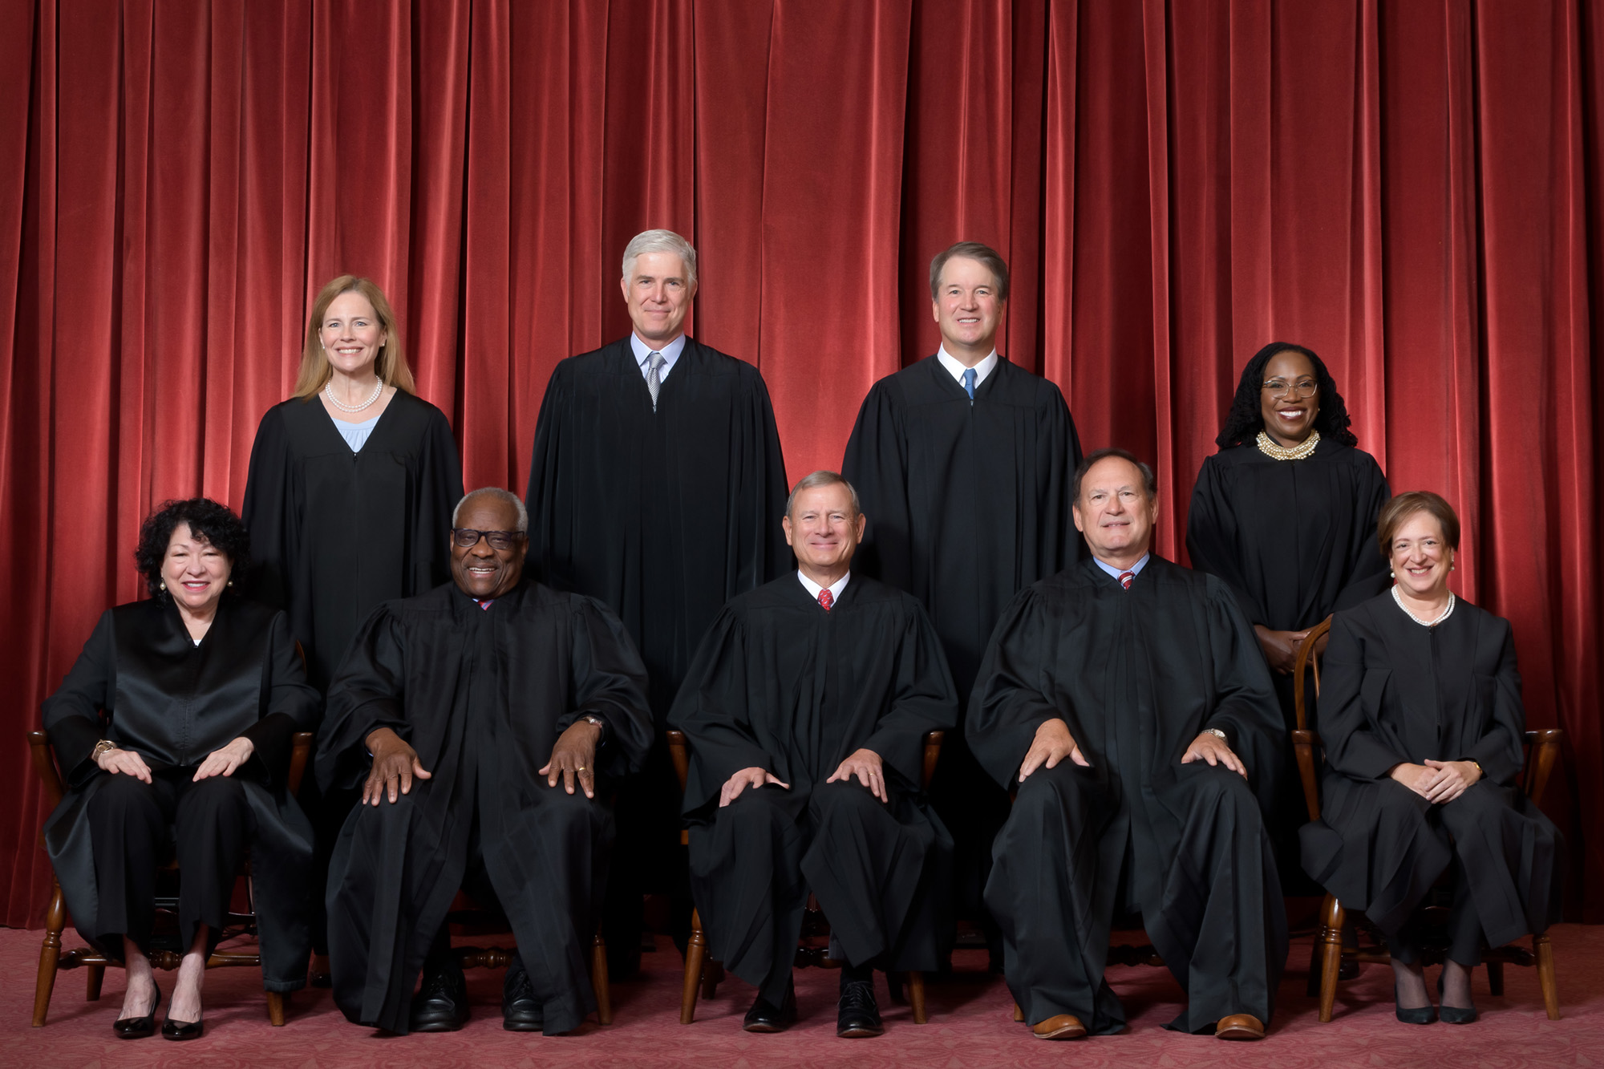
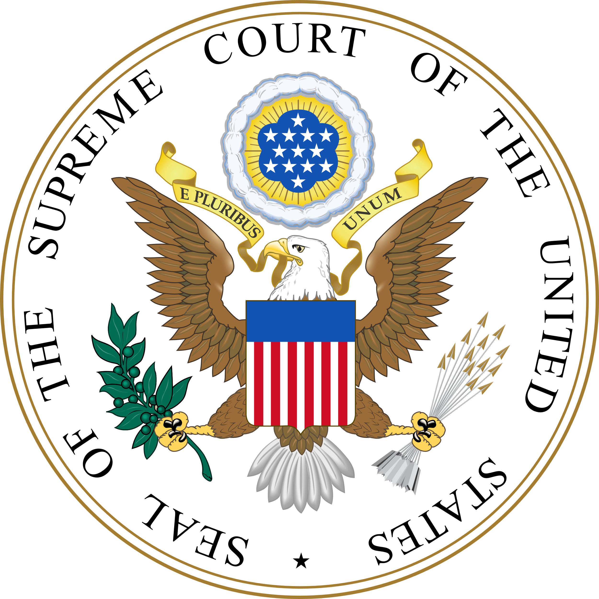
It is evident that partisanship has found a place in the courts. Decisions are being made on a partisan basis, ultimately mirroring the dominant party on the court.
The Effects of Polarization in the United States Supreme Court
Jillian Pusateri, Political Science
Partisanship has always had a strong influence over the judicial branch and system. While the founding father’s original intent for the judicial branch was to keep it nonpartisan, it is obvious that the court is continuously becoming more split. This rise in polarization has had an effect on the United States Supreme Court throughout the last couple of presidencies leading to split decisions from the Court.
Research Question: How does polarization affect the United States Supreme Court decisions concerning the issue of birth control since Griswold v. Connecticut?
This particular study uses case analysis to break down a variety of different court cases. I am also studying some background on judges and their decision-making patterns. I chose five different Supreme Court cases concerning birth control and abortion to analysis. The cases included in this study were: Griswold v. Connecticut (1965), Roe v. Wade (1971), Planned Parenthood of Central Missouri v. Danforth (1976), Planned Parenthood of Southeastern Pennsylvania v. Casey (1992), Dobbs v. Jackson Women’s Health Organization (granted 2021). After doing background research on the justices that had a hand in these cases, I had come to specific conclusions to where they stand politically. Furthermore, I analyzed the decisions supporting opinions written by justices, as well as the dissents that justices have provided in the cases themselves. I compared the different language used by the two sides of the issue to study their differing political standings.
The Current United States Supreme Court
A statistic concerning the outcome of decision percentage outcomes.

