Slide 1
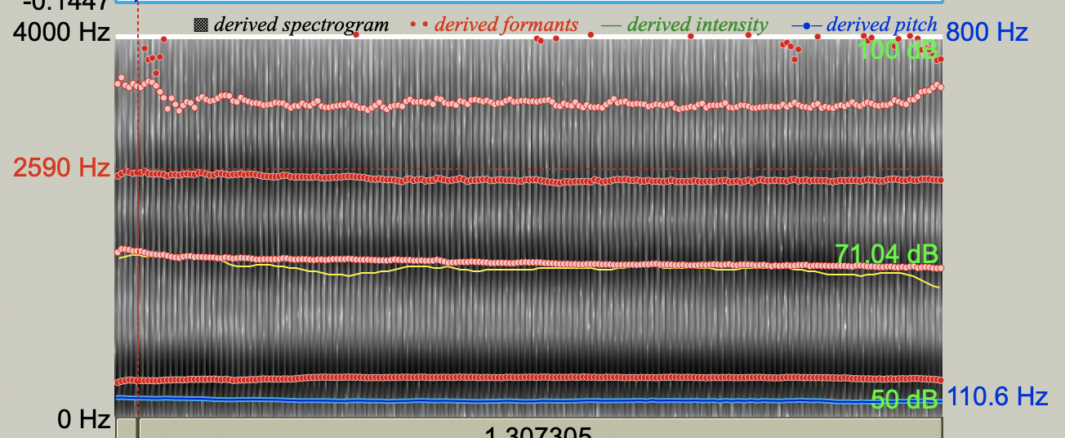
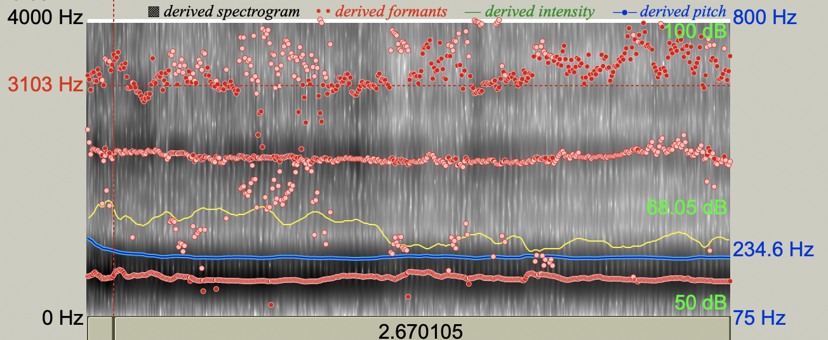
Identify acoustic predictors of gender attribution across various speech tasks
Jonah Savage
Faculty Mentor: Ciara Leydon-Korn
Department of Communication Disorders
Sacred Heart University
Fairfield, CT, USA
Background
Study Design
Listeners attribute gender to speakers using the male/female binary, within 200ms of voicing.¹⁰
Misattribution of gender occurs when the listener’s binary perception does not align with the speaker’s gender.
Gender dysphoria describes the psychological distress that results when sex assigned at birth and gender identity do not align.⁶
Can lead to negative self-image and increased rates of other mental health disorders
Can be exacerbated by misattribution.
Voice acoustics, word choice, and pragmatics guide perception, and intervention.
Anatomical, personal, and social factors influence voice acoustics.¹³
Unguided modification of voice acoustics can lead to functional voice disorders.³
Attempts to increase pitch can result in muscle tension dysphonia.¹
28% of transgender people reported a voice disorder generally resulting from attempts to alter voice characteristics alone, resulting in vocal tension or strain.⁸
Effective gender affirming voice therapy must target voice features that impact perception, without compromising health.
Research question:
Which acoustic variables predict listeners’ accuracy and confidence in assigning gender following digital manipulation of pitch and vowel quality of speech samples?
Speaker characteristics:
Fluent English speakers, aged: 18-25
10 males and 10 females as determined by sex assigned at birth
No voice disorders or prior voice therapy from an SLP
Listener characteristics:
100 males and females, aged 18-25
No self-report of hearing impairment
At least 12 years of education
Sex assigned at birth/gender identity
Speech samples:
Sustained vowel, single words (hVd) following a carrier sentence, sentences, a reading passage, and a 30-second procedural monologue.
Speech manipulations:
Pitch (fundamental frequency) and formants (F₁ and F₂) will be digitally manipulated using Praat software.⁵
Procedure:
Listeners will be presented with 4 samples of each utterance (unmodified, pitch modified, formants modified, both modified).
Listeners will attribute voice as male or female, and indicate the degree of femininity/masculinity in the voice using a visual analog scale
Factors that Influence Perception
Figure 1. Spectrogram - /hId/ produced by a male Figure 2. Spectrogram - /hId/ produced by a female
Perception | Acoustic Measure | Norms Based on Sex | Evidence of Impact on Perception
Pitch | Fundamental Frequency (F₀) | Means: Male – 115Hz⁴ Female - 215 Hz⁴ Androgenous – 150-185 Hz⁹ | Most predictive acoustic variable of attribution⁹ More than 40% of gender attribution by listeners is based on speaking fundamental frequency¹²
Loudness | Intensity | Male – 71.36 dB² Female - 67.14 dB² | Males have a louder voice¹¹ Female voices are considered “light” and “soft”¹²
Voice Quality | Stability and noise | Female – Lower CPP (more dysphonic)¹¹ | Female voices are breathier and quieter¹²
Vowel Quality | Formants | Male – Lower F₁-F₄¹² Female - Higher F₁-F₄¹² | Formant frequencies determine the vowel we hear. They vary by gender, because they depend on the size of the vocal tract⁷ Raising the frequency of first formant (F₁) in vowels gives speech a female quality⁷
References
Antoni, C. (2015). Service delivery and the challenges of providing service to people who are transgender. Perspectives on Voice and Voice Disorders, 25(2), 59–65. https://doi.org/10.1044/vvd25.2.59
Awan S. N. (1993). Superimposition of speaking voice characteristics and phonetograms in untrained and trained vocal groups. Journal of voice : official journal of the Voice Foundation, 7(1), 30–37. https://doi.org/10.1016/s0892-1997(05)80109-2
Baker, J., Ben-Tovim, D., Butcher, A., Esterman, A., & McLAUGHLIN, K. (2013). Psychosocial risk factors which may differentiate between women with Functional Voice Disorder, Organic Voice Disorder and a Control group. International Journal of Speech-Language Pathology, 15(6), 547–563. https://doi-org.sacredheart.idm.oclc.org/10.3109/17549507.2012.721397
Behrman, A. (2017). Speech and Voice Science, Third Edition. Plural Publishing.
Boersma, Paul & Weenink, David (2023). Praat: doing phonetics by computer [Computer program]. Version 6.3.09, retrieved 2 March 2023 from http://www.praat.org/
Bowman, S. J., Casey, L. J., McAloon, J., & Wootton, B. M. (2022). Assessing gender dysphoria: A systematic review of patient-reported outcome measures. Psychology of Sexual Orientation and Gender Diversity, 9(4), 398–409. https://doi-org.sacredheart.idm.oclc.org/10.1037/sgd0000486
Gallena, S. J. K., Stickels, B., & Stickels, E. (2018). Gender perception after raising vowel fundamental and formant frequencies: Considerations for oral resonance research. Journal of Voice, 32(5), 592–601. https://doi.org/10.1016/j.jvoice.2017.06.023
Hancock, A. B., & Garabedian, L. M. (2013). Transgender voice and communication treatment: A retrospective chart review of 25 cases. International Journal of Language & Communication Disorders, 48(1), 54–65. https://doi-org.sacredheart.idm.oclc.org/10.1111/j.1460-6984.2012.00185.x
Hardy, T. L. D., Rieger, J. M., Wells, K., & Boliek, C. A. (2018). Acoustic predictors of gender attribution, masculinity–femininity, and vocal naturalness ratings amongst transgender and cisgender speakers. Journal of Voice, 34(2). https://doi.org/10.1016/j.jvoice.2018.10.002
Latinus, M., & Taylor, M. J. (2011). Discriminating male and female voices: Differentiating pitch and gender. Brain Topography, 25(2), 194–204. https://doi.org/10.1007/s10548-011-0207-9
Murton, O., Hillman, R., & Mehta, D. (2020). Cepstral peak prominence values for clinical voice evaluation. American Journal of Speech-Language Pathology, 29(3), 1596–1607. https://doi.org/10.1044/2020_ajslp-20-00001
Yeptain Leung, Oates, J., & Siew Pang Chan. (2018). Voice, Articulation, and Prosody Contribute to Listener Perceptions of Speaker Gender: A Systematic Review and Meta-Analysis. Journal of Speech, Language & Hearing Research, 61(2), 266–297. https://doi.org/10.1044/2017_JSLHR-S-17-0067
Zhang Z. (2016). Mechanics of human voice production and control. The Journal of the Acoustical Society of America, 140(4), 2614. https://doi.org/10.1121/1.4964509

