Slide 1
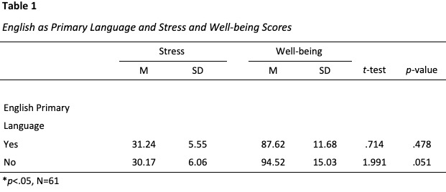
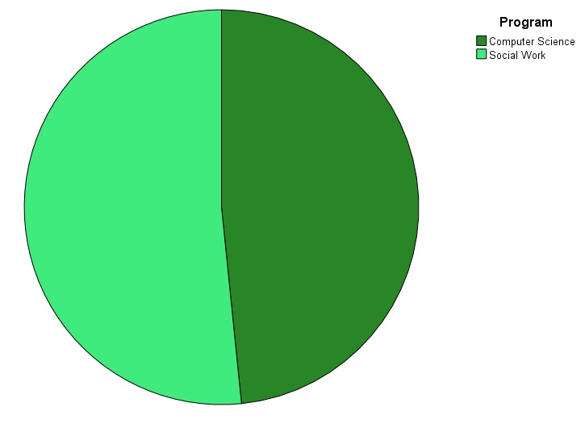
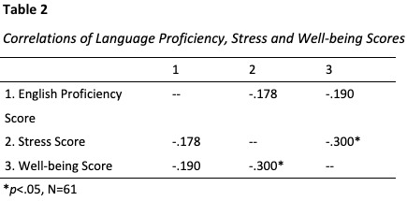
English Language Proficiency: Effects on Stress and Well-Being
Jessica Catterson, Health Science Student
Bronwyn Cross-Denny, Ph.D., LCSW, Faculty Mentor
Background
Results
Moving to a foreign country with or without a support system is hard. It is even harder if there is a language barrier.
International students from culturally and linguistically diverse countries travel to the United States because of the opportunity to study courses in the English language with some coming to America to learn the language itself (Gomes, 2020).
University students face stressors such as course load and extracurriculars. International students also have the stress of speaking in their non-native tongue; for some, English may be their third language.
Study Aims
Table 1 Shows:
Students whose primary language was English reported slightly higher stress score (M=31.24, SD=5.55) than those whose primary language was not English (M=30.17, SD=6.06). However, there was no statistical significance between the means (t=.714, p=.478).
Students whose primary language was English reported lower well-being scores (M=87.62, SD=11.68) while those whose primary language was not English reported higher well-being scores (M=94.52, SD=15.03). There was no statistical significance between the means (t=-1.991, p=.051), but it was close to significant
Limitations
Small sample size
Way language proficiency was measured may not be reliable
The purpose of this study is to determine the correlation between English proficiency and a student’s stress and well-being.
We hypothesize that English language proficiency is related to stress and well-being.
Conclusions
There is no correlation between English language proficiency and stress and well-being
Higher scores of well-being in those who did not have English as their primary language
Further research is needed
Larger sample size may bring different results
Methods
A survey was administered to Graduate students who are in the Computer Science or Social Work program.
The scale used to determine stress level was the Perceived Stress Scale (State of New Hampshire Employee Assistance Program, n.d.).
The scale used for well-being was the Psychological Well-Being Scale (Stanford University, n.d.)
The scale used for English Language Proficiency was the TOEFL Performance Descriptors (Performance Descriptors for the TOEFL IBT Test Level Reading Section Advance, 2021).
References
Gomes, C. (2020). Outside the Classroom. Journal of International Students, 10(4), 934–953. https://doi.org/10.32674/jis.v10i4.1277
Performance Descriptors for the TOEFL iBT ® Test Level Reading Section Advanced.(2021).
https://www.ets.org/pdfs/toefl/toefl-ibt-performance-descriptors.pdf
Stanford University. (n.d.). Psychological Wellbeing Scale | SPARQtools. Sparqtools.org. https://sparqtools.org/mobility-measure/psychological-wellbeing-scale/#18-item-version
State of New Hampshire Employee Assistance Program. (n.d.). Perceived Stress Scale. https://www.das.nh.gov/wellness/Docs%5CPercieved%20Stress%20Scale.pdf
Table 2 Shows:
English proficiency was not correlated to stress (r=-.178, p=.405) or well-being (r=-.190, p=.385).

