Slide 1

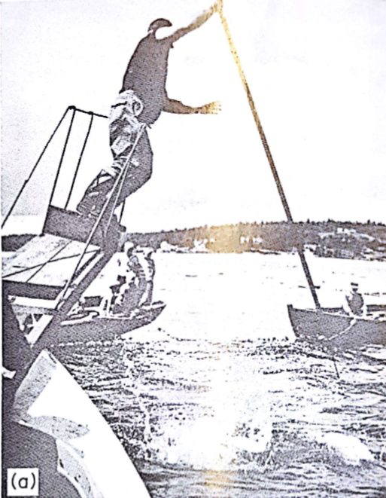
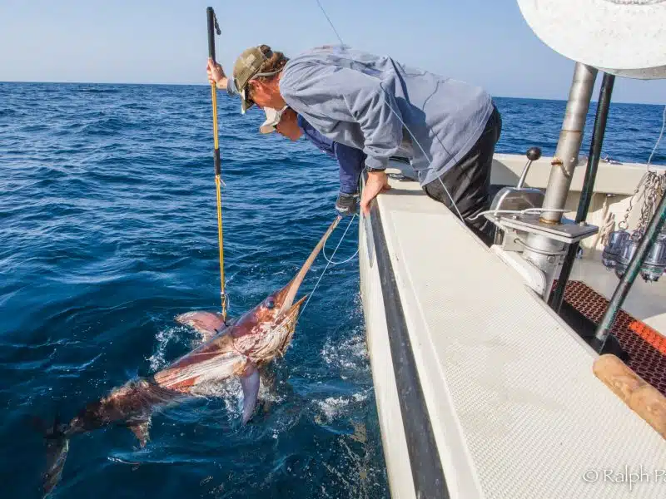
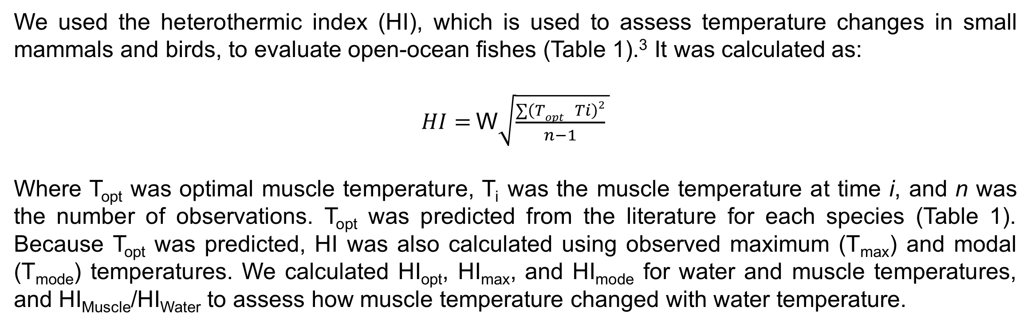
Measuring the Capacity for Endothermy in Open-Ocean Fishes
James Moore and Ashley Stoehr
Sacred Heart University, Fairfield, Connecticut, United States
Introduction
Heterothermic Index
Preliminary Results and Conclusions
Temperature is important to living things because it impacts metabolism - warmer temperatures increase rates of chemical reactions and can increase performance.¹ Most animals are ectothermic, meaning they cannot retain enough metabolic heat to elevate their body temperature above the environment; however, endothermic animals retain metabolic heat, allowing for warmer and more stable body temperatures.^{2,3}
Only ~30 out of 30,000+ species of fishes are able to maintain areas of the body at warmer temperatures.⁴ Most endothermic fishes have counter-current heat exchangers to keep the aerobic sustained swimming muscle warm.¹ Despite this, telemetry studies reveal that muscle temperatures can fluctuate as fishes move through water masses of different temperatures (Figs. 1-2).⁵ This makes these fishes more similar to small, heterothermic animals, which variably regulate or conform different tissues to environmental temperature - rather than larger, endothermic animals with stable body temperatures.³ This, coupled with difficulty in confirming thermistor position in muscle, may be why classifying fishes as either endothermic or ectothermic rarely reveals physiological trends related to the evolution of endothermy (e.g. swimming speed; muscle biochemistry; movement patterns). ^{1,4}
We used the heterothermic index (HI), which is used to assess temperature changes in small mammals and birds, to evaluate open-ocean fishes (Table 1).³ It was calculated as:
$HI=$W$\sqrt{\frac{∑\left(Topt −Ti\right)2}{n−1} }$
Where Topt was optimal muscle temperature, Ti was the muscle temperature at time i, and n was the number of observations. Topt was predicted from the literature for each species (Table 1). Because Topt was predicted, HI was also calculated using observed maximum (Tmax) and modal (Tmode) temperatures. We calculated HIopt, HImax, and HImode for water and muscle temperatures, and HIMuscle/HIWater to assess how muscle temperature changed with water temperature.
Figure 4. (A) HIopt (B) HImax and (C) HImode for water (blue), endothermic muscle (red), deep muscle (purple), and shallow muscle (green) in all fishes. “*” indicates that HIWater was greater than HIMuscle for that calculation and muscle type combination. Numbers are HIMuscle/HIWater and shared superscripts indicate no differences between muscle groups for a specific calculation. Data are mean +/- s.e.m.
*
A
B
C
*
*
*
*
*
Table 1. Optimal temperature of different muscle types and sample sizes for analyzed telemetry data.
0.40 ±
0.07ª
0.82 ± 0.10^{b}
0.07 ± 0.99^{b}
0.50 + 0.16
0.94 +
0.11
0.83 +
0.19
0.41 + 0.09ª
0.73 +
0.07^{b}
0.95 + 0.06^{b}
Scientific Name | Common Name | Muscle Type | T_{opt} | Sample Size | References
Lampris guttatus | Opah | Endothermic Muscle | 20°C | 1 | 6
Thunnus thynnus | Bluefin Tuna | Endothermic Muscle | 24°C | 4 | 5, 7, 8
 |  | Deep Muscle | 24°C | 2
Thunnus obesus | Bigeye Tuna | Endothermic Muscle | 24°C | 1 | 9,10,11
 |  | Deep Muscle | 24°C | 1
Xiphias gladius | Swordfish | Endothermic Muscle | 24°C | 1 | 11-14 Bernal, unpublished data
 |  | Deep Muscle | 24°C | 11
 |  | Shallow Muscle | 24°C | 2
Makaira nigricans | Blue Marlin | Deep Muscle | 24°C | 1 | 15
Figure 5. (A) HIopt (B) HImax and (C) HImode for water (blue), endothermic muscle (red), deep muscle (purple), and shallow muscle (green) in swordfish. “*” indicates that HIWater was greater than HIMuscle for that calculation and muscle type. Numbers are HIMuscle/HIWater and shared superscripts indicate no differences between muscle groups for a specific calculation. Data are mean +/- s.e.m.
C
A
B
C
A
B
*
*
*
*
*
*
Temperature (∘C)
0.65
0.89 +
0.12
0.99 +
0.02
0.55
0.77 +
0.06
0.83 +
0.19
0.21ª
0.64 + 0.02^{b}
0.95 + 0.06^{c}
Figure 1. Telemetry data from free-swimming bluefin tunas (A) tagged with a harpoon. (B) Data shows water (blue) and endothermic muscle (red) temperatures through time from a 272.155 kg fish and (C) % observation of temperatures in track. (D) Water (blue) and presumed deep muscle (purple) temperatures are also shown for a 226.796 kg fish and (E) % observation of temperatures in track. (Carey and Lawson 1972).
Time (hours)
E
Between muscle groups, the HImax ratios were similar when all fishes or only swordfish were considered (Figs 4-5). HIopt and HImode ratios for endothermic muscle were less than deep or shallow muscles when all fishes were considered (p values < 0.003); but in swordfish the HIopt ratios were all similar, while the the HImode ratios were lowest in endothermic muscle and greatest in shallow muscle (Fig. 5; p < 0.001). There were no differences when only tunas were considered (Fig. 6). Taken together, these results could mean that Topt or Tmode are more informative than Tmax to assess the capacity for endothermy between muscle groups - and again, that endothermic and shallow muscles may experience water temperature differently. Conversely, deep muscle may be similar to endothermic and shallow muscles even though it lacks heat exchangers and is far from the skin.
D
Data Comparisons and Analysis
Temperature (∘C)
Data were digitized using Webplot Digitizer (apps.automeris.io), and used to calculate the HIopt, HImax, and HImode for both muscle and water temperature, as well as HIMuscle/HIWater. Muscle temperatures were placed into one of three groups: endothermic, deep, or shallow (Table 1; Fig 3). Endothermic muscles were in known endothermic fishes and displayed elevated, stable temperatures, suggesting that thermistors were in the aerobic, sustained swimming muscle. Deep muscles had a somewhat elevated temperature but fluctuated with water temperature. Thermistors were thought to be in the aerobic, sustained swimming muscles, but the exact location was unclear (Fig 1B vs. 1D; Bernal, personal communication). Shallow muscle temperature approximated that water and thermistors were near the skin.
Time (hours)
Figure 6. (A) HIopt (B) HImax and (C) HImode for water (blue), endothermic muscle (red), and deep muscle (purple) in tunas. “*” indicates that HI for water was greater than the HI for muscle for that calculation and muscle type. Numbers are HIMuscle/HIWater with no differences between ratios. Data are mean +/- s.e.m.
Figure 2. Telemetry data from a free-swimming swordfish of unknown size. Unlike other swordfish tagged via harpoon (A), multiple thermistors were inserted into this fish by hand (Bernal, unpublished data). Data is the % occurrence of water (blue) and (B) deep muscle (purple), or (C) shallow muscle (green) temperatures within the track.
*
*
A
B
C
We compared HIopt, HImax, and HImode within telemetry tracks and the associated HIMuscle/HIWater by One-Way Repeated Measure ANOVAs; HIWater and HIMuscle within tracks by paired t-tests; and HIMuscle/HIWater between muscle groups by One-Way ANOVAs or paired t-tests. When necessary, non-parametric tests were used. Results were significant if p<0.05. Lastly, we assessed thermistor position using HI in some swordfish and tunas (Fig. 1D).
*
*
*
*
A
B
C
0.33 + 0.07
0.44 + 0.14
0.57 + 0.21
1.24 + 0.25
0.50 + 0.10
0.74 + 0.07
This information also supports the conclusion that the deep muscle of some swordfish (previously identified as endothermic muscle) was likely to be anaerobic, burst swimming muscle (Bernal, unpublished data).¹¹⁻¹³ Similarly, HI ratios suggests that the deep muscle of some bigeye tunas, also thought to be the endothermic muscle, was anaerobic, burst swimming muscle (Fig. 6).^{8,9} More information is needed to assess bluefin deep muscle.²
Figure 3. Cross-section through a swordfish showing endothermic muscle (red), shallow muscle (green), and deep muscle (purple).
References
Preliminary Results and Conclusions
Future Directions and Acknowledgements
Brill, R. W. (1996). Selective advantages conferred by the high performance physiology of tunas, billfishes, and dolphin fish. Comparative Biochemistry and Physiology Part A: Physiology, 113(1), 3-15
Clarke, A., & Pörtner, H. O. (2010). Temperature, metabolic power and the evolution of endothermy. Biological Reviews, 85(4), 703-727.
Boyles JG, Smit B, McKechnie AE. (2011). A New Comparative Metric for Estimating Heterothermy in Endotherms. Physiological and Biochemical Zoology. 84(1):115–123.
Harding, L., Jackson, A., Barnett, A., Donohue, I., Halsey, L., Huveneers, C., ... & Payne, N. (2021). Endothermy makes fishes faster but does not expand their thermal niche. Functional Ecology, 35(9), 1951-1959.
Carey FG, Lawson KD. (1973). Temperature regulation in free-swimming bluefin tuna. Comparative Biochemistry and Physiology Part A: Physiology. 44(2):375–392.
Wegner, N. C., Snodgrass, O. E., Dewar, H., & Hyde, J. R. (2015). Whole-body endothermy in a mesopelagic fish, the opah, Lampris guttatus. Science, 348(6236), 786-789. Marcinek et al. 2001
Marcinek, D. J., Blackwell, S. B., Dewar, H., Freund, E. V., Farwell, C., Dau, D., ... & Block, B. A. (2001). Depth and muscle temperature of Pacific bluefin tuna examined with acoustic and pop-up satellite archival tags. Marine Biology, 138, 869-885.
Holland, K. N., Brill, R. W., Chang, R. K., Sibert, J. R., & Fournier, D. A. (1992). Physiological and behavioural thermoregulation in bigeye tuna (Thunnus obesus). Nature, 358(6385), 410-412.
Holland, K. N., & Sibert, J. R. (1994). Physiological thermoregulation in bigeye tuna, Thunnus obesus. Environmental Biology of Fishes, 40, 319-327.
Altringham, J. D., & Block, B. A. (1997). Why do tuna maintain elevated slow muscle temperatures? Power output of muscle isolated from endothermic and ectothermic fish. The Journal of experimental biology, 200(20), 2617-2627.
Carey, F. G., & Gibson, Q. H. (1987). Blood flow in the muscle of free-swimming fish. Physiological zoology, 60(1), 138-148.
Carey, F. G. (1990). Further acoustic telemetry observations of swordfish. Planning the Future of Billfishes, Research and Management in the 90s and Beyond.
Stoehr A, St. Martin J, Aalbers S, Sepulveda C, Bernal D. (2018). Free-swimming swordfish, Xiphias gladius, alter the rate of whole body heat transfer: morphological and physiological specializations for thermoregulation. Eliason EJ, editor. ICES Journal of Marine Science. 75(2):858–870.
Stoehr AA, Donley JM, Aalbers SA, Syme DA, Sepulveda C, Bernal D. 2020. Thermal effects on red muscle contractile performance in deep-diving, large-bodied fishes. Fish Physiology and Biochemistry. 46(5):1833–1845.
Block BA, Booth DT, Carey FG. 1992. Depth and temperature of the blue marlin, Makaira nigricans, observed by acoustic telemetry. Marine Biology. 114(2):175–183.
Within each fish, HIopt was typically greater than HImax or HImode for water or muscle temperature (p values < 0.05). This may be because predicted Topt was usually higher than recorded temperatures (Table 1; Figs 1-2). HIMuscle/HIWater were similar regardless of HI calculation.
Between muscles and water, all HI values for endothermic and deep muscles were less than water (p values < 0.04), but the HI values for shallow muscle were similar to the water values (Figs. 4-6). Endothermic and deep muscles may have lower HI values because endothermic muscle has heat exchangers to reduce convective heat loss, and the position of deep muscle reduces conductive heat loss (Fig. 4). Whereas the shallow muscle’s position leads to more conductive heat loss.
In the future, we aim to digitize more data from endothermic and ectothermic fishes (including sharks) to better predict optimum temperatures for locomotion and other physiological processes. We can use the heterothermic index as a continuous metric when analyzing the relationships between the capacity for endothermy and enzyme capacity, swimming speed, or thermal niche. Our work could help researchers better understand the reasons for the evolution of endothermy when applied to physiological or behavioral patterns.
We would like to thank Diego Bernal, Chugey Sepulveda, and Scott Aalbers for swordfish data. We would like to thank Paul Jacobson for help digitizing data.

