Slide 1

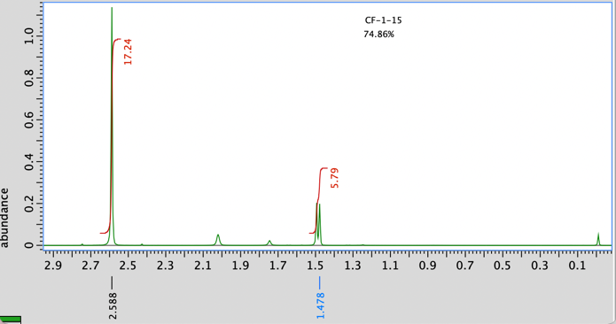
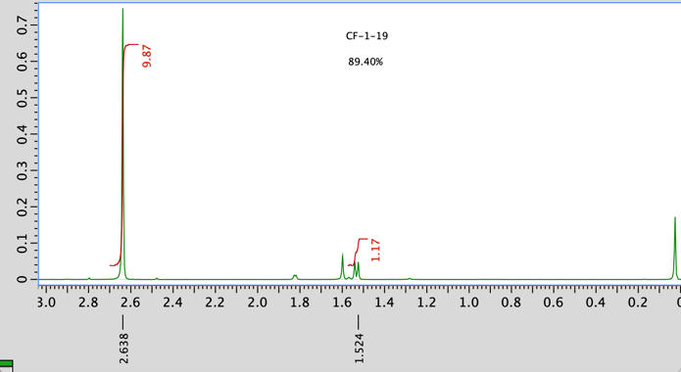
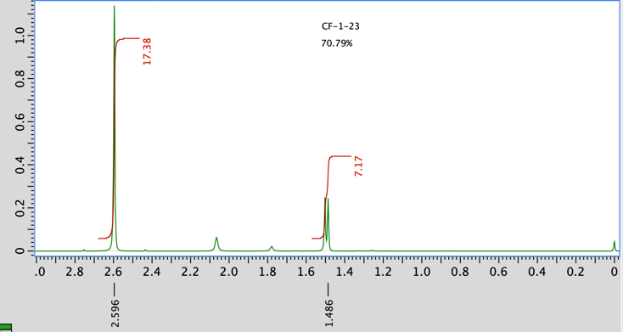
Optimization of the Oxidation of 1- Phenylethanol
Caroline Faraday and Linda Farber, PhD
Chemistry Department, Sacred Heart University, Fairfield, CT
+
ABSTRACT
RESULTS
DISCUSSION
Microwave Assisted Organic Synthesis (MAOS) decreases reaction time, potentially increases yield and is a more efficient, greener approach to organic synthesis. This research focuses on optimizing the MAOS reaction conditions for the oxidation of 1-Phenylethanol to Acetophenone using chromium trioxide resin as the oxidizing agent and dichloromethane as the solvent. Factorial Design methodology is used to design the experiments and statistical analysis will be used to determine which factor, time, temperature, or wattage has the greatest effect on yield.
Table 1. Percent Conversion as it relates to Time at 1200 Watts and 120°C.
Optimized reaction condition, yield and purity:
  1200 W, 120 °C, 7 minutes
    Trial I % Conversion = 74.86%
    Trial II % Conversion = 89.40%
    Trial III % Conversion = 70.79%
    Average % Conversion = 78.35%
Wattage | Time (min) | Temperature (°C) | % Conversion Trial I | % Conversion Trial II | % Conversion Trial III | Average % Conversion
1200 | 3 | 120 | 66.46 | 51.87 | 61.22 | 59.85
1200 | 5 | 120 | 57.38 | 61.18 | 52.99 | 57.18
1200 | 7 | 120 | 74.86 | 89.40 | 70.79 | 78.35
1200 | 10 | 120 | 41.70 | 68.76 | 62.41 | 57.62
INTRODUCTION/BACKGROUND
MICROWAVE ASSISTED ORGANIC SYNTHESIS
Theory
  In microwave assisted synthesis, the dipoles of the materials align in an external field and the material is carried out with a known synthesis strategy¹.
  The alignment of the molecules by the electrical field results in the creation of internal heat that is responsible for reducing time and energy that is needed for the reaction due to the microwaves¹.
Advantages
  Microwave assisted organic synthesis allow for uniform heating of the solvent, whereas conventional heating creates a temperature difference in the solvent⁴
  Deecrease in reaction time and an increase in yield
FACTORIAL DESIGN
  Factorial design is a form of an experiment where more than one factor is varied
  It provides researchers with the opportunity to examine the effects of two or more independent variables simultaneously
  Factorial design also allows researchers to observe the interactions among variables, which is only done when the variables are examined in combination⁵
RESEARCH GOALS
  This research is focused on optimizing the reaction conditions of the oxidation of 1-Phenylethanol (1) to Acetophenone (2) with chromium trioxide resin as the oxidizing agent and dichloromethane as the solvent
  Importance of Acetophenone:
    flavoring agent, solvent, polymerization catalyst², and historically used as an anesthetic agent³
  Factorial Design is used to design the experiments and statistical analysis will determine whether time, temperature, or wattage will have the greatest effect on yield (percent conversion)
(1) (2)
CONCLUSION & FUTURE WORK
    Statistical analysis will be conducted to determine whether time, temperature, or wattage is most important to percent yield
    Optimizing reaction conditions to run multiple reactions at once will also be key in improving efficiency of the oxidation reaction
EXPERIMENTAL SECTION
  EXPERIMENTAL
    All microwave reactions were carried out in a multimode Milestone StartSYNTH microwave oven in a multimode microwave cavity [37 x 34.5 x 33.5 (h) cm] with a rotation system
    The StartSYNTH terminal controller controlled and monitored the reaction parameters (temperature, power, reaction time, stirring speed, and pressure).
    An internal ATC-FO sensor inside the reaction vessel and an external IRTC sensor in the microwave cavity were used to monitor and control the internal and external temperatures
    1-Phenylethanol (99%), polymer- supported chromic acid resin on Amberlyst® A-26 (macroporous, 20-50 mesh, extent of labeling: ~2.5 mmol/g loading), and chloroform-d [99.8 atom% D, containing 0.1% (v/v) TMS] were purchased from Sigma-Aldrich Company
    Dichloromethane (submicron filtered) was purchased from Fisher Scientific Company
  PROCEDURE
    All reactions were run in a 25 mL quartz closed-pressurized reaction vessel with Weflon™ bar and stir bar
    1-Phenylethanol (1), (0.067 g, 5.48 x 10⁻⁴ moles) was dissolved in dichloromethane (5 mL), followed by the addition of polymer-supported chromic acid (1.2 g, 0.013 moles)
    The reaction vessel was then placed in the StartSYNTH laboratory microwave oven and irradiated for various amounts of time, wattage, and temperatures
    The reaction mixture was filtered to remove the resin
    The resin was washed two times with dichloromethane
    All dichloromethane washes were combined with the reaction mixture and the dichloromethane was stripped using a rotary evaporator
    The remaining reaction mixture was analyzed by ¹ H NMR, run in deuterated chloroform
  ¹H NMR Spectral Characterization:
    Synthesis of Acetophenone (2): 7 minutes, 120°C, 1200 Watts
      Trial I: The general procedure was followed. The resulting oil was analyzed by ¹H NMR (400 MHz, CDCl₃). 1-Phyenlethanol (1): δ1.478 (CH₃, d, 3H). Acetophenone (2): δ2.588 (CH₃, s, 3H). Integral height (1): 5.79, Integral height (2): 17.24; 74.86% conversion.
      Trial II: The general procedure was followed. The resulting oil was analyzed by ¹H NMR (400 MHz, CDCl₃). 1-Phyenlethanol (1): δ1.524 (CH₃, d, 3H). Acetophenone (2): δ2.638 (CH₃, s, 3H). Integral height (1): 1.17, Integral height (2): 9.87; 89.40% conversion.
      Trial II: The general procedure was followed. The resulting oil was analyzed by ¹H NMR (400 MHz, CDCl₃, ppm). 1-Phyenlethanol (1): δ1.486 (CH₃, d, 3H). Acetophenone (2): δ2.596 (CH₃, s, 3H). Integral height(1):7.17, Integral height (2): 17.38; 70.79% conversion.
Figure 1. Percent Conversion of the Oxidation of 1-Phenylethanol to Acetophenone with 1200 W at 120 C for 7 minutes Trial I
Figure 2. Percent Conversion of the Oxidation of 1-Phenylethanol to Acetophenone with 1200 W at 120 C for 7 minutes Trial II
REFERENCES
[1] Dahiya, Manjeet S, and S Duhan. “Microwave Assisted Synthesis.” Microwave Assisted Synthesis - an Overview | ScienceDirect Topics, 2018, https://www.sciencedirect.com/topics/chemistry/microwave-assisted- synthesis#:~:text=Microwave%2Dassisted%20synthesis%20works%20on,with%20a%20known%20synthesis% 20strategy.
[2] National Center for Biotechnology Information. "PubChem Compound Summary for CID7410, Acetophenone" PubChem, https://pubchem.ncbi.nlm.nih.gov/compound/ Acetophenone. Accessed 8 May, 2022.
[3] “Acetophenone.” Acetophenone - an Overview | ScienceDirect Topics, 2014, https://www.sciencedirect.com/topics/medicine-and- dentistry/acetophenone#:~:text=Historically%2C%20acetophenone%20was%20used%20as,as%20a%20therap y%20for%20insomnia.
[4] Sumitra Nain, Ruchi Singh, Subramanian Ravichandran*, Importance of Microwave Heating in Organic Synthesis, Adv. J. Chem. A, 2019, 2(2), 94-104.
[5] Lavrakas, Paul J. Encyclopedia of Survey Research Methods. 0 vols. Thousand Oaks, CA: Sage Publications, Inc., 2008. SAGE Research Methods. Web. 7 May. 2022, doi:10.4135/9781412963947.
Scheme 1. Synthesis of Acetophenone.
Figure 3. Percent Conversion of the Oxidation of 1-Phenylethanol to Acetophenone with 1200 W at 120 C for 7 minutes Trial III

