Slide 1
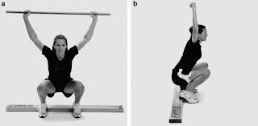
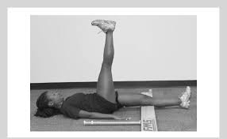
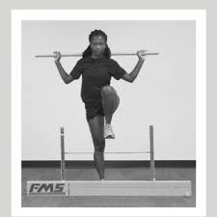
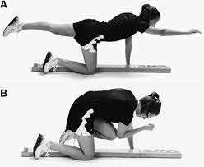
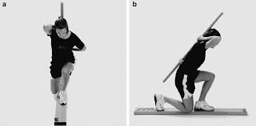
Individualized Exercise Programming
Mia Izzi, Giseberte Jeudi, Patrick O'Neil, Olivia Vadas [Mentor: Jonathan Hudak]
College of Health Professions
Department of Physical Therapy and Human Movement Science
HEALTH HISTORY
45-year-old female
On medication for high blood pressure (Lisinopril)
Two knee surgeries for ACL and meniscus (affects ROM on right knee)
Diagnosed with Polycystic Ovary Syndrome (causes weight gain)¹
Exercises as much as possible around her children's schedule
ASSESSMENT PROTOCOL
PROGRAM SUMMARY
Resistance training 3 times per week, 1 day of upper body targeted exercises, 1 day of lower body targeted exercises and 1 day of full body exercises.
Repetitions and intensity vary between weeks to increase the difficulty of the workout to match strength progressions.
Beginning intensity is based on RPE values from initial fitness assessment.
Mobility focused movements are included in the warm-up each day.
Flexibility focused time is included in the cool-down each day.
Cardiorespiratory fitness training recommended 1-2 times per week and can include her existing preferred method of exercise: Jiu-Jitsu and other fitness classes.
ASSESSMENT CATEGORY | ASSESSMENT | QUALITIES TESTED
Anthropometric | Height and Weight | BMI
 | BodPod | Body composition
Kinesiological | FMS Overhead Deep Squat | Mobility, dynamic stability
 | Inline Lunge | Functional mobility, dynamic and static balance
 | Back Scratch Test | Upper body mobility, Shoulder ROM
Physiological | Ebbeling Single Stage Treadmill | Cardiorespiratory Fitness
Performance | Incline Pushup | Muscle Endurance
 | Goblet Squat | Muscle Endurance
INTERVIEW TOPICS
Current Activities
Brazilian Jiu Jitsu, HIIT and Zumba classes comprised of cardio and resistance training
Activity History
Collegiate Field Hockey
Injury History
ACL Tear
Pain with activity
No, but usage of the elliptical induces knee clicking
Desired outcome of program
Increase mobility, flexibility, and weight loss to keep up with children
ASSESSMENT RESULTS
HIGHLIGHT RELEVANT ASSESSMENT DATA/RESULTS HERE
ASSESSMENT CATEGORY | ASSESSMENT | RELEVANT RESULTS
Anthropometric | Height and Weight | 158.75 cm and 93.24 kg
 | BodPod | 36.5% fat mass and 63.5% lean mass
Kinesiological | FMS Overhead Deep Squat | Foot ext. rotation, inability to reach parallel, dowel fell forward. Score: 2/3
 | Inline Lunge | Unable to contact board. Score 1/3
 | Back Scratch Test | Right Arm: 11.5 cm, Left Arm: 14.5 cm Score: 25% higher than other women²
Physiological | Ebbeling Single Stage Treadmill | MET Capacity: 34ml/kg/min. Score: Fair³
Performance | Incline Pushup | Proper push up mechanics
 | Goblet Squat | Proper squat mechanics
EXPECTATIONS
Client will implement recommended exercise prescription in supplement to current activities.
Client's mobility and flexibility will experience gradual improvements over the course of program implementation.
Client will reach goals of mobility improvement, weight loss, and increased capability to keep up with her children.
NEEDS ANALYSIS
Would benefit from increased mobility and flexibility
Would benefit from weight loss
Prior ACL and Meniscus tear cause slight discomfort at end of ROM
Comfortable with basic common movement patterns for exercise
No obvious limitations
REFERENCES
Chitme HR, Al Azawi EAK, Al Abri AM, et al. Anthropometric and body composition analysis of infertile women with polycystic ovary syndrome. J Taibah Univ Med Sci. 2017;12(2):139-145. doi:10.1016/j.jtumed.2016.11.005
2. Back Scratch Flexibility Test. Accessed April 6, 2023. https://www.topendsports.com/testing/tests/back-scratch.htm
3. ACSM Book Updates. ACSM_CMS. Accessed April 6, 2023. https://www.acsm.org/education-resources/books/acsm-book-updates
4. ACSM | The American College of Sports Medicine. Accessed April 13, 2023 https://www.acsm.org/docs/default-source/regional-chapter-individual-folders/northland/nacsm--wes-e--fms9a9b0c1f5032400f990d8b57689b0158.pdf?sfvrsn=3668bbe0_0.
4
This work was presented at the 2023 Sacred Heart University Academic Festival

