Slide 1
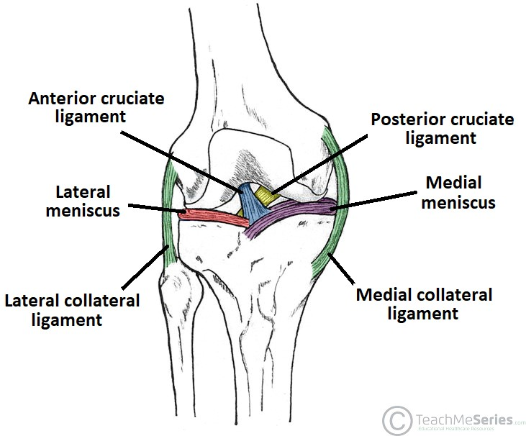
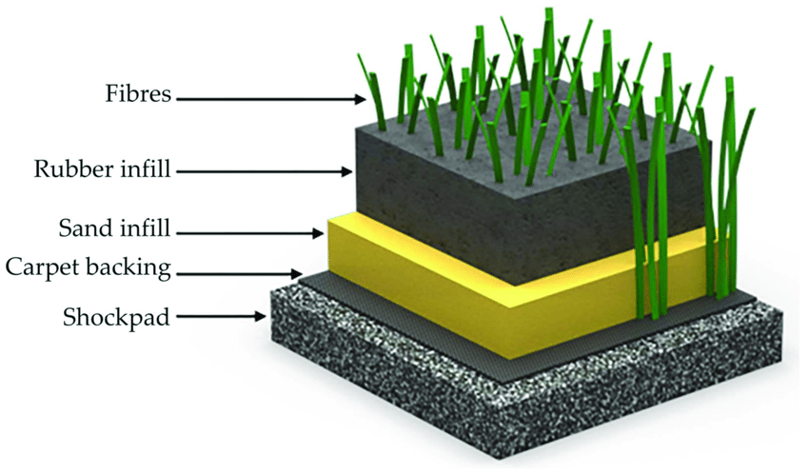
Influence of Artificial Turf on Knee Joint Injuries
Lily Farrell, Exercise Science Major
Introduction
Injury Rate on Artificial Turf
Why it is Important
Artificial turf increases knee joint injuries in sport at a greater rate than natural grass. Important to consider as artificial turf becomes more popular in sporting facilities due to the reduced cost and maintenance compared to grass. Increase in injury rate is due to surface stiffness and increased shoe-surface traction. Sport injuries affect athletes physical and mental with the financial burden and impacts their perceived quality of life.
16% increase in lower extremity injury per play
Risk factor for lower extremity injury increased by a factor of 3.34 compared to grass
Division II and II athletes experience ACL tear at 1.63 x and PCL tears at 3.13x the rate on grass
Division I athletes experience PCL tears at 2.99x the rate on grass
Overall ACL injury was 1.63x higher than grass
$17.7 billion national expenditure annually on ACL reconstructions
Approximately 250,000 ACL reconstructions annually in the U.S.
Approximately 60,000-200,000 ACL injuries annually
36% have medial meniscus tears and 44% have lateral meniscus tears in addition to the ACL tear
20.6% increase in overall coast of treatment for patients from 2013-2017
Knee Joint
Shoe-surface traction & surface stiffness
Knee kept stable through ligaments and musculature.
Commonly injured in sport due to anatomical make-up during running, sudden deceleration, and plant-and-cut movement.
Cleats increase shoe-surface traction
Experience force-limiting factors on natural grass, but not on turf
Increased shoe-surface traction increases resultant loads at joint
Athletes experience peak contact forces over 200N during sport – need shock pad to absorb excess force
Impact’s athletes’ mental health and their perceived quality of life
Sports become a part of athlete’s identity
Turf Engineering
Layers: blades, infill, shock pad
Infill types: sand, rubber, combination
Types: monofilament, slit film, dual fiber
Injury Risk on Natural Grass
References
Cleats are associated with a 2.4-fold increased risk in injury
Portable grass squares – can be laid down rapid which can lead to an uneven surface
Sports on grass are associate with a 2.8-fold increased risk for lower extremity injuries
May be due to lack of maintenance which leads to divots and uneven surfaces
Different types and generations of turf differ in the shoe-surface traction, surface stiffness and level of shock absorbency by shock pad

