Slide 1
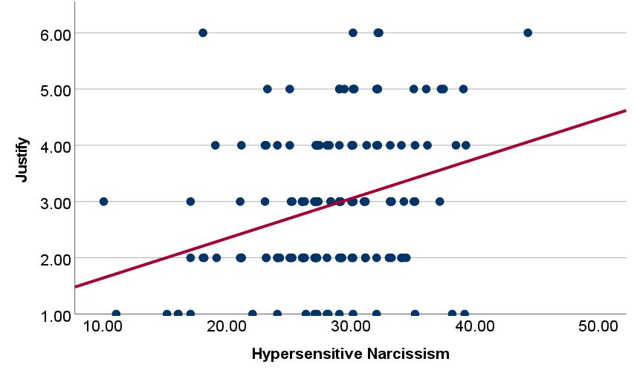
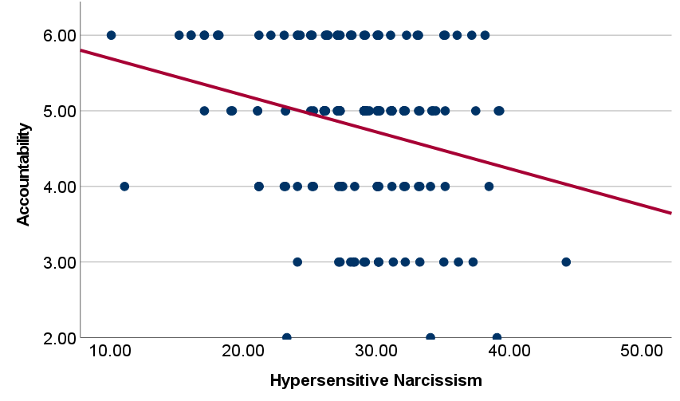
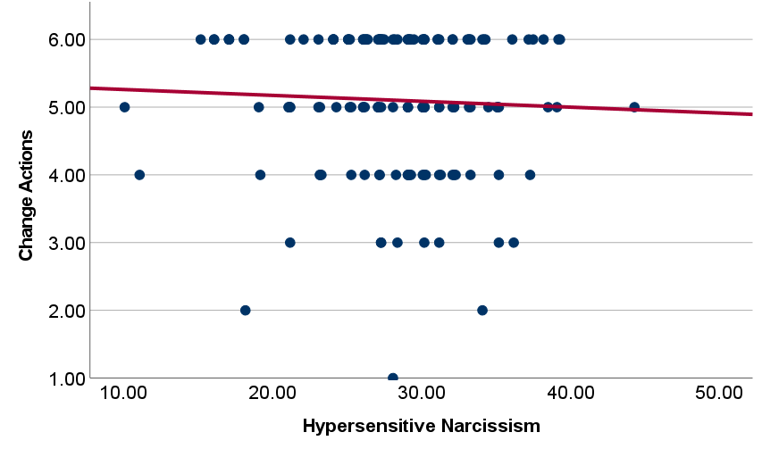
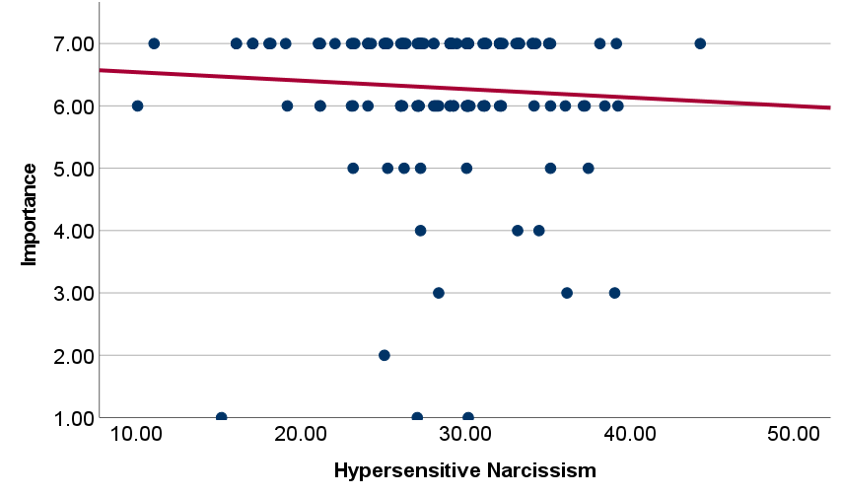
Hypersensitive Narcissism’s Relationship to Defensiveness
Sandra Lezcano, Rosalyn Gutierrez, & Adrienne L. Crowell, PhD
Sacred Heart University
Contact: crowella2@sacredheart.edu
Introduction
Figure 2: Relationship between HN and Justify
Figure 3: Relationship between HN and Accountability
The current study was designed to pilot test five hypothetical scenarios that we designed to induce defensiveness. We created five high threat and five low threat scenarios within these domains: academic, health, romantic, alcohol use, and friendship.
•Self-protection (i.e., defending oneself against negative self-views) occurs when an important self-domain is threatened and is one of the ways we maintain a sense of global self-integrity (Alicke & Sedikides, 2009)
•Dissonance reduction techniques (e.g., changing, rationalizing, and taking responsibility for behavior, trivializing the importance) are types of self-protection.
•Hypersensitive narcissism (HN) increases negative affect to threat (Besser & Priel, 2010)
•Purpose: Investigate the role personality traits, such as hypersensitive narcissism, may play in defensive responses to our hypothetical scenarios.
r(144) = .312, p < .001
r(144) = -.261, p < .001
Method
Figure 4: Relationship between HN and Change
Figure 5: Relationship between HN and Importance
Participants
Undergraduate students (N = 374) participated. Of these, 49 were excluded (31 quit before scenarios, 19 took longer than 1 hour), resulting in a final sample of N = 324 (86% women; 80% White; M_{age} = 18.45, SD_{age} = 0.98).
Questionnaires
Participants first completed questionnaires. This poster focuses on Hypersensitive Narcissism Scale (HN; Hendin & Cheek, 1997). An example item is “I often interpret the remarks of others in a personal way.”
Hypothetical Scenarios
Participants were randomly assigned to one of five hypothetical high threat scenarios and one of five low threat scenarios. Scenario order was counterbalanced. Participants were told to imagine events in five domains: academic, relationship, health, alcohol, friendship. See Figure 1 (low threat are italicized).
This poster focuses on the participants who received the high threat scenario first (N = 150).
Post-Scenario Questions
After each scenario, participants answered the following questions on a scale of 1 (not at all) to 7 (extremely):
How likely would you be to change your behavior?
How likely would you be to justify your actions?
How likely would you be to take accountability for your actions?
How important is [domain] to you?
r(144) = .048, p = .567
r(144) = -.064, p = .440
Figure 1. Hypothetical Threat Scenarios
Discussion
Academic: “Imagine that you just found out that you failed a really important test in your favorite class because you decided to go out the night before instead of studying. You did not prepare for the test at all and are disappointed that you did not do better. The professor calls you into her office to discuss your performance and says that they are very disappointed in you and that you will need to retake the course.”
Relationship: “Imagine that your partner has told you that they need some space because they feel like you are too clingy. They say you text too often and don’t let them hang out with their friends alone. Your partner tells you that if you don’t change your behavior, then the two of you will need to break up.”
Health: “Imagine that you have been an excessive vaper for a few years. Recently you’ve noticed that you are out of breath while walking across campus and are having difficulty working out. You go to the doctor and they tell you to quit vaping now or you could have permanent heart and lung damage.”
Alcohol: “Imagine you and your roommates go out to bars and parties just about every weekend. You get pretty intoxicated every time you go out and you assume that your friends do as well. Last night, you got extremely intoxicated and had to be taken back to your apartment early by one of your friends. This morning, you woke up hungover and came out of your room to all of your roommates sitting in the living room looking a mixture of concerned and annoyed. Your best friend starts off by saying that your drinking is becoming “too much” for everyone and that they no longer want to go out with you.”
Friend: “Imagine it’s your friend’s birthday and you are planning to go to a special dinner for her. The day of her birthday dinner your crush invites you to a big party and you tell your friend that you will just meet up with her at the party after dinner. The next day she calls you out for choosing a person you're interested in over her, when you have been best friends your whole life.”
Hypersensitive narcissism was related to more defensive responding (i.e., more justification and less accountability
Limitations: correlational design and hypothetical
Future research should manipulate narcissism to see if it causes more defensiveness.
Future research should investigate real threats.
Future analyses will investigate HN’s role in responses to specific domains.
HN is a subtype of narcissism. Future research should include other subtypes (e.g., grandiose narcissism).

