Slide 1
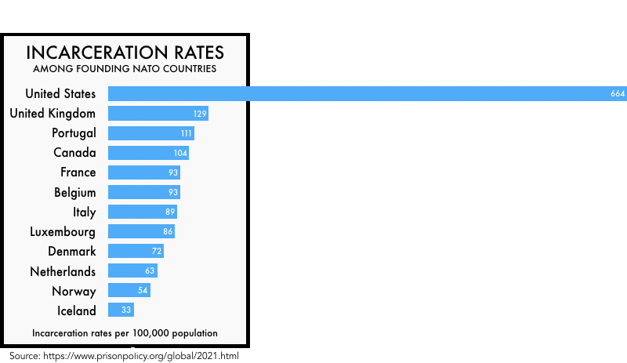
REPLACE THIS BOX WITH OUR ORGANIZATION’S
HIGH REOLUTION LOGO
Jail Reform: An Examination of the United States Justice System
Dominick Scardigno
RESEARCH QUESTION/ THESIS
A Better Model
CONCLUSIONS
ABSTRACT
1 in 100. Those are the approximate odds of a U.S. citizen being incarcerated during their lifetime. This statistic alone is enough to prompt discussion regarding the efficiency of the United States criminal justice System. According to the National Institute of justice, an estimated 44% people that have been arrested in the United States are arrested again within the span of a single year and 77% are arrested again within 5 years. These statistics provoke conversations on a global level as to what the actual goals of a criminal justice system should be. It seems nearly impossible to declare an institution with a 77% failure rate to be functional. Scandinavian countries, for example, incarcerate 33% less individuals on average than the United States. Given this data, investigations of criminal justice systems and the intricacies surrounding prison life itself are necessary to determine the factors inducing the gaping disparities in post-prison outcomes. The U.S. criminal justice system must be reformed to reduce the incarceration rate, provide alternatives to prison, and offer effective reintegration into society. A nation that claims to be “for the people” cannot abandon portions of the population.
My research question: What are the causes of the disproportionately high incarceration and recidivism rates in the United States?
Why it matters: The United States has a 77% 5-year recidivism rate and has the most incarcerated individuals across the globe.
My thesis: The United States criminal justice system must be reformed to reduce the incarceration rate, provide alternatives to prison, and offer effective reintegration into society.
Establishing the role of juror as a full-time job
International ideas from Norwegian criminal justice system:
Correctional facilities that hold 100 people
Multi-year training for corrections officers
Improvements to living spaces
Job training at facilities
Supporting data from Norway:
20% two-year recidivism rate
40% increase in employment rates post-incarceration
The United States Criminal Justice System currently has detrimental outcomes
Human beings are not treated as such
“It is recognized that going to prison is itself the punishment for crime; prison conditions [should] then approximate to life outside as far as possible, rather than being allowed to degrade and debase all within” (Hyatt et al., 2021).
Statistical failures warrant examinations of more successful countries
Budget issues are not an excuse for lack of humanity
A nation that is “of the people, by the people, and for the people” must hold themselves accountable
THE PROBLEM AND MY FINDINGS
The problem:
1. Erroneous Judgement and Changes in Legislation
- 78% of retrials examined result in a conviction of lesser offense
- Laws are constantly changing yet do not adequately aid those affected (i.e., marijuana)
2. The Jury System
- No knowledge of law required
- Personality conflicts (dominant/submissive roles)
- Lack of motivation/compensation
3. Foundational and Structural Issues
- Punitive system that does not promote change
- Correctional officer only requires 12 weeks training
- Oversized, understaffed, bleak, animalistic
- Lack of resources available post-incarceration
My findings:
Facilities are far to small and underfunded relative to their levels of occupancy (i.e., 6,000 people)
Little to no support is offered to reinstate incarcerated citizens back into society
Government labels ex-convicts as “risky workers”
65% of employers are not willing to hire this population
Scandinavian countries have demonstrated large success in a reform-focused environment
The largest barrier to a systemic change is cost
REFERENCES
Statistical Failure
Bhuller, M., & Dahl, G. B. (n.d.). Policies to Reintegrate Former Inmates Into the Labor Force. 15.
How Norway turns criminals into good neighbours. (2019, July 6). BBC News. https://www.bbc.com/news/stories-48885846
Hyatt, J. M., Andersen, S. N., Chanenson, S. L., Horowitz, V., & Uggen, C. (2021). "we can actually do this": adapting scandinavian correctional culture in pennsylvania. American Criminal Law Review, 58(4), 1715-1746.
Katsiyannis, A., Whitford, D. K., Zhang, D., & Gage, N. A. (2018). Adult Recidivism in United States: A Meta-Analysis 1994–2015. Journal of Child & Family Studies, 27(3), 686–696. https://doi-org.sacredheart.idm.oclc.org/10.1007/s10826-017-0945-8
Keene, D. E., Murillo, S., Benfer, E. A., Rosenthal, A., & Fenick, A. M. (2020). Reducing the Justice Gap and Improving Health through Medical–Legal Partnerships. Journal of Legal Medicine, 40(2), 229–245. https://doi.org/10.1080/01947648.2020.1816233
Kethineni, S., & Falcone,, D. N. (2007). Employment and ex-offenders in the United States: Effects of legal and extra legal factors. Probation Journal, 54(1), 36–51. https://doi.org/10.1177/0264550507073325
Lartey, J. (2022, October 15). Don't expect mass prison releases from Biden's marijuana clemency. The Marshall Project. Retrieved October 16, 2022, from https://www.themarshallproject.org/2022/10/15/don-t-expect-mass-prison-releases-from-biden-s-marijuana-clemency#:~:text=Last%20week%20President%20Joe%20Biden,it%20will%20lead%20to%20none.
NCSC. (2022, May 25). Juror compensation in the United States. https://www.ncsc.org/information-and-resources/trending-topics/trending-topics-landing-pg/juror-compensation-in-the-united-states
Poveda, T. G. (2001). Estimating wrongful convictions. Justice Quarterly, 18(3), 689–708. https://doi.org/10.1080/07418820100095061
U.S. Department of Justice (2022). FY 2022 Budget Request At a Glance. (n.d.). 7.
CONTACT
Figure 1. Incarceration Rates by Country
Dominick Scardigno
Sacred Heart University
Email: scardignodom@gmail.com
Phone: 201-615-0354
“If we treat inmates like animals in prison, then we will release animals onto the street.”
~Ari Hoidal, Norway Prison Governor

