Slide 1
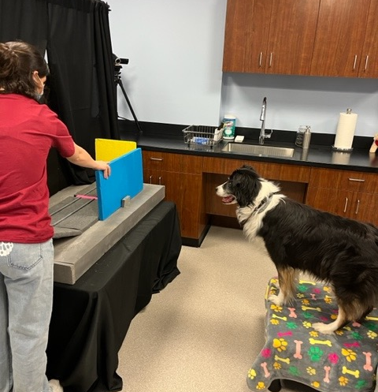
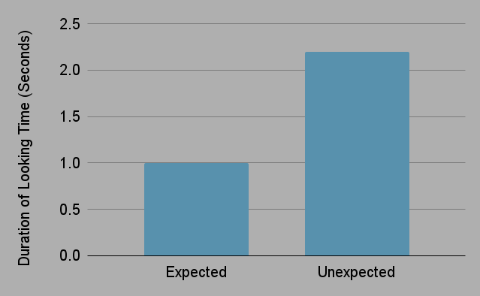
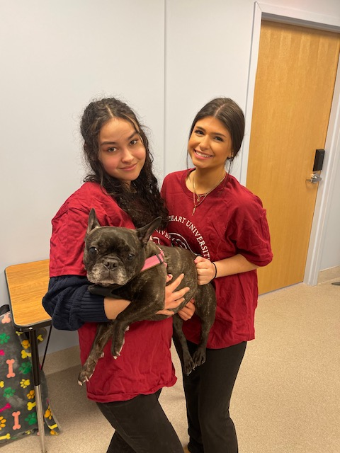
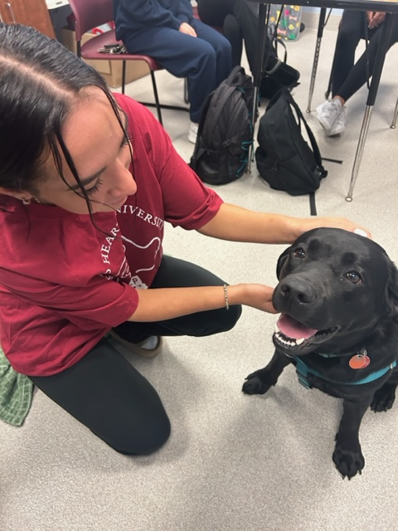
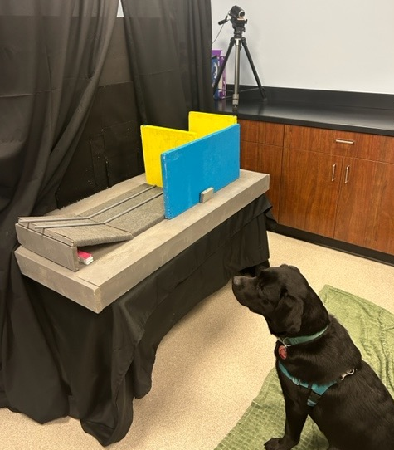
Can Dogs Detect a Surprising Event?
Samantha Faeth, Emma Higley, Nicole Alvira, Kaitlyn Borg, Marissa Colloca & Gabrielle Esposito
Mentors: Drs. Dawn Melzer & Deirdre Yeater, Psychology Department
Introduction: Infants demonstrate object permanence understanding during violation of expectation tasks. These tasks consist of expected (e.g., ball stops at solid wall) and unexpected (e.g., ball rolls through solid wall) events. Infants look longer at the unexpected event as opposed to the expected event (Perez & Feigenson, 2021). Similarly, studies have shown that dogs present increased looking times during unexpected object permanence tasks (Pattison et al., 2010). In the current study, dogs participated in a violation of expectation task which investigated object permanence understanding. It was hypothesized that dogs participating in the experiment would look longer at the unexpected event compared to the expected event.
Results:
Paired t-test results indicate that canine subjects looked longer at the unexpected event versus expected event, t (21) = 2.15, p = .032. See Figure 1.
Figure 1. Canine Mean Expected Look Time Compared to Unexpected Look Time
Method: This study was conducted on 22 different dogs, including a variety of breeds and ages. Each dog was positioned in front of a stage with a concealed opening in the back wall and a ramp. One wall was placed at the end of the ramp, and the other in the middle of the ramp. An occluder was placed in front of the ramp. A tennis ball was rolled down the ramp, behind the occluder. After the occluder was removed, the dog would see either the ball was stopped in front of the solid wall (expected event), or the ball would appear to have rolled through the solid wall (unexpected event). Dogs saw two familiarization trials, followed by two test trials (one expected and one unexpected) which were counterbalanced.
Conclusion: The initial hypothesis was supported: the dogs looked longer at the unexpected event rather than the trials that were expected, displaying that dogs have a knowledge and understanding of object permanence. Additionally, this study demonstrated the validity of using human methods and procedures to evaluate cognition in different animal
Species. In the future, we will look at dog's understanding of cause and effect and object continuity.

