Slide 1
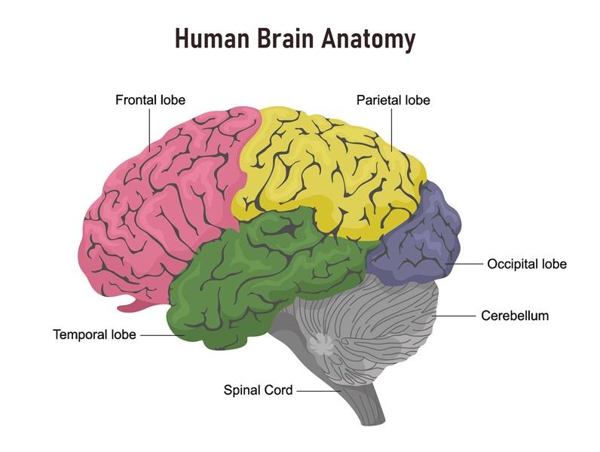
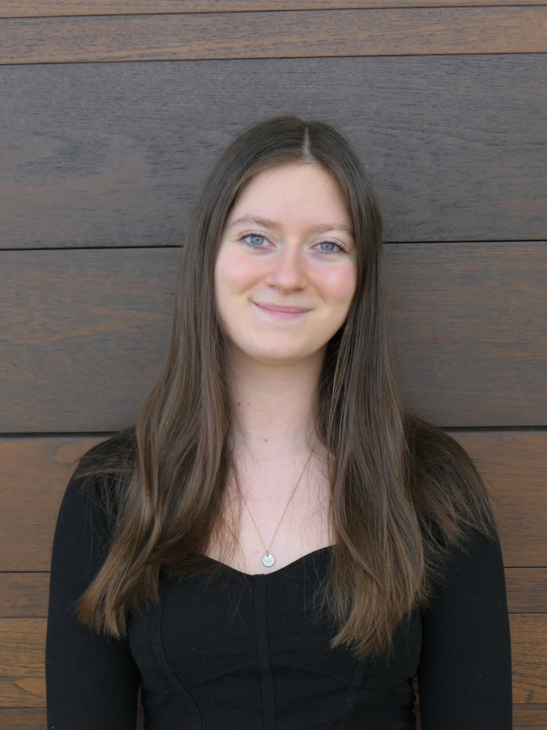
Tick Tock, TikTok, Tic: An Examination of TikTok and its Negative Effects on the Brain
RESEARCH QUESTION/THESIS
BACKGROUND INFORMATION
CONCLUSIONS
My research question: Does TikTok affect the neurological function of those that use it?
- What happens to the brain?
- How is it connected to FND?
- What research has been done?
Why it matters: TikTok has over one billion users. Around 33% of that population are teenagers who are susceptible to developing FND and other neurological disorders.
My thesis: An examination of Tiktok and its effects on the brains of adolescents might help us better understand the cause of functional neurological disorder and how we can treat it.
Our brain holds our short- and long-term memories, personalities, and emotions, and it also controls every involuntary and voluntary action that allows our bodies to function (Johns Hopkins Medicine, 2021)
Functional neurological disorder (FND), “is a loss of or change in body function that cannot be explained by any known medical disorder or pathophysiological mechanism” (pg. 606, Morgan & Townsend, 2021)
TikTok is a social media app that can be used to create or watch 15-second to 3-minute videos. The app uses an algorithm to create a “For You” page geared towards the user’s preferences
The research up until this point has shown that Functional Neurological Disorder does not correlate to TikTok
The long term effects of both FND and TikTok are still unknown
It is crucial that we research these topics in order to make informed decisions to benefit our health
THE PROBLEM AND MY FINDINGS
REFERENCES
Problem: How TikTok is affecting the neurological functioning of the brain and thus leading to increased rates of Functional Neurological Disorder Findings: The brain works like a pathway. It sends and receives signals from the body. With increased blue light and phone usage along with modeling stimuli (videos from TikTok), the pathways no longer work like they once did.
EX: You accidentally touch a hot stove. The nerves in your fingertips send a signal to your brain. In a matter of split seconds the brain processes and relays a response that the surface is hot and causes pain. This is what causes you to remove your hand from the stove. Solutions: As of right now there are no medical solutions because there is no known cause of FND.
(A majority of my research is my hypothesis to what is causing FND and its symptoms and how I believe it connects to TikTok.)
Basics of Functional Neurological Disorder (FND). Massachusetts General Hospital. (2022). Retrieved November 2022, from https://www.massgeneral.org/neurology/treatments-and-services/functional-neurological-disorder-basics
Brain Anatomy and How the Brain Works. Johns Hopkins Medicine. (2021, July 14). Retrieved October 6, 2022, from https://www.hopkinsmedicine.org/health/conditions-and-diseases/anatomy-of-the-brain
Dryfoos, D. (2022, August 23). The real story behind the 'TikTok tics'. Scienceline. Retrieved November 2022, from https://scienceline.org/2022/04/the-real-story-behind-the-tiktok-tics/
D'Souza, D. (2022, October 13). Tiktok: What it is, how it works, and why it's popular. Investopedia. Retrieved October 2022, from https://www.investopedia.com/what-is-tiktok-4588933
Dunckley, V. L. (2014, February 27). Gray Matters: Too Much Screen Time Damages the Brain. Psychology Today. Retrieved October 2022, from httpss://www.psychologytoday.com/us/blog/mental-wealth/201401/gray-matters-too-much-screen-time-damages-the-brain
Espay, A. J., Aybek, S., Carson, A., Edwards, M. J., Goldstein, L. H., Hallett, M., LaFaver, K., LaFrance, W. C., Lang, A. E., Nicholson, T., Nielsen, G., Reuber, M., Voon, V., Stone, J., & Morgante, F. (2018, September 1). Current concepts in diagnosis and treatment of functional neurological disorders. JAMA neurology. Retrieved November 2022, from https://www.ncbi.nlm.nih.gov/pmc/articles/PMC7293766/
Functional Neurological Disorder. NORD (National Organization for Rare Disorders). (2018, April 23). Retrieved October 5, 2022, from https://rarediseases.org/rare-diseases/fnd/
Guy-Evans, O. (2021, Oct 11). Grey matter in the brain. Simply Psychology. Retrieved November 2022, from www.simplypsychology.org/what-is-grey-matter-in-the-brain.html
Hull, M., & Parnes, M. (2021, June 17). Tics and TikTok: Functional tics spread through social media. Tics and TikTok: Functional Tics Spread Through Social Media. Retrieved November 2022, from https://movementdisorders.onlinelibrary.wiley.com/doi/10.1002/mdc3.13267
Khedaroo, J. (2022, January 3). Rising incidence of functional tic-like behaviors. Tourette Association of America. Retrieved October 6, 2022, from https://tourette.org/rising-incidence-of-functional-tic-like-behaviors/
Mateos-Aparicio P and Rodríguez-Moreno A (2019) The Impact of Studying Brain Plasticity. Front. Cell. Neurosci. 13:66. doi: 10.3389/fncel.2019.00066
Mercadante AA, Tadi P. (2022, July 25). Neuroanatomy, Gray Matter. StatPearls. Retrieved November 2022, from: https://www.ncbi.nlm.nih.gov/books/NBK553239/
Morgan, K., & Townsend, M. (2021). Psychiatric Mental Health Nursing. (10th ed.). F.A. Davis 8 Company.
Petrillo, S. (2021, December 13). What makes TikTok so addictive?: An analysis of the mechanisms underlying the world's latest social media craze. Brown Undergraduate Journal of Public Health. Retrieved October 6, 2022, from https://sites.brown.edu/publichealthjournal/2021/12/13/tiktok/
Stone, J. (n.d.). Functional neurological disorder (FND) – a patient's guide to FND. Functional Neurological Disorder FND. Retrieved November 2022, from https://www.neurosymptoms.org/en/
U.S. Department of Health and Human Services. (2021, August 2). Functional neurologic disorder2. National Institute of Neurological Disorders and Stroke. Retrieved October 6, 2022, from https://www.ninds.nih.gov/functional-neurologic-disorder
Wang, Y., Zou, Z., Song, H., Xu, X., Wang, H., d'Oleire Uquillas, F., & Huang, X. (2016). Altered Gray Matter Volume and White Matter Integrity in College Students with Mobile Phone Dependence. Frontiers in psychology, 7, 597. Retrieved November, 2022 from https://www.ncbi.nlm.nih.gov/pmc/articles/PMC4855531/
Zhang, A., & Wishaupt, N. (2016, September 26). Why doesn't your brain heal like your skin? Frontiers for Young Minds. Retrieved October 2022, from https://kids.frontiersin.org/articles/10.3389/frym.2016.00022
Presented by
Emma Basha
bashae@mail.sacredheart.edu
(Johns Hopkins Medicine, 2021)

