Slide 1
Medical Marijuana Efficacy: Treatment of Chronic Pain and Inflammation
By: Erin Keenan

Slide 2
Outline
Introduction
Chronic pain and inflammation
Cannabis
Endogenous Cannabinoid System
Thesis
Arguments for medical marijuana use
Arguments against medical marijuana use
Conclusion
Notes:
Intro
Chronic pain and inflammation
Definition
Mechanism of pain
Types of pain
Cannabis
Definition
Laws regarding its use
Ingredients
Endogenous cannabinoid system
Natural endocannabinoids
CB1 and CB2 receptors
Mechanism
Thesis
Pro
Con
Conclusion and future research

Slide 3
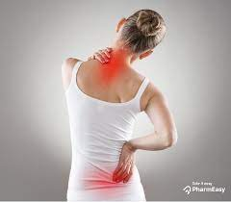
Introduction: Chronic Pain
Pain- unpleasant, subjective sensory experience that can come with actual or potential tissue damage.
Chronic pain- pain lasting more than 3 months.
20.4% of U.S. adults had chronic pain; 7.4% of U.S. adults had chronic pain that limited their activities.
U.S spends 100 billion dollars a year on pain management costs.
https://pharmeasy.in/blog/what-can-be-the-causes-of-back-pain-in-females/
(Dydyk & Conermann, 2022; Hill et al., 2017; Stella et al., 2021)
Notes:
Acute pain lasts less than 3 months
Has specific cause
Goes away when there’s no longer a cause for the pain
Chronic pain
Can continue after an injury or illness
Can appear even with no past injury or body damage

Slide 4
Introduction: Chronic Pain
Types of Pain:
Nociceptive pain- caused by damage to the body tissue with noxious stimuli.
Neuropathic pain- pain from nerve damage or damage to the somatosensory nervous system.
Nociplastic pain- from altered nociception with no clear evidence of tissue damage or evidence of damage to the somatosensory system.
(Hill et al., 2017; Mlost et al., 2020; Stella et al., 2021)
Notes:
Nociceptive pain
Noxious stimuli→ hot or cold, intense mechanical force, chemicals
Internal or external stimuli
Example: intestinal injuries (appendicitis), endometriosis, joint or bone injury, skin trauma, strained muscle, etc.
Neuropathic pain
Examples: diabetes, multiple sclerosis, Parkinson’s, stoke, HIV, shingles, autoimmune conditions
Nociplastic pain
Examples: fibromyalgia, complex regional pain syndrome type 1, IBS

Slide 5
Introduction: Chronic Pain
Nociceptive pain mechanism:
- Normal functioning pain detection
https://www.slideserve.com/cecile/ascending-pain-pathway
Notes:
Peripheral nociceptors detect the noxious stimuli which generates an action potential
Stimulus is transmitted through primary afferent nerve fibers to synapse with inhibitory interneuron in dorsal horn
Inhibitory interneuron gatekeeper function→ sends the signal up to the brain or not
If it allows signal→ second order neuron crosses the spinal cord and goes to the brain thru spinothalamic tract
Pain is first perceived in the thalamus
Goes to somatosensory cortex to localize pain
Limbic system and cingulate cortex→ process emotions associated with the pain

Slide 6
Introduction: Chronic Inflammation
Inflammation- process by which immune cells recognize and eliminate pathogens to begin healing.
Vasodilation of blood vessels
Increase blood flow
Capillary permeability
Diapedesis→ macrophages, lymphocytes, and plasma cells migrate to infected tissues replacing neutrophils.
Worldwide, 3 of 5 people die due to chronic inflammatory diseases.
Inflammatory pain- pain and hypersensitivity in response to tissue damage and inflammatory mediators.
(Furman et al., 2020; Júnior et al., 2016; Pahwa et al., 2022)
Notes:
Inflammation→ response to tissue damage or pathogen
Can cause pain, but can also have pain without inflammation
Acute inflammation→ neutrophils migrate to site of infection
Chronic→ neutrophils replaced because they’re short lived
Macrophages, lymphocytes, and plasma cells produce inflammatory cytokines, growth factors, and enzymes that contribute to tissue damage.
Inflammatory diseases: stroke, chronic respiratory diseases, heart disorders, cancer, etc.
Tissue damage causes nociceptors to release inflammatory mediators
Mediators: bradykinin, prostaglandin, leukotrienes, histamine, IL6, and TNF in (neuropathic pain)

Slide 7
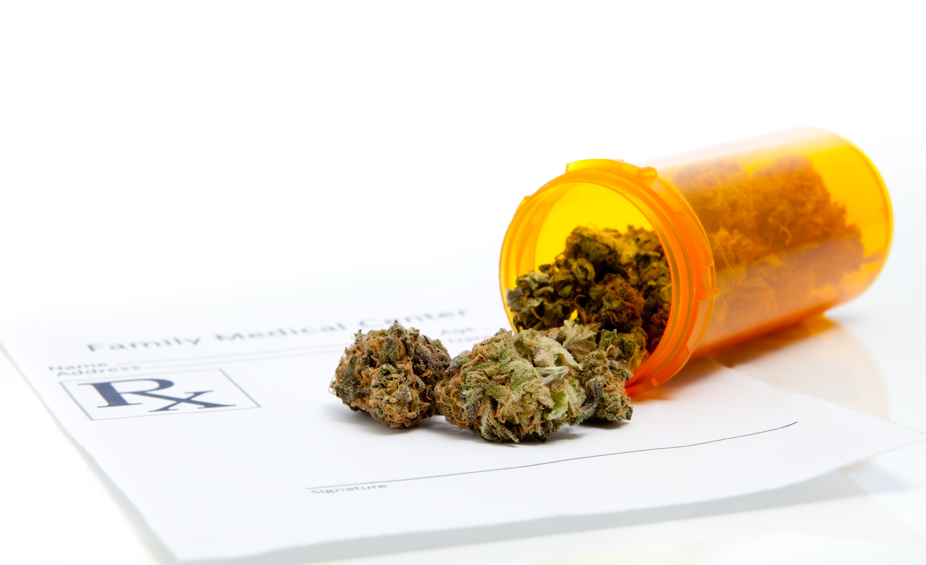
Medical Marijuana
https://www.networkforphl.org/wp-content/uploads/2018/06/iStock-160086948.jpg
Medical Marijuana- derivatives of the cannabis sativa plant that’s meant for medicinal purposes.
In 1976, the U.S. Controlled Substance Act classified cannabis as a schedule I drug, indicating is has no medicinal purposes and high chance of abuse.
Made research of medical implications of cannabis difficult.
Recently becoming legalized.
Two main ingredients:
Tetrahydrocannabinol (THC)
Cannabinoids→ main one is Cannabidiol (CBD)
(Hill et al., 2017; Levy et al., 2022; Mlost et al., 2020; Romero- Sandoval et al., 2015; Stella et al., 2021)
Notes:
Derivatives→ dried and shredded flowers and leaves of the plant
Recent legalization→ Cannabis act in Canada, legal in U.S. in 36 states

Slide 8
Endogenous Cannabinoid System
ECS- regulates and controls critical bodily functions.
Endocannabinoids- fatty acids that selectively bind to CB1 and CB2 receptors.
2 main endocannabinoids:
Anadamide (ANA)
2- arachidonylglycerol (2-AG)
2 main receptors:
CB1 receptors
CB2 receptors
(Burston & Woodhams, 2013; Maayah et al., 2020; McPartland et al., 2014; Mlost et al., 2020; Levy et al., 2022; Romero- Sandoval et al., Stella et al., 2021)
Notes:
Bodily functions: learning and memory, emotional processing, pain control, inflammatory and immune responses, etc.
Receptors:
CB1→ found in the brain, spinal cord, and primary neurons that transmit nociceptive signals
Inhibitory action when active
CB2→ found in peripheral tissue, immune cells, and glial cells
Activation inhibits release of pro- inflammatory and nociceptive mediators

Slide 9
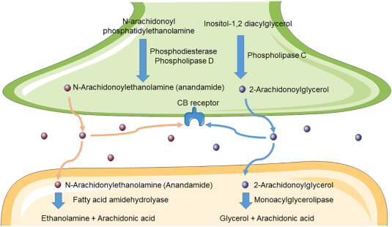
Endogenous Cannabinoid System
(Maayah et al., 2020).
Notes:
Membrane phospholipid precursors go thru enzymatic hydrolysis to produce ANA and 2-AG
Pain/ inflammation stimulation cause depolarization of the pre-synaptic neuron
ANA and 2-AG are released into the synaptic cleft where they bind to presynaptic CB receptors
Activating these receptors inhibits adenyl cyclase, producing less cAMP, causing closing of the calcium channels to stop polarization of the presynaptic membrane.
The rest of ANA and 2-AG are taken up by the post synaptic neurons and degraded
ANA by FAAH
2-AG by MAGL

Slide 10
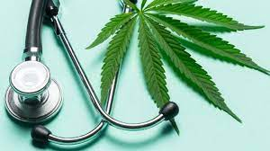
Thesis
Medical Marijuana action on the endocannabinoid system and other targets, is effective in reducing nociceptive signals and inflammation.
https://www.euronews.com/next/2022/03/24/medical-marijuana-doesn-t-help-anxiety-and-depression-and-doubles-addiction-risk-new-study

Slide 11
Medical Marijuana Benefits

Slide 12
CB1 receptor action
THC binds to CB1
CB1 receptor agonists:
Systemic and local administration have anti- nociceptive effects in neuropathic pain models.
In rat models, it reduced TPRV1 sensitization in peripheral nociceptors.
CB1 receptor antagonists:
Intra-thecal administration enhanced nociception in spinal cord neurons in mice.
(Burston & Woodhams, 2013; Guerrero- Alba et al., 2019; Romero- Sandoval et al., 2021)
Notes:
TPRV1→ detects noxious heat in nociceptors

Slide 13
CB2 receptor action
CBN binds to CB2 receptors
CB2 receptor agonists:
-Suppress release of inflammatory mediators by cells adjacent to nociceptors
-Blocks transduction of pain signals to the CNS
-Decreases neutrophil migration to the site of damage
-Reduce sensitivity to mechanical stimuli
(Guerrero- Alba et al., 2019; Levy et al., 2022; Maayah et al., 2020; Romero- Sandoval et al., 2021)
Notes:
Inflammatory mediators suppressed→ IL6,8, and 23
In mouse models with injured spinal cords
In RA models

Slide 14
CBD Action
Activates:
Serotonin 1S receptor
Adenosine A2
A2 antagonists showed significant inflammation
PPAR-γ
Suppresses:
TPRV1**
Agonists reverse anti- nociceptive effect of CBD
Antagonists reduced mechanical and thermal sensitivities
GPR55
NMDA
A1-adrenoceptors
Notes:
Serotonin receptor→ modulates release of pain NT from first- order neurons; helps with anxiety and depression
Adenosine receptor→ diminished inflammation by inhibiting neutrophil adhesion to vascular endothelium; hyperpolarize presynaptic neurons to decrease release of excitatory NT
PPAR- gamma→ increases anti- inflammatory gene expression and down regulates pro- inflammatory mediators through action on macrophages
TPRV1→ in neurons in dorsal spinal horn, open to allow Ca influx to cause AP and send pain signals to the brain
GPR55→ receptor in endocannabinoid system; increases intracellular Ca, mitigates neuropathic pain
NDMA→ activation causes spinal cord neurons to be more responsive to inputs

Slide 15
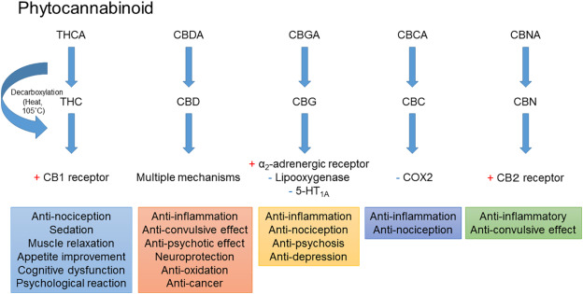
Summary of Phytocannabinoid Action
(Maayah et al., 2020)
Notes:
Cox→ produce prostaglandins (pain, fever, inflammation)

Slide 16
Medical Marijuana Drawbacks

Slide 17
Tolerance
Chronic administration of CB2 and CB1 receptor agonists show tolerance to antinociceptive effect.
9% of cannabis users developed dependence.
There’s a therapeutic window for dosage working to decrease pain.
Notes:
CB receptors become downregulated in certain brain areas when tolerance is developing, process reverses after 4 weeks of abstinence.
9%
A moderate dose of inhaled cannabis showed a significant decrease in pain, but the higher and lower doses didn’t

Slide 18
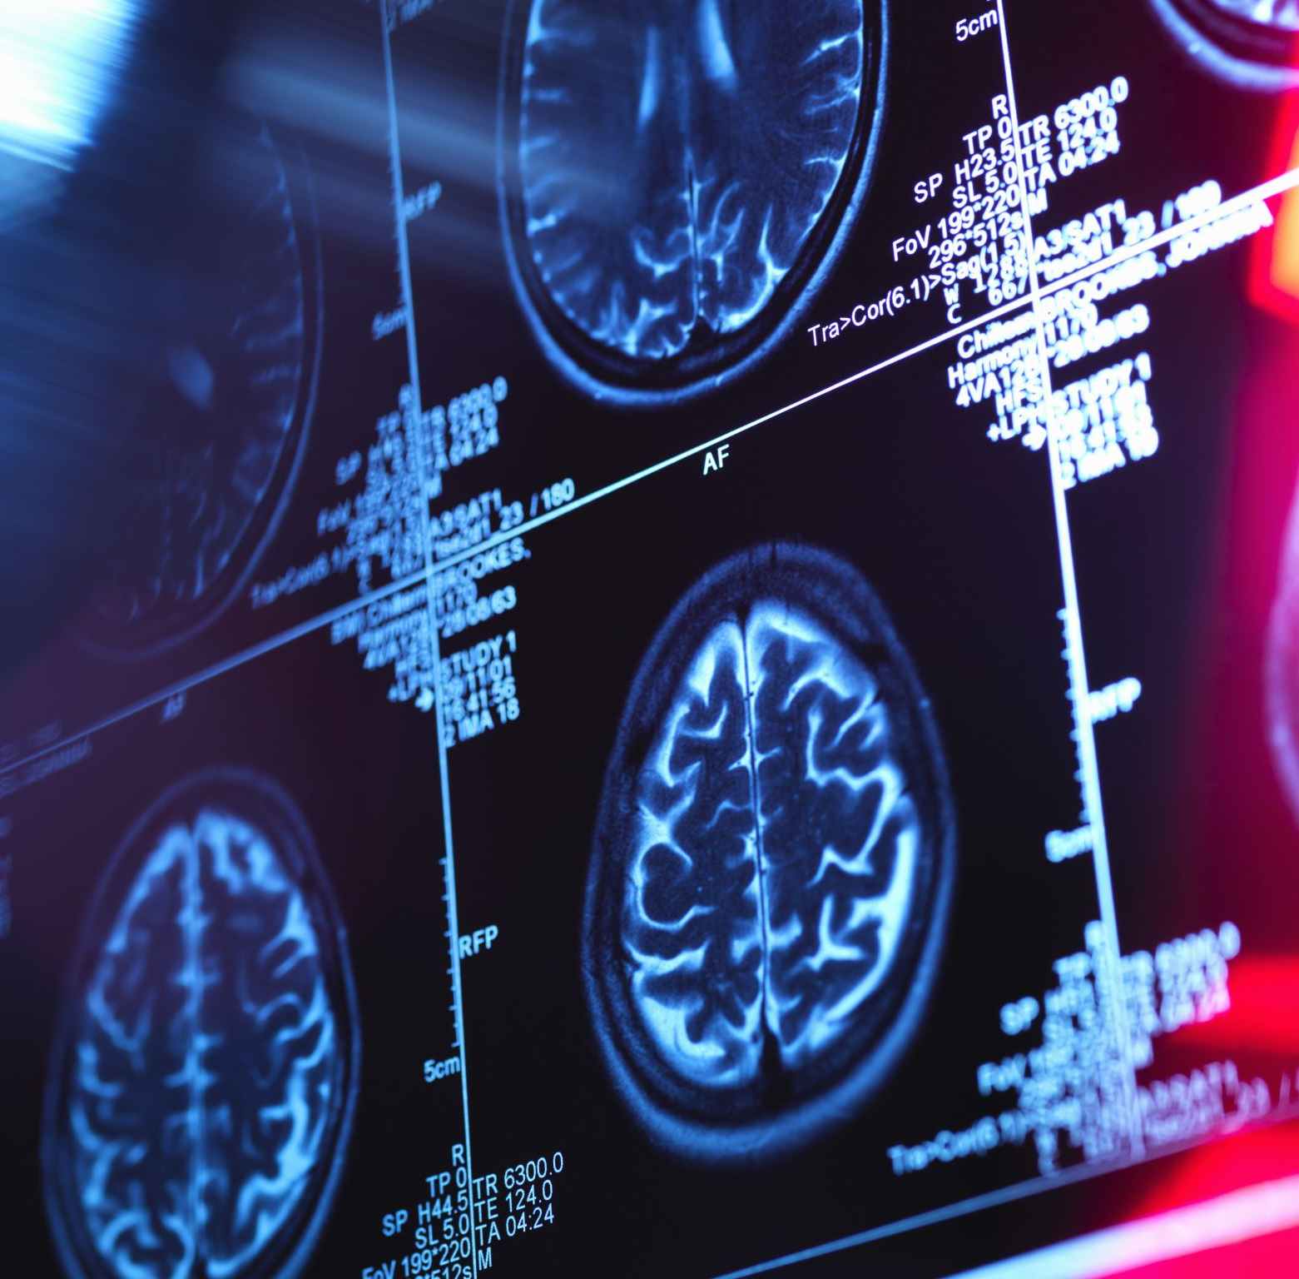
Impact on the Brain
Adolescent exposure to THC can impair neural connectivity in some brain regions.
Can impair learning and memory, attention, and executive functions.
Long term use of cannabis beginning around 16 or 17 can blunt cognitive development.
Notes:
- Prefrontal cortex, and hippocampus

Slide 19
Smoking Impact on the Lungs
One week of smoking showed airway hyperresponsiveness.
One month of marijuana smoke exposure can cause perivascular/ peribronchial edema.
2 months of marijuana smoking showed lymphocyte accumulation.
3 months of smoking showed macrophage- like cells and destroyed bronchial mucosa.
4 months showed obstructed or damaged bronchioles and endothelial proliferation.
Notes:
- Tobacco smoke induced hyperresponsiveness after 2 months and significantly later caused inflammatory cell infiltration with mild emphysema

Slide 20
Conclusion
The ingredients in medical marijuana can act on different receptors to decrease sensitivity to pain and reduce inflammation.
However, it's been shown to have negative consequences on the lungs, developing brain, and possible tolerance.
There should be certain conditions/ requirements in which medical marijuana can be used:
For patients over 18
Under a doctor's supervision
Find alternative safer routes of administration
Notes:
Transdermal patches, under the tongue, cannabis topicals, mists

Slide 21
References
Burston, J., & Woodhams, S. (2014). Endocannabinoid system and pain: An introduction. Proceedings of the Nutrition Society, 73(1): 106-117. doi:10.1017/S0029665113003650.
Dydyk AM, Conermann T. 2022. Chronic Pain. Treasure Island (FL). StatPearls Publishing;
[accessed 2023 Apr 10]. https://www.ncbi.nlm.nih.gov/books/NBK553030/.
Furman D, Campisi J, Verdin E, Carrera- Bastos P, Targ S, Franceschi C, Ferrucci L, Gilroy DW, Fasano A, Miller GW, Miller AH, Mantovani A, Weyand CM, Barziali N, Goronzy JJ, Rando TA, Effros RB, Lucia A, Kleinstreuer N, Slavich GM. 2019. Chronic Inflammation in the etiology of disease across the lifespan. Nat Med 25: 1822- 1832. 10.1038/s41591-019-0675-0
Guerrero- Alba R, Barragán- Iglesias P, González- Hernándes A, Valdes- Moráles EE, Granados-Soto V, Condés- Lara M, Rodriguez MG, Marichal-Cancino BA. 2019. Some Prospective Alternatives for Treating Pain: The Endocannabinoid System and Its Putative Receptors GPR18 and GPR55. Front Pharmacol, 9: ISO 1663-9812. 10.3389/fphar.2018.01496.
Hill KP, Palastro MD, Johnson B, Ditre JW. 2017. Cannabis and pain: A clinical review. Cannabis and Cannabinoid Research 2(1): 96- 104.
Levy SR, Halpert G, Amital H. 2022. Cannabis and Autoimmune Diseases. IMAJ 24: 417- 420.
Júnior JODO, Junior CSAP, Cohen CP. 2016. Inflammatory mediators of neuropathic pain. Revista Dor 17(1): 35- 42. <https://doi.org/10.5935/1806-0013.20160045>.

Slide 22
References Cont.
Maayah ZH, Takahara S, Ferfaoussi M, Dyck JRB. 2020. The molecular mechanisms that underpin the biological benefits of full- spectrum cannabis extract in the treatment of neuropathic pain and inflammation. BBA Molecular Basis of Disease 1866(7): ISO 165771.
McPartland JM, Duncan M, Di Marzo V, Pertwee RG. 2014. Are cannabidiol and Δ⁹- tetrahydrocannabivarin negative modulators of the endocannabinoid system? A systematic review. Brit J of Pharm 172(3): 737-753.
Mlost J, Bryk M, Starowicz K. 2020. Cannabidiol for Pain Treatment: Focus on Pharmacology and Mechanism of Action. Int J Mol Sci 21(22): ISO 8870.
Pahwa R, Goyal A, Jialal I. 2022. Chronic Inflammation. Treasure Island (FL). StatPearls Publishing; [accessed 2023 Apr 15]. https://www.ncbi.nlm.nih.gov/books/NBK493173/.
Romero-Sandoval EA, Asbill A, Paige CA, Byrd-Glover K. 2015. Peripherally Restricted Cannabinoids for the Treatment of Pain. Pharmacotherapy 35(10): 917-925.
Stella B, Baratta F, Pepa CD, Arpicco S, Gastaldi, Dosio F. 2021. Cannabinoid formulations and delivery systems: Current and future options to treat pain. Drugs 81(13): 1515-1557.

