Slide 1
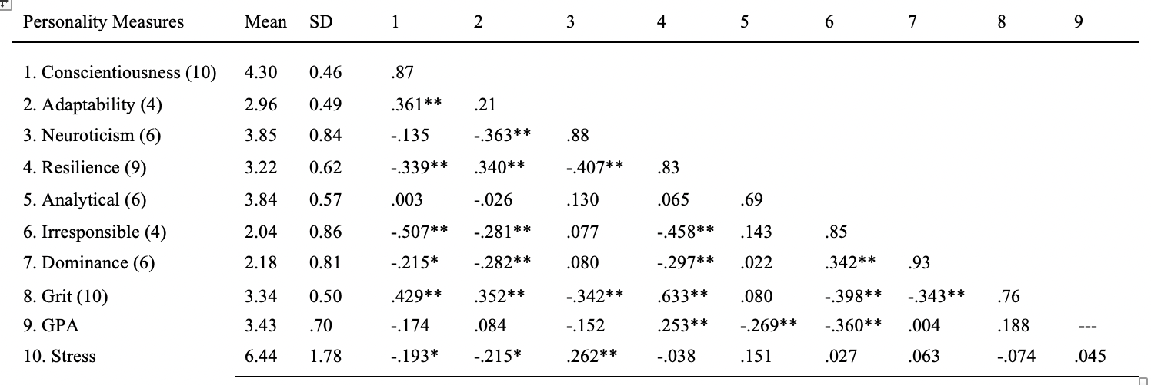
Relationships Between Personality Factors, Stress and GPA
Intro
Research Questions
Has undergraduate stress increased over the years?
Is Conscientiousness positively correlated with GPA?
Is Neuroticism positively correlated with stress?
Investigate the correlation between neuroticism and GPA.
Investigate correlations between other traits, GPA, and stress.
Method
Participants- undergraduate students at SHU and students recruited through social media.
All participation was voluntary.
Participants consisted of 98 women, 16 men, age M = 19.14, SD = 1.14, 71 freshmen, 13 sophomores, 20 juniors, 10 seniors, 1 missing class data, 111 Sacred Heart University students, 93 whites.
Materials
Seven personality scales derived from International Personality Item Pool
Cronbach Alphas showed high reliability (Taber, 2018)
Stress measured on a 1-9 scale
GPA self-reported on a 0-4 scale
Non-Cognitive Predictors of Student Success: A Predictive Validity Comparison Between Domestic and International Students
Faculty Mentor Dr. Maureen Conard
Newest Findings
Discussion
Different from previous studies:
Conscientiousness negatively correlated with GPA but not significantly. Previously it was positively correlated (Conard, 2006).
Neuroticism not significantly correlated with GPA
Current conscientiousness items had higher reliability than NEO_FFI previously used
Stress is much higher now compared to a previous study (Conard, 2008). Supports societal concerns about increased anxiety, depression, and mental health issues
Conscientiousness and Neuroticism significantly correlated with stress
Correlations
With GPA
Conscientiousness = -.174 (ns)
Resilience = .253**
Analytical = -.269**
Irresponsible = -.360**
Correlations
With Stress
Conscientiousness = -.193*
Adaptability = -.215*
Neuroticism = .262**
Has stress increased?
YES - Compared to Conard (2008) stress has increased significantly
Mean stress (2008) = 5.71 (SD = 1.6)
Mean stress (2023) = 6.44 (SD = 1.78)
t(571) = 4.24***
Table
Correlations Among Study Variables
Note. Cronbach Alphas are presented on the diagonal. *p < .05. **p < .01.
Presented by:
Kayla Fitzgerald
Jenna Vargas
Chloe Yagy
Madeleine Pralea
Joelys Morel
Notes:
Notes:
In Powerpoint, click View > Guides
Keep text within gutter guides.
Author list: Don’t split names onto two lines (e.g., “Jimmy [break] Smith”). If that happens, use a new line, unless you need the space. Bold the first names of anybody who’s presenting in person.
Intro/methods/result: Do not drop below font size 28, but if you have extra space, jack up the font size until the space is full.
Do not use color in the sidebars except in graphs/figures. It’ll pull attention from the center and slow interpretation for passersby.

