Slide 1
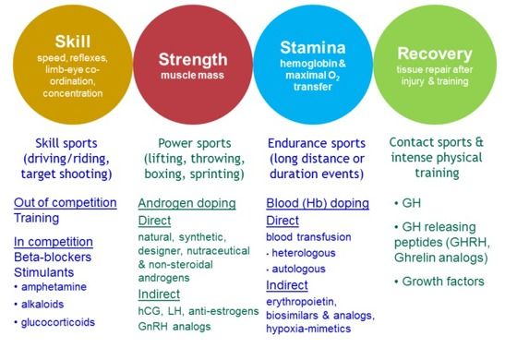
Enhancing Health & Performance: The Benefits of PED Use in Pro Sports Capstone Presentation Gregory Aldrich
History of PED’s in Sports
Beginning of PED Use
Doping is the use of banned performance-enhancing substances in sport.
Doping can include a wide range of substances, but most people often think of anabolic steroids in this topic.
The first official ban on substances was in 1928, but PED testing was not enforced until the late 90’s and early 2000’s.
The current punishment for using PED’s is very harsh in all professional sports for good reason.
Athletes using substances without medical supervision are putting themselves at serious health risk and compromising the integrity of sport.
Reasons for Use
Athletes commonly use PED’s to recovery from injury or alleviate pain from intense contact sports.
Some only use for reasons of gaining advantage over their opponents.
Aging athletes are more likely to use PED’s to maintain physical health, not as much for performance benefit.
Implementation of medically supervised substance use would benefit athletes health and reduce risk of injury without causing a serious advantage in performance.
Thesis
It would take just one open minded executive in a pro sports league to introduce a new era of sports where medically supervised performance enhancing drug use would be allowed for health benefits of the athletes.
Testosterone
Testosterone is a naturally produced hormone impacting bone/muscle mass and strength, red blood cell production, libido, and fat percentage.
Although natural test production usually decreases starting at 30 years old, men may experience limited testosterone production as early as early to mid 20’s.
Testosterone replacement therapy benefits both male and women with low levels; can improve strength and RBC count, cognitive function, and reduce CVD risk.
Cannabis
Cannabis is the most used recreational substance and is used by athletes for health benefits, muscle relaxation, sleep improvements, exercise recovery, and reduced stress and anxiety.
Cannabis is banned during most leagues in-competition phase.
Studies have shown that cannabis has no performance-enhancing effect and only provides physiological effects on recovery and pain management.
Commonly Used PED’s
Testosterone
Human Growth Hormone (HGH)
Erythropoietin (EPO) (Blood Doping)
Marijuana
Anabolic Steroids
Conclusion
Current rules for banned substances in sports are like bad parenting, constantly banning new substances without finding safe alternatives.
Medically supervised performance enhancing drug use could benefit athlete’s health and recovery
An open minded executive in one pro sports league could start a positive change for the future of pro sports, creating a safer environment for athletes to play at their peak physical abilities, avoid injury, and have better overall health in their post-career lives.
Presented by
Greg Aldrich
aldrichg35@mail.sacredheart.edu

