Slide 1
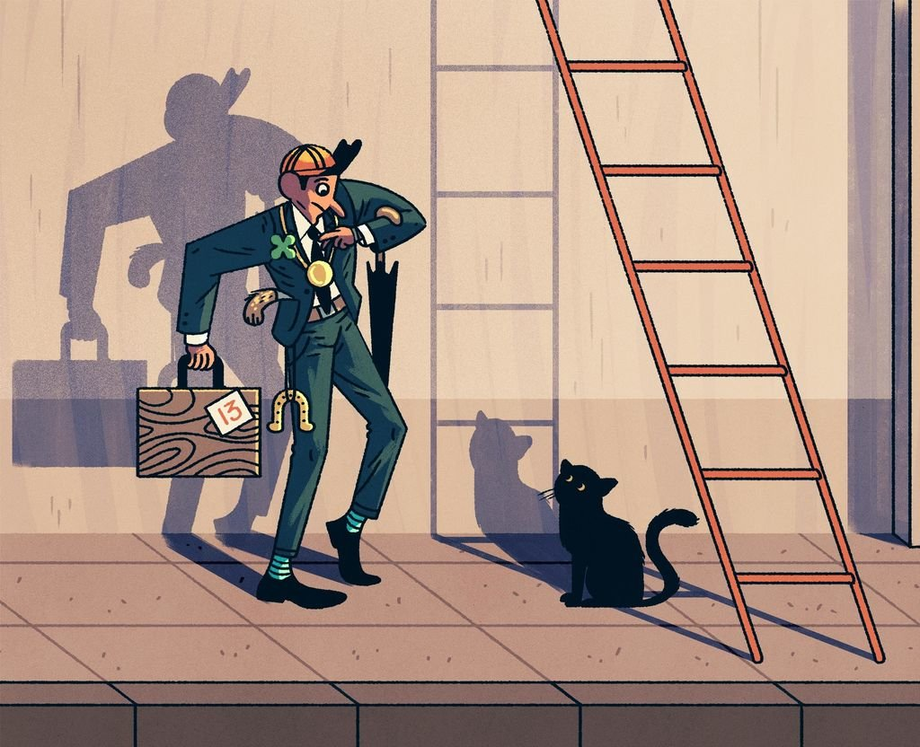
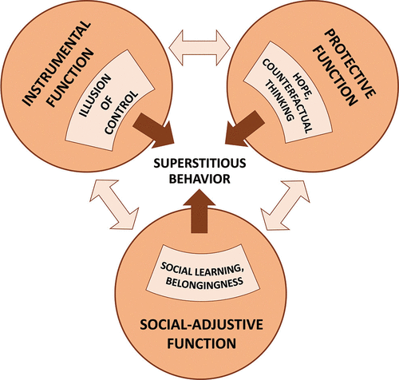
Superstitions can dramatically impact one’s mental health. Even though they have the potential to disrupt one’s life, they are rational in the aspect that they can make a person feel better in their daily life when regulated properly.
The Impacts of Superstitious Behavior
Marissa LaValle, Business Management Major
Superstitions cause mental strain on many but are believed and followed to feel comfort in daily life by all who practice them. My father is a very superstitious man, and by observing his behavior and consistency, I know how superstitions can truly affect someone’s life.
Superstitions stem from religious behavior and are used by many today to regulate business performance and athletic performance, similarly to rituals. People find a sense of comfort in routine and a sense of control when they do something with an expected outcome. They are not only used in performance, but in everyday activities for some.
Visual representation of many common superstitions in daily life and obstacles faced by those who are superstitious.
In superstition there is the conscious abstract representation of cause and effect (psychological relationship).There are three different functions that feed into superstition and superstitious behavior. Superstitions give people a sense of hope, the illusion of control, and social learning belongingness.
To read more please ask for a copy of my academic journal…

