Slide 1
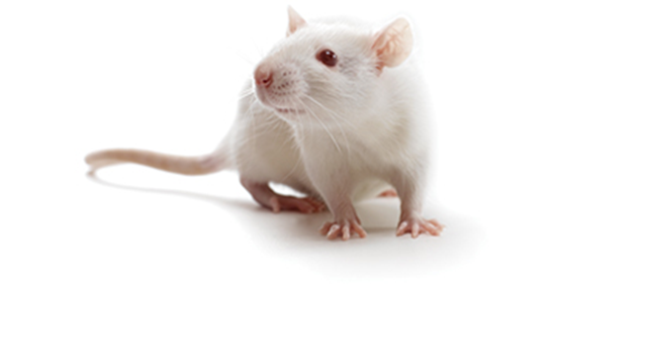
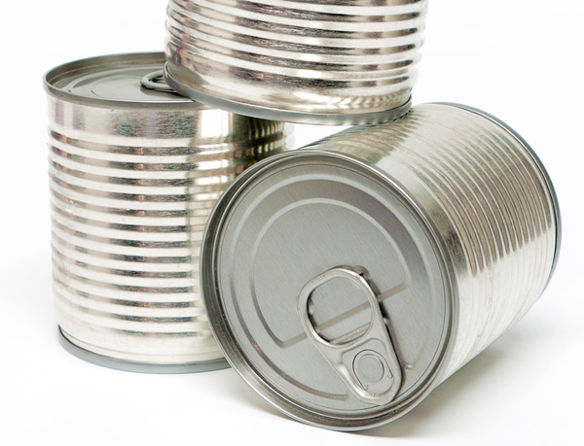
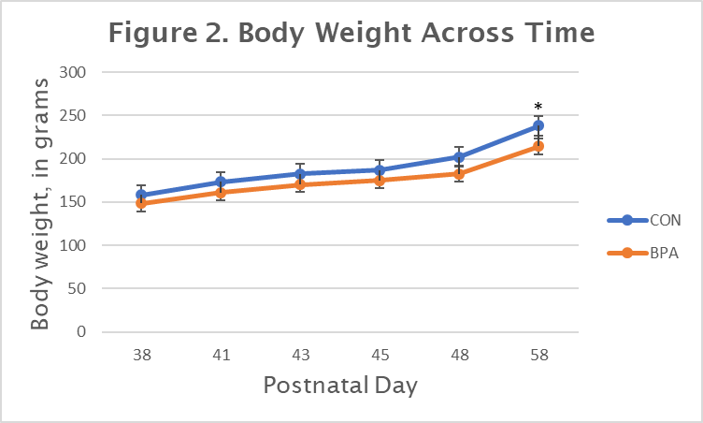
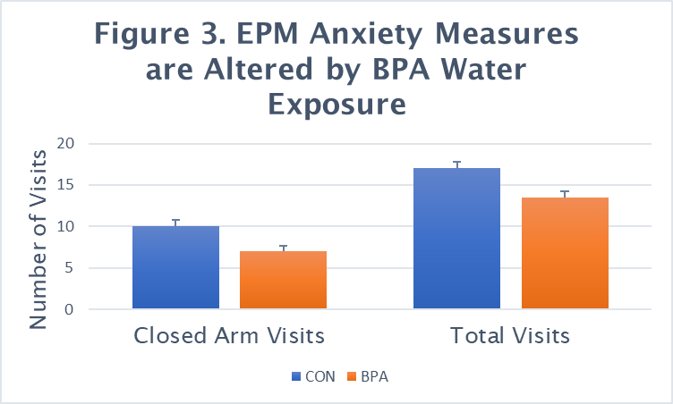
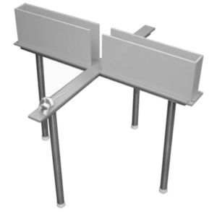
Low-dose drinking water bisphenol-A alters weight gain and anxiety, but leaves cognitive functioning intact
O. Chaponis², N. Pasnoori, P. Janicijevic², N. Alvira¹, A. Andre² , R. Ginocchio² ,
J. Herrick², T. Regalado¹ (Mentor: Rachel E. Bowman^{1, 2} )
Department of Psychology¹ & Neuroscience Major²
Introduction
Figure 1. Experimental Research Timeline
Bisphenol-A (BPA) is a common environmental endocrine disruptor exerting effects on many parameters (neural, physiological, and behavioral measures) via both estrogen and androgen receptors. BPA is an industrial compound used to make polycarbonate plastics and epoxy resins, such as CDs and DVDs, electronic equipment, cars, sports safety equipment, and is widely used in the manufacturing of hard plastic products such as food storage containers, bathtubs and countertops, can linings, and reusable bottles. Detectable levels of BPA have been reported in body fluids of humans and animals, indicating BPA exposure is ubiquitous and a potential health hazard (review, Prins, 2019).
Our studies are designed to assess the effects of low-dose levels of BPA (below the current reference safe daily limit of 50 µg/kg/day set by the United States Environmental Protection Agency) exposure during the vulnerable adolescent period when the brain is undergoing rapid neurodevelopmental changes. We have previously demonstrated that short-term, low-dose BPA exposure (40 µg/kg/bodyweight) during adolescent development in intact male and female rats impairs memory in both adolescence and adulthood (Frankfurt, et al., 2020).
Changes in both heat and pH levels can cause BPA to leach from containers into consumables (beverages & food). BPA ingestion is considered to be the main source of exposure in humans (Rubin, 2011). Thus, the current study was designed to examine whether BPA delivered via drinking water, during adolescent development, would alter body weight, anxiety, and/or cognitive functioning.
Female Subjects (n=16)
Water Bottle
Manipulation
BPA or CON
Sacrificed PND 59
Golgi & Serum
Behavioral testing
28 38 49 58
Postnatal Day (PND)
Results Con’t
Table 1. Adolescent BPA drinking water exposure did not alter object placement or
recognition memory.
Object Placement Object Recognition
Inter-trial delay Inter-trial delay
10 min 30 min 1 hr 10 min 30 min 1 hr
CON 79.6 ± 4.8 55.2 ± 7.2 59.0 ± 2.4 68.9 ± 3.4 71.7 ± 4.5 50.5 ± 3.5
BPA 73.9 ± 3.6 53.8 ± 3.0 59.0 ± 5.3 72.1 ± 4.6 63.7 ± 4.6 51.0 ± 3.9
Note: Data is the percentage of time spent with the object in the new location/ new object during the second three minutes.
Results
Conclusions
•Adolescent BPA exposure, via drinking water, altered body weight and EPM performance but did not lead to group differences on either the OP or OR task. These results are different from previous findings following subcutaneous BPA exposure, suggesting avenue of exposure is a critical factor in understanding deleterious effects of BPA. Current research suggests the oral-route exposes ingested BPA to metabolic processes which are capable of rapidly clearing it from the body, while subcutaneous injections circumvent these processes, resulting in greater effects on the organism (Takahashi & Oishi, 2007).
•The dosage used in this experiment was below the approved dose set by the EPA today, and was found to have potentially detrimental effects. This indicates that the EPA should reconsider the current restrictions on BPA use in everyday items.
•These brains are currently being processed via Golgi analysis to examine dendritic spine density.
•Future studies will examine drinking water BPA exposure in males and hormonally controlled animals (i.e., OVX females).
References
Frankfurt, M., Luine, V., & Bowman, R.E (2020). Bisphenol-a and memory: a role for dendritic spines. Hormones and Synapse, Volume 114, in the Vitamins and Hormones series. Publication date, August 1, 2020.
Prins GS, Patisaul HB, Belcher SM, Vandenberg LN. 2019. CLARITY-BPA academic laboratory studies identify consistent low-dose Bisphenol A effects on multiple organ systems. Basic Clin Pharmacol Toxicol 125 Suppl 3: 14-31.
Rubin, B., 2011. Bisphenol A: an endocrine disruptor with widespread exposure and mutiple effects. J. Steroid Biochem. Mol. Biol. 127, 27–34.
Takahashi, Ol, & Oishi, S (2003). Testicular toxicity of dietarily or parenterally administered bisphenol A in rats and mice. Food Chem Toxicology, 41(7):1035-44.
UnitedStatesEnvironmentalProtectionalAgency,1993.BisphenolA,CASRN80-05-7. IntegratedRiskInformationSystem.U.S.EnvironmentalProtectionAgency, Washington,DC Available at: http://www.epa.gov/iris/subst/0356.htm.
Methods
Subjects: Female Sprague-Dawley subjects (n=16) were weaned on postnatal day(PND) 21 and arrived in our laboratory on PND28. Following acclimation, subjects were assigned to a control or experimental group. Subjects were single housed, had free access to food and water, and were weighed regularly. All experimental procedures were approved by Sacred Heart University IACUC.
BPA exposure: On PND38-49 of adolescent development, water bottles were filled with 450 g of tap water. Half of the water bottles contained 11.25 µl BPA solution (10mg/ml) corresponding to a dose of 40 µg/kg bodyweight and half contained vehicle only.
Behavioral testing: Anxiety was measured using the Elevated Plus Maze. Entries into the open vs. closed arms during a 5 min trial were recorded. Spatial memory was tested using the object placement test and non-spatial working memory was tested using the object recognition test. The time spent with old versus new location (OP) or object (OR) was recorded and used as an index of memory performance on both tasks.
Sample Trial Inter-trial Object Object Delay Placement Recognition

