Slide 1
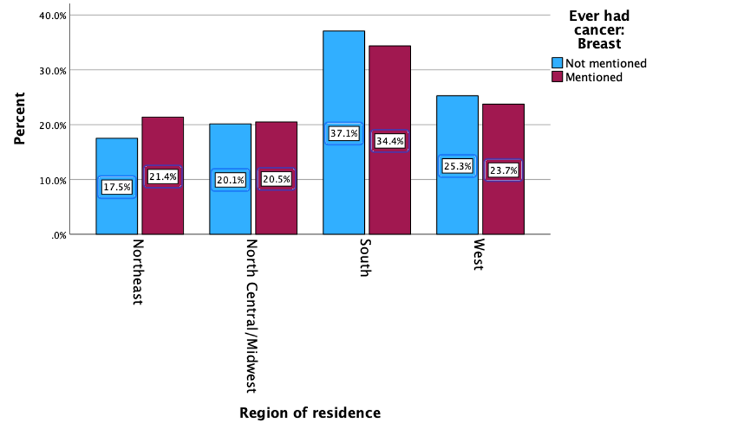
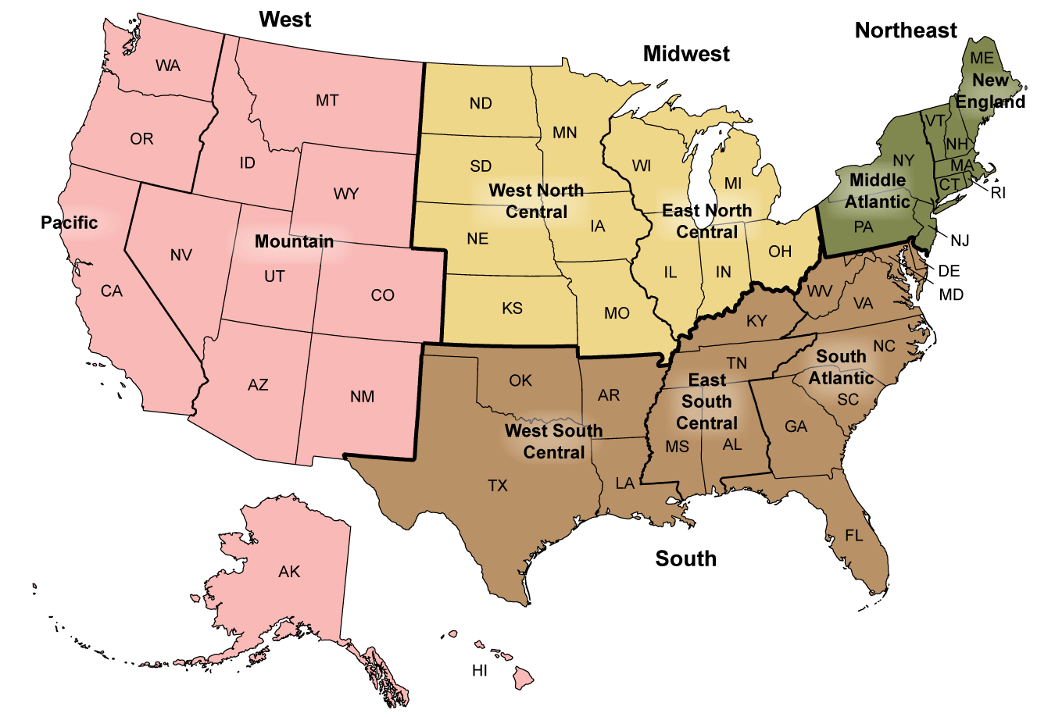
The Influence of Region of Residence on Diagnosis of Breast Cancer
Jessica Catterson, Mollie McManus, Erin Tumbrello , [Faculty Mentor: Dr. Liu]
College of Health Professions
Department of Health Sciences, Sacred Heart University
Background
Methods
Results
Conclusion
240,000 women are diagnosed with breast cancer each year in the United States (CDC, 2023a).
42,000 women pass away yearly (CDC, 2023a).
Factors such as region of residence are known to impact access to resources which may lead to a variation in breast cancer prevalence.
Cross-sectional study using secondary data from the National Health Interview Survey (NHIS).
The NHIS is conducted through computer-assisted personal interviewing, face-to-face in-home interviews, and follow up telephone interviews (CDC, 2023c).
This data was self reported in 2021.
The data sets included data on region of residence and diagnosis of breast cancer.
After excluding 1,515 males from the original data set, the analytical sample size comprised 2,048 women between the ages of 18-85.
Exposure and Outcome Measures
The participants in the study were from the Northeast, North/Central Midwest, South, and Western portions of the U.S.
Participants in the study either had received a diagnosis of breast cancer or had never received this diagnosis.
Descriptive analysis was conducted to describe the characteristics of the study participants.
A bivariate Chi-square analysis was used to determine if a statistically significant association existed between these two variables.
Participant Characteristics | Frequency (%)
Region of residence Northeast North Central/ Midwest South West | 385 (18.8%) 415 (20.3%) 741 (36.2%) 507 (24.8%)
Breast Cancer Diagnosis Mentioned Diagnosis Never Mentioned Diagnosis | 678 (33.1%) 1,370 (66.9%)
Age in years (Mean, SD) | 66.67 (13.703)
Gender Female Male | 2,048 (100%) 0 (0%)
Race/Ethnicity White Black/African American American Indian/ Alaska Native Asian Other | 1,808 (88.3%) 138 (6.7%) 14 (0.7%) 50 (2.4%) 38 (1.9%)
Takeaways:
All four regions of residence had similar percentages of having/not having breast cancer.
No significant association between region of residence and diagnosis of breast cancer exists based on this data set.
Resources available in specific populations can contribute to differential health outcomes.
Future Implications:
Including men in further research may provide different correlations.
Other factors such as race, economic status, education level, and insurance may also provide different correlations.
Objective
To investigate if region of residence influences diagnosis of breast cancer in women in the United States.
To add to the current literature, we researched women between the ages of 18-85 residing in the Northeast, North Central/Midwest, South, and Western regions of the United States.
Hypothesis: Region of residence impacts the rates of breast cancer diagnosis.
Table 1. Descriptive Statistics of Study Participants (N= 2,048)
References
Canyon Vista Medical Center. (2022). [Breast cancer awareness]. Canyon Vista Medical Center. https://www.canyonvistamedicalcenter.com/news/breast-cancer-your-questions-answered
Centers for Disease Control and Prevention . (2023a). Basic information about breast cancer. Centers for Disease Control and Prevention. https://www.cdc.gov/cancer/breast/basic_info/index.htm#:~:text=Each%20year%20in%20the%20United,cancer%20than%20all%20other%20women.
Centers for Disease Control and Prevention. (2023b). [Map breakdown of United States by region]. Centers for Disease Control and Prevention. https://www.cdc.gov/nchs/hus/sources-definitions/geographic-region.htm
Centers for Disease Control and Prevention . (2023c). NHIS - about the National Health Interview Survey. Centers for Disease Control and Prevention. https://www.cdc.gov/nchs/nhis/about_nhis.htm
(Canyon Vista Medical Center, 2022)
Figure 2. Women who have or have not received a diagnosis of breast cancer according to region of residence.
Based on Figure 2 there is no difference in breast cancer diagnosis within each region of residence.
The p-value for the bi-variate Chi-square test was p=0.173.
There is no significant relationship between region of residence and diagnosis of breast cancer among women in the United States.
Figure 1. Breakdown of United States by region (CDC, 2023b)

