Slide 1
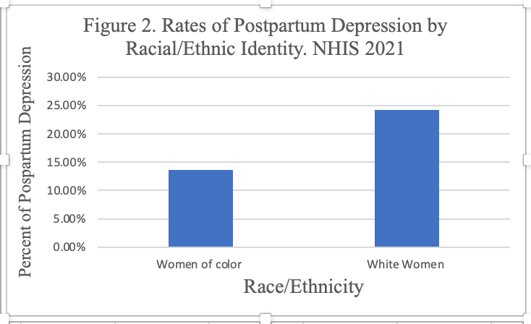
Unveiling the Silent Struggle: Postpartum Depression in Black Women
Alexa Scaglione and Bridget Cronin
Department of Health Sciences, Sacred Heart University
BACKGROUND
HYPOTHESIS
Bivariate Analysis
The relationship shown in Figure 1. is statistically significant [p-value: 0.020]
White women have a higher frequency of postpartum depression than women of color
High prevalence of bias and racism in the health care setting (Davis, 2019)
can cause women of color to avoid reporting symptoms of PPD
white women do not hesitate to report their symptoms and get tested for PPD (Kozhimanni et al., 2011).
Postpartum depression (PPD) is the long-lasting and intense feelings of sadness, tiredness and worry that occur after having a baby (CDC, 2023).
Women of color will have a higher rate of post partum depression compared to white women.
METHODS
Our study design was an observational secondary data analysis using cross-sectional data.
Analysis Used: Crosstab with chi square
Data set: National Health Interview Study (2021)
Outcome of Interest: Post partum depression
Exposure: women of color [Black, Latina, and Native]
Total Participants in Study: 323
Symptoms of PPD are experienced by 1 in 8 women with a recent live birth (CDC, 2023).
Strengths
large study = 2021 NHIS
Offered nationally representative insights
Use of self-identified race and ethnicity
Weaknesses
No data available to measure racism directly
Future Recommendations
To further address disparities in health care: explore perceptions, cultural influences and barriers women of color faced in seeking help
Figure 1. One in eight women with a recent live birth experience symptoms of PPD
CONCLUSION
Treatment of PPD is vital
If it goes untreated, it can cause an array of negative health outcomes for both the mother and child
RESULTS
Our findings did not support our hypothesis
Descriptive Statistics
Why do white women have higher
rates of PPD?
Table 1. Sample Characteristics of Postpartum Women in the 2021 National Health Interview Study (N=323)
Variable | Frequency
Depression | 20%
Women of color | 38.7%
Age | 31 years old
Gender | 100% female
Race/Ethnicity | -
Black, Latina, Native | 38.7%
White | 61.3%
Hispanic | 24.5%
Non-Hispanic White Only | 61.3%
Non-Hispanic Black/African American only | 12.7%
Non-Hispanic Asian and any other group | 1.5%
Not a lot of research done on PPD in women of color (Wenzel et al., 2021).
Our sample comprised of more white women than women of color
There is more data available for white women compared to women of color (Kozhimannil et al., 2011)
Because white women are more likely to accept and utilize medical treatment for PPD
If information is not documented by medical professionals in a healthcare setting, it cannot be included in a data analysis
Racism can can affect access and quality of PPD treatment
Racist and biased attitudes from healthcare professionals can lead to a decreased efficacy of treatment (Nelson et al., 2022).
REFERENCES
Centers for Disease Prevention and Control. (2023). Postpartum depression. https://www.cdc.gov/reproductivehealth/depression/index.htm#:~:text=Postpartum%20depression%20is%20depression%20that,experience%20after%20having%20a%20baby.
Centers for Disease Prevention and Control. (2023). Trends in postpartum depressive symptoms— 27 states, 2004, 2008, and 2012. https://www.cdc.gov/mmwr/volumes/66/wr/mm6606a1.htm#:~:text=Postpartum%20depressive%20symptoms%20(PDS)%20are,Postpartum%20depression%20is%20treatable.
Davis, D. A. (2019). Obstetric racism: The racial politics of pregnancy, labor, and birthing. Medical anthropology, 38(7), 560-573
Nelson T, Ernst SC, Watson-Singleton NN. Journal ofRacial Ethn Health Disparities. (2023). Perinatal complications, poor hospital treatment, and positive screen for postpartum depressive symptoms among black women. doi:10.1007/s40615-022-01322-6. Epub 2022 May 5. PMID: 35513596.
Kozhimannil KB, Trinacty CM, Busch AB, Huskamp HA, Adams AS, Kozhimannil, K. B.,
Trinacty, C. M., Busch, A. B., Huskamp, H. A., & Adams, A. S. (2011). Racial and ethnic disparities in postpartum depression care among low-income women. Psychiatric Services, 62(6), 619–625. https://doi-org.sacredheart.idm.oclc.org/10.1176/ps.62.6.pss6206_0619
Wenzel, E. S., Gibbons, R. D., O’Hara, M. W., Duffecy, J., & Maki, P. M. (2021). Depression and anxiety symptoms across pregnancy and the postpartum in low-income Black and Latina women . Archives of Women’s Mental Health, 24(6), 979–986. https://doi-org.sacredheart.idm.oclc.org/10.1007/s00737-021-01139-y
OBJECTIVES
This paper will explore the relationship between racism and postpartum depression among black pregnant women in the United States.

