Slide 1

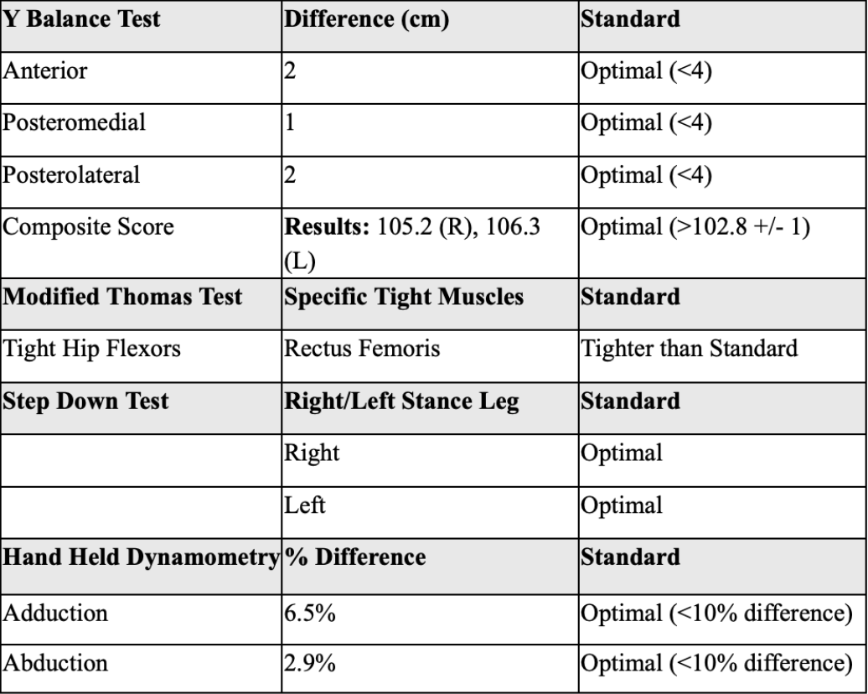
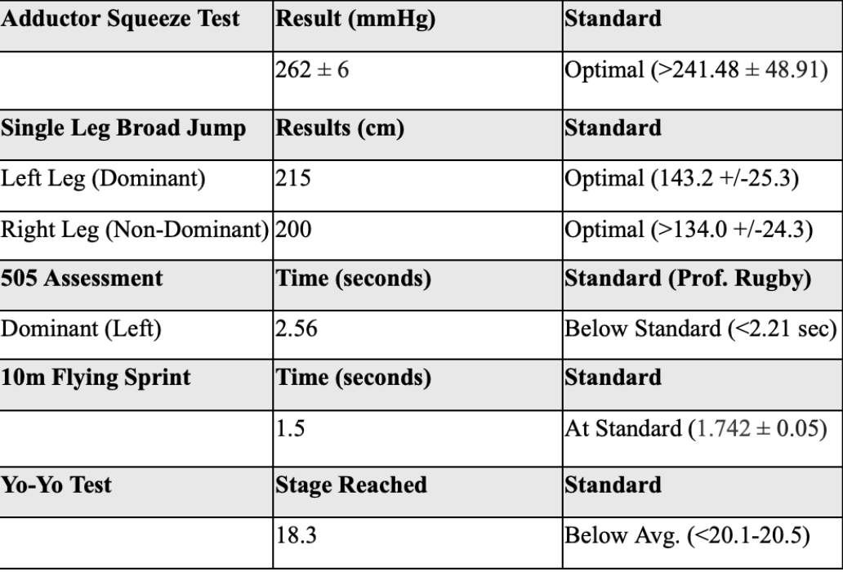

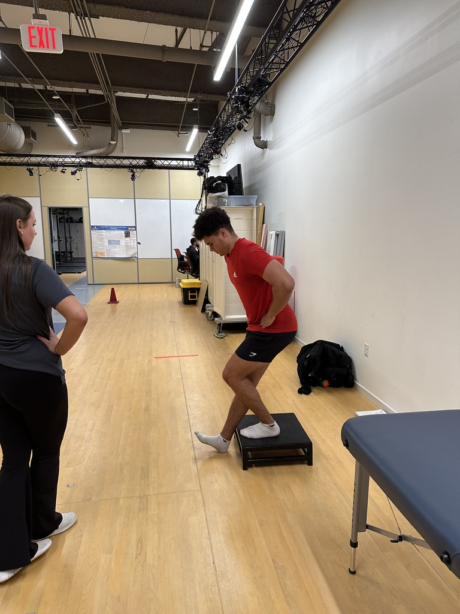
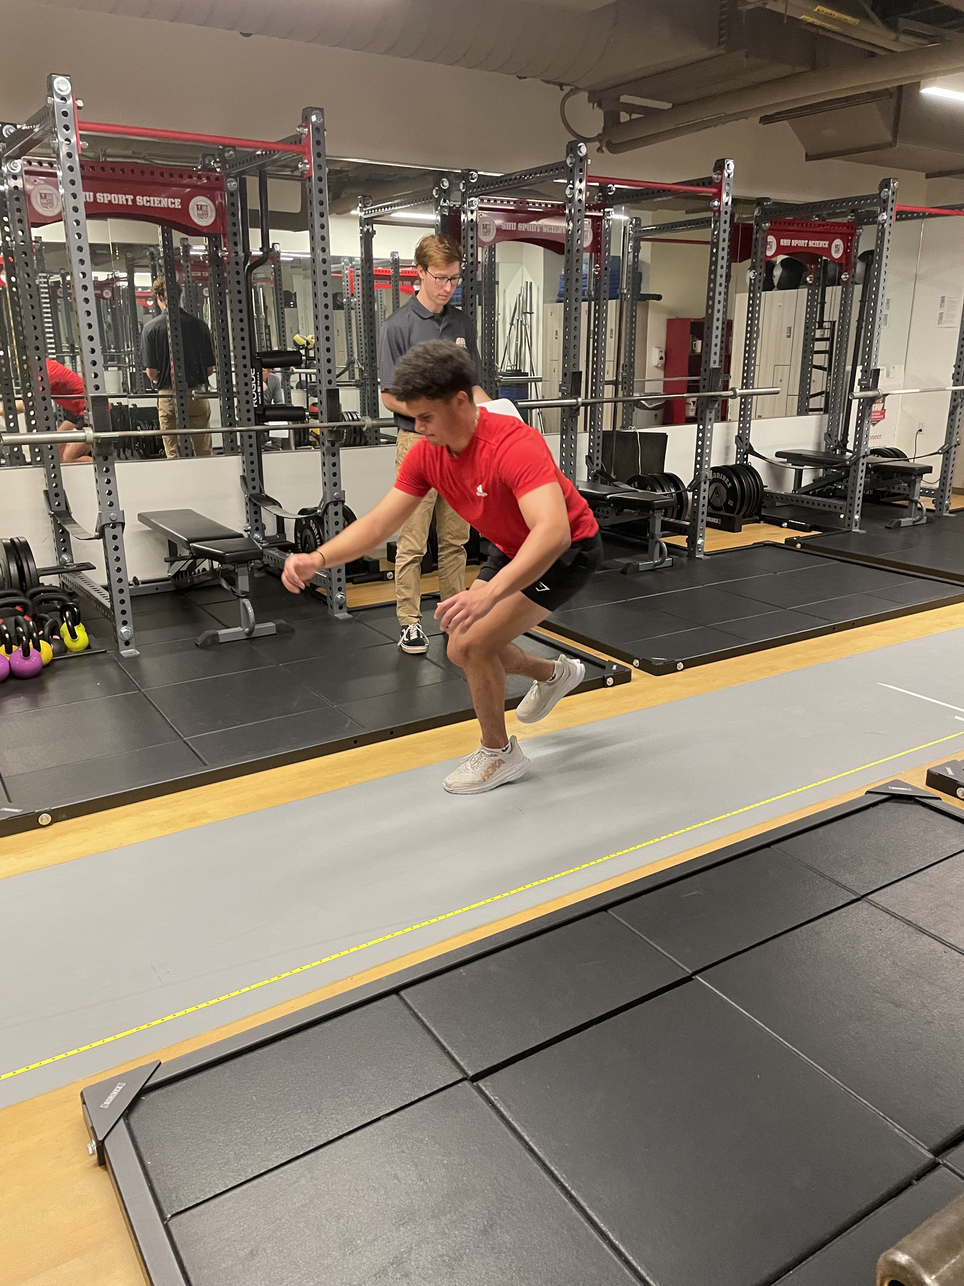
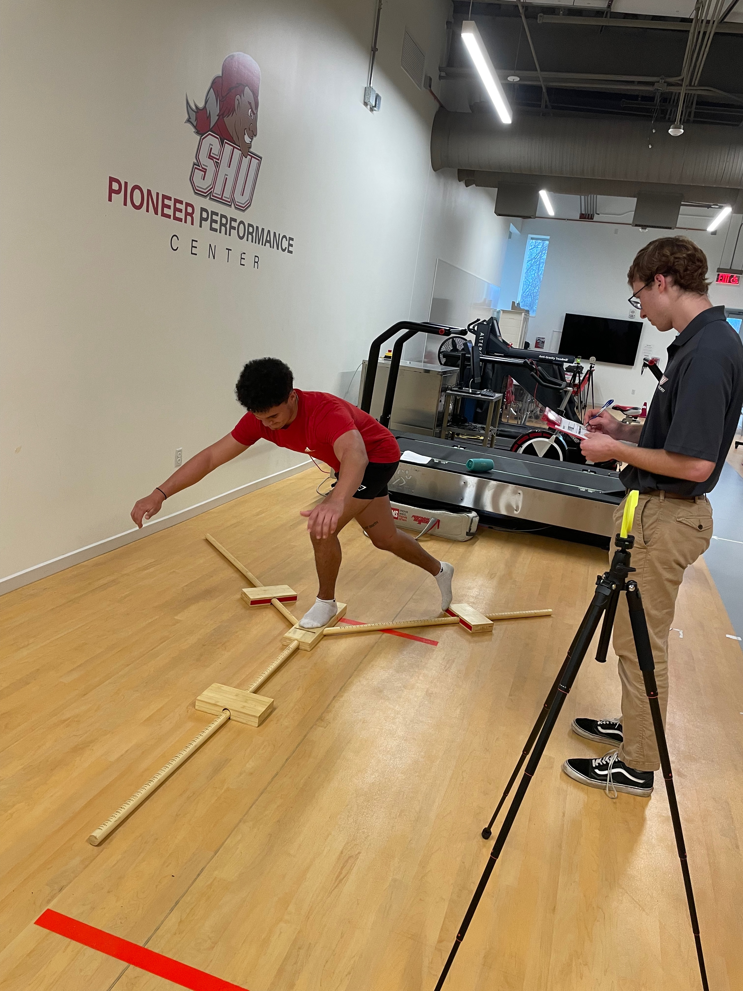
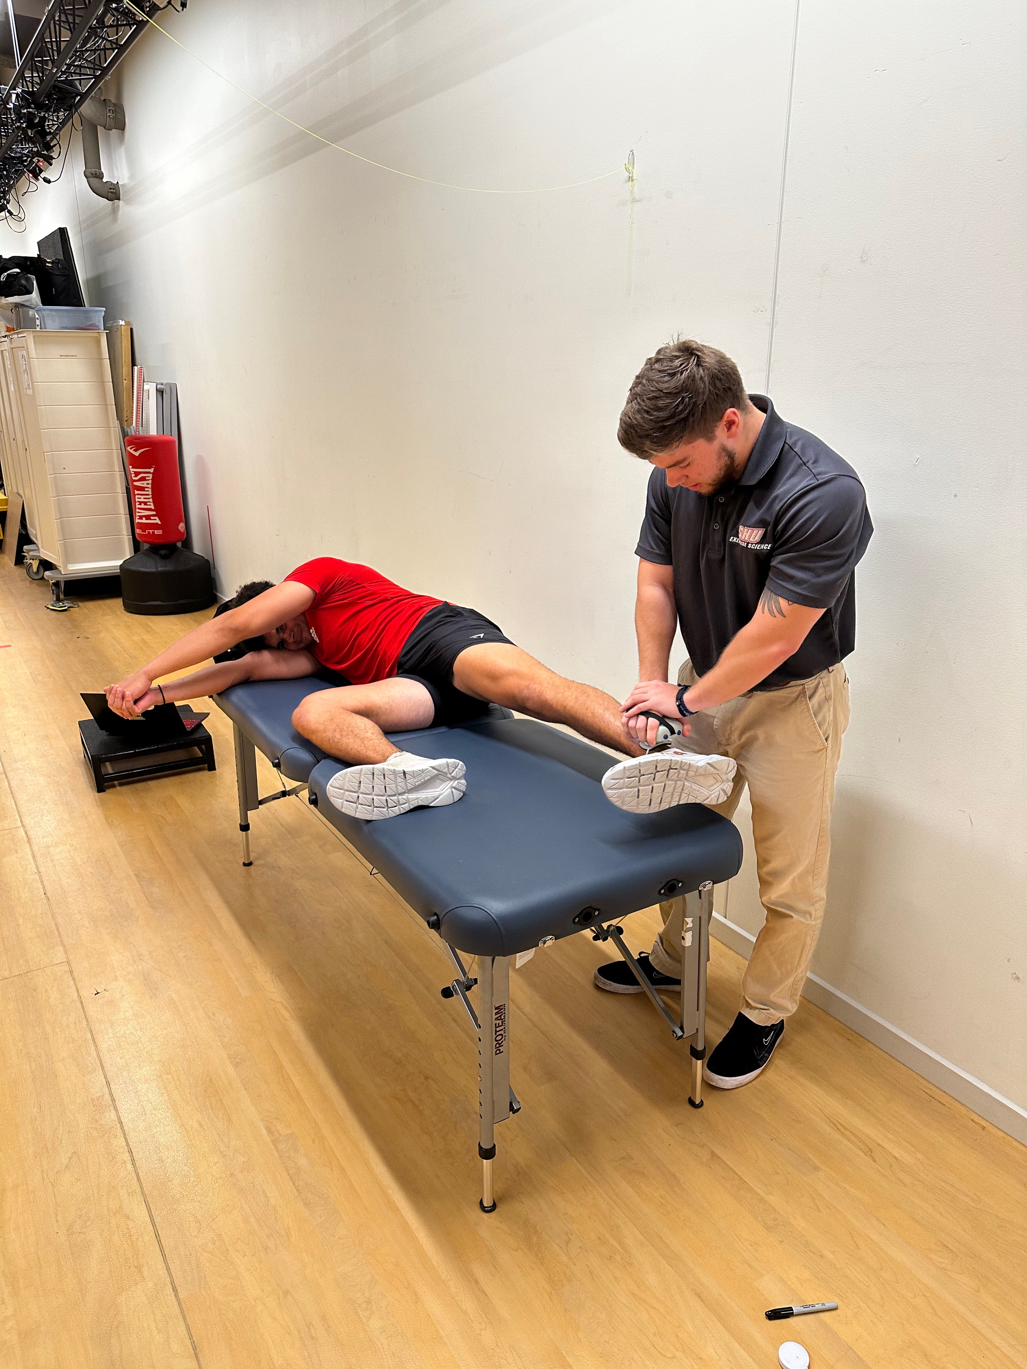

Creating An Individualized Training Program for a Student Athlete
Jack Elliott, Laura McKinley, Ryan Phillips [Mentor: Jonathan Hudak]
College of Health Professions
Department of Exercise Science
INTRODUCTION
Our client is a Division I soccer goalie. Our client is 19 years old with two years of serious strength training experience, as well as a high level of self-reported self-efficacy in a gym setting. He plans on strength training 4-5 days a week over the summer, since that is when his requirements for the soccer team are reduced. He has a history of spondylosis and surgery on a hip labrum tear in July, he was fully cleared for exercise in January.
ASSESSMENT PROTOCOL & RESULTS
PROGRAM SUMMARY
This program was written for an individual that is a D1 Soccer student-athlete. This plan consists of 3 days of strength training per week to supplement the client’s cardiovascular exercise and summer soccer league. The program contains 3 mesocycles, General Strength, Strength, and Power, over the course of 12 weeks. Of the 3 days, the first is Push, the second is Pull, and the third is Legs. With periodization in mind, volume and intensity increase throughout the program while some lower volume weeks allow for optimal adaptations to the high training stimulus.
Mesocycles:
General Strength: 3 x 8-10 at 60-80% 1RM
Strength: 3 x 6-8 at 70-85% 1RM
Power: 3 x 3-5 at 80-90% 1RM
This progression allows for the client to reach a high level of lower extremity strength and power while also keeping his upper body and core muscular fitness adequate for sport. When choosing exercises for the client, previous injury history and exercise familiarity were considered. Additionally, the client has a preferred warmup, cooldown and stretches to do accompanying each strength workout.
INTERVIEW SUMMARY
Our client’s fitness goals, stated by him, were predominantly center on strength and athletic performance, with a focus on increasing squat and RDL strength and enhancing lower body stability to prevent injuries. His exercise routine includes track workouts and team lifts, with a plan to increase frequency. He prefers high-intensity exercises such as dumbbell/barbell bench presses and front squats, with a willingness to try new activities to keep workouts engaging. Despite past injuries and surgeries, including spondylosis in the lower back and a hip labral tear, he is cleared for exercise but avoids specific movements like deadlifts and back squats. His daily schedule revolves around academic commitments and sports practice, with Wednesday, Friday, and weekends being the most convenient times for exercise. He prefers working out at a typical gym and is not currently on any prescription medications.
The Y Balance Test was employed to gauge dynamic balance through a tri directional movement pattern, requiring the client to extend the non-stance leg as far as possible while maintaining stability. The Thomas test focused on assessing flexibility and posture by observing the patient's ability to perform a posterior pelvic tilt. Functional demands specific to soccer were addressed through the step-down assessment, which examined dynamic stability, unilateral lower body strength, and balance crucial for injury prevention. Handheld dynamometry assessed hip abduction and adduction strength, crucial for identifying injury risks associated with lower extremity strength deficits. The adductor squeeze test measured adductor muscle strength using a blood pressure cuff technique. The Single Leg Broad Jump evaluated explosive power and landing control, particularly relevant for lower body strength assessment. Agility and change of direction ability were assessed with the 505 test, essential for sports like soccer requiring quick and precise movements. The change of direction deficit is 1.06 seconds. The 10-meter sprint evaluated sprinting speed with a five-meter flying start, while the Yo-Yo Intermittent Recovery Test measured aerobic endurance and high-intensity exercise capacity through interval running. These assessments collectively provided valuable insights into the client's physical capabilities, aiding in personalized training and injury prevention strategies.
OVERALL IMPRESSIONS
The client we worked with is impressively fit for his age and showcased a high level of muscular strength and healthy movement patterns. He has a history of injury but it does not greatly affect his athletic ability or training safety. The areas of improvement for our client were in lower extremity agility, hip/knee mobility and aerobic capacity. It is important to note that the client did not perform poorly on any assessments and these areas of improvement are mainly for peak performance as an athlete. To work on agility, we included lower body power exercises utilizing unilateral landing and propulsion techniques. In regards to mobility, exercises utilizing tension under the full range of motion will aide in the improvement of functional mobility for our client. The client did not wish to receive an aerobic training plan, so he is planning on improving his cardiovascular fitness through other means. However, he can complete exercises as a circuit, adding an aerobic factor to the workout. In summary, our client will be utilizing a periodized strength plan with an individualized focus to improve his athletic performance in the off-season.
PICTURES (permission was given to take and use photos and videos)
NEEDS ANALYSIS
19 year old Division I men's soccer goalie
Two years of weightlifting experience
Spondylosis and hip labrum surgery in July, cleared for exercise in January
Client already maintains a high level of aerobic fitness on his own, so he wants to focus on strength training
Main goals are improving lower body strength and stability, as well as preventing injury
Goalies engage in much more high intensity, and less aerobic actions than the typical soccer player
Goalies need high levels of agility, requiring optimal eccentric strength of hip abductors, hip extensors, and knee extensors
Hip, knee, and ankle injuries are common among soccer players, so strengthening muscles surrounding those joint complexes needs to be a priority
REFERENCES
This work was presented at the 2024 Sacred Heart University Exercise Science Capstone Symposium

